Slide 1
2023-2024 EDUCATOR SHORTAGE SURVEY

Slide 2
SURVEY IN ITS SEVENTH YEAR
PARTNERSHIP BETWEEN IARSS AND GOSHEN EDUCATION CONSULTING
CONDUCTED IN FALL 2023
MORE THAN 750 SCHOOLS
STATEWIDE RESPONDING
ABOUT THE SURVEY

Slide 3
TOP RESULTS

Slide 4
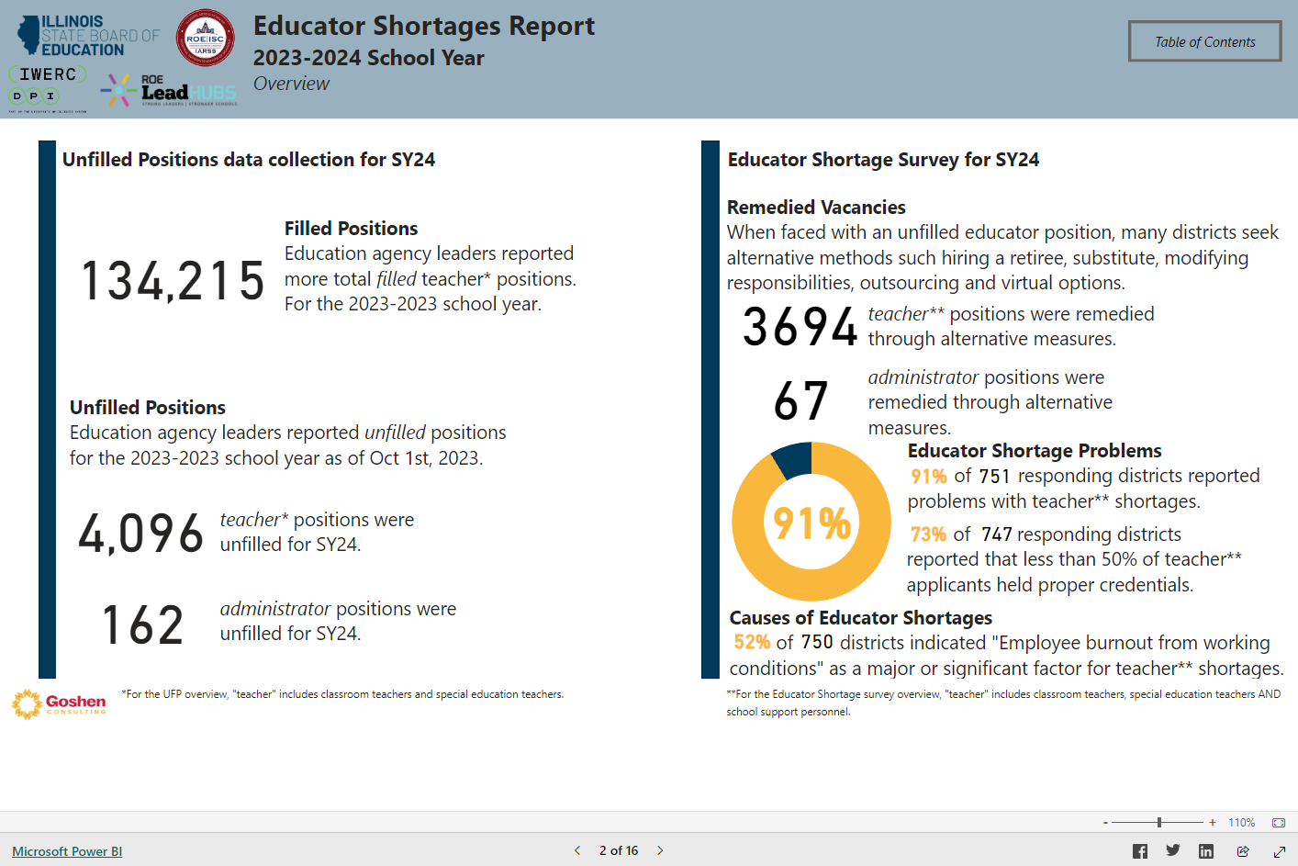
TOP RESULTS

Slide 5
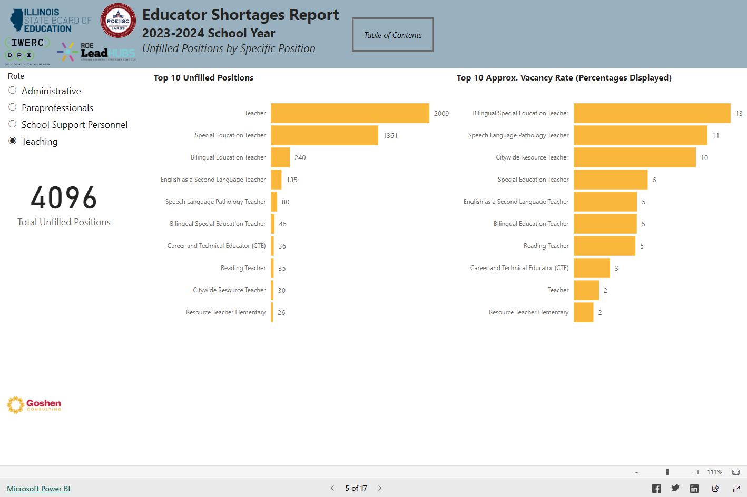
UNFILLED POSITIONS

Slide 6
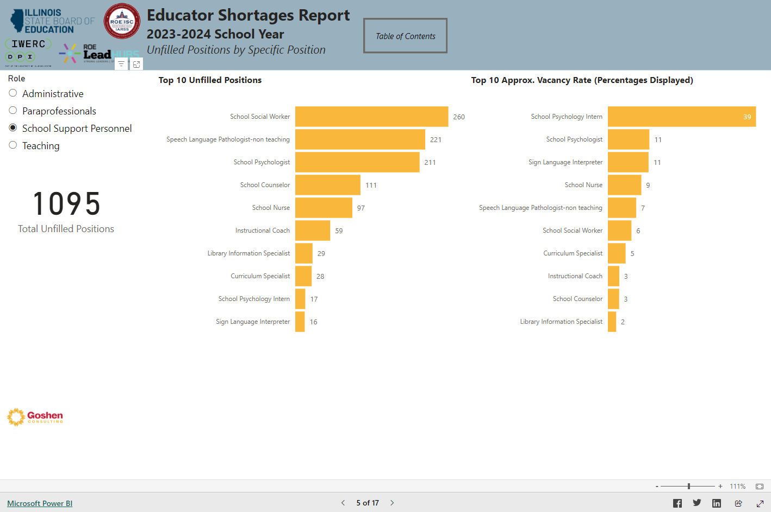
UNFILLED POSITIONS

Slide 7
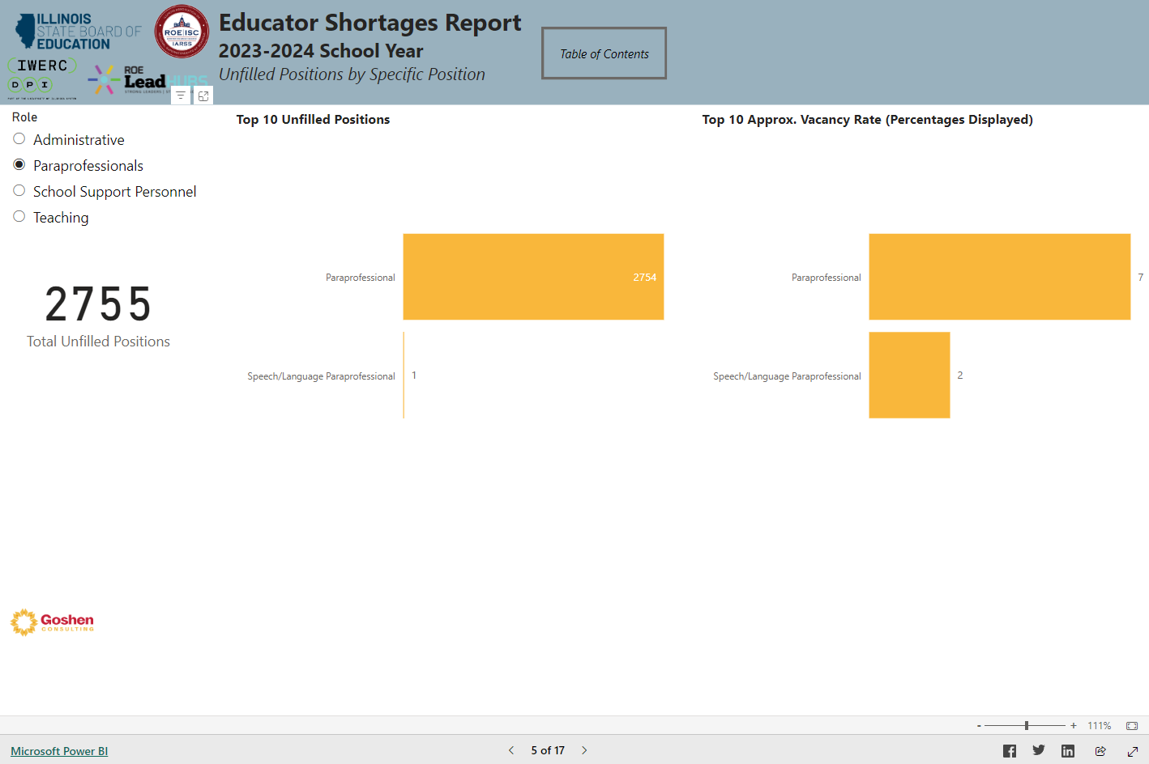
UNFILLED POSITIONS

Slide 8
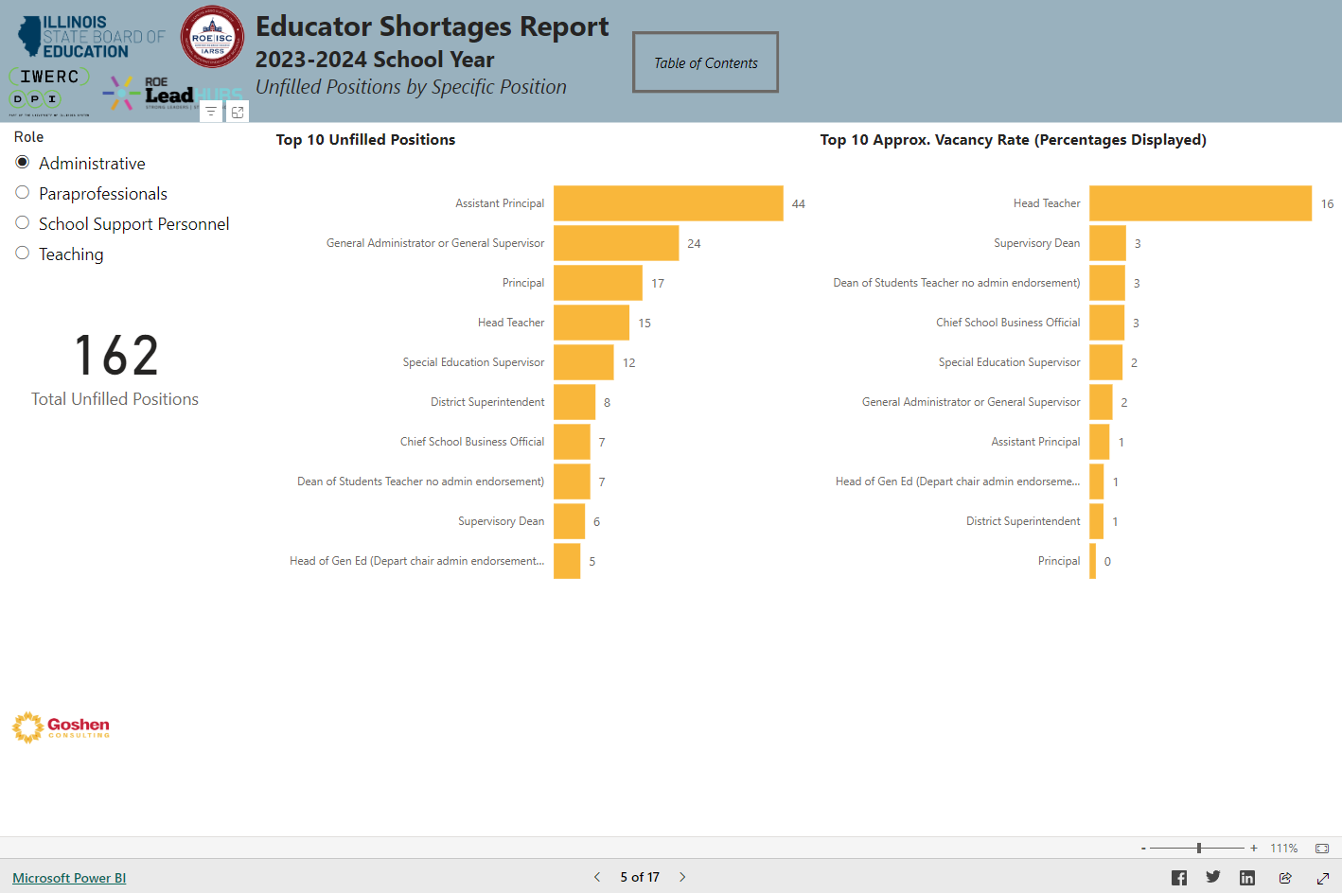
UNFILLED POSITIONS

Slide 9
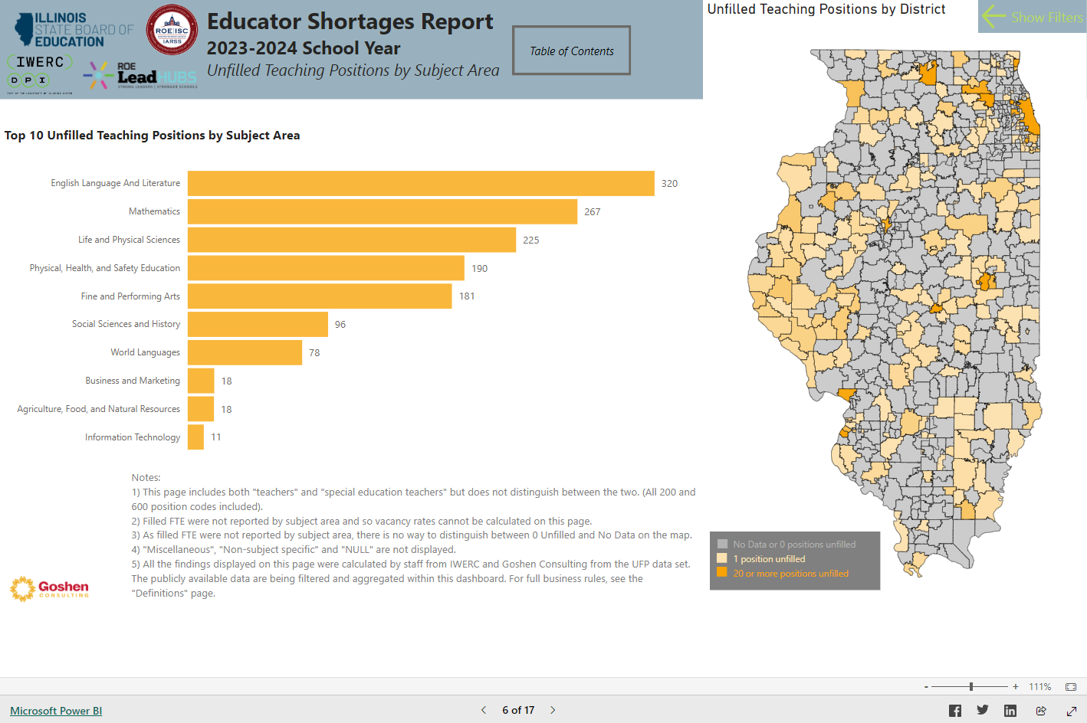
UNFILLED POSITIONS

Slide 10
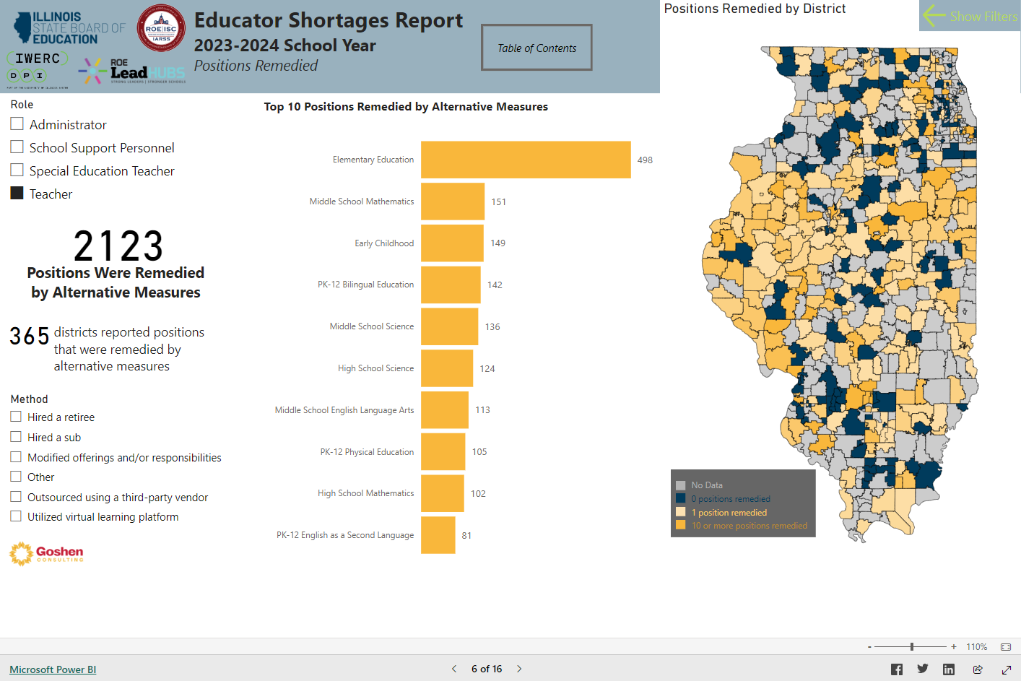
POSITION REMEDIES

Slide 11
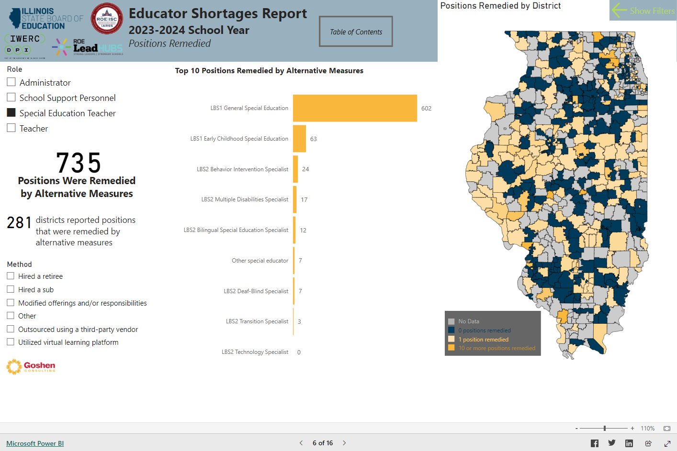
POSITION REMEDIES

Slide 12
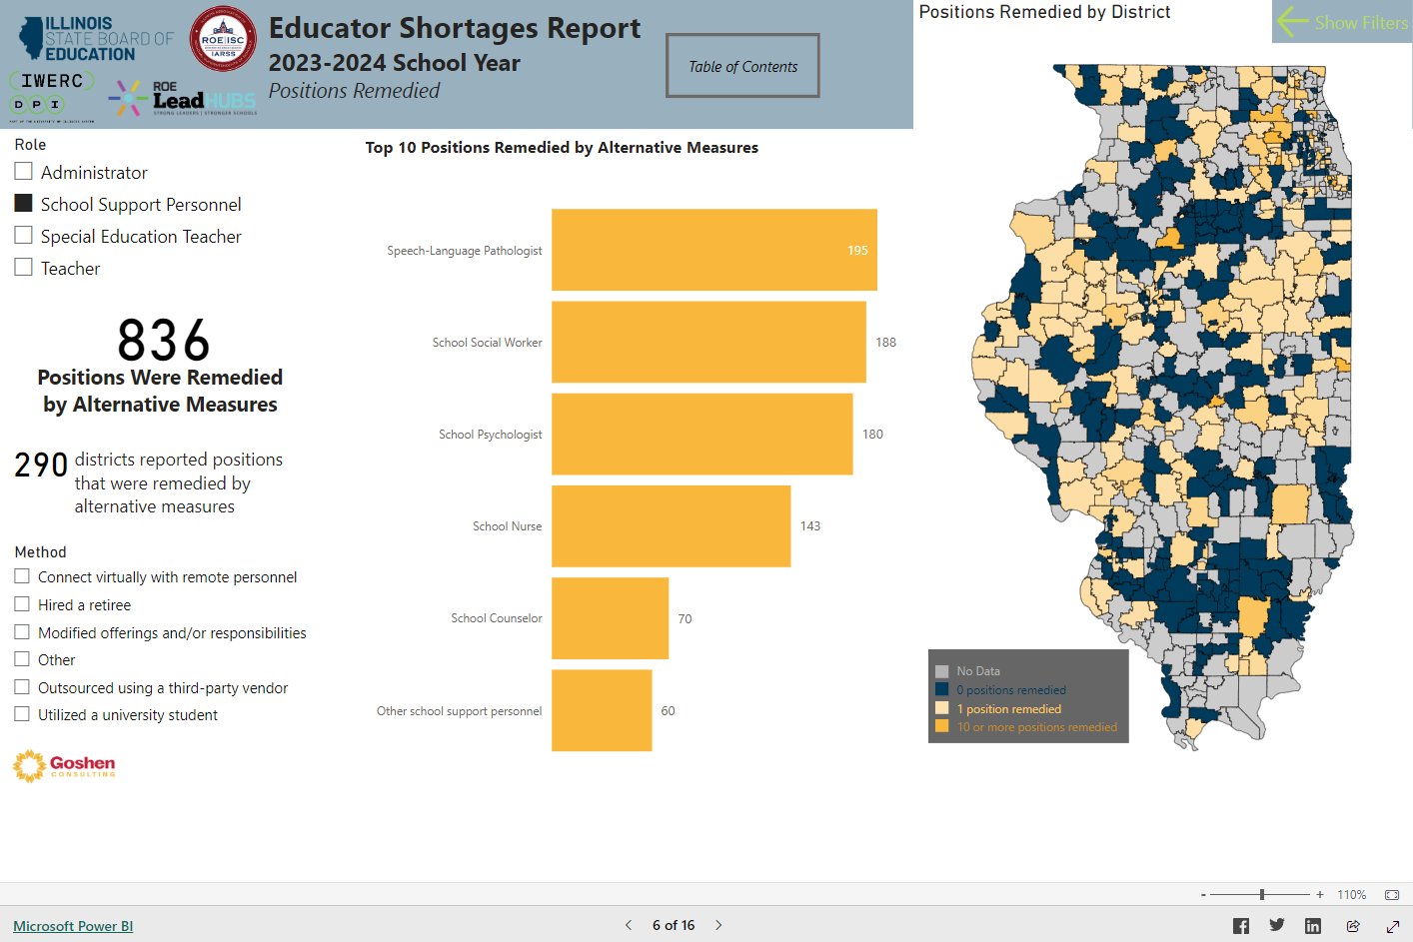
POSITION REMEDIES

Slide 13
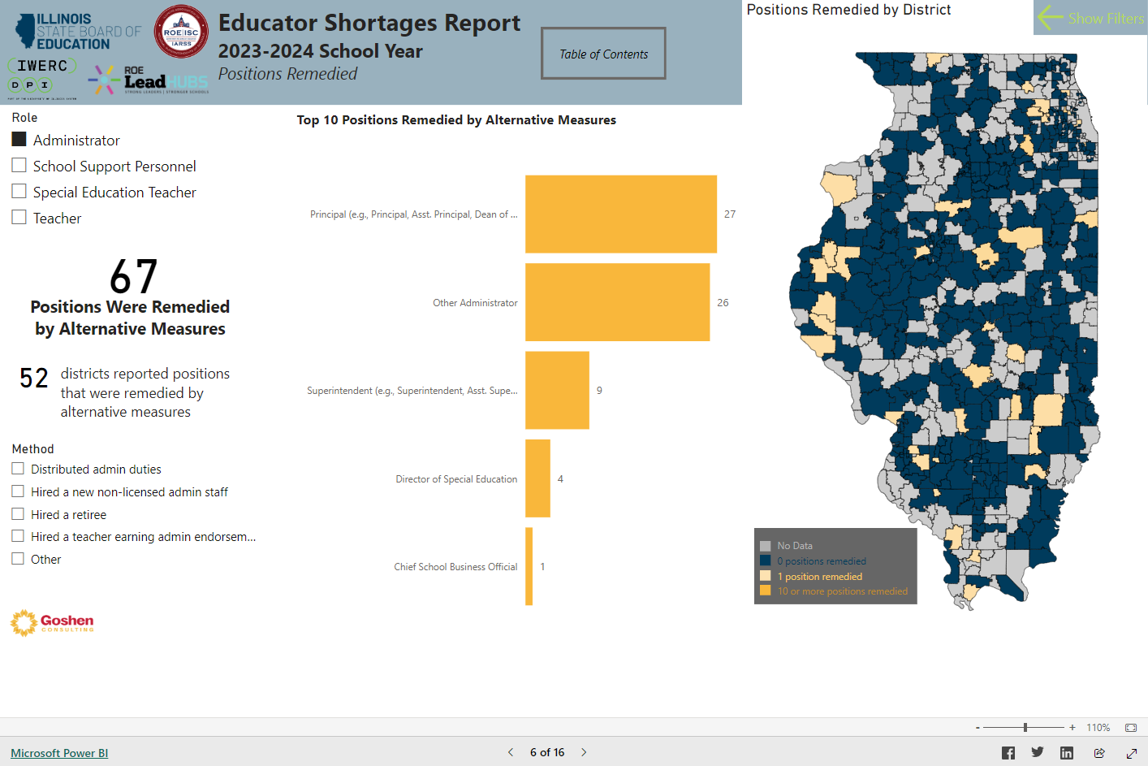
POSITION REMEDIES

Slide 14
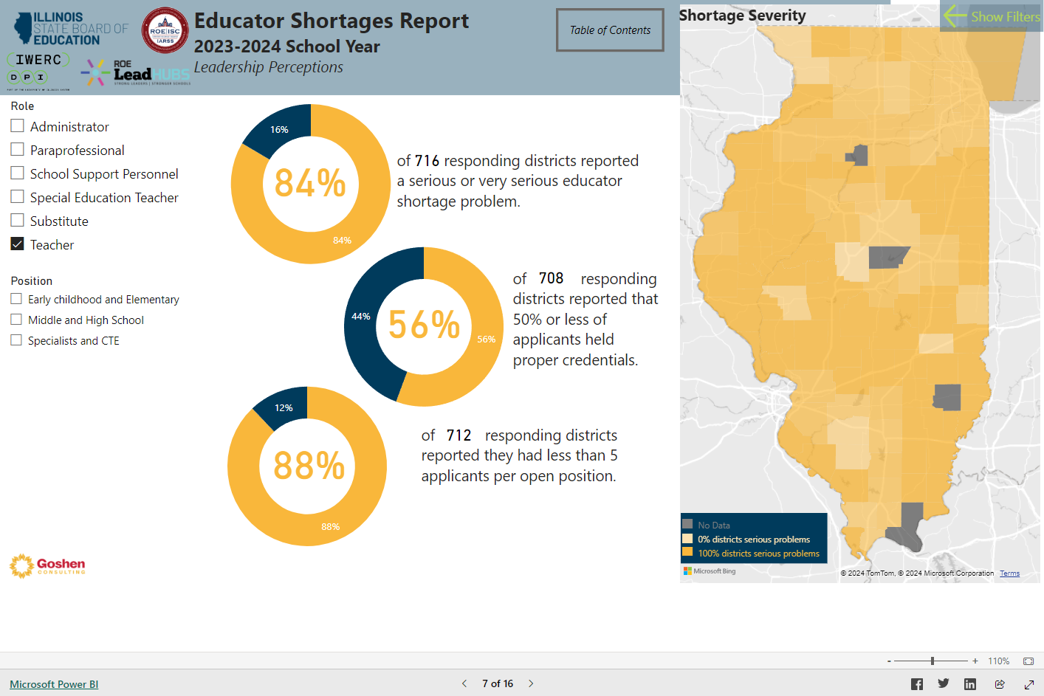
SHORTAGE SEVERITY

Slide 15
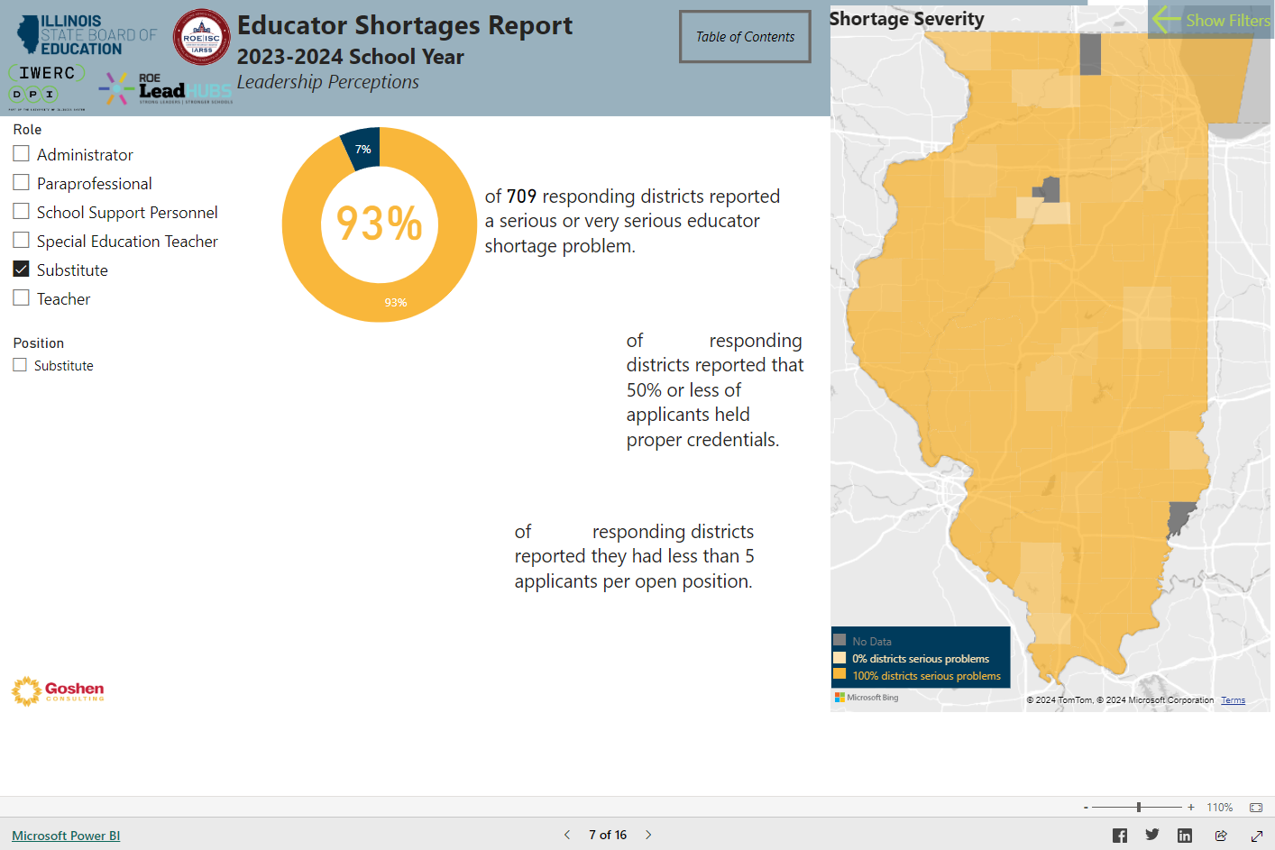
SHORTAGE SEVERITY

Slide 16
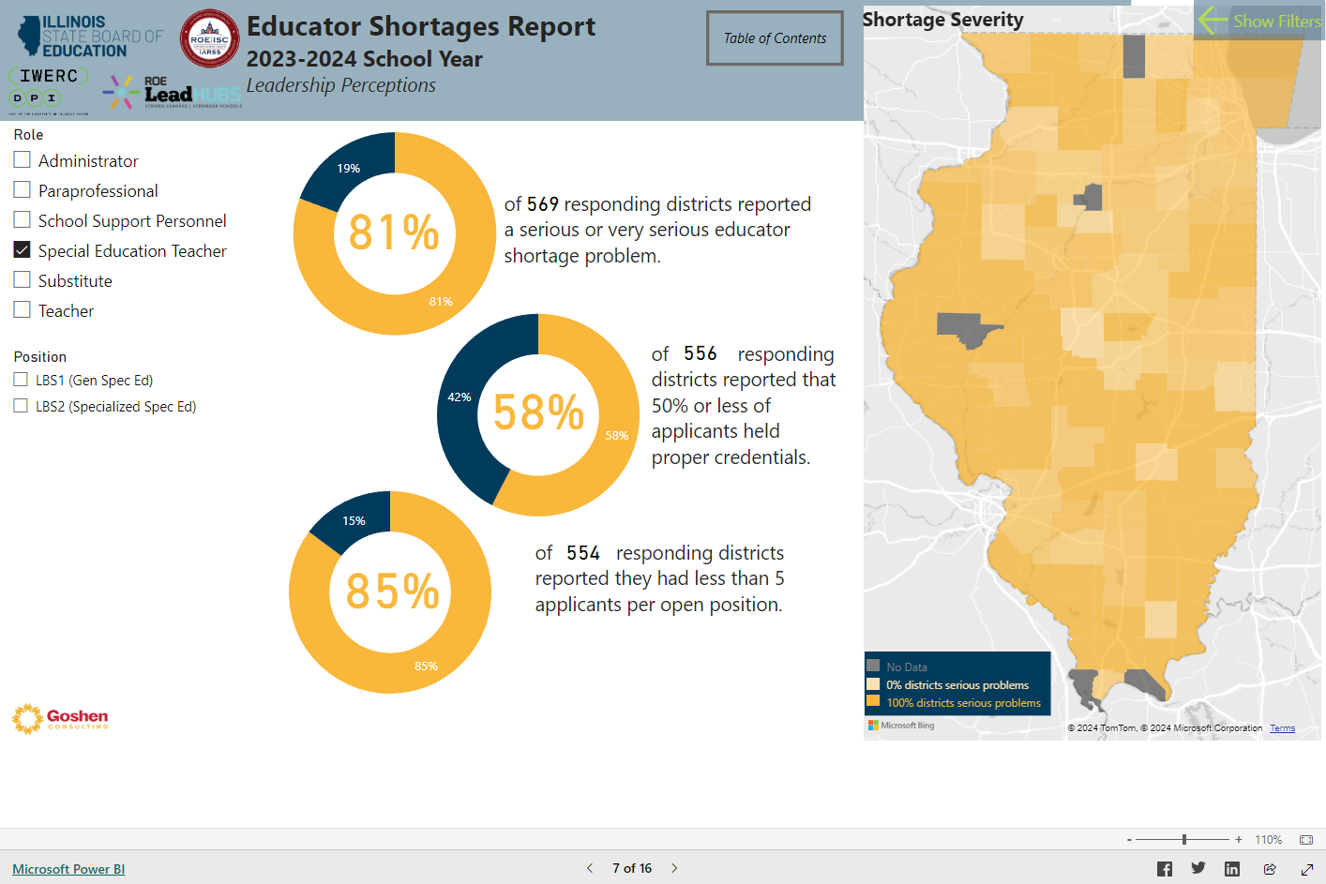
SHORTAGE SEVERITY

Slide 17
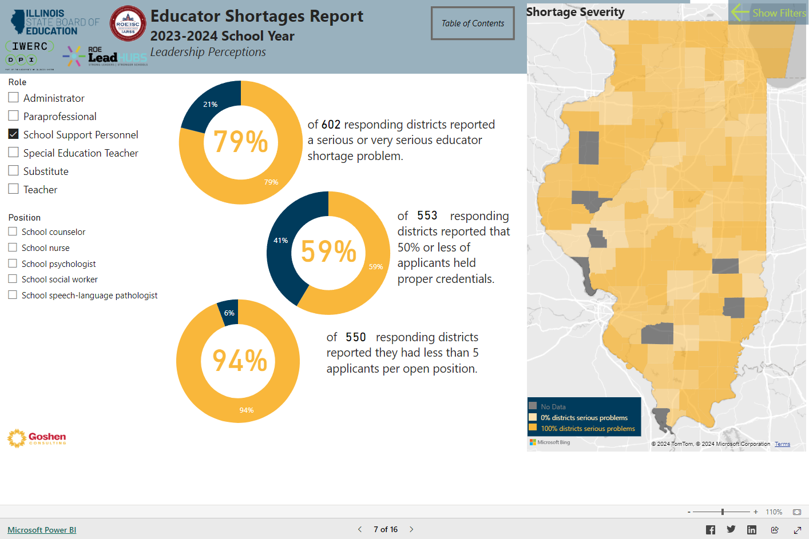
SHORTAGE SEVERITY

Slide 18
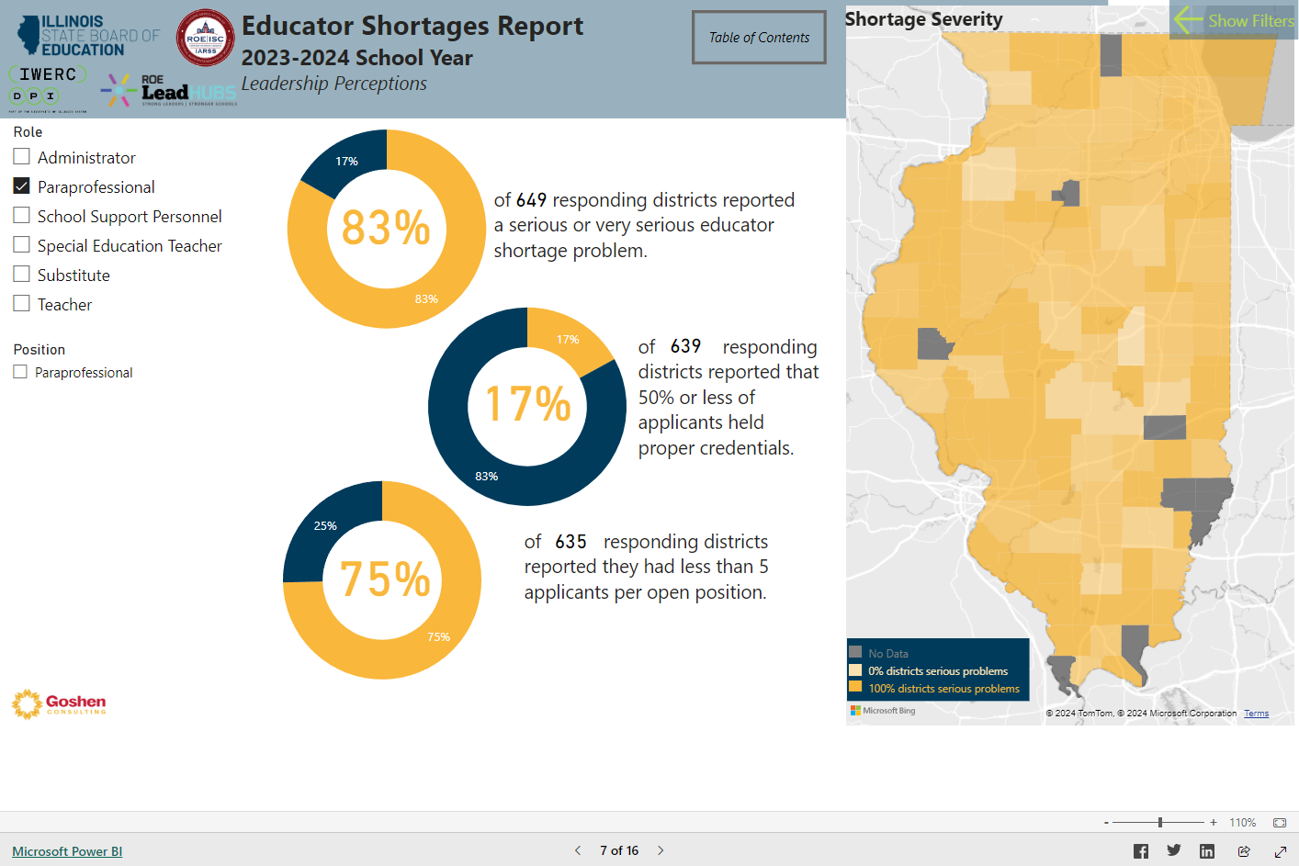
SHORTAGE SEVERITY

Slide 19
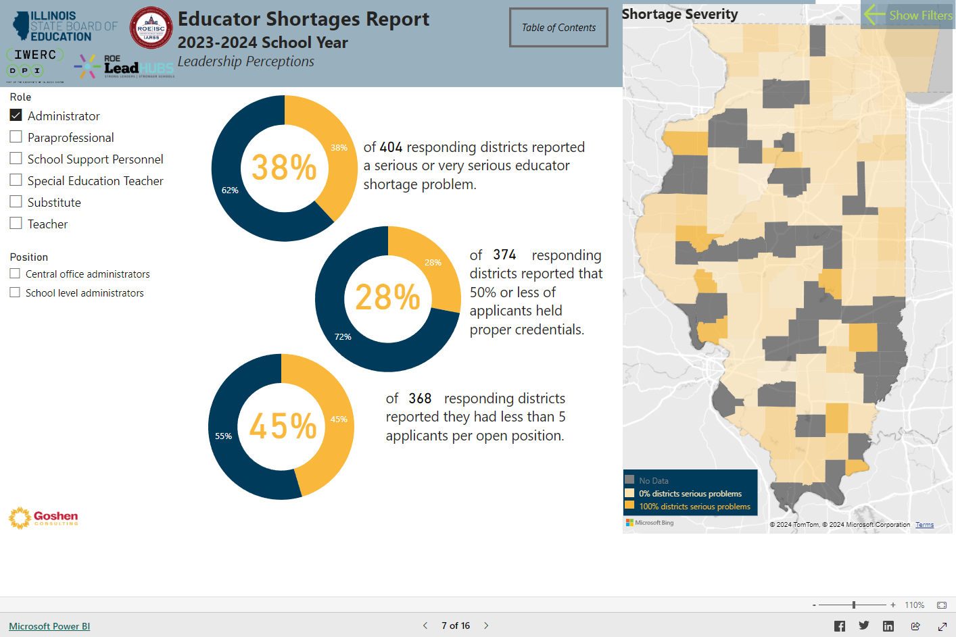
SHORTAGE SEVERITY

Slide 20
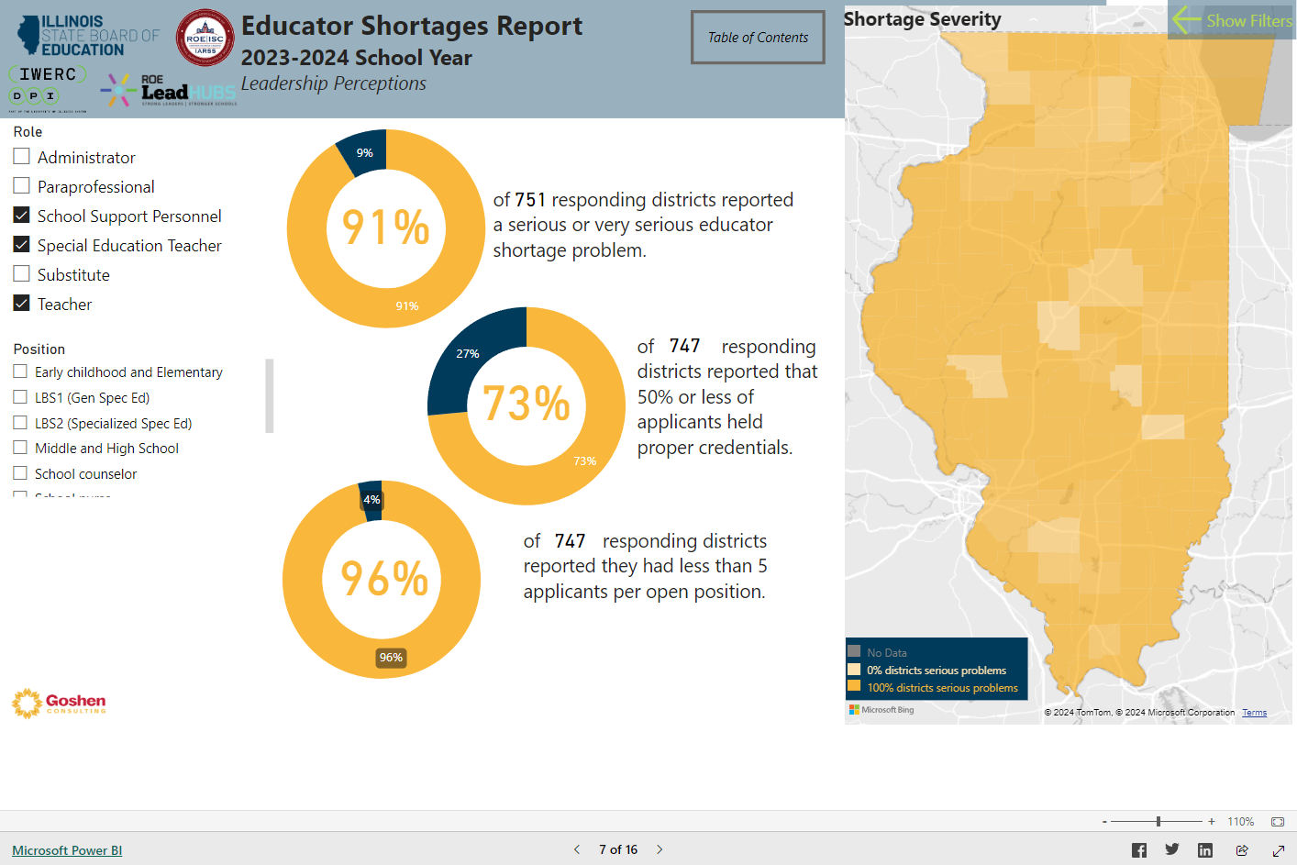
SHORTAGE SEVERITY

Slide 21
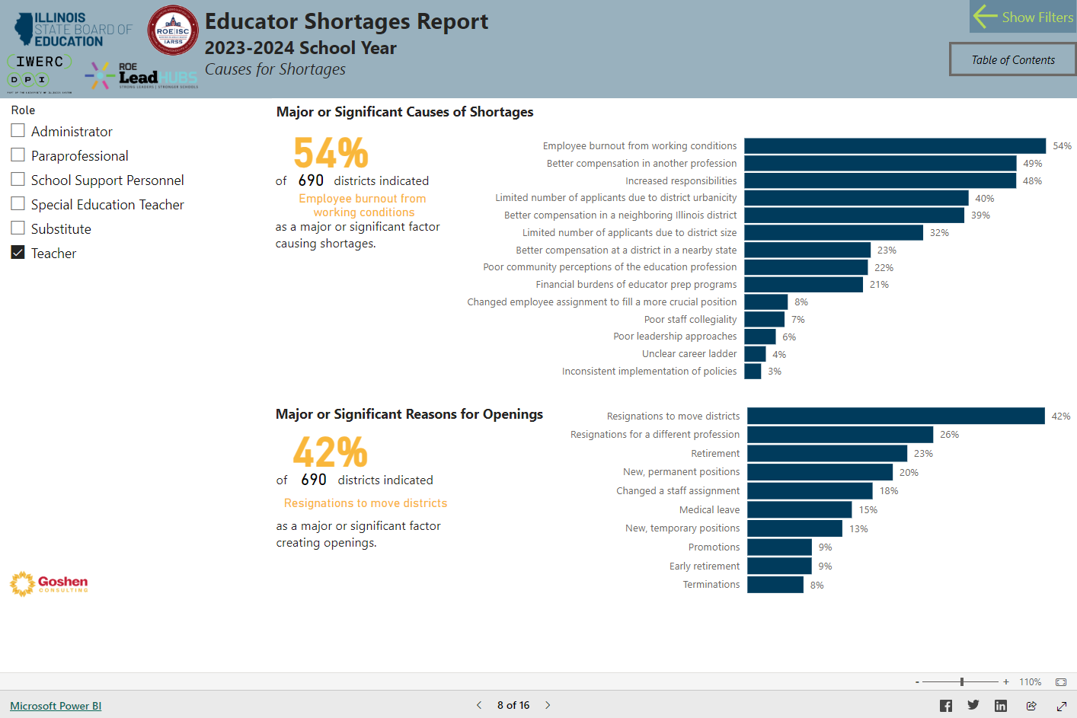
SHORTAGE CAUSES

Slide 22
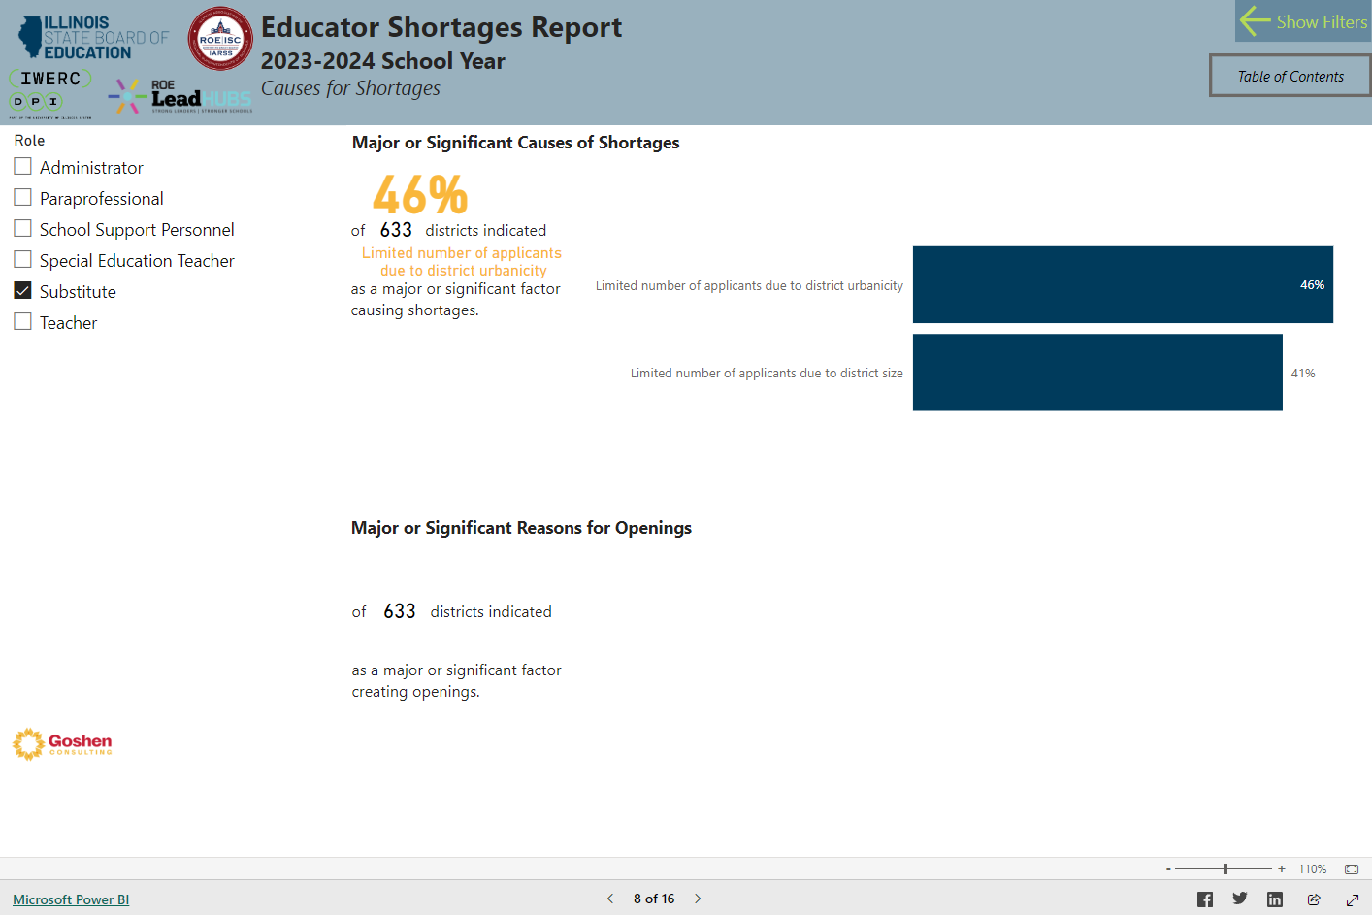
SHORTAGE CAUSES

Slide 23
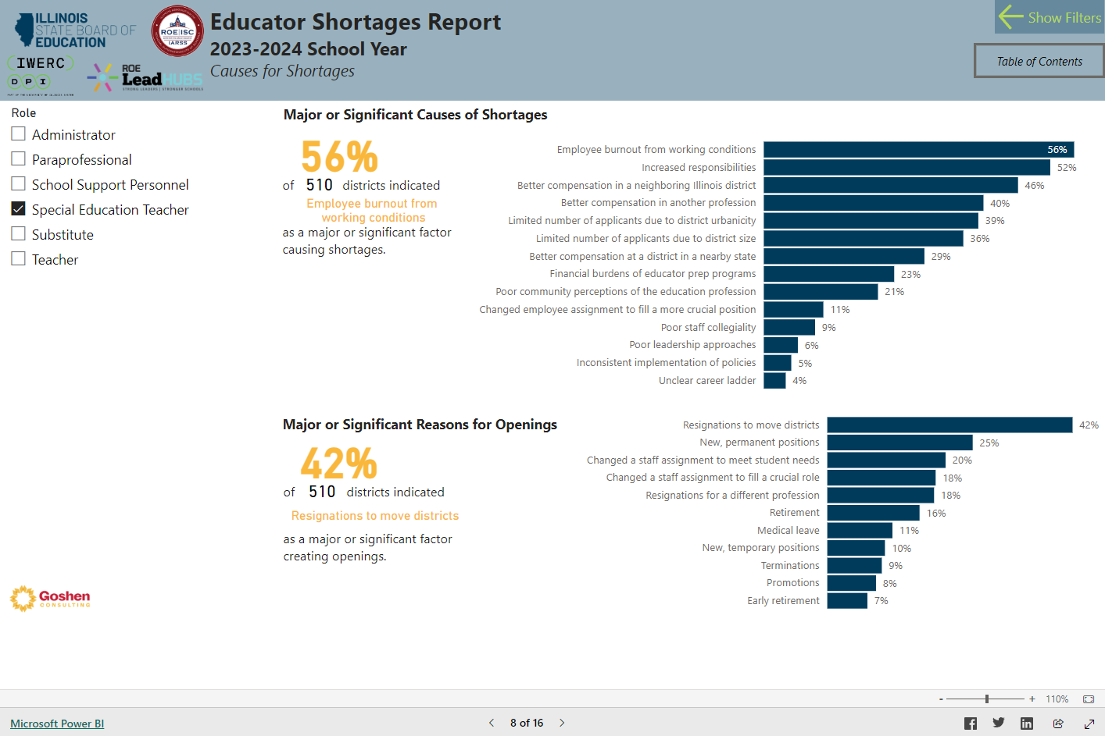
SHORTAGE CAUSES

Slide 24
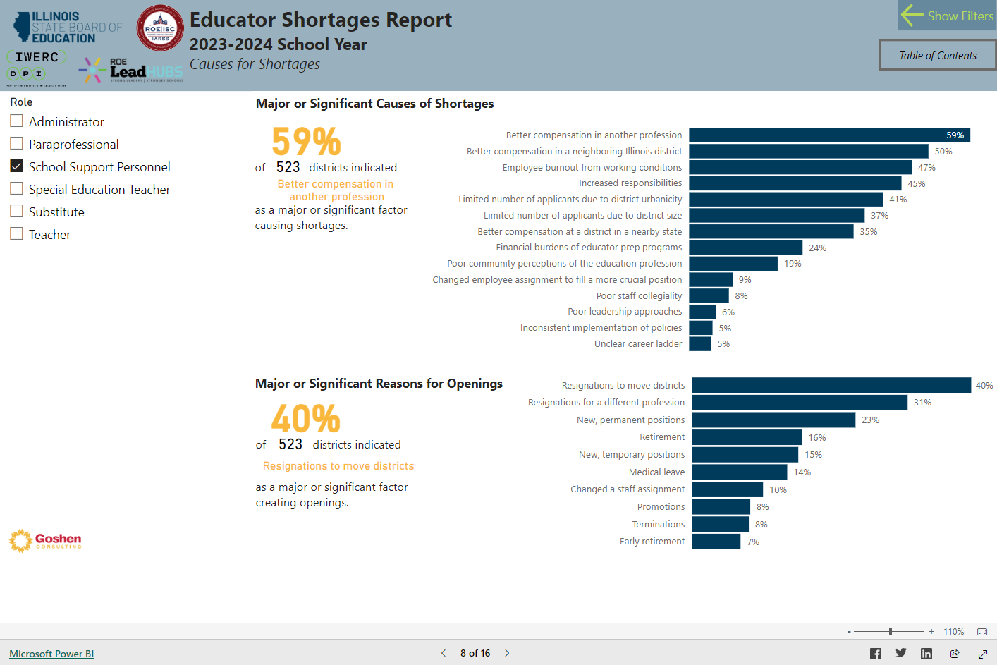
SHORTAGE CAUSES

Slide 25
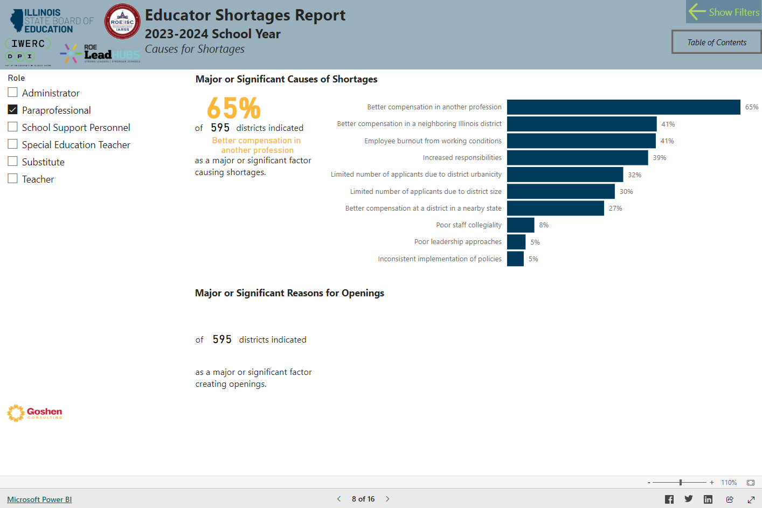
SHORTAGE CAUSES

Slide 26
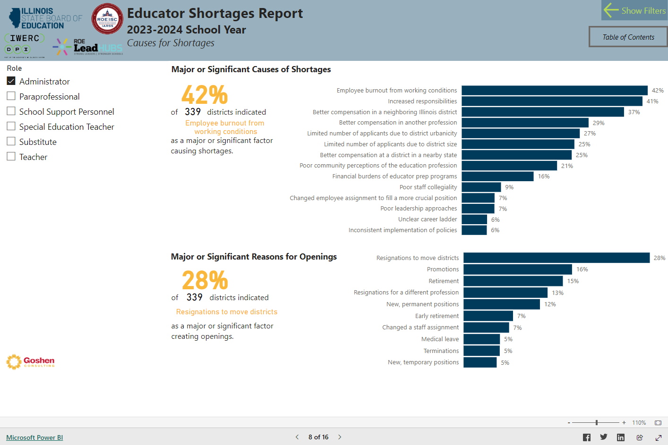
SHORTAGE CAUSES

Slide 27
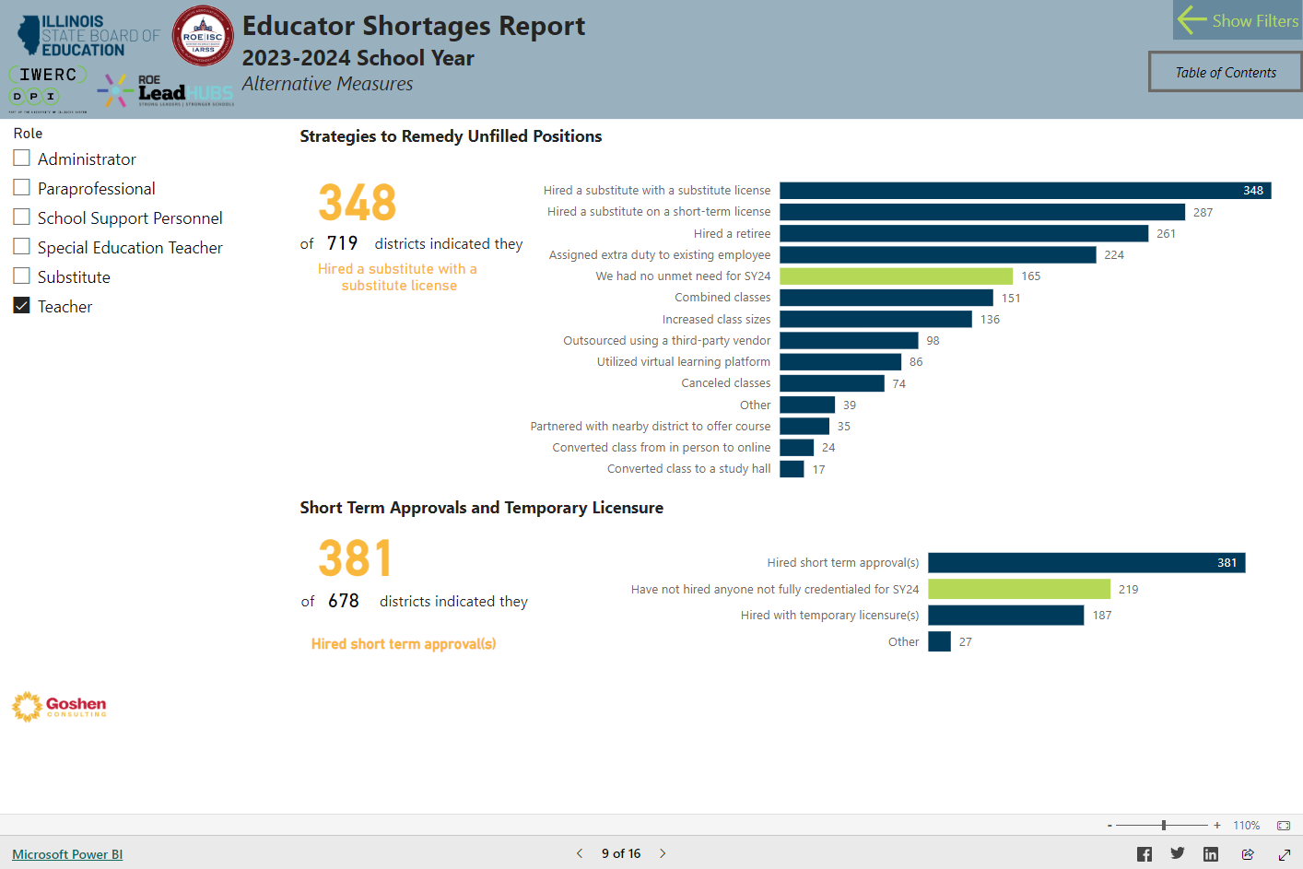
UNFILLED REMEDIES

Slide 28
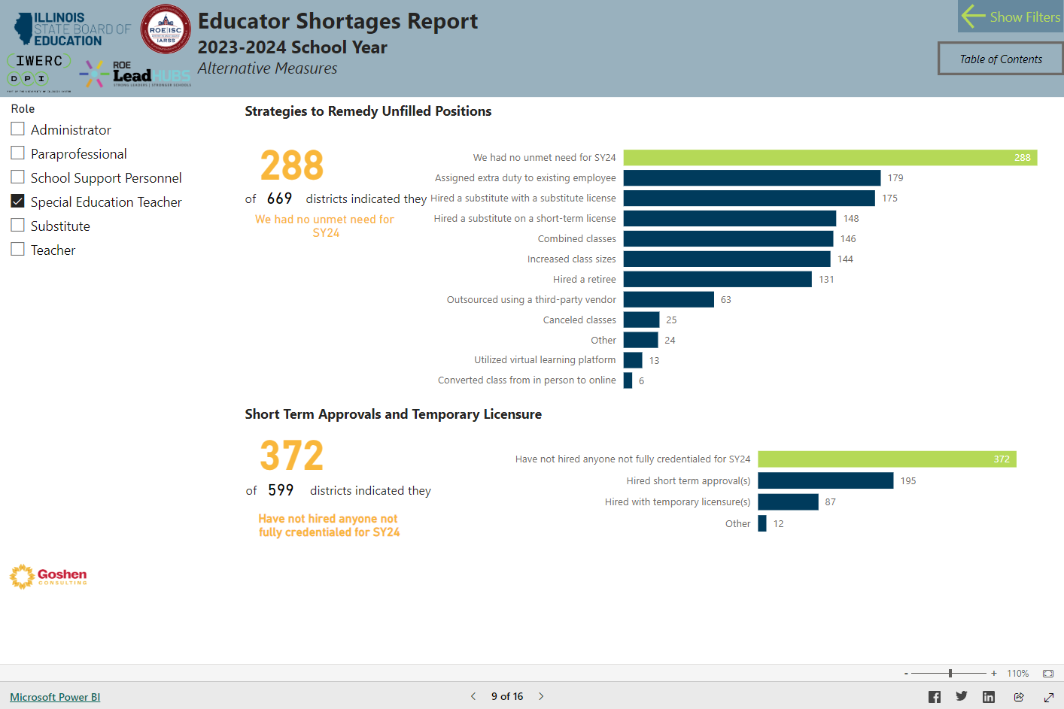
UNFILLED REMEDIES

Slide 29
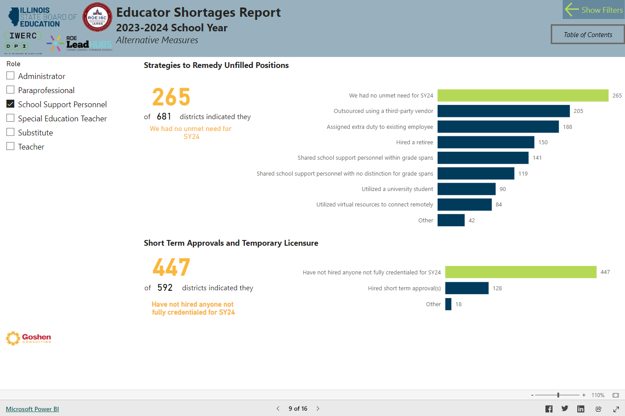
UNFILLED REMEDIES

Slide 30
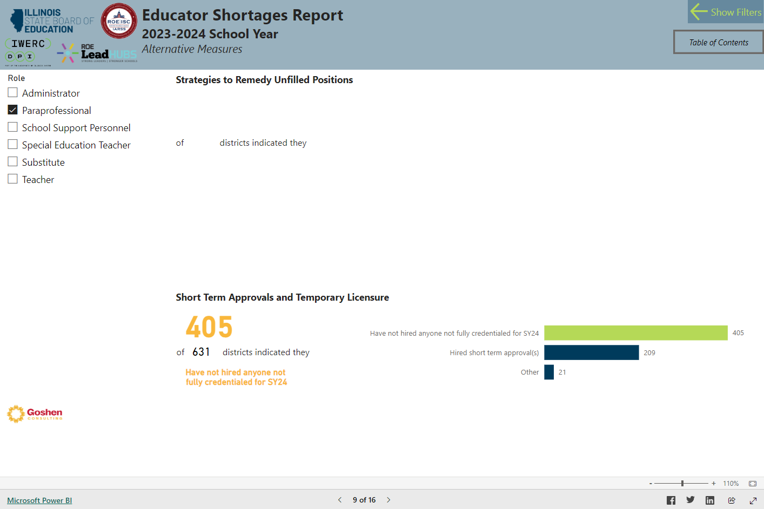
UNFILLED REMEDIES

Slide 31
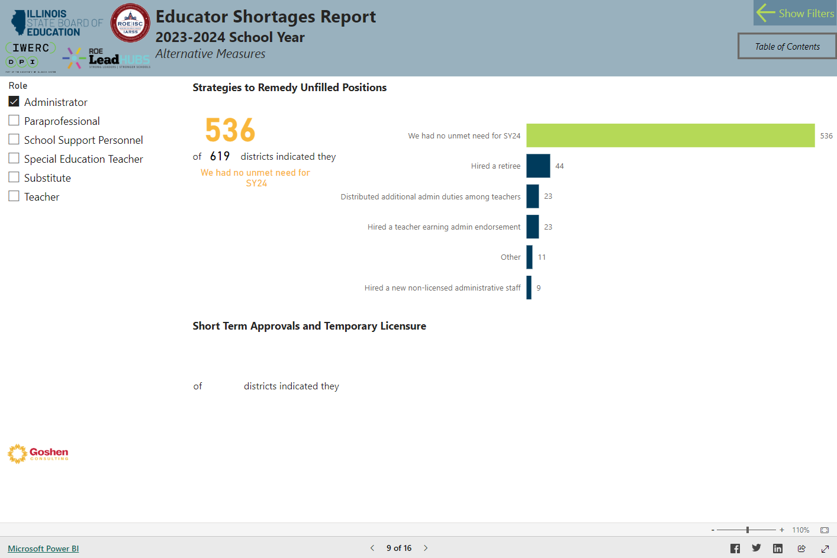
UNFILLED REMEDIES

Slide 32
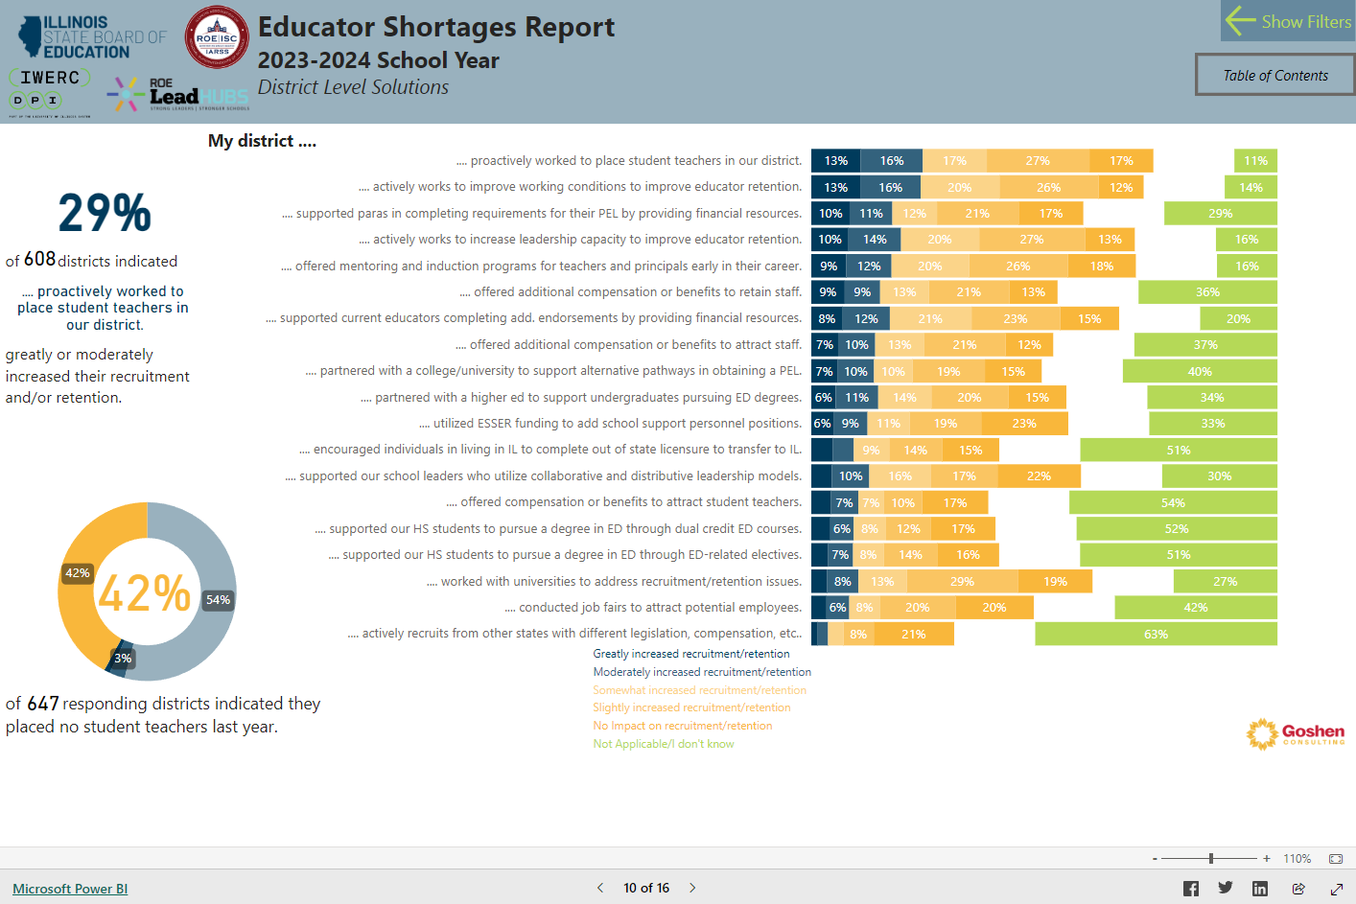
RECRUITMENT TOOLS

Slide 33
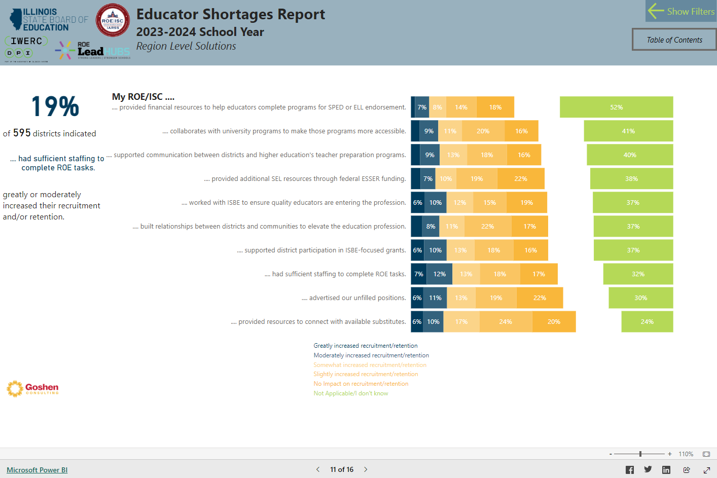
RECRUITMENT TOOLS

Slide 34
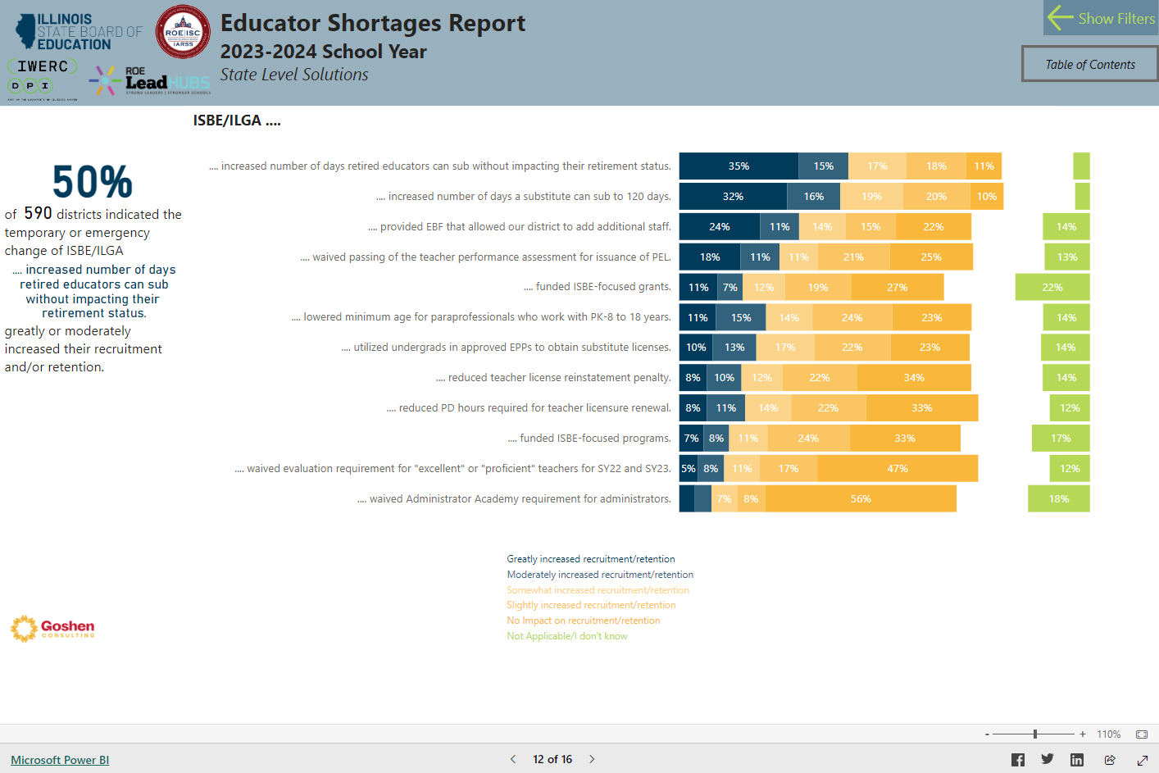
RECRUITMENT TOOLS

Slide 35
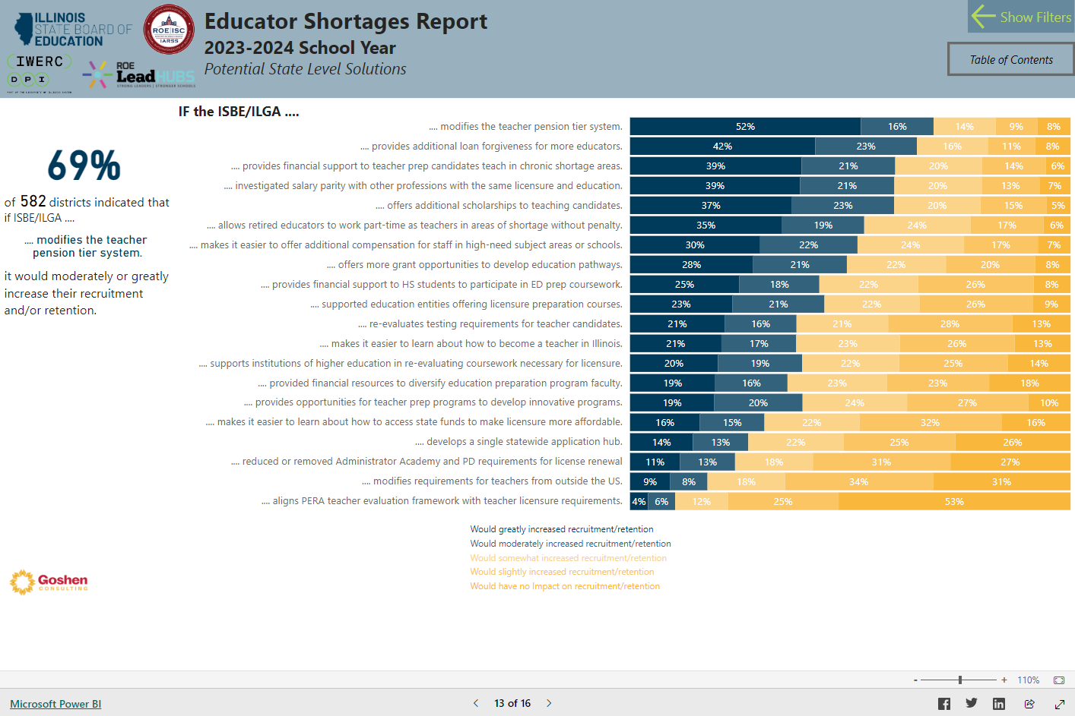
RECRUITMENT TOOLS

Slide 36
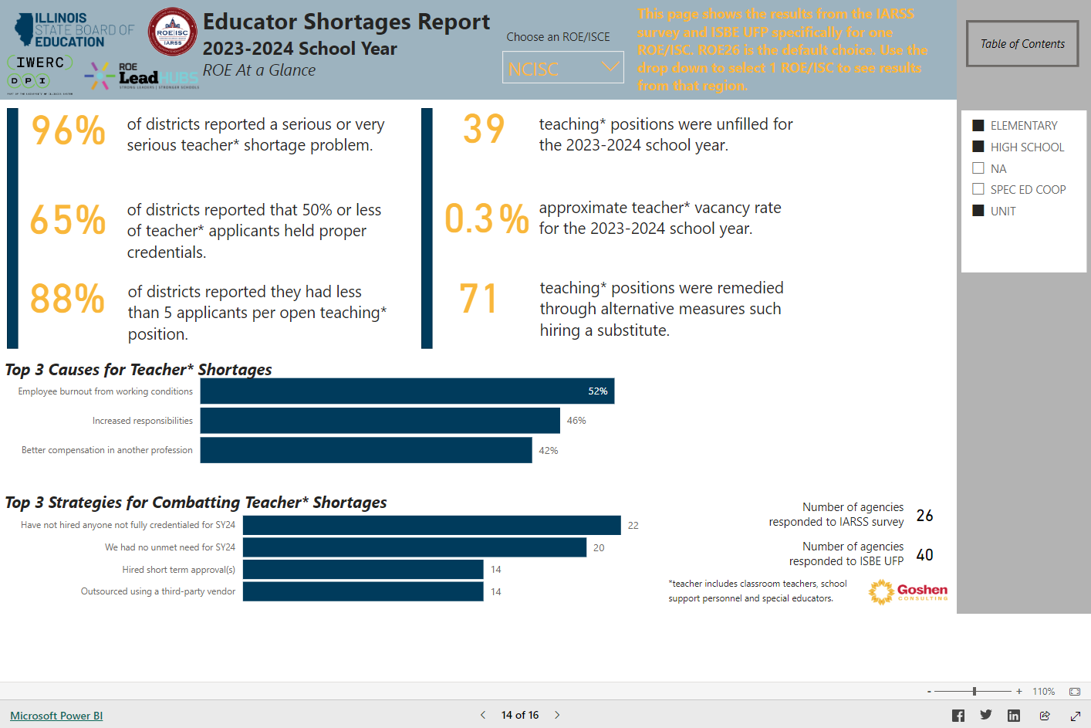
REGIONAL DATA

