Slide 1
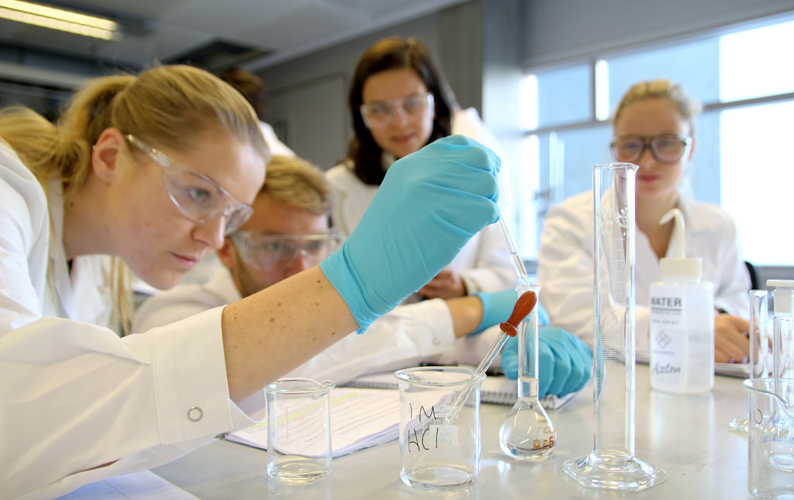
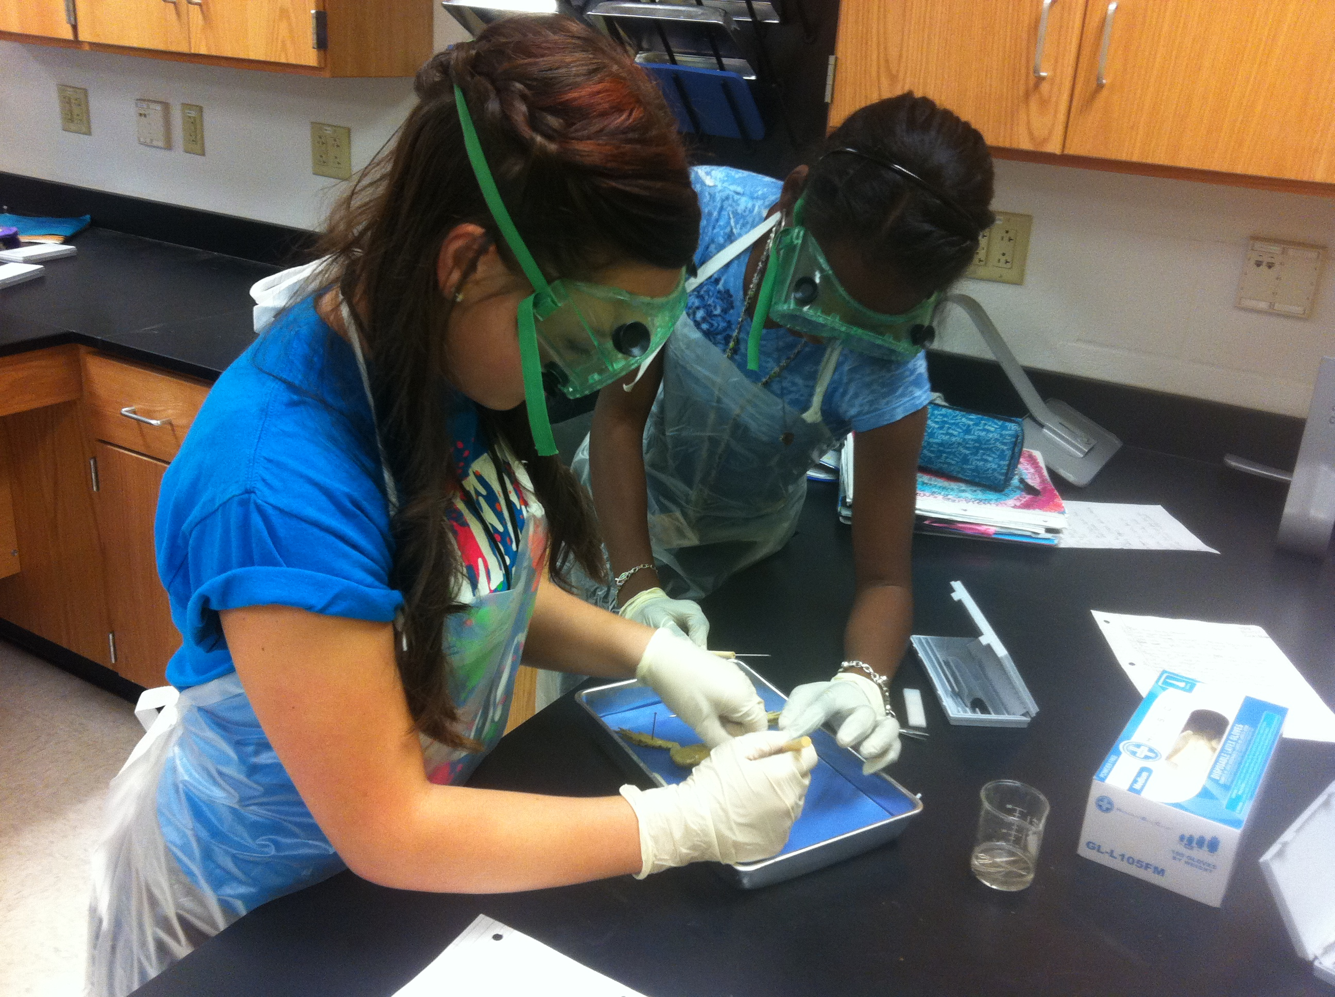
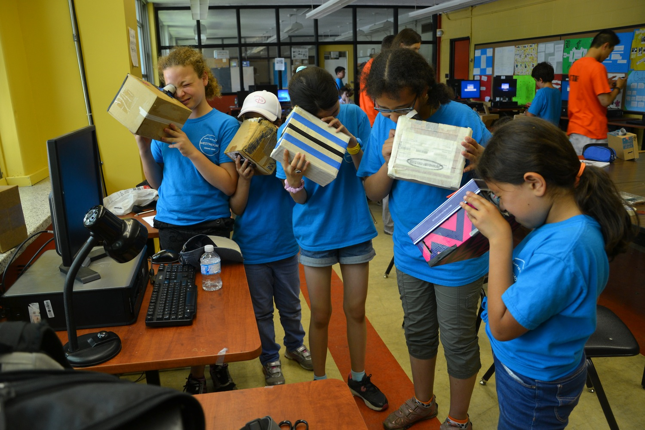
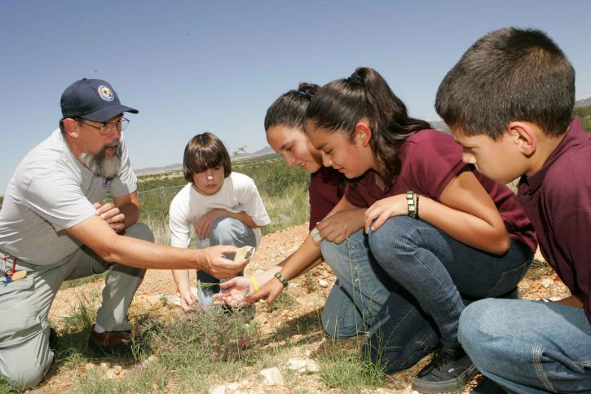
Foundational Services
Science
Phase 3

Slide 2
Facilitator Notes – Set Up
Notes:
Supplies:
Participants will be working in groups throughout the sessions. This will enhance networking, but will also enable participants to maximize NGSS experience. Groups will need to be created. It is best if groups can have a mixture of grade levels.
Suggestions for groupings:
Prepare card numbers in advance. On the back of each number, write Elementary, Middle, or High School. For 1, you should have three 1s each labeled with either Elementary, Middle, or High School.
As participants enter, provide each with a card. Tables are labeled with corresponding cards.
Cards (1/participant)
Tables:
Group Norms Table Tents
Table # Labels
Discussion Norms
Display:
Discussion Goals
Prepare Areas:
Whiteboard for Unpacking Consensus Discussion
Notes:
During the Facilitation of Small and Whole Group Discussion, utilize the Talk Moves Map. Potentially, reread the Talk Science Primer before facilitation.
From ACs on May 26th – Reminders for facilitating discussions:
Don’t Answer Questions – Ask Questions.
Look for things to pull out of a discussion.
Poker face!

Slide 3
Session 2
What is coherence? why is it important in NGSS Aligned units?
Notes:
Talking Points
Throughout Foundational Services for Science, we have focused our learning on the shift towards three-dimensional learning in the classroom.
Now that we have begun the process of developing or evaluating units of study through the storyline development process, it is also important for us to understand another key shift in NGSS - the concept of coherence.

Slide 4
Session 2: Facilitator Notes
Time: 30 minutes
Supplies:
Notes:
In this session, you will be bringing the work of Storylining together to understand coherence.
PowerPoint
Participant Workbook
Resource Packet
1 envelop with questions/group
1 sheet Chart Paper
Markers

Slide 5
Our Targets are…
I can explain the concept of coherence with respect to a unit of study aligned to the Next Generation Science Standards (NGSS).
I can analyze whether or not lessons in a unit of study fit together coherently targeting a set of performance expectations.
Notes:
Talking Points
The targets for this session, then, focuses on building an understanding of coherence.
In doing so, we will not only develop lessons and units of study with coherence, but we will also be able to evaluate units for the presence of coherence.

Slide 6
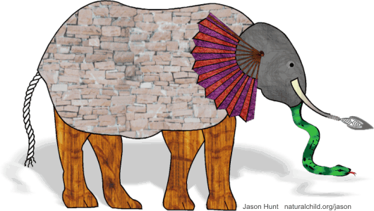
Coherence in NGSS
Elephant illustration (C) Jason Hunt - naturalchild.org/jason
Notes:
Facilitator Notes
Click here to see the story of the blind men and the elephant - http://wordinfo.info/unit/1/ip:3/il:B
The illustration above may be reproduced for non-commercial, offline use provided it is accompanied by the following acknowledgement: Elephant illustration (C) Jason Hunt - naturalchild.org/jason
Talking Points
Who knows the story of the blind men and the elephant?
[Note to facilitator: Have someone share the story with the whole group. If no one volunteers, the facilitator should retell the story. Click to display picture of perceived elephant at end of story.]
Although the men in this story certainly examined the parts of the elephant, their individual explanations did not depict a coherent representation of the elephant. Their various descriptions of the parts of an elephant did not fit together to create a picture of an entire elephant that made sense. Their individual descriptions, when examined as a whole, lacked coherence.

Slide 7
Coherence in NGSS
Task: Initial Thoughts - Coherence
Consider the term “Coherence.” What does this mean?
Take a few minutes to consider what you think coherence might look like in a longer lesson, a series of lessons, or a unit in science.
Write your current working definition for the term “coherence” in regards to NGSS aligned materials.
Notes:
Facilitator Notes:
Set the timer for 3 minutes.
Encourage participants to work individually.
Talking Points
So what is coherence?
Take a few minutes to consider about what you think coherence might look like in a longer lesson, a series of lessons, or a unit in science.
Write your current working definition for the term “coherence” in regards to NGSS aligned materials.

Slide 8
Coherence in NGSS
As a whole group, take a moment to share out your ideas.
Notes:
Facilitator Notes:
Set the timer for 5 minutes.
Lead the group in a discussion regarding their small group conclusions.
Use Talk Moves to elicit participants reactions and responses to the questions posed.
Talking Points
Now we will discuss as a whole group for a few minutes.

Slide 9
What Is a Storyline?
Q
A
Notes:
Talking Points
In creating a storyline, we are attempting to draft a coherent story for our students.
So what exactly do we mean by a coherent storyline?
Think of your favorite episode of Law and Order or another TV mystery series you watch regularly. The episode begins with a question: “Who committed the crime?” From here the plot proceeds logically as evidence is collected, suspects are questioned, and a case is built. The show ends when everything comes together, the question we began with is answered, and the perpetrator of the crime is revealed.
This exemplifies a coherent storyline.
Now think back to a TV show or movie you’ve watched where you’ve reached the end only to discover that the answer to the question of who committed the crime comes straight out of left field. There was no way you could have figured out the ending because either it wasn’t logical or the crime ended up being committed by someone who wasn’t even present in the earlier portion of the show. You feel as if you’ve wasted your time because the storyline wasn’t coherent; one thing did not follow from another.

Slide 10
What’s the Storyline Here?
Notes:
Facilitator Notes:
Set the timer for 5 minutes.
Move from table to table.
Sit down and listen to the participants at the table.
Do not answer questions. Ask questions.
Use Talk Moves.
Talking Points
In the center of your table you’ll find an envelope. Inside are five slips of paper, each with a question on it.
As a group, read through these questions and then put them in the order that you believe to be the most coherent storyline.
As you work to make a coherent storyline from these cards, think about what this process would look like in a classroom where students are trying to make sense of phenomena and/or design solutions to problems.
As you arrange the cards, ask yourself the following questions:
Can students see how what they are trying to figure out in a lesson fits into a larger storyline for making sense of phenomena and/or for designing solutions to problems?
Is there a coherent story that, based on explicit evidence found in the lessons, builds across the unit to reach a bundle of performance expectations?
Can you arrange the questions on the cards so that students see how what they are trying to figure out in a lesson fits into a larger storyline for making sense of phenomena and/or for designing solutions?
Can the questions be organized to build a series of lessons or a unit to reach a bundle of performance expectations?
[Note to facilitator: Allow five minutes for the groups to work and then have two to three tables share.]
Now let’s look at these same questions in a graphic representation of coherence.

Slide 11
A Graphic Representation of Coherence
Notes:
Facilitator Notes:
Set the timer for 3 minutes.
Move from table to table.
Sit down and listen to the participants at the table.
Do not answer questions. Ask questions.
Use Talk Moves.
Talking Points
Notice the “making sense question” at the top — the anchoring phenomenon.
Now look at the order of the phenomena-driven questions — the questions in the green boxes.
Take a minute or two at your tables to compare how you ordered the cards from the envelope with the order of these phenomena-driven questions.
[Note to facilitator: Allow one to two minutes.]
In this example, we can see coherence just by virtue of the fact that each subsequent phenomena-driven question relates directly back to our attempt to answer the making sense question.
In other words, if we assume that each phenomena-driven question relates to one lesson in a series of lessons, all of which are designed to address the making sense question, then each lesson connects and builds onto the previous as students work to answer the making sense question.
Here students engage in science practices to answer each of the phenomena-driven questions.
And, since the phenomena-driven questions logically and sequentially build on one another, what the students figure out — the meaning they make — logically and sequentially builds as well. In other words, their learning is coherent because the students can see how what they are trying to figure out in one lesson fits into a larger storyline for making sense of phenomena.

Slide 12
Coherence in the Storyline
Task: Storyline
Consider the concept of coherence in reference to the storyline we worked on as a whole group.
Where is there evidence of coherence in our storyline?
As you are working, ask yourselves the following questions:
How does a storyline have coherence?
How do we create coherence – in storylines or in the classroom?
What do we need to “remember to do” in regards to coherence?
Notes:
Facilitator Notes
Set aside 10 minutes for this task.
Talking Points
We worked together to start creating a row or two in a storyline. And, we were also provided with a storyline created by other teachers.
Let’s look at these two sources and determine how we are seeing that coherence in the storyline. Consider the following questions:
How does a storyline have coherence?
How do we create coherence – in storylines or in the classroom?
What do we need to “remember to do” in regards to coherence?

Slide 13
Session 2 Reflection
Task: What Can I Take Away?
Reflect on your experiences within this past session and work as a large group to generate a list of general Take-Away statements regarding coherence.
After discussing as a large group, consider your personal plan of action and record your reflections in your packet.
Notes:
Talking Points
As we know, even with the best of professional development, it is always challenging for educators to bring back the PD to the classroom. Let’s take a moment and generate a list actions we could take tomorrow in relation to the coherence and our work today.
Facilitator Notes:
Use Talk Moves to elicit participants major take-aways.
Scribe the groups thoughts on a white board or large sheet of chart paper.
Talking Points
Let’s consider your personal plan of action.
Take a moment and record your reflections in your packet on page 3.
Consider this your plan to bring coherence back to your planning and instruction.
Facilitator Notes:
Provide a few moments for participants to record their plans.
Following the reflection use the following talking points to move into the next portion of the presentation.
Talking Points
Now it is time to bring all three phases of Foundational Services full circle. We will do this by looking at the tool, the EQuIP Rubric for Science Lessons and Units.

