Slide 1
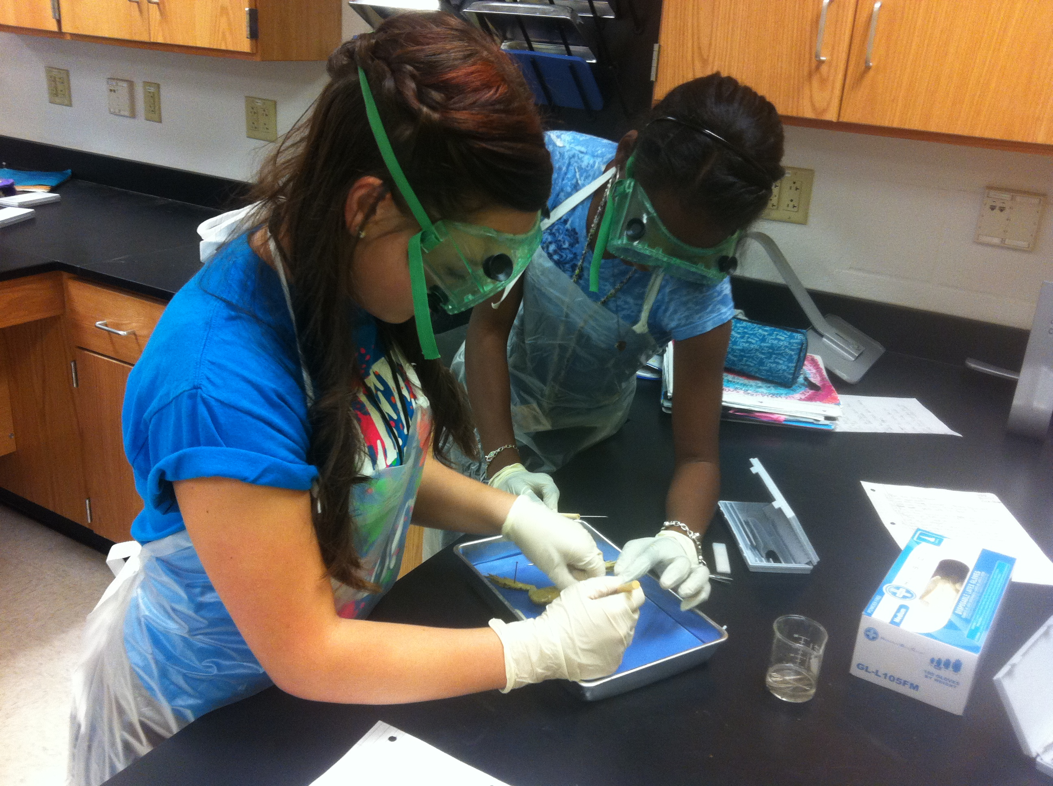
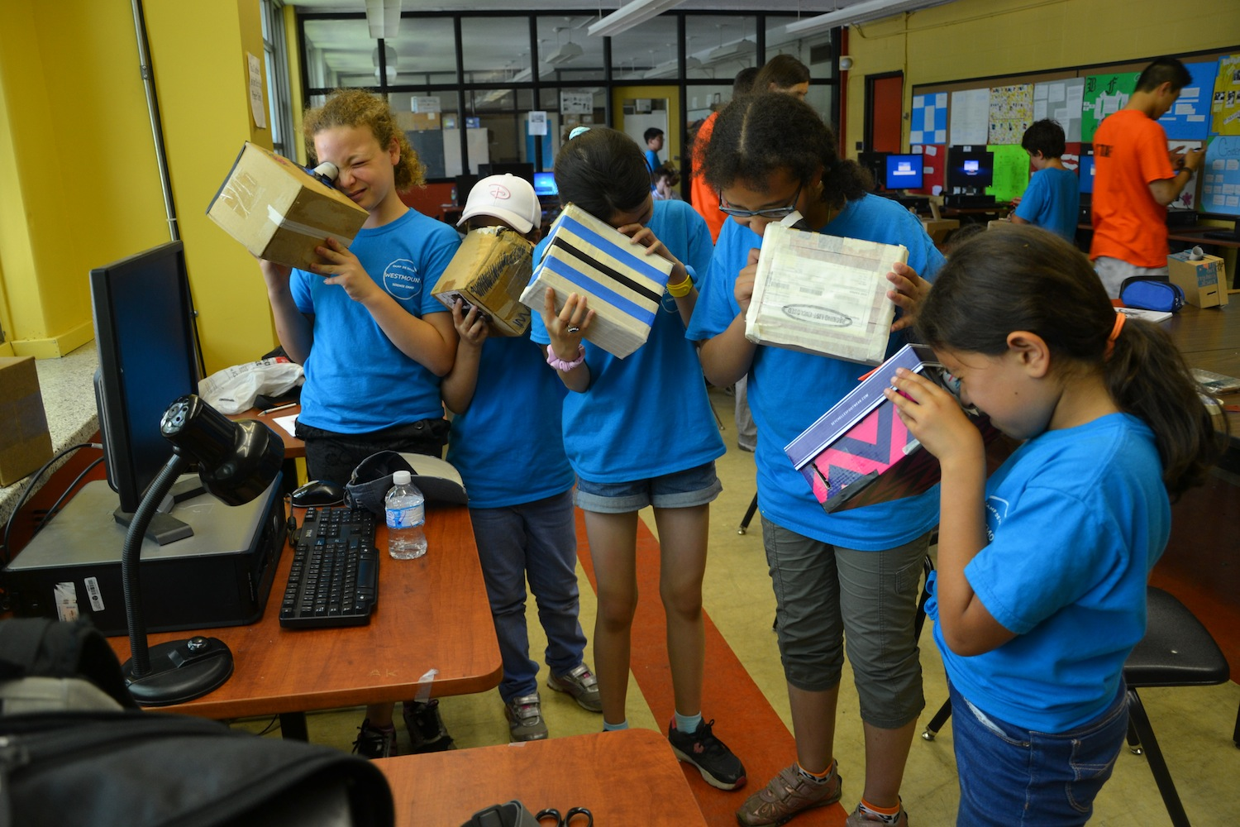
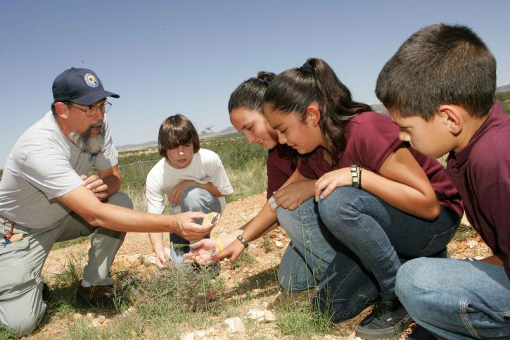
Foundational Services
Science –
Phase 2

Slide 2
Session 1: Facilitator Notes
Time: 2 hours
Supplies
PowerPoint
Participant Workbook
Chart Paper
Markers for Facilitator
Document Camera or Projection App
6 random objects around the room
Light Boxes 1/group
1 Object in the Box
1 Divider/Box – each divider should have a hole in a different place.
Items to be used for 3D Model (might include Table Toys, Candy, Sticky Notes, Markers, etc.)
Printable: Eye, Object, & Light Source model pieces 1/table
Glue sticks
Pencils/Markers
2 sheets of plain paper/table

Slide 3
Session 2
How do we determine the core IDEAS OUR STUDENTS need to learn?
Notes:
Talking Points
We will begin our process of Bringing NGSS to the Classroom by utilizing tools to make sense of the Disciplinary Core Ideas.
As an educator, we must ask the question: How do we determine the core ideas our students need to learn?
In the past, educators often relied upon textbooks, textbook resources, syllabi, or science kits to determine the content of their courses. When unit planning such as UBD emerged in education, teachers used those resources and the state standards to design units of study.
The standards have changed.
Those resources are attempting to catch up.
So, what we are really trying to figure out is: What am I supposed to be teaching?
Depending on our experiences:
We may have a clear idea of what has been taught in the past or what we think should be taught.
Conversely, we may have no idea what needs to be taught.
The reality is that both the Framework and NGSS focus on a smaller set of Disciplinary Core Ideas (DCI) that students should know by the time they graduate from high school, focusing on deeper understanding and application of content.
No matter what your previous experience, expertise, or initial thoughts may be, in order to truly answer the questions with respect to the vision for Science Education intended with NGSS, we (teachers, department heads, administrators, curriculum developers, etc.) must look to the Framework and NGSS for guidance.

Slide 4
Session 2: Facilitator Notes
Time: 1hour 30 minutes
Supplies
PowerPoint
Participant Manual
Chart Paper
Markers for Facilitator
Phenomena Reading (packet) – At the end of this session, it is important to assign the reading for the next session as homework. If this is a one day training, have participants read the article on their lunch. If this is multiple day training, assign to be completed prior to the next session.

Slide 5
Our Targets are…
I can read the performance expectations and identify where to go for more information regarding those performance expectations.
I can examine the disciplinary core ideas to determine a focus for curriculum.
Notes:
Talking Points
The targets for this session, then, focus on providing tools to make sense of the disciplinary core ideas. In doing so, we will also become more familiar with the performance expectations.
Within Session 2, you will learn and practice a process for diving into the disciplinary core ideas.
The intention of this session is for you to be able to replicate this process within professional learning communities with other Next Generation Science Standards and the related performance expectations that are relevant to your classrooms.

Slide 6
Disciplinary Core Ideas in the NGSS
Notes:
Talking Points
If we consider the lessons we experienced at the onset of this module and its alignment to NGSS, how do we know if it is aligned?

Slide 7
Disciplinary Core Ideas in the NGSS
Notes:
Talking Points
Let’s look at NGSS [click on image to go to website]
If we click on Next Generation Science Standards in the tool bar at the top of the site [click on tool bar], we will be able to search by disciplinary core ideas or topics. If we want to know what topics may come up related to a topic we teach, we may select Topic. If we want to know all the NGSS within a particular DCI, we may select DCI. We can also perform a search as well. We will look by Disciplinary Core Idea. [click on disciplinary core ideas]
If we are in K-5 grade bands, we look directly to the assigned performance expectations. [scroll to K-5]
For middle school, determining which performance expectations fall to which grade is a local decision in the State of Illinois. And, for high school, determining which performance expectations fall to which course is a local decision in the State of Illinois. However, seeing which NGSS are related to the four major disciplinary core idea strands is possible here. [scroll to 6-12]
Since our lesson had to do with light, lets search by electromagnetic radiation to see the appropriate grade level and connection. [In the search box Disciplinary Core Idea, click on PS4B: Electromagnetic Radiation.]
Here we are able to see all the standards at different grade levels related to this topic. If we select, 4-PS4 Waves and Their Applications in Technologies for Information Transfer we will see performance expectations most closely related to the task we considered today.
As an educator, how do we determine the core ideas our students need to learn?

Slide 8
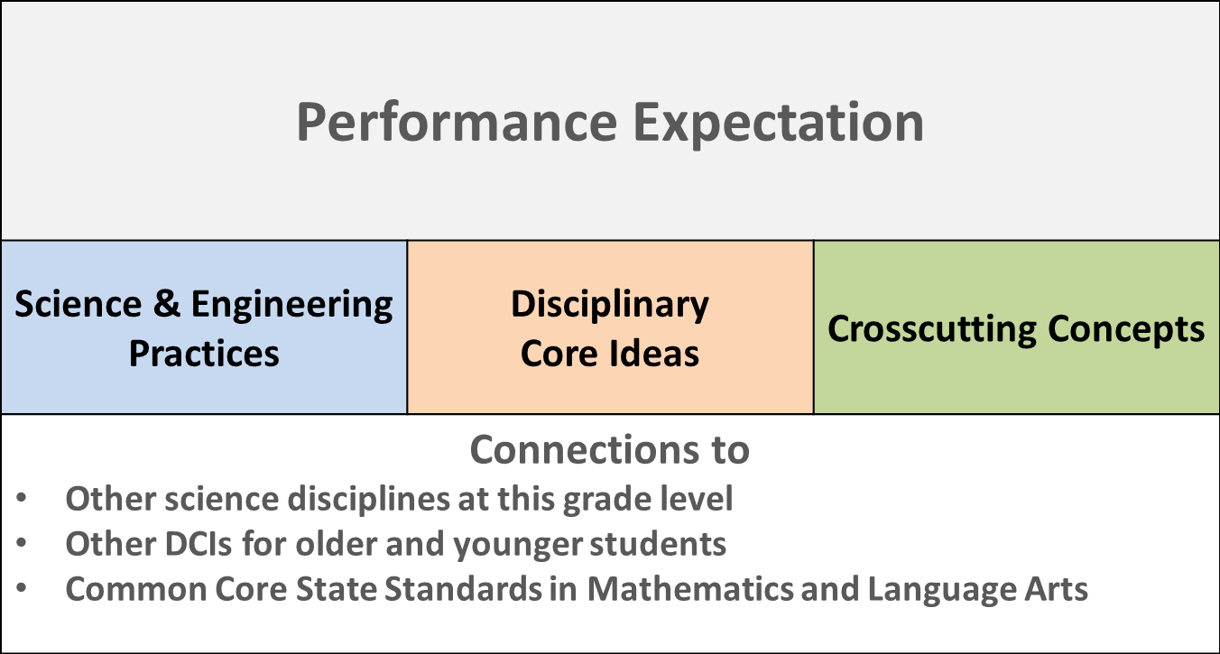
Disciplinary Core Ideas in the NGSS
Make Sense of the DCI
Summarize the DCI
Read and Mark the DCI
Performance Expectation
Task: Make Sense of the Standard - Performance Expectations
Individually, read over the performance expectations, foundational boxes, and connections.
Notes:
Facilitator Notes:
Set aside 5 minutes for this task.
The intention is to look over these standards as individuals before engaging in partner talk.
Talking Points
Not all of the performance expectations for this standard are directly related to our lesson. 4.PS4-2, however, seems to be the most closely related to the work we did today.
Let’s examine the performance expectation.
Take a moment to read over the performance expectations, foundational boxes, and connections. Make notes or comments in your packet on page 27.

Slide 9
Disciplinary Core Ideas in the NGSS
Make Sense of the DCI
Summarize the DCI
Read and Mark the DCI
Performance Expectation
Task: Make Sense of the Standard - Performance Expectations
Working with a partner, briefly review your notes and thoughts with one another.
Compare these with the lessons we experienced.
Consider the following questions:
What aligns?
What doesn’t align?
What are you unsure about?
Notes:
Facilitator Notes:
Set aside 5 minutes for this task.
The intention is a short elbow partner talk to prepare for the large group discussion.
Talking Points
Now discuss with a partner. Focus on sharing your thoughts and comparing these with the lessons from the beginning of this module.

Slide 10
Disciplinary Core Ideas in the NGSS
Make Sense of the DCI
Summarize the DCI
Read and Mark the DCI
Performance Expectation
Task: Make Sense of the Standard - Performance Expectations
As a whole group, take a moment to share out your ideas.
Discuss the following question:
Does the lesson align to this performance expectation for the standard 4-PS4 Waves and Their Applications in Technologies for Information Transfer?
Why or why not?
Notes:
Facilitator Notes:
Set the timer for 5 minutes.
Lead the group in a discussion regarding their small group conclusions.
Use Talk Moves to elicit participants reactions and responses to the questions posed.
Talking Points
Now we will discuss as a whole group. Let’s focus on these two questions.
The performance expectation gives us some idea of what is needed to address these performance expectations of the standard. However, the performance expectation is a statement explaining what students should be able to do. The Foundational Boxes provide a little more clarification. However, they are excerpts from the Framework. As a matter of fact, there is no new language in the foundational boxes; instead, this is language from the Framework.
When viewing the standard online, you can click on the foundational boxes and they will link directly to the corresponding section of the Framework. [click on performance expectation to go to NGSS. Demonstrate how clicking on the foundational box will take you to the section of the Framework.]

Slide 11
Utilize the Framework
The section entitled “Disciplinary Core Ideas” is reproduced verbatim from A Framework for K-12 Science Education: Practices, Cross-Cutting Concepts, and Core Ideas.
Notes:
Talking Points
When we look at the performance expectation and the foundation boxes, we can gain some insight into the necessary elements of the core ideas that needs to be taught.
The performance expectation gives us some idea of what is needed to address these performance expectations of the standard. However, the performance expectation is a statement explaining what students should be able to do.
The Foundational Boxes provide a little more clarification.
However, they are excerpts from the Framework. As a matter of fact, there is no new language in the foundational boxes; instead, this is language from the Framework.
When viewing the standard online, you can click on the foundational boxes and they will link directly to the corresponding section of the Framework. [click on performance expectation to go to NGSS. Demonstrate how clicking on the foundational box will take you to the section of the Framework.]
To better prepare ourselves for determining what core ideas need to be a focus in our lessons, we look to the Framework for guidance.

Slide 12
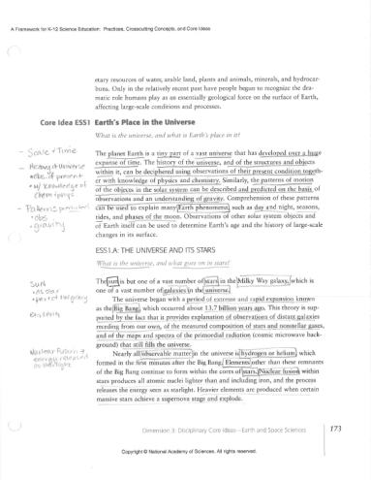
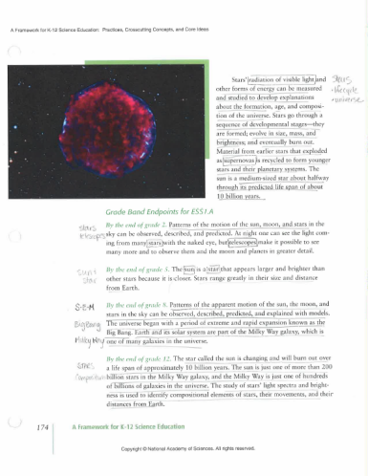
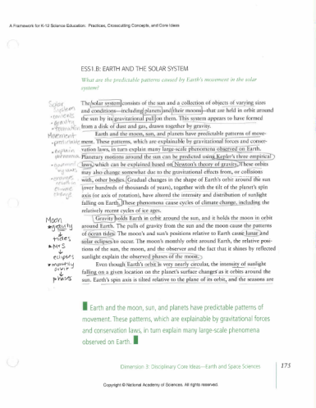
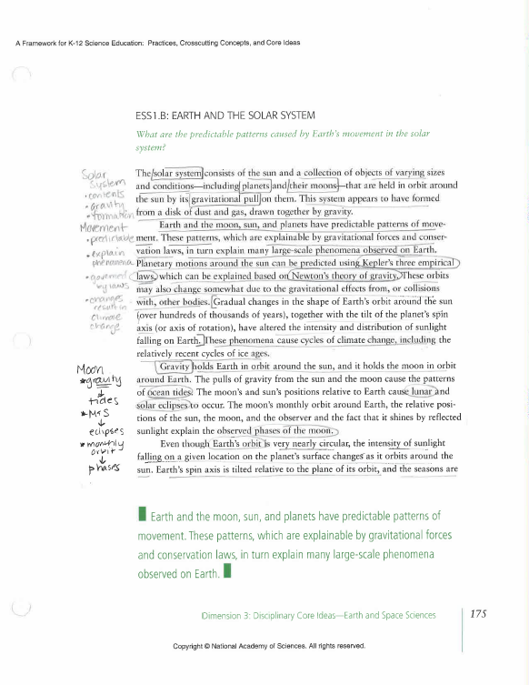
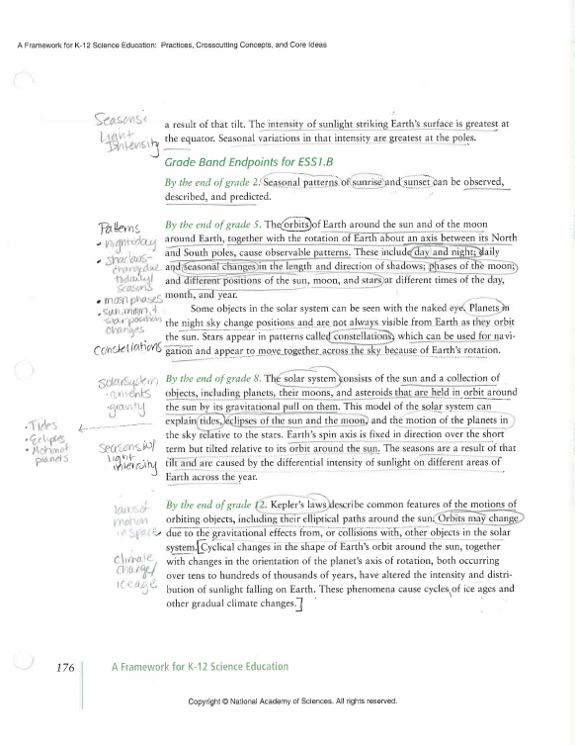
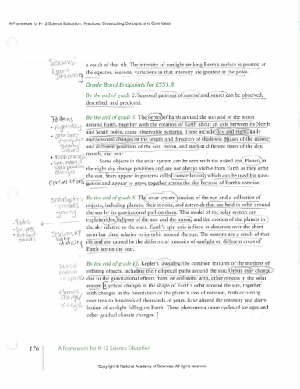
Read & Mark the Framework
Make Sense of the DCI
Summarize the DCI
Read and Mark the DCI
Performance Expectation
Notes:
Talking Points
The concept of unpacking is not foreign to any teacher who worked with our previous Illinois Learning Standards for Science. While the idea of making sense of the standards still applies, both the process and result of unpacking are very different when working with NGSS.
We look here at a sample of unpacking. Currently, Lisle Junior High School is developing a middle school science unit addressing the middle school NGSS for Space. The images on the screen are their process of unpacking the disciplinary core ideas behind their standards.

Slide 13
Read & Mark the Framework
Make Sense of the DCI
Summarize the DCI
Read and Mark the DCI
Performance Expectation
Task: Read & Mark the DCI
Using the excerpt copy of the Framework, determine the core ideas within this performance expectation.
Individually, read and make notes. Underline the most important ideas you find. Write questions or thoughts in the margins. Read "between the lines" to see what understandings are implicit.
Be prepared to explain the core ideas to the group.
Notes:
Facilitator Notes:
Set aside 15 minutes for this task.
Encourage participants to work individually.

Slide 14
Make Sense of the Ideas
Make Sense of the DCI
Summarize the DCI
Read and Mark the DCI
Performance Expectation
Notes:
Talking Points
Once we have read and marked up the framework. We need to make sense of the markings and ideas in our heads and in our discussion.
The next step requires some processing. Lisle Junior High School teachers engaged in a discussion and got their ideas out on the table. As they discussed, they scribed their thoughts.

Slide 15
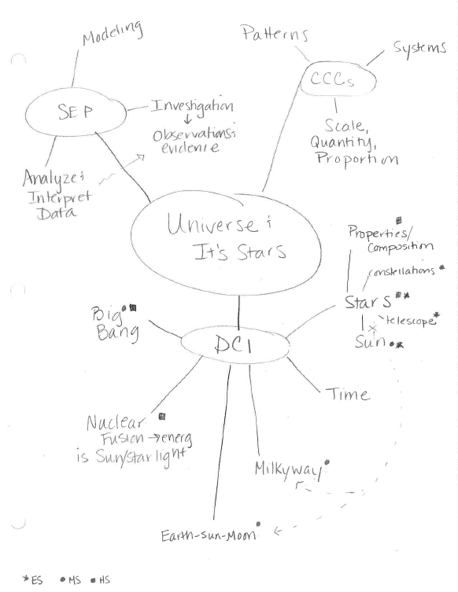
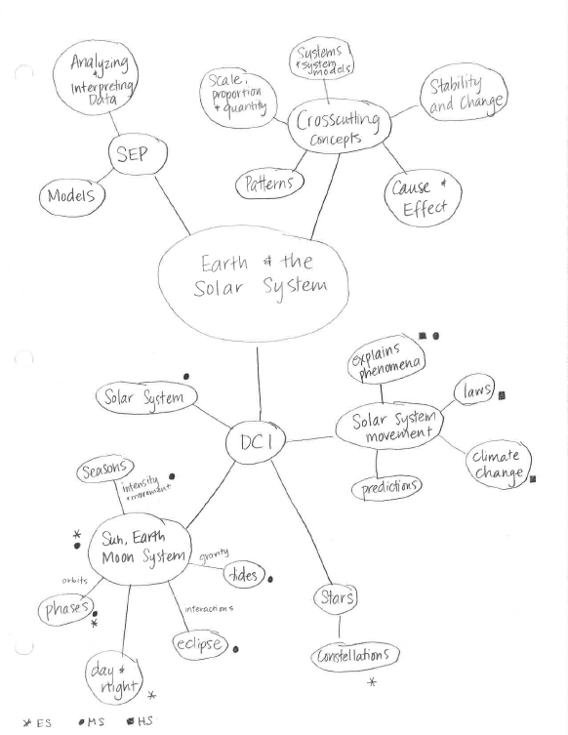
Make Sense of the Ideas
Make Sense of the DCI
Summarize the DCI
Read and Mark the DCI
Performance Expectation
Notes:
Talking Points
From their rich scientific discussion of ideas, Lisle Junior High School teachers used a concept map to link the ideas and make sense of the connections.
For added clarification, they have also looked at the evidence statements.

Slide 16
Make Sense of the Ideas
Make Sense of the DCI
Summarize the DCI
Read and Mark the DCI
Performance Expectation
Task: Make Sense of the DCI
Working in a small group, make sense of the ideas you unpacked from the Framework. While you are working, consider what we want students to know at the end of the 3 – 5 grade band.
Using whatever process makes sense to your group, create a list or image of the core ideas within the Framework.
As you are working, ask yourselves the following questions:
Do your statements and connections go beyond vocabulary?
Do your ideas go beyond restating and add clarity?
Are the ideas on your list or image both the explicit and implicit ideas in the framework.
Did you include the "how" and "why"?
Notes:
Facilitator Notes:
Set aside 20 minutes for this task.
Move from table to table.
Sit down and listen to the participants at the table.
Do not answer questions. Ask questions.
Use Talk Moves.

Slide 17
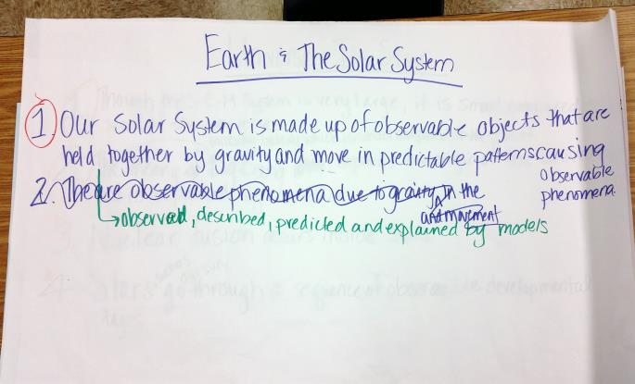
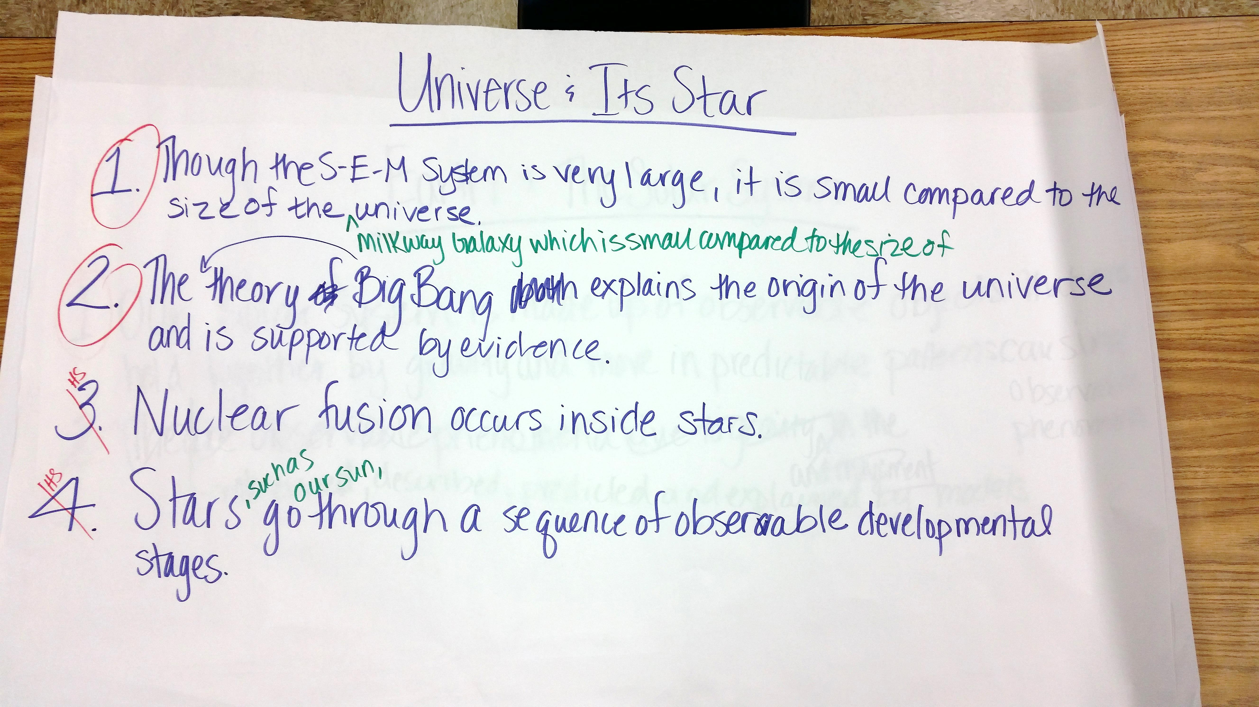
Summarize the Ideas
Make Sense of the DCI
Summarize the DCI
Close Read the DCI
Performance Expectation
Notes:
Talking Points
After all the work of unpacking, Lisle Junior High School teachers worked together to summarize the big ideas in these two core ideas of Space Science.
Through discussion, the teachers worked to reword and add clarification to the statements that would be the essence of the lessons and unit they are building.

Slide 18
Summarize the Ideas
Make Sense of the DCI
Summarize the DCI
Close Read the DCI
Performance Expectation
Task: Summarize the DCI
Working as a whole group, come to a consensus about the big ideas students need to know about this disciplinary core idea.
Individuals may also make notes in their packet as the group works together.
Notes:
Facilitator Notes:
Set aside 20 minutes for this task.
Use Talk Moves to elicit participants responses.
Scribe the groups thoughts on a white board or large sheet of chart paper.

Slide 19
Sample
Notes:
For guidance, this is what the AC group came up with on November 19th.

Slide 20
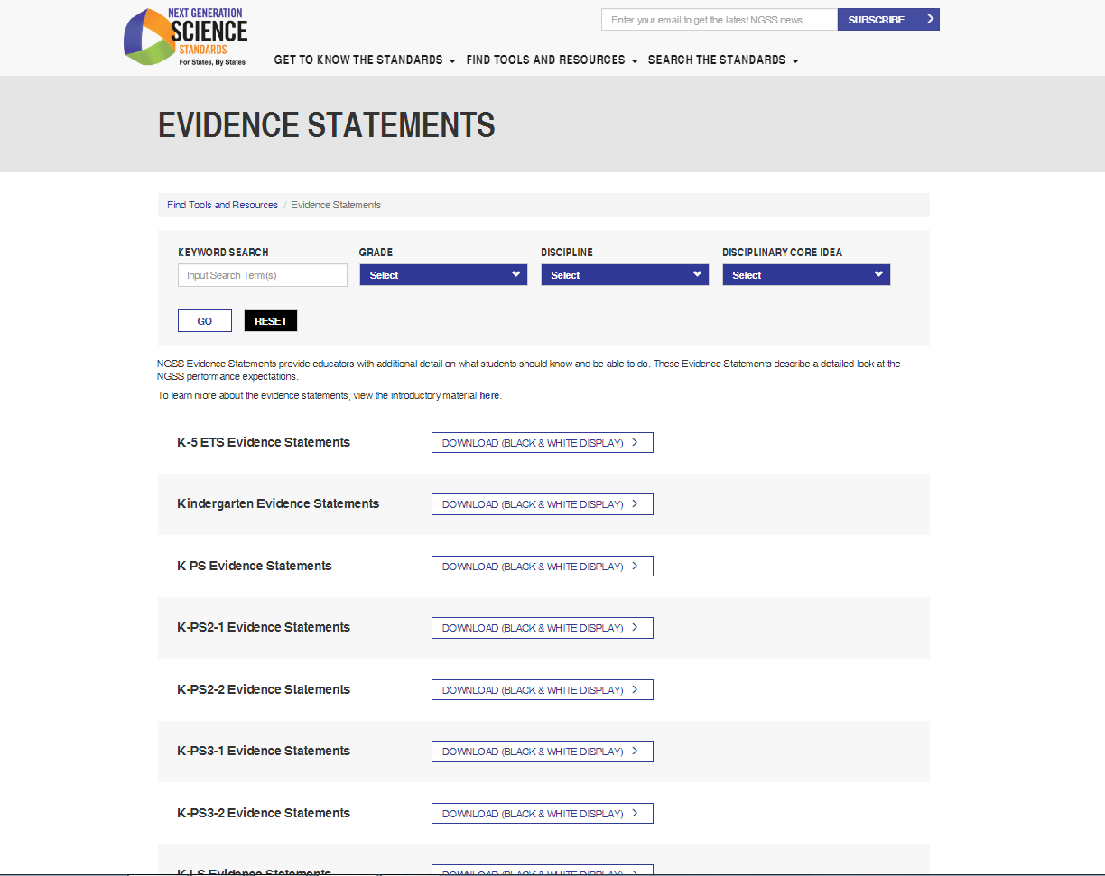
Disciplinary Core Ideas in the NGSS
Performance Expectation
Make Sense of the DCI
Summarize the DCI
Read & Mark the DCI
Notes:
Talking Points
While there is no one way to make sense of what science educators are supposed to be teaching, the method we practiced today has been developed over the past decade.
Illinois science educators used this method with the creators, Dr. Brian Reiser and Michael Novak during the ISBE Curriculum Resource Project. (With the changes in the Illinois state government and Board of Education, this project has unfortunately been put on hold.) This method was further developed during the Math and Science Partnership (MSP) Grant that involved NGSX, a research group out of Northwestern University and Clark University with Dr. Brian Reiser and his team of Michael Novak, Tara McGill, Aimee Park, and others using NGSX to train 24 Area Teacher Leaders who then trained 24 participants in NGSX in their own regions. In addition, NGSX has worked with many other states and teams of teachers as they make sense of NGSS and attempt to bring it life in their classrooms.
While there may be other methods or approaches to making sense of the Science or we could simply wait for curriculum developers to do this for teachers, this method works for teachers. This process can be used as the beginning steps of creating units of study in a process called Storylining or this process can be used to then evaluate a curriculum for alignment. No matter what the situation, being able to make sense of the Disciplinary Core Ideas is essential to inform education practice in Science classrooms.

Slide 21
Session 2 Reflection
Task: What Can I Take Away?
Reflect on your experiences within this past session and work as a large group to generate a list of general Take-Away statements regarding the disciplinary core ideas.
After discussing as a large group, consider your personal plan of action and record your reflections in your packet.
Notes:
Talking Points
As we know, even with the best of professional development, it is always challenging for educators to bring back the PD to the classroom. Let’s take a moment and generate a list actions we could take tomorrow in relation to the practices and our work today.
Facilitator Notes:
Use Talk Moves to elicit participants major take-aways.
Scribe the groups thoughts on a white board or large sheet of chart paper.
Talking Points
Let’s consider your personal plan of action.
Take a moment and record your reflections in your packet on page 3.
Consider this your plan to make sense of the disciplinary core ideas in the standards that you will be working towards in your lessons.
Facilitator Notes:
Provide a few moments for participants to record their plans.
Following the reflection use the following talking points to move into the next portion of the presentation.
Talking Points
Now that we have a method to dive into the core ideas, we need to begin to consider how we will engage the student in those core ideas. Three-dimensional learning shifts the focus of the science classroom to environments where students use practices, disciplinary core ideas, and crosscutting concepts together to make sense of phenomena and/or to design solutions to problems.
In order to get at the core ideas, this means we engage students in making sense of phenomena – phenomena that is directly related to the core ideas.

