Slide 1
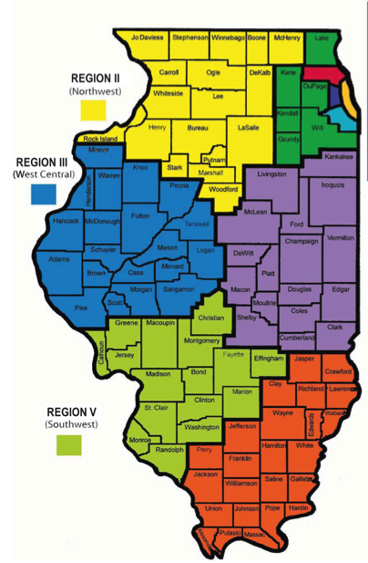
Mathematics Instructional Design, Delivery, and Assessment
High School
ISBE Math Foundational Services
June 2016
Notes:
Mathematics Instructional Design, Delivery, and Assessments
Updated 8-17-16

Slide 2
Mathematics Instructional Design, Delivery, and Assessments Pre Post
I can use the Math Implementation Guides to drive curricular decisions
I can facilitate a number talk in a math classroom utilizing the IL Teach and Talk
I can assess using open-ended questions representative of the instructional shifts for Math
I can embed the PARCC Released Items (3-12) where appropriate in my curriculum throughout the year
I can use appropriate models of instruction in the 9-12 classroom including geometric and algebraic transformations, modeling and reasoning (9-12 only)

Slide 3
Professional Learning Standards
Resources: We will show you how to find and use the ILTeachandTalk.org and PRC.PARCConline.org.
Learning Design: Integrate the theories of Number Talks and Re-engagement Lessons in student learning.
Implementation: We continue on the path of implementing the Illinois Learning Standards.

Slide 4
Assessment
Delivery
Design
Notes:
The tasks we create influence the design of what we are doing, but then this interacts with the delivery which leads us to the assessment, which then circles back to the design. Quality instruction can’t leave without all three components working successfully together.

Slide 5
Look at the 9-12 Implementation Guides.
Read through Primary Resources, Materials (Curriculum) and Classroom Culture.
Consider where you are in your implementation.

Slide 6
Notes:
https://www.youtube.com/watch?v=3icoSeGqQtY
Consider pausing video and giving educators time to independently answer.
Is this appropriate for students to see? What part(s)?

Slide 7
The National Council of Teachers of Mathematics (NCTM) in their 1991 professional standards describes discourse as ways of representing, thinking, talking, agreeing, and disagreeing; the way ideas are exchanged and what the ideas entail; and as being shaped by the tasks in which students engage as well as by the nature of the learning environment.
Notes:
http://www.mathsolutions.com/documents/how_to_get_students_talking.pdf
A Number Talk really focuses on computation while a Math Talk can be good discussion surrounding a rich task that goes beyond computational fluency and might ask for application knowledge.
Both can be set up as a routine set to last between 5 and 15 minutes.
For todays purposes we will use the word Math Talks as it is more encompassing.

Slide 8
Math Talks
In your Table Groups discuss:
What are some main components of a Math Talk?
How do you do a Math Talk?
Notes:
Activate some prior knowledge

Slide 9
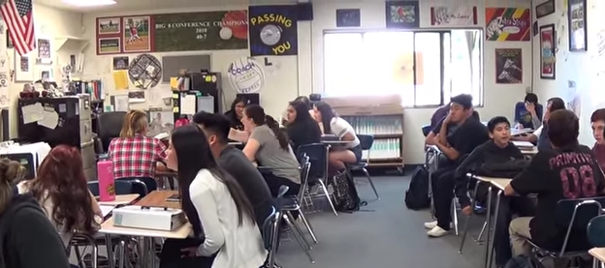
High School number talk
https://www.youtube.com/watch?v=59T97wPANzU

Slide 10
Getting Started
Teacher poses a purposeful problem
Students signal when they are ready to give a solution
Teacher collects answers orally
Students explain or defend their answer
Teacher records student strategies
Teacher asks questions to facilitate Mathematical Discourse
Class comes to consensus
Notes:
Making Number Talks Matter by Cathy Humphreys and Ruth Parker

Slide 11
Opportunity for application
Why reinvent the wheel?
Il Math Teach and Talk
http://www.ilteachandtalk.org/
Take some time to review and then choose a standard and a ppt slide
Pick someone's at the table to do.

Slide 12
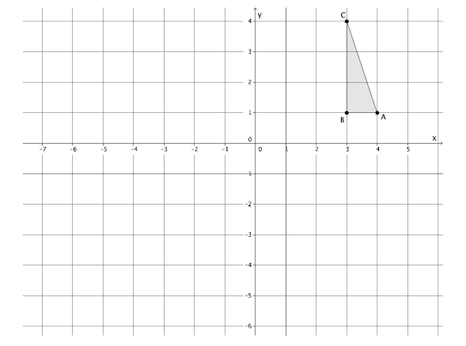
Reflect triangle ABC across the vertical line, parallel to the 𝑦-axis, going through point (1, 0). Label the transformed A’, B’, C’
Reflect triangle A’,B’,C’′ across the horizontal line, parallel to the 𝑥-axis going through point (0, −1). Label the transformed points of A’’, B’’, C’’ respectively.
Is there a single rigid motion that would map triangle ABC to triangle 𝐴′′𝐵′′𝐶′′?
Notes:
Ilteachandtalk.org
8.G.2
Answer on next slide
Note: 3.OA.3 good example of powerpoint with “student” work included.

Slide 13
C”
The final image could also be obtained by a rotation of 180º around the point (1,-1)
A”
B”

Slide 14
Teacher Evaluation
Fluency
Math Talks
Rigor
Growth Mindset
Assessment
Notes:
Domain 2 – Classroom Environment: 2a: creating an environment of respect and report, 2b: establishing a culture for learning. Climate and Culture,
Domain 3 – Instruction; 3a: Communicating with students, 3b: Using questioning and discussion techniques

Slide 15
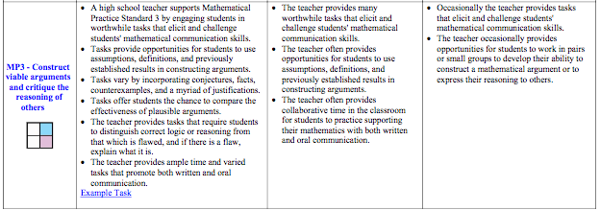

Slide 16
Planning a Number Talk
Anticipate different strategies | Recording Methods
Questions | Reflections
Notes:
Making Number Talks Matters Grades 4-10
By Cathy Humphreys & Ruth Parker
Anticipate different strategies students might use for solving the problem (or how they might “see” a dot card)
How will you record each of these strategies?
What questions might you ask to fully understand and represent a student’s thinking and/or method?
In reflecting on this Number Talk, what do you want to remember, what problem might you do next, and why?

Slide 17
Jigsaw Concerns
Trouble getting students to participate
I don’t understand what the student is saying
Only a few students participate
How to handle mistakes (student and teacher)
How do I keep the conversation going?
Notes:
1. Start with dot talks. Use “previous students’ work as examples” (so students are explaining someone else's work). Show a video or two of math talks and discuss expectations.
2. Ask clarifying questions, “What I think I heard you say…”, :I want to make sure I understand what you mean. Could you please repeat that last part?”, “Who can explain what…..said in your own words?”
3. Review classroom culture and how it is a safe place for everyone to share ideas. Have students use physical clues to indicate when they have an answer. Encourage those who often speak to come up with more than one way to “see” the problem. Call on others who show they are prepared. “I would like to hear from someone who hasn’t had a chance to share.” Increase wait time. Have students turn and talk to a neighbor than share out what their neighbor said.
4. Own up to mistakes. Opportunity to talk about mistakes as chances to learn, “Yikes. I think there is something wrong here. Can anyone help me think about this?” “I just confused myself. Hmm- Where am I? Can anyone help me think about this?” “Do you want to revise your answer.” “I would like to revise my answer.” “Let me think about this overnight and we can talk about it tomorrow.” Turn mistakes into class investigations. Discuss where the reasoning went awry.
5. Ask “What questions do you have for…?” “Why did you do…?” compare and contrast student strategies. Discuss efficiency of strategies.

Slide 18
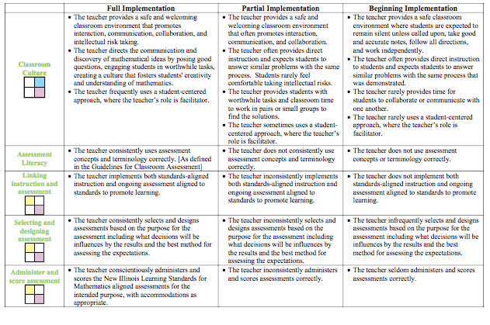

Slide 19
Create your own Math Talk based on the following PARCC Problem
Share with a partner
Make sure all components are present
Think about, reflect or practice how you will facilitate this problem
Notes:
PARCC
PRC page: prc.parcconline.org
il code: il1818

Slide 20
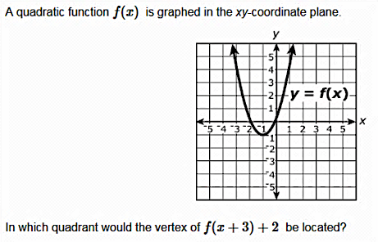
Notes:
Quadrant 2
It would be in quadrant 2, because I looked at the current vertex and knew that it moved 3 to the left and then up 2.
Quadrant 2, because I thought that in vertex form now it would be y=(x+1)^2-1, so the x+3 would go where the x is making it x+3+1 which is x+4 and the +2 would go at the end making the number outside the parenthesis -1+2=+1. So, the vertex would be (-4, 1) which is in the 2nd quadrant.
Incorrect: It would be in the first quadrant because it would move right 3 because of the +3 and then up 2 because of the plus 2.
Algebra 1 eoy
27
VF640492
Type I
F-BF.3-1
Subclaim B
Calculator section
Math 2

Slide 21
Create your own Math Talk based on a PARCC Problem and an upcoming lesson in your classroom
Share with a partner
Make sure all components are present
Think about, reflect or practice how you will facilitate this problem
Notes:
PARCC
PRC page il code

Slide 22
Re-engagement Tasks
Re-engagement is not Re-teaching. Re-teaching presents the same material again to a group of students. Re-engagement involves students thinking about mathematical concepts in a new way. Formative re-engaging lessons are directly tied to the results of formative assessments. They reengage students in the core mathematical ideas of the assessment task in order to deepen their understanding of the core math and build a better conceptual foundation to learn further mathematics.

Slide 23
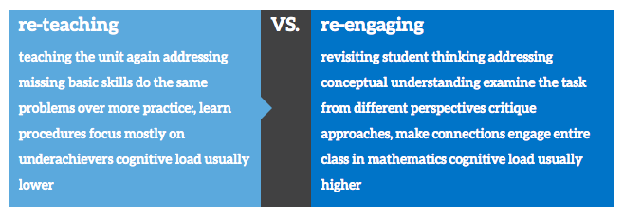
Notes:
Additional information, including videos, http://www.insidemathematics.org/classroom-videos/formative-re-engaging-lessons

Slide 24
The above-ground swimming pool in Lien’s backyard is shaped like a right circular cylinder with diameter 12 feet and height 4 feet. The pool is filled with water to a height of 3.5 feet. One person who is completely in the water will displace about 18 gallons of water. (Note: 1 cubic foot is approximately 7.48 gallons.)
Lien is inviting high school classmates to swim in the pool. Create a model to determine the greatest number of classmates who can be in the pool before the water overflows. Explain your reasoning.
Notes:
Geometry pba
18
VH003506
Type
III
HS.D.1-2
D
cal
Math
2
This is a 6 point problem

Slide 25
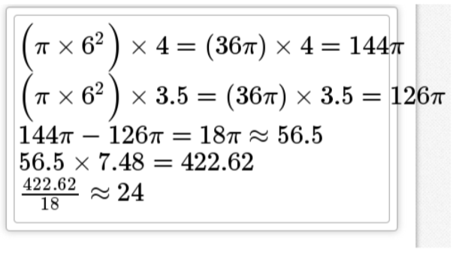
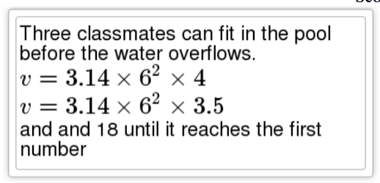
Student 2
Student 1
Notes:
Student 1:
Anchor Paper 4 Score Point 5
This response receives partial credit. The student includes five of the six required elements:
•The correct volumes for the water currently in the pool and the capacity of the pool
are shown with the formulas setup and solved
((∏ × 6^2) × 4 = (36∏) × 4 = 144∏, (∏ ×6^2) × 3.5 = (36∏) × 3.5 = 126∏)
Note: The volumes may be left in terms of pi (∏).
•The correct volume for the part of the pool that is currently without water is shown
with work as needed (144∏ – 126∏ = 18∏ ≈ 56.5).
•This response shows correct conversion of cubic feet to gallons or gallons to cubic feet
(56.5 × 7.48 = 422.62).
•The number of people is determined
(422.62/18≈ 24).
Note: The method to find the number of people is correct but the answer is rounded up instead of down so the rounding point is not given credit, but this fraction with answer is sufficient.
•All computations are correct.
The number of people is incorrectly rounded up instead of down to have a whole number of people.
Student 2:
Anchor Paper 11
Score Point 1
This response receives partial credit. The student includes one of the six required elements:
•The correct volumes for the water currently in the pool and the capacity of the pool are shown with the formulas set
up and solved (v = 3.14 × 6^2 × 4, v = 3.14 × 6^2 × 3.5).
Note: Although the equations are not solved, the student did show how the formula is used so the correct solution is not necessary.
The volume remaining in the pool is not found. The conversion explanation is incorrect, with division instead of multiplication shown. No number of people is shown, so no credit for rounding is given. No credit is given for the calculations without final values

Slide 26
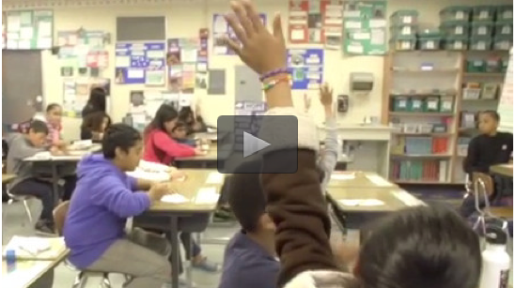
5th Grade Re-engagement Lesson Video
Notes:
Determine how long you want the video to run based on how much time you have.
http://www.insidemathematics.org/classroom-videos/formative-re-engaging-lessons/5th-grade-math-interpreting-fractions/lesson-part-1
“Students were asked to look at an area model and 3 different numerical representations (2 1/3, 7/3, and 7/9) given by different students to represent the area model. They were asked which student they agreed with and why. They then shared their reasoning with partners and with the class as a whole. To structure students’ responses and provide access to all, students were asked to use the sentence frame: I agree with ___ because.”

Slide 27
Create your own Re-engagement Lesson based on a PARCC Problem and an upcoming lesson in your classroom
Share with a partner
Think about, reflect or practice how you will facilitate this problem
Notes:
PARCC
PRC page il code

Slide 28
Resources
Number Talks - Helping Children Build Mental Math and Computation Strategies (K-5), by Sherry Parrish Making Number Talks Matter - Developing Mathematical Practices and Deepening Understanding, Grades 4-10, by Cathy Humphreys & Ruth Parker.

Slide 29
Mathematics Instructional Design, Delivery, and Assessments Pre Post
I can use the Math Implementation Guides to drive curricular decisions
I can facilitate a number talk in a math classroom utilizing the IL Teach and Talk
I can assess using open-ended questions representative of the instructional shifts for Math
I can embed the PARCC Released Items (3-12) where appropriate in my curriculum throughout the year
I can use appropriate models of instruction in the 9-12 classroom including geometric and algebraic transformations, modeling and reasoning (9-12 only)

Slide 31
Additional Slides
First few are for Math Talks
Next are from PARCC and can/should be used for Math Talks

Slide 32
Notes:
Modeling with Geometry G.MG.A
https://www.illustrativemathematics.org/content-standards/HSG/MG/A/tasks/415

Slide 33
Notes:
Geometry
https://www.illustrativemathematics.org/content-standards/HSG/SRT/A/1/tasks/602

Slide 34
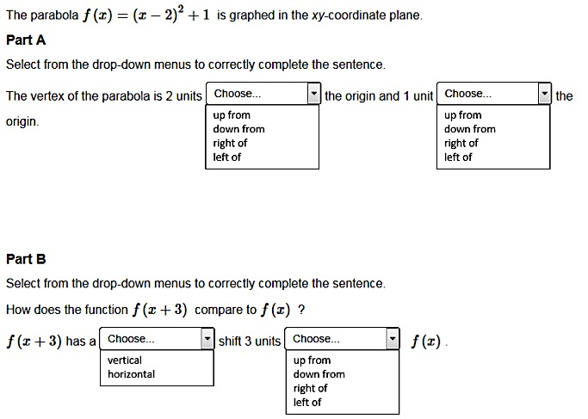
Notes:
Algebra 1 eoy
24
VF581995
Type
I
F-BF.3-4
B
cal
Math
2

Slide 35
Notes:
Geometry PBA
1
VF901754
Type
I
G-SRT.2
A
non
-
cal
Math
2

Slide 36
Notes:
Geometry pba
4
VF803457
Type
I
G-SRT.1b
A
non
-
cal
Math
2

Slide 37
Notes:
Geometry pba
15
VF867187
Type
II
HS.C.15.14
C
cal
Math
2

Slide 38
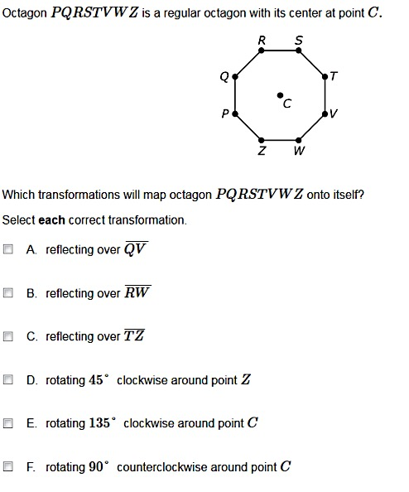
Notes:
Geometry eoy
VF798931
Type
I
G-CO.3
B
non
-
cal
Math
1

Slide 39
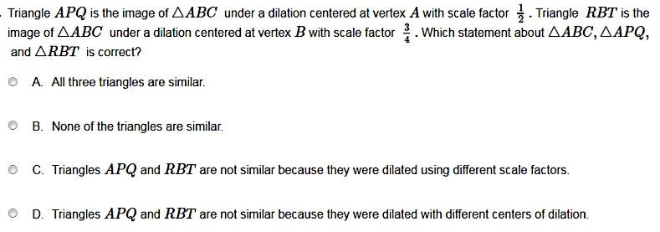
Notes:
Geometry eoy
16
VF902282
Type
I
G-SRT.2
A
cal
Math
2

Slide 40
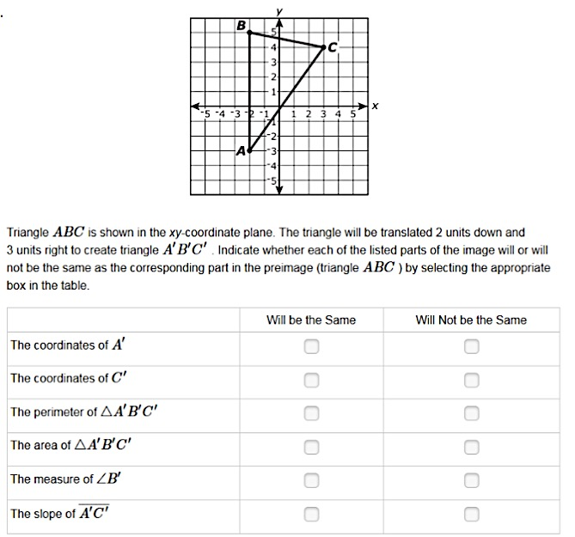
Notes:
Geometry eoy
17
VF819856
Type
I
G-CO.6
A
cal
Math
1

Slide 41
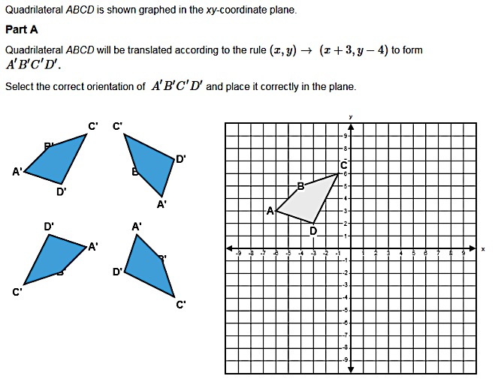
Notes:
Geometry eoy
23
VF803321
Type
I
G-CO.5
B
cal
Math
1

Slide 42
Notes:
Geometry eoy
23
VF803321
Type
I
G-CO.5
B
cal
Math
1

Slide 43
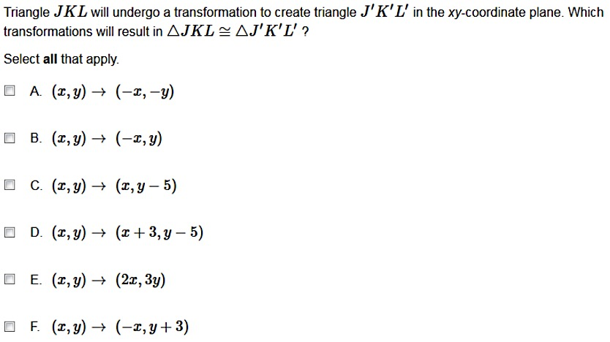
Notes:
Geometry eoy
33
VF891370
Type
I
G-CO.6
A
cal
Math
1

Slide 44
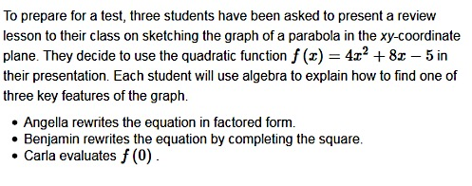
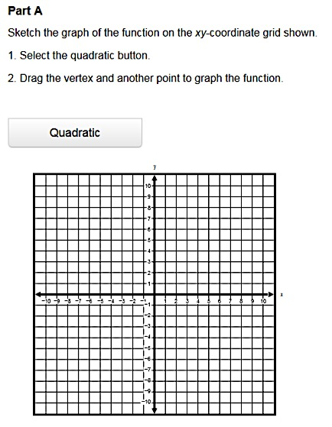
Notes:
Algebra 2 pba
11
VH029260
Math
-
Type
II
HS.C.CCR
C
cal
Math 3

Slide 45
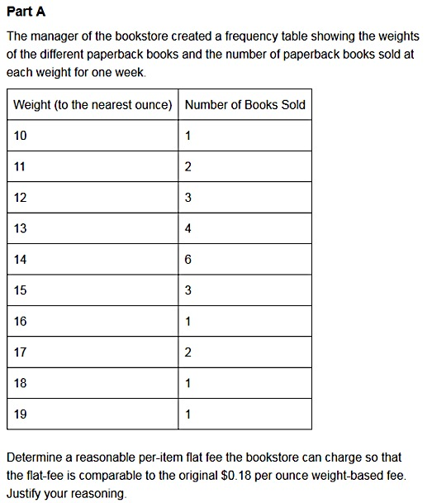
Notes:
Algebra 2 pba
14
VF650068
Math
-
Type
II
HS.C.17.5
C
cal
Math
3

Slide 46
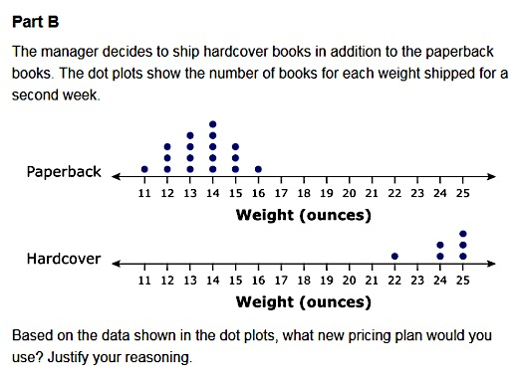
Notes:
Algebra 2 pba
14
VF650068
Math
-
Type
II
HS.C.17.5
C
cal
Math
3

Slide 47
Notes:
Algebra 2 pba
16
3052
-
M44168
Math
-
Type
III
HS.D.CCR
D
cal
Math
3

Slide 48
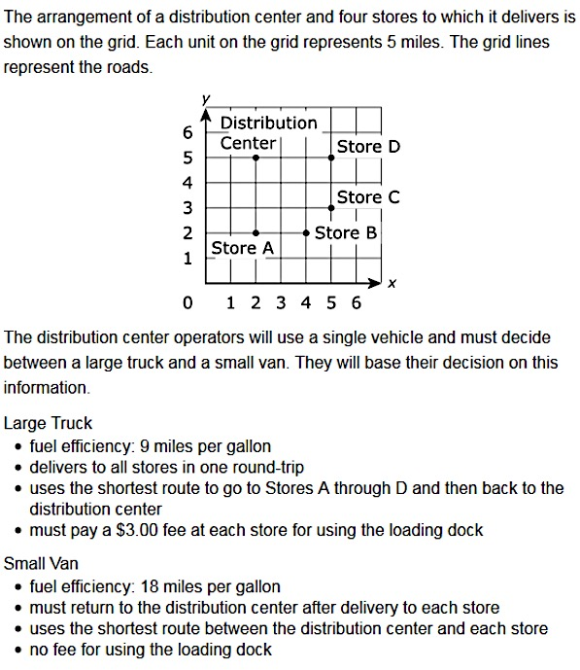
Part A
Create a model that shows the total cost to deliver to all the stores for each type of vehicle based only on the information provided. Justify your models, including any assumptions you made.
Notes:
Algebra 2 pba
12
VF884971
Math
-
Type
III
HS.D.3-6
D
cal
Math
3

Slide 49
Part B
Determine when it is more cost efficient to use the van for deliveries than it is to use the truck. Justify your answer.
Notes:
Algebra 2 pba
12
VF884971
Math
-
Type
III
HS.D.3-6
D
cal
Math
3

Slide 50
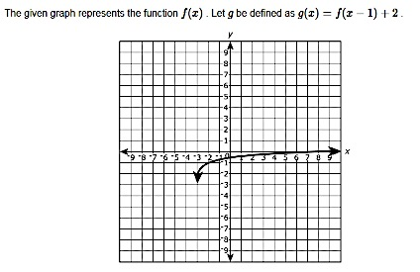
Notes:
Algebra 2 eoy
10
M40263P
Type
I
F-BF.3-2
B
cal
Math
3

Slide 51
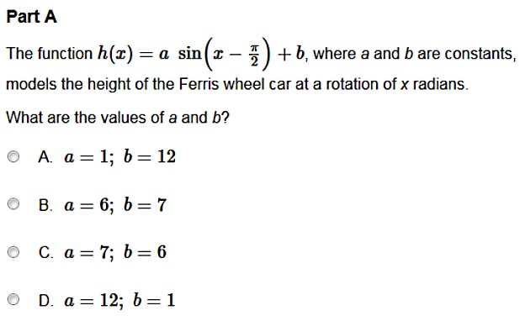
Notes:
Algebra 2 eoy
18
VH024538
Type
I
F-Int.3
B
cal
Math
3

Slide 52
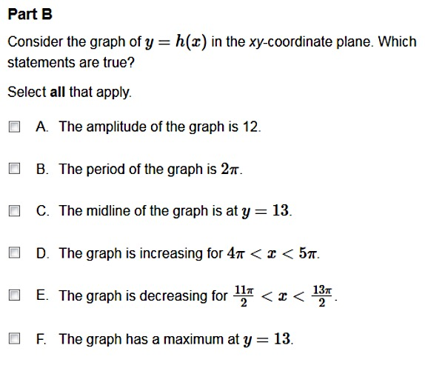
Notes:
Algebra 2 eoy
18
VH024538
Type
I
F-Int.3
B
cal
Math
3

