Slide 1
Statewide System of Support Foundational Services September 2015 Illinois State Board of Education In Collaboration with Regional Offices of Education/Intermediate Service Centers and the Illinois Center for School Improvement
Notes:
Last update – 1-25-16 sfd

Slide 2
Statewide System of Support Regional Delivery System
Area 2 (Northwest)
Cook County
Chicago (Region 1-A)
West Cook (Region 1-B-B)
South Cook (Region 1-B-C)
North Cook (Region 1-B-D)
Area 1-C (Northeast)
Area 3 (West Central)
Area 4
(East Central)
Area 5 (Southwest)
Area 6
(Southeast)
Notes:
The Illinois State Board of Education has divided the state into 6 geographic areas served by Regional Offices of Education and 3 served by Intermediate Service Centers as illustrated in the map on the slide. ISBE delivers support to Illinois school districts through the Statewide System of Support.

Slide 3
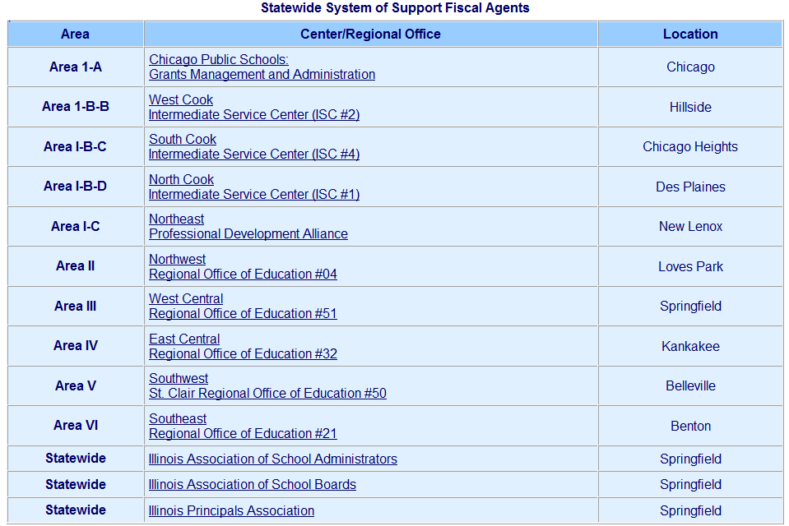
Notes:
In each of the nine areas of the state (not including Chicago), Fiscal Agents help disseminate support and information within their region. Listed above are the Fiscal Agents for the Statewide System of Support

Slide 4
ISBE Statewide System of Support
Priority Services to
Districts with Priority Schools
(147 schools in 30 districts)
Lowest 5% of Title I or Title I eligible schools
Less than 60% graduation rate
High Priority Districts (2)
State Take Over
Tier III
5%
Focus Services to
Districts with Focus Schools (TBA-at least 250 schools)
With the lowest performing subgroups
Foundational Services to
all Illinois districts aligned to
8 Essential Elements
Tier II
10%
Tier I
All IL Districts
Notes:
ISBE’s Statewide System of Support is illustrated above. Foundational Services is Tier 1 of the State’s support. Under Foundational Services, available to all districts, ISBE has identified seven topic areas for quality professional development to be delivered consistently throughout the state at little/no cost to districts. In addition to Foundational Services, 10% of the schools in Illinois (around 250 schools with the lowest performing subgroups) will receive Focused services through Illinois CSI, and 5% of the schools in Illinois (147 schools in 30 districts) who receive Title 1 funding and have less than a 60% graduation rate will receive Priority services through Illinois CSI. The High Priority Schools are taken over by the state.
**As a trainer, you can determine how deep to go into this slide – the most important part is visually seeing that ALL schools in Illinois should have access to low/no cost PD in the identified 7 topic areas.**

Slide 5
Foundational Services Coordination & Delivery of Services for All Districts
Illinois State Board of Education (ISBE)
Regional Office of Education and Intermediate
Service Centers (ROEs/ISCs)
Illinois Center for School Improvement(Illinois CSI)
Illinois Principals Association: Ed Leaders Network
Notes:
We want participants to understand that the training they are receiving is from a collaboration between ISBE, the ROEs/ISCs, Illinois CSI, and The Illinois Principals Association via Ed Leaders Network.

Slide 6
Regional Offices of Education Intermediate Service Centers Delivery of Foundational Services through SSoS
Plans and coordinates uniform delivery of Foundational Services for all districts statewide in seven topic areas
Delivers ISBE-approved content developed by Content Area Specialists
ROE/ISC delivery of content in three methods:
Technical Assistance
Professional Development Workshops
Targeted Networking Sessions
ROE/ISC documentation through the Service Tracker Tool and the Evaluation System
Notes:
This slide explains the ROE/ISC role in Foundational Services – highlight that SPs will be delivering the same content as their colleagues throughout the state in their given topic area. For district trainings, highlight that the goal of Foundational Services is to deliver Quality PD consistently throughout the state (e.g. they are receiving the same content as their district counterparts throughout the state).

Slide 7
Training & Professional Development
Statewide Training
for AREA Coordinators hired by Area Fiscal Agents
Regional Capacity Building
for Service Providers representing ROEs/ISCs
Local Delivery
for Districts
Notes:
Right now, the Delivery SYSTEM provides the consistency for Foundational Services. ACs are trained by the Content Developers and Core Planning Team, then, in turn, train SPs in their areas of the state, and the SPs deliver the training to district personnel.
STATE Trainings :
Train Area Coordinators across the state
Provided by Illinois CSI Content Area Specialists, partners, ROE/ISC personnel and/or ISBE personnel as directed by ISBE
Regional Training (Capacity Building Sessions)
These training sessions are held in each of the 6 AREAS (ISCs do not have Service Providers; their ACs train district personnel) to train the Service Providers (SPs) who will provide the professional development at the District level
Attendees:
Service Providers from the ROEs/ISCs who will facilitate the trainings in their regions.
ACs, in addition to training and supporting SPs in their content areas, also function as Service Providers, delivering training to districts in their region
District Training: Professional Development/Networking Sessions
The training sessions around the 7 Foundational Services topics are offered by the ROEs and ISCs for District/School Teams. Limited Technical Assistance is available on-line and via phone in each area.
Attendees:
District teams in those regions
District staff in those regions
Parents/Community members where appropriate (e.g. Family Engagement training for District Leadership teams may/are encouraged to include and bring family/community members to the training sessions).

Slide 8
Quality, Consistency, & Coverage
foundationalservices.org
Notes:
The three pillars of Foundational Services:
Quality Professional Development – Utilizing the on-line evaluations to measure quality, along with formative assessments (pre-posts) in each training session
Consistently delivered – Using the materials and process for the content area training sessions = Foundational Services. If trainers are creating their own materials, that is Beyond Foundational. Consistency is achieved through Statewide coordination, area-wide accountability, & local delivery, monthly content area calls for Area Coordinators (ACs), monthly coordination between ACs and Service Providers (SPs), and listservs for multi-way communication.
Covering the entire state of Illinois – All school districts in Illinois should have access to these professional development opportunities through Regional Offices of Education (ROEs) and Intermediate Service Centers (ISCs) as well as access to all materials for them to replicate in their own districts should they have the capacity to do so.

Slide 9
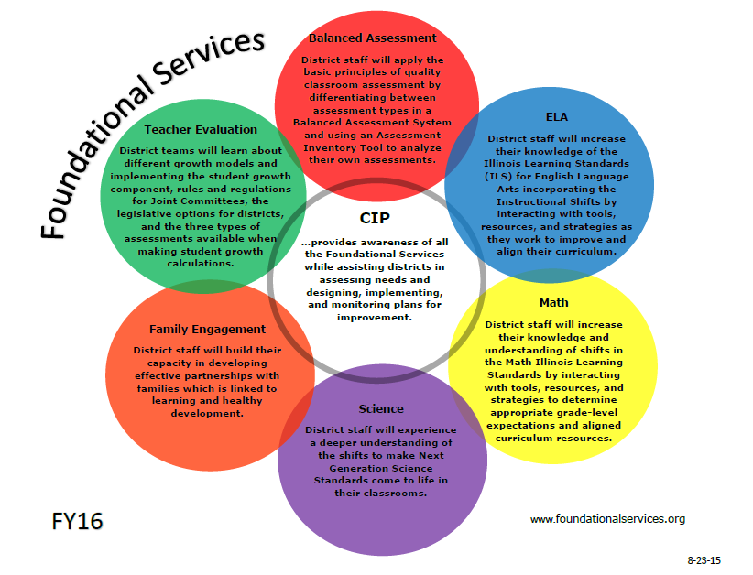
Notes:
Brief descriptions of the seven content areas. This is the other side of the infographic shown on the prior slide and the infographic can be found on every content area webpage located at foundationalservices.org

Slide 10
Foundational Services: Topics
Balanced Assessment
Continuous Improvement Planning
Family Engagement
Illinois Learning Standards - ELA
Illinois Learning Standards - Math
Illinois Learning Standards - Science
Teacher Evaluation
Notes:
Science and Family Engagement were added Spring of 2015

Slide 11
Balanced Assessments
ISBE Foundational Services for Balanced Assessment include the following content:
Balanced Assessment Framework
State Assessments in a Balanced Assessment Framework
Classroom Assessments in a Balanced Assessment Framework
Notes:
Balanced Assessment Foundational Services will provide instructional leaders and classroom teachers with information and tools as they work to implement the PARCC assessment and to implement assessment that informs instruction at the school and classroom level.
For detailed descriptions of each training session available and all related resources, please go to foundationalservices.org and select the Balanced Assessment webpage.

Slide 12
Continuous Improvement Planning
ISBE Foundational Services for Continuous Improvement Planning include the following content:
Continuous Improvement Planning – coming soon
Using Rising Star (RS) for Continuous Improvement Planning
Informal Needs Assessment (one-on-one with districts)
Notes:
CIP Foundational Services will to provide districts with an understanding of the process needed to set, plan for, and reach district goals for the betterment of their students, teachers, and community.
For detailed descriptions of each training session available and all related resources, please go to foundationalservices.org and select the Continuous Improvement Planning webpage.

Slide 13
Family Engagement
ISBE Foundational Services for Family Engagement include the following content:
Making the Case for Family Engagement
Building Cultural Competency
Family Engagement Framework Overview Training
Collaborative Approach Training
Assessment and Action Planning Tool
Notes:
Family Engagement Foundational Services will help build the capacity of participants in developing effective partnerships with families linked to learning and healthy development. The Illinois State Board of Education’s Family Engagement Framework provides the core content for the trainings.
Family Engagement Training: (Full day of training)
Participants, working in teams, will increase their capacity to build effective partnerships with families that is linked to learning and healthy development. These materials were developed to be a one-day training, but could be broken up and delivered over time (in the order listed above) if that is preferred. Many districts are opting to do these individual 1.5 – 2 hour sessions over time.
For detailed descriptions of each training session available and all related resources, please go to foundationalservices.org and select the Family Engagement webpage.

Slide 14
Illinois Learning Standards: English Language Arts (ELA)
ISBE Foundational Services for ILS- ELA include the following content:
Shift Kits
EQuIP (Educators Evaluating Quality Instructional Products) Rubric
Writing Matters
Writing to Read
Notes:
ELA Foundational Services will provide district level staff with tools, resources, and strategies as they work to develop, improve, and align their ELA curriculum and increase their knowledge of the Illinois Learning Standards (ILS) for ELA incorporating the Instructional Shifts.
For detailed descriptions of each training session available and all related resources, please go to foundationalservices.org and select the ELA webpage.

Slide 15
Illinois Learning Standards: Mathematics
ISBE Foundational Services for ILS- Math include the following content:
Introduction to Math Standards and Resources
Model Math Curriculum Resources
EQuIP Rubric​
Implementation
Notes:
Math Foundational Services are designed to provide district level staff with information and tools as they work to develop, improve and align their mathematics curriculum. Training sessions will contain components to prepare participants to be able to:
Analyze and explain the components of the ISBE Model Curriculum Resources (Unit Maps, Assessments and Lessons)
Describe and analyze the balanced assessment suite (purposes of the varied assessment formats)
Create and analyze real-world problems using the problem-solving structures described in the Illinois Learning Standards
Describe connections between assessments and lessons
Articulate the characteristics and goals of the Illinois Learning Standards.
Articulate the characteristics and goals of the PARCC assessment.
Apply the EQuIP rubric to evaluate a lesson or unit.
Learn state-level expectations and available support for the Illinois Learning Standards of Mathematics
For detailed descriptions of each training session available and all related resources, please go to foundationalservices.org and select the Math webpage.

Slide 16
Illinois Learning Standards: Science
ISBE Foundational Services for ILS/NGSS- Science include the following content:
NGSS Overview Training
The Tools Needed to Bring NGSS to the Classroom
Notes:
Science Foundational Services will provide district level staff with information and tools as they work to develop, improve and align their science curriculum and increase their knowledge of the new Illinois Learning Standards for Science incorporating the Next Generation Science Standards (NGSS).
NGSS Science Overview Training: (Full day of training) — immerses participants in a sample NGSS lesson and integrates that experience into the training sessions. These materials were developed to be a one-day training, but could be broken up and delivered over time (in the order listed on the webpage) if that is preferred.
The Tools Needed to Bring NGSS to the Classroom — This Phase Two training is designed to follow the Foundational Services Overview training and focuses on bringing three-dimensional learning to the classroom. In order to do this, participants will utilize a lesson to both examine three-dimensional learning and the key shifts required to bring NGSS to the classroom. Participants will learn how to utilize phenomenon to drive instruction, “unpack” the disciplinary core ideas to determine the content of our lessons, utilize the crosscutting concepts as a lens for students to make sense of the science, and engage students in the science and engineering practices to study phenomenon. While participants will focus on one performance expectation, the process will be applicable to all performance expectations. Similar to the Overview, these materials were developed to be a one-day training, but could be broken up and delivered over time (in the order listed on the webpage) if that is preferred.
For detailed descriptions of each training session available and all related resources, please go to foundationalservices.org and select the Science webpage.

Slide 17
Teacher Evaluation
ISBE Foundational Services for Teacher Evaluation include the following content:
Module 1: Rules & Regulations Part 50
Module 2: Decisions of the Joint Committee
Module 3: Student Learning Objectives (SLOs)
Module 4: Measurement Model
Module 5: State Model Plan
Module 6: Summative Rating
Notes:
Foundational Services in Teacher Evaluation will outline the legislation and options for district level staff including rules and regulations for a Joint Committee. These modules were developed to be delivered in the order listed below and can be combined as needed.
For detailed descriptions of each training session available and all related resources, please go to foundationalservices.org and select the Teacher Evaluation webpage

Slide 18
Foundational Services Data Collection & Reporting
Foundational Service Tracker
www.ilservicetracker.airprojects.org
Evaluation Tool for Participants
www.i-kan.org/eval
Notes:
This slide indicates how the state is collecting data on the quality (evaluation tool) and coverage (service tracker tool) pieces of Foundational Services.
Foundational Service Tracker will be used to record data on participants and content for each professional development or networking session to support the evaluation of system-wide processes. www.ilservicetracker.airprojects.org ROE/ISC personnel complete the tracker following each session. The data will be used to track the facilitation of services by the core planning teams, fiscal agents, Illinois CSI, and ISBE to determine future needs.
Fiscal Agents develop and implement the evaluation tool for participants to complete at the end of professional development and networking sessions to be used for all seven topic areas. www.i-kan.org/eval Monthly evaluation data reports from the areas are sent to core planning team members who compile a monthly statewide report (through the I-KAN regional office). Data will be reviewed with area coordinators and core planning team members at monthly check in calls; adjustments to training will be made as necessary. Data will also be reviewed by the core planning teams, fiscal agents, Illinois CSI, and ISBE to determine future needs .

Slide 19
Foundational Services For more information
gmurphy@i-kan.org
gmurphy@i-kan.org
Foundationalservices.org
Illinois State Board of Education
Foundational Services Administrator
Suzy Dees deess@roe17.org
Illinois Association of Regional Superintendents of Schools
Regional Superintendent I-KAN ROE
Dr. Gregg Murphy gmurphy@i-kan.org
This program is fully (100%) funded by the United States Department of Education using No Child Left Behind, Title I Part A Funds through a grant from the Illinois State Board of Education, Statewide System of Support funds.
Notes:
If anyone wants more information on Foundational Services, they may contact their ROEs/ISCs and/or the people listed on the slide.

