Slide 1
Continuous Improvement Planning – Informal Needs Assessment
Foundational Services
Notes:
Updated 9-24-15 sfd

Slide 2
Welcome!
Sign-in
Find a seat and fill out a table tent (both sides, please) with your Name, ROE/ISC and Area
Complete the Pre section of the Pre-Post

Slide 3
What do you know about ALL of Foundational Services?
Individually, write three facts about FS on post-it notes
Then, find someone you do not know
Introduce yourself
Tell them 1 fact on your list and have them share a different one
Repeat 2 more times
Return to your seat and, as a table group, brainstorm everything you, collectively, know about FS on chart paper
Notes:
As a large group, have participants share out the information on their chart paper. With each new group, only have them add new information. **As the facilitator, fact check to ensure information shared IS, indeed, correct regarding Foundational Services. If you are unsure, contact Suzy, listserv for appropriate content area, or Core Planning Team of appropriate content area with questions or for clarifications

Slide 4
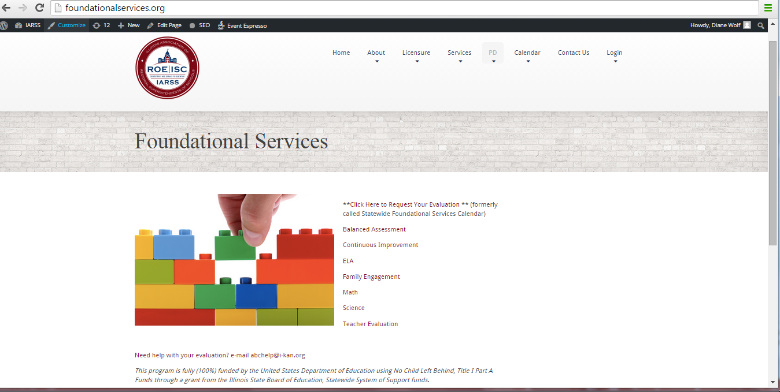
Notes:
Foundational Services Overview. Share the Infographic (located on all content area pages) and the pillars.
You can get to Foundational Services simply by typing foundationalservices.org into your browser

Slide 5
Continuous Improvement Planning (CIP) as a Foundational Service Content Area
Notes:
Evolution of CIP
Show informational sheet for CIP
Began as a way to help districts navigate the Rising Star Platform as a tool to use with CIP
Rising Star no longer required, but platform is still available for use for districts using it
Continuous Improvement Planning (without Rising Star) training is in development (as of 9/24/15)
Spring of 2015, CIP became a way to determine district needs (using the Informal Needs Assessment), LISTEN to districts and offer them options for FS training that would not use their valuable PD dollars and meet their continuous improvement planning needs.
Discuss the Top 5

Slide 6
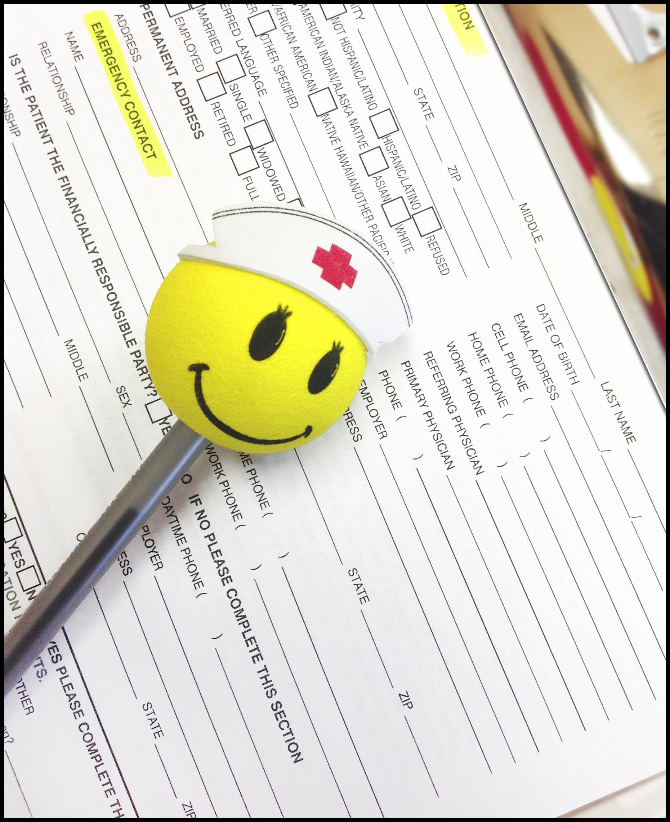
As a table group, look through the protocol, evaluate, and make suggestions for improvement.
Share out with the larger group
Notes:
The following slides help guide participants through their action planning process

Slide 7
On your Action Plan
Step One:
list out at least three people you will call when you go back to your office
share, with your
tablemates, the
titles of the people
you are contacting
and why that is the
“right” person to
contact
3. as you hear other
ideas, capture those
on your paper as
well

Slide 8
On your Action Plan
Step Two:
Call contact(s) and schedule meeting(s)
Look at the script on your protocol list -- as a group, discuss the script and make suggestions for improvement
Notes:
Participants can write the date they are going to call the various districts.

Slide 9
On your Action Plan
Step Three:
Send follow-up email to confirm the meeting time & location
as a group, look at potential follow-up e-mail, discuss and make suggestions for improvement
day before the meeting,
call (or have someone call)
to confirm the meeting

Slide 10
On your Action Plan
Step Four:
Go to the meeting: ROLE PLAY!
Individually, evaluate the modeled conversation against the protocol
find someone in the room you don’t know, introduce yourself and take turns role-playing (Superintendent/other decision maker & Service Provider) and giving feedback to your partner (5 minutes per person)
come back to your table groups and debrief (what was challenging as you played the role of SP? How would you change what you say based on this experience? How will you prepare to contact your districts?

Slide 11
On your Action Plan
Step Five:
Send a follow-up e-mail with a summary and outline of next steps
Look at follow-up e-mail model and make suggestions for improvement

Slide 12
Notes:
General updates
Existing training sessions available in the various topic areas – updates from each content area would be helpful here
How to get others trained in this material/protocol ACs can train SPs (in this or any content area) at any time. If your Area is not hosting a training any time soon, reach out to the other Areas or train SPs as needed and approved by your ROE/Fiscal Agent for your Area.
Evaluations -- What is new regarding evaluations? (use your recent AC call-in notes as a reference)

Slide 13
Notes:
Questions? What if? Barriers? Activity
On a post-it, write down any questions you have or think a district might have
What - if...?
Barriers...?
Select reporter to share questions, what-ifs, and barriers with the larger group (crowdsourcing)

Slide 14
Presenter(s) name(s)
Title
ROE
Phone number
E-mail
Notes:
Remind participants to complete the post part of the evaluation

