Slide 1
This PowerPoint was updated on 6-1-2017 with the following revisions:
The writing page is structured like the previous Writing matters site. However, you must click the writing button after you choose a grade level.
Graphic of updated site has changed to reflect website update. (Slides 9 & 88)
All previous writing matters links have been updated with the new website address.
Any notes changes begin with “Update”.
The previous “Guidance for Writing Scope and Sequence” documents have been revised and are now titled “Guidance for Literacy Task Design.” They are grade specific and can be found by clicking a grade level on the home page. (See slide 88 )
The model content frameworks are still located on the site (click a grade level, then writing, then PARCC/SAT button) and can be used, but will a revised version will be released in the fall of 2017.

Slide 2
Workshop “Must Haves”
Internet
Pre-Post Test
Chart paper or regular paper & sticky notes for Writing Task Activity (shoes)
Handout: Guidance for Literacy Task Design for Writing Task Activity (shoes)
Other Materials You May Need for this Session:
Printed PowerPoint
Writing Standards
Writing Glossary
Text Structure Handout
“App”etizers Handout
Strategy Handouts
Optional Idea
Best Practice Documents can be found at the bottom of each grade level home page – possible jigsaw activity.
Notes:
The items in the “must haves” are necessary for the workshop. The one handout listed here is a “must have” because of the details we want all participants to learn about the writing tasks expected at their grade level.
The optional idea listed on this slide is for presenters who feel their audience would benefit from reading writing research about writing best practices. The documents you can choose from are on the ilwritingmatters webite homepage.

Slide 3
Writing Matters
Implementation of the New Illinois Writing Standards: K – 12th Grade
Jill Brown ISBE ELA CAS
jbrown@isbe.net
Kathi Rhodus ISBE ELA CAS
krhodus@isbe.net
Notes:
Updated: The email addresses for Jill and Kathi have been updated.

Slide 4
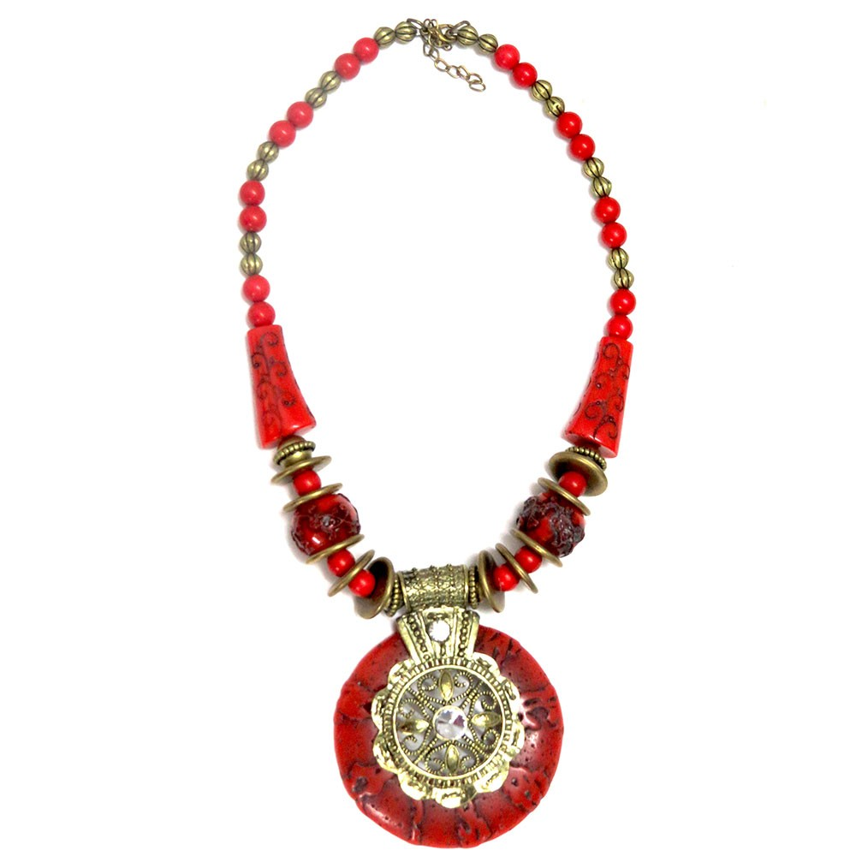
Writing Matters: Year 2 ELA Foundational Services
Basic
Training
Additional Features
Mentor Texts
EQuIP
Writing Task Activity
Writing Matters
Implementation Guides
Model Content Frameworks
Notes:
We want to provide area coordinators and ROE personnel with a basic training for all educators. (We are calling that our “little black dress”). We recognize the needs in all areas and roe’s are different so we want to give an assortment of additional components that you can use if you see fit and if time allows. A description of the components are below:
Foundation Services require the little black dress—can’t show up to the party without the dress.
You should have shoes at the party as well—those will be the PARCC writing tasks, activity and Guidance Scope and Sequence Documents we will discuss with you today.
Next, the purse which carries books, is the Mentor Text document with questions and professional texts on writing: The Writing Thief is given to everyone in the room! Don’t forget the texts that are listed in the Shift Kits and recommended resources on the Writing Website in the books and doc section on each grade!
Necklace connects to the EQuIP rubric and key shifts in practice that need to be at the foundation for lesson and unit design.
The earrings highlight the PARCC MCF and how a school district and teacher of any grade level should be concerned about guiding literacy framework. These have been revised and updated recently to better match the tasks that PARCC has released.
Our bracelet is the Implementation guides that is the reminder to continually think about classroom implementation, not just with the writing standards, but how all of the initiatives connect.

Slide 5
Connections from 2014
Shift Kit Writing Connections
http://education.illinoisstate.edu/casei/ela/
Implementation Guide
Shift Two (Extract & Employ Evidence)
http://www.ilclassroomsinaction.org/implementation-guides-for-ela.html
EQuIP Rubric
http://www.ilclassroomsinaction.org/alignment--equip-rubuic.html
Connections in all four dimensions
Notes:
All kits have writing connections in them. When working with school districts, it is helpful to make connections to these kits as well.
Many of the writing components from the shift kits are now on the ilwritingmatters.org site. Some key connections between writing and the kits are as follows:
ELA Handouts Section – CCSSO Adolescent Literacy Toolkit – Analyzing Essays
Content Area Literacy 3 journal article links about writing
Adolescent Literacy Toolkit - Handouts
Narrative Writing – Table of Contents - Marvelous Mini-lessons (professional book) & Amelia and Eleanor (picture book) lesson ideas
Rhode Island – Writing an Argument Module (click the small arrow see the components)
Handouts – Text Structure for Writing – Content Area Teachers – especially science
Informational Text Kit – PowerPoints have writing sprinkled throughout them
H.O. Top 5 Strategies
Text Dependent Questions Kit - Tons of great resources about developing questions – we want students to write to good questions dependent on text.
Writing to Sources Journal Article – Fisher and Frey
Handouts – Adolescent Literacy in Perspective – Writing Argument
Websites for Text Structure – great for informative/explanatory writing
The implementation guides are not a required piece of presentation materials for teachers however they are a necessary piece of information that allow leaders to understand the larger scope of work that leads to full implementation.
EQuip Rubric—this tool also connects to writing and should be at the foundation of lesson and unit design for classroom implementation.

Slide 6
Today’s Agenda
Teaching for Learning
Text Types and Purposes : Standards #1 - #3
Production and Distribution of Writing:
Standards #4 - #6
Research to Build and Present Knowledge:
Standards #7 - #9
Range of Writing : Standard #10
Writing Task Activity
Additional Components
Notes:
This is an outline of the agenda. The additional components can be deleted based on the presenters discretion.

Slide 7
“There are no silver bullets in education. But writing—particularly nonfiction writing—is about as close as you can get to a single strategy that has significant and positive effects in nearly every other area of the curriculum. Nonfiction writing is the backbone of a successful literacy and student achievement strategy.”
Douglas B Reeves
Notes:
Have participants read silently the slide which is a quote from Douglas Reeves an author and founder of The Leadership and Learning Center which provides professional development services, research and solutions for educators and school leaders.

Slide 8
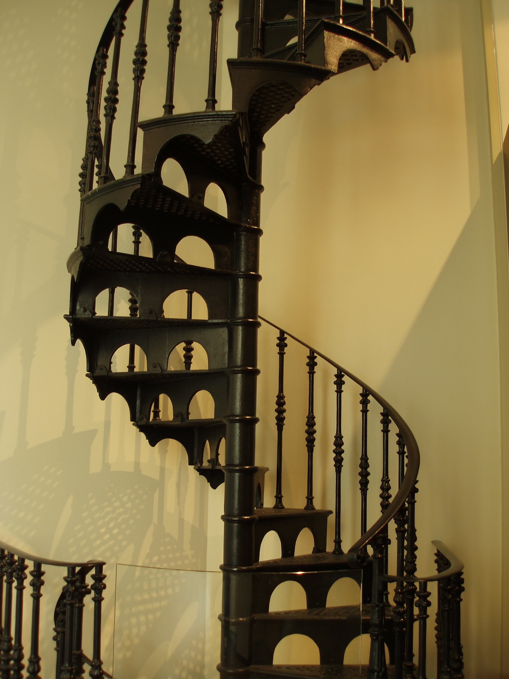
Progression Activity
Notes:
Print Progression Activity cards for writing—Cards are just for writing standard 2, part A and progress from year to year.
Idea #1
Progression Activity
Pass out cards to various audience members prior to activity. Facilitator begins activity by showing/reading aloud the chart containing the College and Career Ready/Anchor Standard. Explain that this standard is the goal for all students upon completion of high school (regardless of whether they are attending a 4 year university, community college, technical school, military, or joining workforce).
Facilitator will use audience participants to create a “horizontal staircase” and show each “step” of the staircase beginning by calling for the person holding the Kindergarten standard. The participant comes to the front and reads the standard aloud. Do this for the remaining grade levels.
Each participant or someone from the audience recognizes what is new on the card from year to year.
Idea #2
Progression Sort
Print the progression cards after deleting the grade level from each card. Give each group of participants a set of cards to put in order from Kindergarten to Anchor Standards.

Slide 9
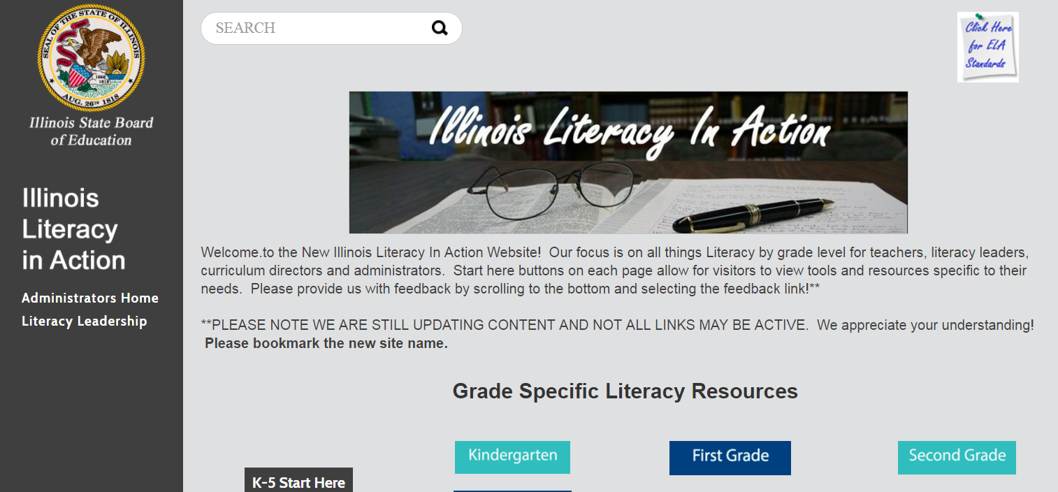
www.illinoisliteracyinaction.org
Notes:
The ISBE ELA Content Specialists have developed the Illinois Literacy in Action (formerly Writing Matters) website. The look has changed, but resources have been updated and new resources have been added for all literacy strands. Click on these to access additional ELA strand resources. The philosophy behind this website creation was to assist educators in finding resources and strategies for implementing the new Illinois ELA/Writing Standards. The site should be the first thing participants should go through if they are attending a session. If possible, participants could be asked to go through the site prior to the training. If not, plan 30 minutes to go through the site together.
NOTE: Click on the K-5 or 6-12 Start Here buttons on the homepage for a quick tour through the site.

Slide 10
The Writing Standards
.
3 Types of Writing
Standards 4-6
Standards 7-9
Standard #10
Standard #10
Notes:
The graphic on this slide is an attempt to show how all 10 writing standards play into one another. We will look at them today as well as the role we play as teachers to teach the New Illinois Writing Standards.

Slide 11
TEACHER RESPONSIBILITY
“I do it”
Focus Lesson
Guided Instruction
“We do it”
“You do it
together”
Collaborative
Independent
“You do it
alone”
STUDENT RESPONSIBILITY
A Model for Success for All Students
Fisher, D., & Frey, N. (2008). Better learning through structured teaching: A framework for the gradual release of responsibility. Alexandria, VA: Association for Supervision and Curriculum Development.
Notes:
At first we need to remind ourselves how students learn. A model for success for our students comes from Fisher and Frey.
Teaching and learning anything requires a reminder on how students learn. The Gradual Release of Responsibility model show us the 4 components necessary for success in learning.

Slide 12
The sudden release of responsibility
TEACHER RESPONSIBILITY
“I do it”
Focus Lesson
“You do it
alone”
Independent
STUDENT RESPONSIBILITY
Fisher, D., & Frey, N. (2008). Better learning through structured teaching: A framework for the gradual release of responsibility. Alexandria, VA: Association for Supervision and Curriculum Development.
Notes:
Fisher and Frey (with a humorous, but not absent in many classrooms twist) is the “Sudden Release of Responsibility”. This framework can seem successful but it is for students who learn quickly and on their own or for those who already can do the skill.

Slide 13
DIY School
TEACHER RESPONSIBILITY
(none)
“You do it
alone”
Independent
STUDENT RESPONSIBILITY
Fisher, D., & Frey, N. (2008). Better learning through structured teaching: A framework for the gradual
release of responsibility. Alexandria, VA: Association for Supervision and Curriculum Development.
Notes:
Hopefully this version of the Gradual Release of Responsibility is absent in classrooms – the “Do It Yourself” version.

Slide 14
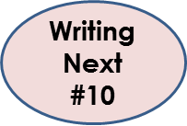
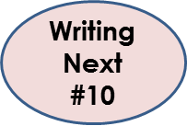
TEACHER RESPONSIBILITY
Focus Lesson
“I do it”
Guided Instruction
“We do it”
“You do it
together”
Writing Next
#3
Collaborative
Independent
“You do it
alone”
STUDENT RESPONSIBILITY
A Model for Success for All Students
Fisher, D., & Frey, N. (2008). Better learning through structured teaching: A framework for the gradual release of responsibility. Alexandria, VA: Association for Supervision and Curriculum Development.
Notes:
The collaborative portion of this model is essential and an added piece that many classrooms need to focus on. Collaboration means practicing the skills somewhat with just the support of peers and releasing the support of the teacher. Independent practice means watching the students practice it still under the watch of the teacher prior to assigning a task completely on their own at home.
For example, we watched this in a restaurant work beautifully as a training model recently. 4 personnel from the restaurant were engaged in an activity for training. A waitress learned her craft by watching how to wait on a table modeled, then had someone instruct her as she assisted waiting on two others. Next, she waited on them herself while the couple gave her feedback and finally, she came back and completed the rest of the “waiting” on her own while being watched by the manager. He coached her and supported her the entire time while everyone was able to give feedback and she was able to ask questions. Huge investment of time but she was far more skilled than had she just been sent out and the worker couple had an opportunity to sample the food they would be serving in the future.
Have participants look at the structure of the GRR. Have them turn and talk about which area may need improving in their classrooms. Share out.

Slide 15
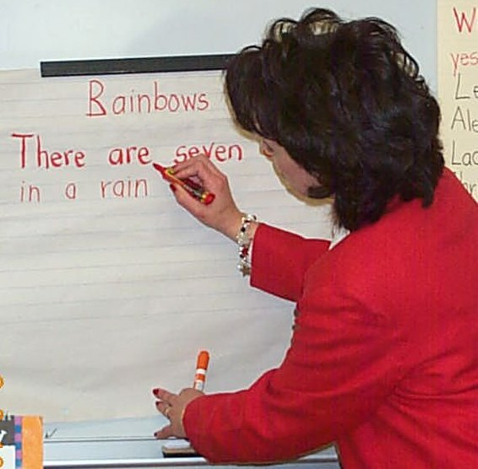
Shared Writing
Shared Writing will allow teachers to both model and actively engage students in the writing processes that they most need in order to improve their writing.
Teacher and students compose text together, with both contributing their thoughts and ideas to the process, while the teacher acts as scribe, writing the text as it is composed.
http://www.readwritethink.org/professional-development/strategy-guides/shared-writing-30686.html
http://www.regieroutman.org/files/6713/7842/4352/Tps_for_shared_writing.pdf
Notes:
For K-5 classrooms, students need a great deal of teacher modeling and guidance which is called for in the standards. Which part of the Model for Student Success chart is shared writing? Answer: We Do It
An additional handout “Must Know Tips for Shared Writing” from Regie Routman can be accessed here:
http://www.regieroutman.org/files/6713/7842/4352/Tps_for_shared_writing.pdf

Slide 16
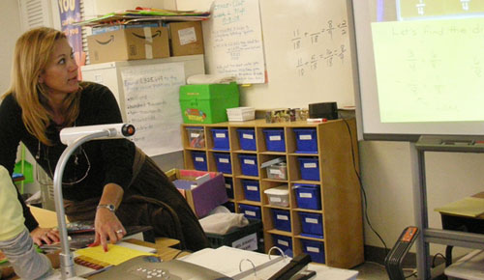
Shared Writing
Grades 4-12
https://www.youtube.com/watch?v=OJFMhWtFVnA
Notes:
At the 4-12 classroom, shared writing may look a bit differently as it is modeled. An Elmo or Smartboard can be used to share writing in a whole group to engage older students.
If time, watch the video from Kelly Gallagher, author of Write Like This. In the video Gallagher talks about the importance of shared writing through modeling and the value of mentor texts. The video is 6 min and 40 seconds.

Slide 17
Guided Writing
Students are provided with opportunities to experience successful and independent writing within the context of strong teacher support.
Guided writing is taught to small groups in briskly paced, 20-minute lessons. These groupings should be flexible, based on observation of students' current needs, and might be implemented following a whole-class writing lesson.
http://www.readwritethink.org/professional-development/strategy-guides/guided-writing-30685.html
Notes:
Guided writing is defined here as a small-group instructional framework presented to students who share similar needs at a particular point in time (Fountas & Pinnell, 2001)
More writing in the classroom where the teacher can support students and group students with similar needs is necessary.
Additional Resources;
Gibson, S.A. (2008, December). An Effective Framework for Primary-Grade Guided Writing Instruction. The Reading Teacher, 62(4), 324–334.
http://www.readingrockets.org/article/effective-framework-primary-grade-guided-writing-instruction
As students progress through their elementary years and even in MS, guided writing and conferences such as in Writer’s Workshop, meet the needs of students and offer teachers an opportunity to scaffold instruction.
According to Lori Oczkus in her book Guided Writing, some of the following ideas can be employed:
✐ Implement guided writing during a whole-class lesson.
✐ Meet with table groups. Have each student at the table read his or her piece aloud. Ask the other group members to pay compliments and offer suggestions.
✐ Invite a student volunteer in each table group to read her or his piece and tell what else she or he is going to write. Have the other team members write a suggested next line or word the writer could use. (The suggestions might be written on a sticky note or sentence strip to give to the writer.)
✐ Implement guided writing with a temporary specific-needs group. Meet with a different group every Monday (or Tuesday).
✐ Implement guided writing with an intervention group. Group the struggling writers who need extra help and meet with them briefly to help them get started at the beginning of the session or to review their work at the end of the session.
✐ Assess student progress. Can students now work independently or do they need to continue to meet in a group to finish their work?

Slide 18
The Writing Standards
.
3 Types of Writing
Standards 4-6
Standards 7-9
Standard #10
Standard #10
Notes:
Now lets look at the 10 writing standards beginning with the 3 types.

Slide 19
Long before students begin writing they need to:
understand the language of the standards.
observe teachers modeling the different components of writing.
look at other writings and identify necessary components
Notes:
Before many students can be successful as writers of different genres, writing teachers need to make sure that they (as well as the students), understand the language of the standards. Students need opportunities to watch their teachers model various components of the writing expected and to look at other texts written in the same genre. Teachers should provide students graphic organizers or frames to offer support for structure and as a tool for collecting notes.

Slide 20
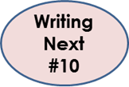
Opinion (K-5) and Argument (6-12)
Definition
Model, Model, Model
Mentor Texts
Teacher Samples
Picture Books, etc..
Student Writing Samples
Graphic Organizers/Frames
Strategies
Marzano
#9
Writing Next
#1
Notes:
Lets look at opinion (K-5) and argument (6-12) writing first by defining it, sharing graphic organizers and providing supports for the classroom.
Background Information
Graphic organizers show how new ideas or concepts relate, providing students with a visual framework for acquiring and organizing new information.
In Robert Marzano’s book Classroom Instruction That Works, Marzano notes 9 high-yield instructional strategies, Questions, Cues and Advanced Organizers is one of those.
http://www.ascd.org/publications/curriculum-update/winter2002/Getting-Acquainted-with-the-Essential-Nine.aspx
Advance organizers, including graphic ones, help students learn new concepts and vocabulary (Stone, 1983). Presenting information graphically as well as symbolically in an advance organizer reinforces vocabulary learning and supports reading skills. (Brookbank Grover, Kullberg, & Strawser, 1999; Moore & Readence 1984).
Paragraph Frames
provides a framework for writing strong paragraphs
guides students by providing the transitional phrases for sentences
incorporates various sentence types: long and short, simple and complex.
Sejnost, R., & Thiese, S. (2007). Reading and Writing Across Content Areas 2nd Ed.Thousand Oaks, CA: Corwin Press.

Slide 21
What is Opinion Writing?
K-5 Opinion
The way you think or feel about something.
Can be based on someone’s feelings, what they’ve heard, or what they have been told. (REASONS)
Does not necessarily have to be supported by facts or evidence.
Notes:
The definition for pre-argument writing is opinion writing. The standards state clearly that K-5 students are not able to form the logical thinking that supports a formal argument but need the basis to form the basis of that argument which is opinion.

Slide 22
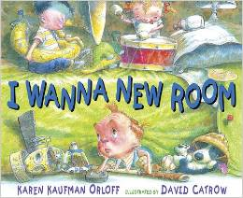
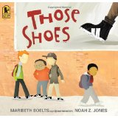
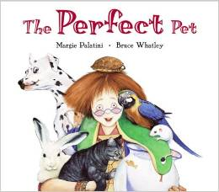
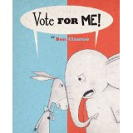
Mentor Texts for Opinion Writing
Student Samples on Illinois Literacy in Action.
Resources:
www.illinoisliteracyinaction.org Mentor Texts for the 3 Types of Writing
Click on the grade level, then writing and then scroll for Mentor texts.
http://writingfix.com/genres/persuasive.htm
http://www.lausd.net/Corona_EL/Mentor_Text.html
Notes:
Update:
Make sure users know that they have to select their grade level and THEN WRITING to get to the mentor texts on the website.
This slide shows just a few examples of mentor texts for opinion writing. As time allows, explore the links at the bottom of the slide which offer additional mentor text ideas.

Slide 23
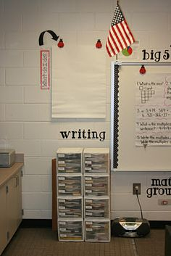
Record and Post Opinion Language from Mentor Texts
K-5 Opinion
Introductory Phrases
“In my opinion…”
“I believe…”
“From my point of view…”
“It seems to be…”
Concluding Phrases
“For the reasons above…”
“As you can see…”
“Obviously…”
“Summarizing…”
Notes:
The gurus in the writing community have differing opinions regarding the standards stance on opinion writing. Ruth Culham doesn’t believe in opinion statements but Caulkins does. We feel that in moderation, a healthy balance can be drawn. In early elementary, students will probably not understand that their opinions won’t wish to be heard but as they grow to later elementary and facts have to support opinion, the statements above cannot support a true argument paper so leading them away from these types of statements is necessary.

Slide 24
Graphic Organizers Sentence/Paragraph Frames
K-5 Opinion
Graphic Organizers are a helpful way to organize information.
They help students
understand how things go together,
remember things better,
make it easier to write a draft (in a student’s own words).
Resource: www.illinoisliteracyinaction.org
Click on grade level, then writing and then graphic organizers as you scroll.
Notes:
Graphic organizers show how new ideas or concepts relate, providing students with a visual framework for acquiring and organizing new information.
In Robert Marzano’s book Classroom Instruction That Works, Marzano notes 9 high-yield instructional strategies, Questions, Cues and Advanced Organizers is one of those.
http://www.ascd.org/publications/curriculum-update/winter2002/Getting-Acquainted-with-the-Essential-Nine.aspx
Advance organizers, including graphic ones, help students learn new concepts and vocabulary (Stone, 1983). Presenting information graphically as well as symbolically in an advance organizer reinforces vocabulary learning and supports reading skills. (Brookbank Grover, Kullberg, & Strawser, 1999; Moore & Readence 1984).
Sentence/Paragraph Frames
It provides a framework for writing strong paragraphs
The frame guides students by providing the transitional phrases for sentences
It can incorporate various sentence types: long and short, simple and complex.
Sejnost, R., & Thiese, S. (2007). Reading and Writing Across Content Areas 2nd Ed.Thousand Oaks, CA: Corwin Press.
Slide 21’s introductory phrases and concluding phrases can become sentence frames for students.

Slide 25
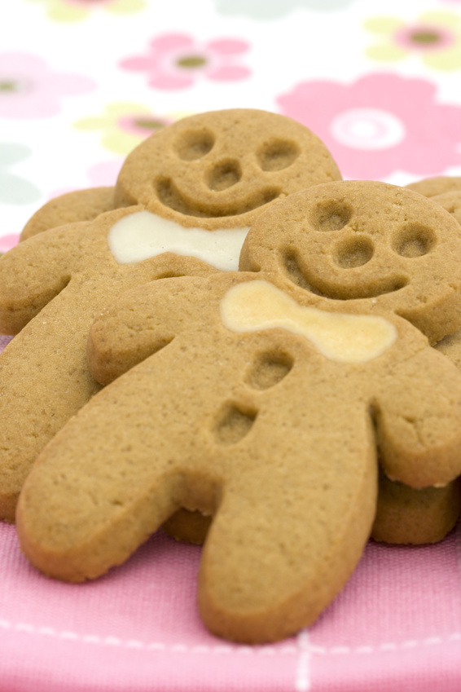
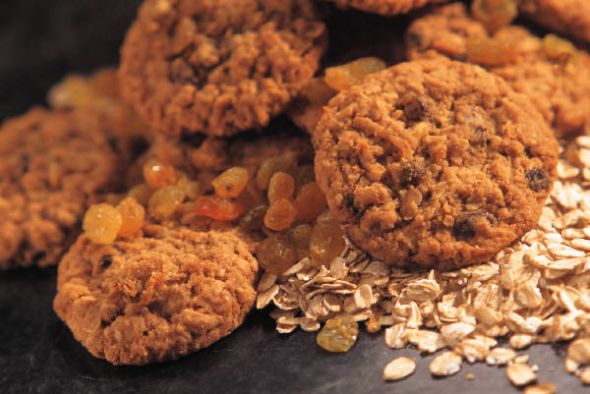
Which Cookie Do You Like Best?
K-5 Opinion
Strategy Idea
Notes:
Let’s consider a strategy idea for K5 and how it could be differentiated with shared writing and graphic organizers aligned with the expectations of the standards.
Teachers could bring in a sampling of cookies in the classroom.
After taste-tests (keeping allergy issues in mind), students could form groups based on their cookie choice.
Give each group pieces of paper to write, or draw (not in complete sentences) why they like a certain cookie best. Each reason/detail goes on each piece of paper.
Tell students that we will be planning a writing collaboratively.
Choose one group to use as the first example.
Take a round table cloth with a small circle drawn in the middle (use a marker or masking tape) and place it on the floor and have student gather around it. The cookie of choice goes in the middle.
Then students place their reasons in the larger circle around the cookie. Then when the reasons are placed on the tablecloth. Students can decide if they want to add more (ideas from the rest of the group) if they want.
Then the teacher can lead them in developing an opinion piece by letting the students decide which piece of information should go first, second and so on. They can also use learned sentence stems for the introduction and conclusion from mentor texts.

Slide 26
Kindergarten Grade Opinion Graphic Organizer
K-5 Opinion
Name the book or topic:
State Opinion:
Notes:
Each graphic organizer shares only the standard statement that is required of each grade level. Each organizer will show the progression of the difference in expectations of the standards as the grade levels increase.

Slide 27
1st & 2nd Grade Opinion Graphic Organizer
K-5 Opinion
Name the book or topic:
State Opinion:
Support Opinion:
Closing:

Slide 28
3rd Grade Opinion Graphic Organizer
K-5 Opinion
Introduce topic and list reasons (for organizational structure):
State Opinion:
Support Opinion: (reasons)
Closing:

Slide 29
4th Grade Opinion Graphic Organizer
K-5 Opinion
Introduce topic and group ideas to support opinion (create organizational structure):
State Opinion:
Support Opinion: (reasons with facts and details)
Closing:

Slide 30
5th Grade Opinion Graphic Organizer
Introduce topic and logically group ordered reasons (create organizational structure):
State Opinion:
Support Opinion: (logically ordered reasons with facts and details)
Closing:

Slide 31
Would You Rather…
2nd – 5th Grade
Introduction to Text or Topic
Opinion Statement
Reason Support Facts and Details | Reason Support Facts and Details
Conclusion
Notes:
1st and 2nd but can be adapted for use with 3rd-5th

Slide 32
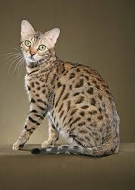
Would you rather….
K-5 Opinion
Notes:
The following slides provide more opinion ideas for writing topics but instead of using a graphic organizer, they use sentence frames to assist with addressing the standards.
For a fun activity, students can use the same idea that was used for the cookie activity, but with a different tablecloth and different instructions.
Students read a text about dogs and one about cats independently or in small groups.
After that each of the groups has read the texts, they receive sentence strips to write the reasons and evidence found in the text to place on the graphic organizer. The organizer that is drawn or taped on the tablecloth should be reflective of the grade level standards – see slides 24-28.
Choose a group that has chosen cats and one that has chosen dogs to “complete the tablecloth graphic organizer”.
This gives students a chance to not only work collaboratively, but to create in their minds how to structure an opinion based on the standards.
Then students can either write an essay independently or with their groups based on their “larger than life” graphic organizer.

Slide 33
Would you rather…
K-5 Opinion
be able to fly?
be super strong?
http://www.gestaltjournal.com/fun-and-games/sky-dreams-of-flying-revisited-jan-von-holleben/
http://addicted2success.com/quotes/22-inspirational-strength-courage-quotes-to-build-you-up/
Notes:
Students might begin their work around argument with a playful discussion. Gallagher (2011) asks students to discuss if they’d rather have a voice like Darth Vader or Elmo. Next, students are broken into small groups to discuss additional either-or questions (based on the influence of Justin Heimberg and David Gomberg’s (1997) Would you rather...?). Questions might be...
Would you rather be able to pause the world around you or silence it?
Would you rather be able to fast forward life or to rewind it?
Would you rather be stuck on a desert island with (fill in the blank with a current person in the news) or with (fill in the blank with another current person in the news)?
After a brief discussion, students do quick writes to state and explain their stands. This is just a means to introduce argument writing. Much more instruction, modeling, practice and scaffolding will follow. Adolescent writers will need good models of well written arguments. Teachers should always be on the look-out for such mentor texts. These might be found in current magazines or online.

Slide 34
Would you rather…
K-5 Opinion
live without music?
live without television?
Notes:
Or….would you rather live without music or live without television?
Gallagher (2011) provides guidance on argument writing in his book Write Like This Teaching Real-World Writing Through Modeling & Mentor Texts, Chapter 7, “Take a Stand/Propose a Solution”. This chapter focuses on real-world problems and issues. He suggests a variety of templates for students to gather and organize information. Gallagher models his expectations for writing using Composing Think-alouds.

Slide 35
Would You Rather…
Kindergarten
Draw
Complete the sentence frame: I would like to have a _________________________________.
Notes:
Kindergarten

Slide 36
Would You Rather…
1st Grade
Draw
I really want a pet________________ because_________________. I think it would be ___________________________________________. I would love to have _________________________________________.

Slide 37
Opinion Strategies on Illinois Literacy in Action
K-5 Opinion
Which Silverware? – Grades K-2
www.illinoisliteracyinaction.org: Click on grade level and then writing. Click on strategies for Standard #1.
Color Coding – Grades 3-5
www.illinoisliteracyinaction.org: Click on grade level and then writing. Click on strategies for Standard #1.
Notes:
All strategies are located on www.illinoisliteracyinaction.org. Teachers should click on their grade level and then click on writing.

Slide 38
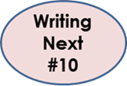
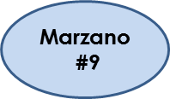
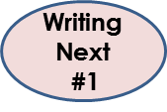
Argument Writing: Grades 6-12 and Content Area
Standard #1
Definition
Model, Model, Model
Mentor Texts
Teacher Samples
Picture Books, etc..
Student Writing Samples
Graphic Organizers/Structures
Strategies
Notes:
Lets look at argument (6-12) writing first by defining it, sharing graphic organizers and providing supports for the classroom

Slide 39
What is Argument Writing?
An argument’s intent is to make a point or claim and substantiate it with evidence.
Arguments have a variety of purposes, not all of which are aimed at winning.
Do the teachers in your building know the language of Standard #1?
Do the students?
Glossary
Handout
Notes:
Have participants read the top 2 statements on the slide.
Bring in the next 2 statements to remind teachers how important it is for the language of the standards to be used and understood to teachers as well as students.
Provide participants the glossary (that can be found on the website) to clarify key writing terms.
Additional Information: “Argument” and “Persuasion”
When writing to persuade, writers employ a variety of persuasive strategies. One common strategy is an appeal to the credibility, character, or authority of the writer (or speaker). When writers establish that they are knowledgeable and trustworthy, audiences are more likely to believe what they say. Another is an appeal to the audience’s self-interest, sense of identity, or emotions, any of which can sway an audience. A logical argument, on the other hand, convinces the audience because of the perceived merit and reasonableness of the claims and proofs offered rather than either the emotions the writing evokes in the audience or the character or credentials of the writer. The Standards place special emphasis on writing logical arguments as a particularly important form of college- and career-ready writing
Additional Information about Claims and Evidence
Brainstorm the argument skills students/participants use in their everyday lives. Educators need to specifically instruct students to identify the difference between claims and evidence—that they must first examine data and evidence and then develop claims on the basis of this exploration. Explain that students will need multiple opportunities, both collaboratively and independently, to practice the thinking involved in argumentation. Teachers will need to give students the language support they need (such as academic phrases and sentence frames) to introduce, develop, and support their claims.
Don't ask students to formulate a claim about an unfamiliar issue or topic and come up with evidence to support it.

Slide 40
Terms in Argument Writing Standards
6th – 8th Grade
9th – 12th Grade
Claims
Reasons
Evidence
Credible Sources
Formal Style
Conclusion
Opposing Claims (7th)
Counterclaims (8th)
Claims
Reasons
Evidence
Credible Sources
Substantive Topics
Formal Style
Conclusion
Counterclaim
Objective Tone
Vocab/glossary handout
Notes:
This slide reminds participants of the terms that must be defined and understood before students can begin to write arguments. Please note that tone is taught in elementary through narrative so that by MS students understand how to apply it in other forms of writing.

Slide 41
Mentor Texts for Argument Writing
6-12 and Content
Student Samples on Illinois Writing Matters
www.procon.org
TEDTalks
Former State of Union Speeches
Seminal Documents
Resource
http://writingfix.com/genres/persuasive.htm
Notes:
One great way to provide students (as well as teachers) with examples of argument writing is through mentor texts. Ask participants what parts of the newspaper can be used to model argument/opinion writing? Editorials, restaurant or movie reviews, etc….

Slide 42
Should Animals be Used for Scientific Testing?
6-12 and Content
Yes
No
check the safety of products destined for human use
has enabled the development of many life-saving treatments for both humans and animals
there is no alternative method for researching a complete living organism
strict regulations prevent the mistreatment of animals in laboratories.
cruel and inhumane to experiment on animals
alternative methods available to researchers can replace animal testing
animals are so different from human beings that research on animals often yields irrelevant results.
www.procon.org
Notes:
One mentor text listed above is a great tool for 6-12 grades. (Spend a couple of minutes going to the site).
This is a topic based from www.procon.org. Debatable issues are critical in teaching argument writing and allowing students to have the platforms for Socratic seminars or flash debates meets the speaking and listening standards as well.
Background Information
93% of higher education faculty believe critical thinking is an essential learning outcome.
A 2005 report by the Association of American Colleges and Universities demonstrated the need for efforts to promote critical thinking by highlighting the disparity between the 93% of higher education faculty that perceive critical thinking to be an essential learning outcome and the 6% of undergraduate seniors that actually demonstrated critical thinking proficiency.
Discussing current events and debating controversial issues are associated with higher scores on the National Assessment of Educational Progress (NAEP), the largest national standardized test in the United States.
An Apr. 2013 fact sheet from the Center for Information & Research on Civic Learning & Engagement (CIRCLE) reported that 12th grade students who took part in frequent discussions of current events and debates about current issues "including controversies" scored higher on the NAEP Civics test than students who did not frequently engage in those activities. Eighth graders also scored higher when regularly participating in current events discussion.
Regular discussion of current events was correlated with a 16 point gain on the NAEP Civics test for male 12th graders and a 13 point gain for females. Male eighth graders taking part in current events discussion gained a 10 point advantage, while female eighth graders gained five points. Frequent debates were correlated with a six point gain for male 12th graders and an eight point gain for female 12th graders.

Slide 43
Annotating/Coding Writing Samples
Before students write…
6-12 and Content
Introductory Paragraph
Attention grabber –
Claim stated clearly –
Statement of the counterclaim –
Body
Evidence to support the claim –
Conclusion
Concluding statement or section- ☺
Notes:
The strategy for coding text in a close reading is applicable for writing as well. Students are expected to analyze an argument for structure and components, which by the way, also meets some reading standards. Students cannot be expected to write arguments until they have analyzed arguments for their parts. K. Gallagher suggests modeling with the type of texts you wish students produce. Remember the coding system above and apply it to the next slide which contains and argument piece.

Slide 44
Argument Writing Sample
Notes:
This slide shows how students will get to know the terms of argument writing by annotating or coding a sample.
About the Document on This Slide
This is part of a larger writing project on 6th grade www.illinoisliteracyinaction.org from Student Achievement Partners. There is a NO section as well and after that, is the concluding section. This piece is just one paper that supports a culminating RST (Research Simulation Task). All papers are on the writing page for each grade level and the Argument user guide suggests other ways to incorporate this piece into the classroom for instruction.

Slide 45
Graphic Organizers Sentence/Paragraph Frames
6-12 and Content
Graphic Organizers are a helpful way to organize information.
They help students
understand how things go together,
remember things better,
make it easier to write a draft (in a student’s own words).
Resources:
Click on grade level, then writing and halfway down, click on graphic organizers to see a number of organizers.
www.illinoisliteracyinaction.org
Notes:
Another way to provide support through argument writing is through graphic organizers and sentence/paragraph frames.
www.illinoisliteracyinaction.org– each grade level has graphic organizers under standards 1,2 & 3.

Slide 46
Would you rather…
6-12 and Content
live without music?
live without television?
Notes:
Although this is repeated, another way to scaffold it for older students might be to begin their work around argument with a playful discussion. Gallagher (2011) asks students to discuss if they’d rather have a voice like Darth Vader or Elmo. Next, students are broken into small groups to discuss additional either-or questions (based on the influence of Justin Heimberg and David Gomberg’s (1997) Would you rather...?). Questions might be...
Would you rather be able to pause the world around you or silence it?
Would you rather be able to fast forward life or to rewind it?
Would you rather be stuck on a desert island with (fill in the blank with a current person in the news) or with (fill in the blank with another current person in the news)?
After a brief discussion, students do quick writes to state and explain their stands. This is just a means to introduce argument writing. Much more instruction, modeling, practice and scaffolding will follow. Adolescent writers will need good models of well written arguments. Teachers should always be on the look-out for such mentor texts. These might be found in current magazines or online.
Gallagher (2011) provides guidance on argument writing in his book Write Like This Teaching Real-World Writing Through Modeling & Mentor Texts, Chapter 7, “Take a Stand/Propose a Solution”. This chapter focuses on real-world problems and issues. He suggests a variety of templates for students to gather and organize information. Gallagher models his expectations for writing using Composing Think-alouds.

Slide 47
Argument Strategies on Illinois Literacy in Action
6-12 and Content
Argument Sentence Frames - Grades 6-8
http://www.illinoisliteracyinaction.org/uploads/4/0/7/1/40712613/6-8_ela_1_all.pdf
Modeling An Argument: The Toulmin Method– Grades 9-10
http://www.illinoisliteracyinaction.org/uploads/4/0/7/1/40712613/9-12_ela_st._1_all.pdf
Notes:
All strategies are located on ilwritingmatters.org at each grade level under each writing type and standard.

Slide 48
Informative/Explanatory Writing
Standard #2
Definition
Model, Model, Model
Mentor Texts
Teacher Samples
Picture Books, etc..
Student Writing Samples
Graphic Organizers/Structures
Strategies
Notes:
We will now look at Standard #2 and follow the same outline as for Standard #1 – Teaching Informative/Explanatory writing. We will define this type of writing, talk about the importance of modeling and mentor texts, look at writing samples, and examine possible graphic organizers/text structures and strategies.

Slide 49
Informative/Explanatory
Information/explanatory writing conveys information accurately.
It’s purpose is to:
• Increase readers’ knowledge of a subject
• Help readers better understand procedure
or process
• Provide readers with an enhanced
comprehension of a concept.
Notes:
K-5: the two types of writing are combined however as students engage in different content areas at MS and HS, the two writing types should be divided. Many teachers may not even understand the variances as they apply to their content areas but the main differences are as follows:
Expository writing imparts information, shares ideas and provides explanations and evidence. Some examples of expository works include magazine and newspaper articles, textbooks, autobiographies and persuasive college essays. According to Stanford University, when composing an expository piece, it should not be assumed that readers already possess prior knowledge of the subject matter. Answers to any questions the reader might have about your topic must be provided. For example, when writing an expository essay claiming that consuming honey is a better alternative to sugar, you would not just tell the reader about the health benefits of honey, but would compare the health advantages and disadvantages of both substances, supporting your arguments and claims with the necessary evidence; it does contain a thesis statement.
Informative writing educates readers by imparting straightforward information and facts, but never personal opinions. Examples include course descriptions, how-to articles and essays that help a reader understand how something works, such as "How to Clean a Polyester Shirt," "Understanding the Link Between Lung Cancer and Cigarettes" and "The Health Benefits of Drinking Green Tea.“ An informative text is not intended to persuade your reader, but to educate.

Slide 50
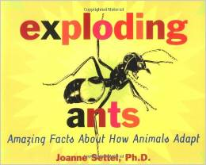
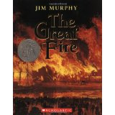
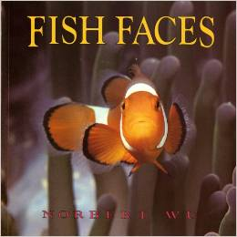
Mentor Texts for Informative/Explanatory
K-5
Exploding Ants: Amazing Facts About How Animals Adapt, by Joanne Settel
(adding supporting details)
Feathers for Lunch, by Lois Ehlert
(labeling a picture)
The Great Fire, by Jim Murphy
(writing a caption)
Fish Faces, by Norbert Wu
(using repetition for emphasis)
Student Samples on Illinois Literacy in Action
Notes:
One great way to provide students (as well as teachers) with examples of informative/explanatory writing is through mentor texts. Not only will students hear the language of this type of writing, but they will see the different structures of writing that informative/explanatory that can be used.
Student samples can be accessed on any grade level under standard two. They are from Appendix C of the Common Core Standards however not every grade level has a sample for standard 2. If there is not one under that grade level, then scroll to Teachers College of Reading and Writing for examples there.

Slide 51
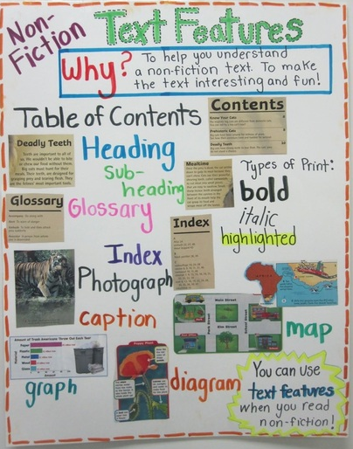
Also use mentor texts to model…
Pictures/photos with labels or captions
Sideboxes for defining domain-specific vocabulary
Hyperlinks to website addresses, videos or photos
Charts, tables, graphs and diagrams with labels
Notes:
Although we assume students understand the differences between text features and text structures, it is important to model both for MS students. If students are to incorporate these items in their writing, text features make all presentations more appealing but also more accessible to other populations such as special education, ELLs, etc. They assist with comprehension so if students are applying these, they are working with a higher level of Bloom’s Taxonomy as well.

Slide 52
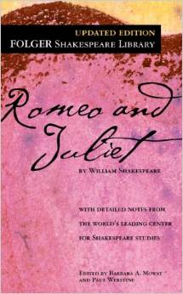
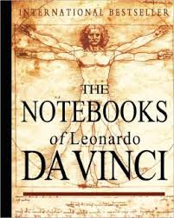
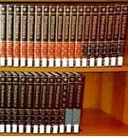
Mentor Texts for Informative/Explanatory
6-12 & Content
User Manuals
(Evaluate the format and ease of use)
Literary Analysis
(Evaluate the literature for images)
Scientific Report
(Interpret the structure of the report)
Encyclopedia Website
(Analyze the content for historical significance or
relationship to event studying)
Notes:
Although we are hitting many reading standards with these activities, they are the heart of what a writer includes in their pieces. Modeling how to construct a literary analysis must be done first along with how to create the proper structure for a scientific report. Many examples must be provided if students are to emulate these types of writing. Links to samples of these types of writing can be found in the background knowledge report for grades 6-12 on ilwritingmatters.org.

Slide 53
Graphic Organizers Sentence/Paragraph Frames
Graphic Organizers are a helpful way to organize information.
They help students
understand how things go together,
remember things better,
make it easier to write a draft (in a student’s own words).
https://www.teachingchannel.org/videos/jumpstart-student-writing
http://www.readingrockets.org/strategies/framed_paragraphs
Notes:
(Repeated slide- but source is different) Sentence or paragraph frames help students organize their words to match the type of writing they have been assigned. They help students write with various kinds of text structure.
The first link listed is a video clip from The Teaching Channel. It is a 2:10 clip for grades 3-5 entitle “Using Sentence Frames to Jumpstart Writing”.
The 2nd link has some great tips for using framed paragraphs and is from Reading Rockets.

Slide 54
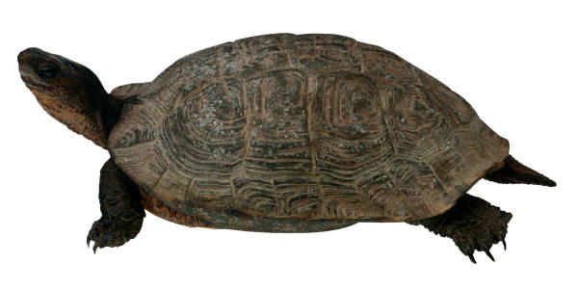
Sample Paragraph Frame
“Mother box turtles prepare for their babies in a very interesting way. First, _____________________________. Next, __________________________________________
__________________. After this, ___________________
_____________. Finally, _________________________.”
1. Model
2. Provide students with a simpler frame to complete on
their own.
3. After enough practice, students will not need a
frame, but be able to write this structure on their own.
Notes:
Even though this sentence frame is appropriate for K-5, Kelly Gallagher suggests that if we expect students to write a specific way, we must provide them with the structure to emulate a few times prior to expecting them to write in this format. Lucy Caulkins suggests the same methodology for MS and HS students.

Slide 55
Graphic Organizers
Informative/Explanatory
Text Structure Graphic Organizers
Text structure refers to how information within a written text is organized. Not only will teaching students to recognize common text structures help with comprehension, but it can help students organize their own writing.
http://www.literacyleader.com/textstructure
Text Structure
Handout
Notes:
Note about the Handout: The handout lists “sequence” as one of the text structures. Have participants write in “chronological” in the same section. Both of these are similar but have differences. For example, chronological text structure is when the author uses dates and puts information in a chronological order.
Sequential text structure is when the author puts steps in order- sort of like how you would go about making your favorite chocolate chip cookie recipe.
Informative/explanatory writing is written in one or more different text structures. Students are comfortable with recognizing the structure of narrative (beginning, middle, and end), but most are not comfortable with recognizing, let alone writing, in different text structures.
Have participants read slide and look at handout.
It is beneficial to teach students common nonfiction text structures: Cause & Effect, Sequential, Problem/Solution, Description, Compare/Contrast
Each text structure should be taught individually as students need time to recognize one structure, it’s signal words and organization, before learning another.
Students may be able to grasp easier text structures like sequence and comparison contrast so teachers may want to teach these structures first. Harder structures for students to grasp are description, cause and effect, and problem solution.
4. Teaching students the various text structures can give students ideas on how to organize their nonfiction writing.
5. After studying the key features and vocabulary of each text structure, students can practice integrating the structures into their own writing.
6. Use resources at the link on the slide to find graphic organizers and other tools to help students organize their writing.
(This link provides a number of resources for teachers.)

Slide 56
Notes:
This resources if found on the link on the previous slide and titled “Text Structure Master Chart”.

Slide 57
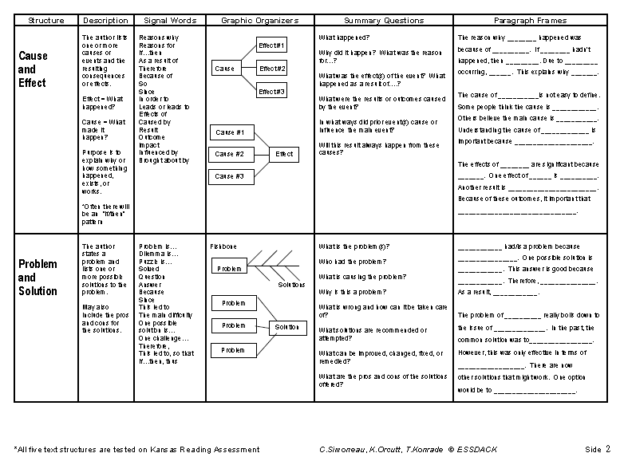

Slide 58
Informative/Explanatory Strategies on Illinois Literacy in Action
Sketch to Stretch – K-2
http://www.illinoisliteracyinaction.org/uploads/4/0/7/1/40712613/k- 2_st._2_all.pdf
Brainstorm : BME – 3-5
http://www.illinoisliteracyinaction.org/uploads/4/0/7/1/40712613/st._2_3rd_-_5th.pdf
SCQR – 6th -8th
http://www.illinoisliteracyinaction.org/uploads/4/0/7/1/40712613/6-8_ela_2_all.pdf
Mentor Texts
http://www.illinoisliteracyinaction.org/uploads/4/0/7/1/40712613/6-8_ela_2_all.pdf
Notes:
All strategies are located on www.illinoisliteracyinaction.org at each grade level, after clicking on writing. They will e found under each writing standard.

Slide 59
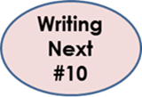
Narrative Writing
Standard #3
Definition
Model, Model, Model
Mentor Texts
Teacher Samples
Picture Books, etc..
Student Writing Samples
Graphic Organizers/Structures
Strategies
Notes:
We will now look at Standard #3 – teaching narrative writing. We will define this type of writing, talk about the importance of modeling and mentor texts, look at writing samples, and examine possible graphic organizers/text structures and strategies.

Slide 60
Narrative Writing
Purposes of Narrative Writing
Convey an experience, either real or imaginary.
Uses time as its key structure.
(Note: There can be some overlap in purpose since a narrative account might be non-fiction and serve to inform the reader of a particular topic.)
Notes:
Time as it’s key structure is critical. Consider stories that are about a moment in time such as It’s Wonderful Life or An Occurrence at Owl Creek Bridge or sagas that are about generations such as The Godfather or Legends of the Fall. Frederickson, Wilhelm and Smith state: “One of the decisions a storyteller must make is one of putting boundaries around time within the story itself. The questions that must be asked include:
Which events are worth recounting, dramatizing, and sharing in a story? When do those events begin and end?
What is the order of events that a character experiences and is that the best order for my audience to experience that character’s story?
When do I want to slow down time and when do I want to speed it up?

Slide 61
Elements of Narrative
Characters
Scene Setting
Action
http://www.readwritethink.org/classroom-resources/student-interactives/plot-diagram-30040.html
Notes:
Elements of narrative structure is imperative to understand.
The Plot Diagram is an organizational tool focusing on a pyramid or triangular shape, which is used to map the events in a story. This mapping of plot structure allows readers and writers to visualize the key features of stories.
The basic triangle-shaped plot structure, representing the beginning, middle, and end of a story, was described by Aristotle. Gustav Freytag modified Aristotle's system by adding a rising action and a falling action to the structure. This interactive version of the graphic organizer supports both Aristotle's and Freytag's conceptualizations of plot structures.
Exposition is the information needed to understand a story.
Rising Action is the complication or the catalyst that begins the major conflict.
Climax is the turning point in the story that occurs when characters try to resolve the complication.
Resolution is the set of events that bring the story to a close.
With each of these elements , the writing standards give specific direction to students about the development of characters, setting and the action.

Slide 62
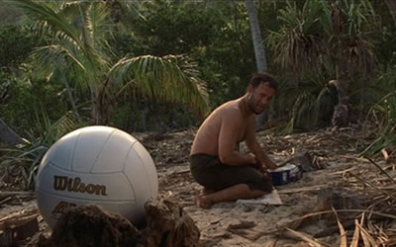
To fully understand theme, is to intertwine all of the elements highlighted so far so that the reader has to engage fully with the plot and not just tell a story
in chronological order.
Theme
Notes:
Theme is defined as a main idea or an underlying meaning of a literary work which may be stated directly or indirectly. Theme is a part of Reading Literature standard #2. As students recognize theme in literature, they will see how they can do the same in their writing. Theme is stated in the standards starting in 4th grade – Reading Literature #2. In previous grades, students will identify terms that are similar in nature.
2nd - 3rd grade – central message, lesson or moral
1st grade – central message or lesson
Notes about the picture:
When looking at the photograph, it doesn’t just elicit a man sitting on a beach thinking about playing volleyball, but it shows deep reprieve and survival instincts. It was a moment in the movie that Tom Hanks had to dig deep to make the viewers believe his identity/sanity would be lost if he gave up and didn’t connect with something he personified as human.
Background Information
“It is important not to confuse a theme of a literary work with its subject. Subject is a topic which acts as a foundation for a literary work while a theme is an opinion expressed on the subject. For example, a writer may choose a subject of war for his story and the theme of a story may be writer’s personal opinion that war is a curse for humanity”
When trying to ascertain the theme of a story, it is important to consider the elements of the plot and the story line. Theme involves the emotion, logic and judgment shaped by the action, performed by the characters and their point of view and seen in the atmosphere through imagery (Burroway, Stuckey-French, & Stuckey-French, 2011). When determining the theme, questions such as: What attitudes are implied? How do the elements described above contribute or compare to our experiences and to the ideas and attitudes in the story? “Some of the obvious theme or action archetypes are quest, search, journey, pursuit, capture, rescue, escape, love, forbidden or unrequited love, adventure, riddle, mystery, sacrifice, discovery, temptation, loss or gain of identity, metamorphosis, transformation, dragon-slaying, descent to an underworld, rebirth and redemption” (Hart, pg. 141). Whether writing fiction or narrative nonfiction, “the way a character resolves their complication emerges from the author’s beliefs about how the world works”

Slide 63
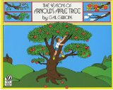
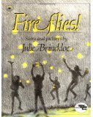
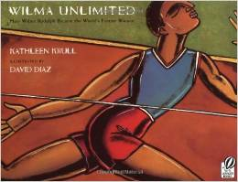
Narrative Mentor Texts
Waiting for Wings
(sequencing)
The Seasons of Arnold’s Apple Tree
(sequencing)
Fireflies
(beginning, middle and end)
Wilma Unlimited
(Writing a lead)
Notes:
Narrative Mentor texts should be used to show the skills that are highlighted above.

Slide 64
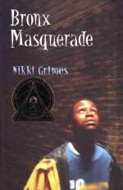
Narrative Mentor Texts
Harriet and the Promised Land by Jacob Lawrence
(Biography)
Milkweed by Jerry Spinelli
(Memoir)
Bronx Masquerade by Nikki Grimes
(Poetry)
http://writingfix.com/genres/narrative.htm
Notes:
One great way to provide students (as well as teachers) with examples of narrative writing is through mentor texts. Not only will students hear the language of this type of writing, they will see how authors write narratives. Even though Standard #3 (narrative) is not required of content teachers, narrative writing can be infused with Social Studies, Science and Technical subjects. For example….
“In history/social studies, students write narrative accounts about individuals. They also construct event models of what happened, selecting from their sources only the most relevant information. In science, students write narrative descriptions of the step-by-step procedures they follow in their investigations so that others can replicate their procedures and (perhaps) reach the same results. With practice, students expand their repertoire and control of different narrative strategies. “ (Appendix A, pg. 24 - http://www.corestandards.org/assets/Appendix_A.pdf)
Examples:
Explain a scientific process or welding process you have learned about
Explain the steps in an experiment or scientific investigation you have done
Write about something you are learning in your science, health, ag or welding class
Write about how to use a certain device or piece of science equipment
Write about a historical figure, the person’s contributions or significance, etc.
Write about something you are learning in your social studies class
Write as if you were the historical character during an important historical event

Slide 65
Graphic Organizers Sentence/Paragraph Frames
Graphic Organizers are a helpful way to organize information.
They help students
understand how things go together,
remember things better,
make it easier to write a draft (in a student’s own words).
http://www.scholastic.com/teachers/top-teaching/2014/03/graphic-organizers-personal-narratives
Notes:
(Repeated slide—with exception of source at bottom) Sentence or paragraph frames help students organize their words to match the type of writing they have been assigned. They help students write with various kinds of text structure.

Slide 66
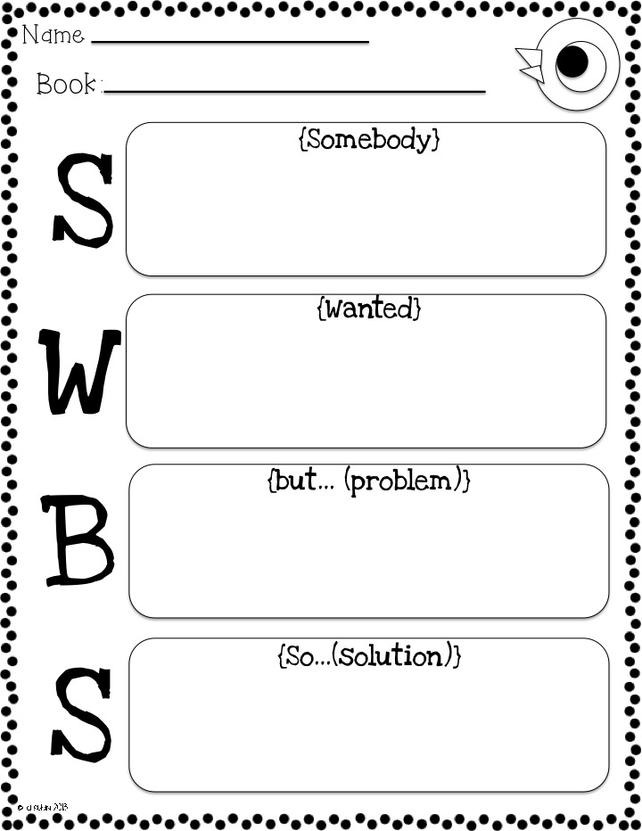
Story Map
Notes:
This elementary story map allows students to move through time but doesn’t assist with character development. The next GO does so used in conjunction with one another to more fully develop the story elements is a must. At older elementary, such as third, developing scene setting to layer in the story would also be expected.

Slide 67
Character Map
www.edhelper.com
Notes:
If we are to help writers delve deeper into character presentation, this character map assists with adding details that can be woven into the story. The details should add to the rising action or conflict of the story as students get to older elementary. (www.edhelper.com does have a subscription cost per year)

Slide 68
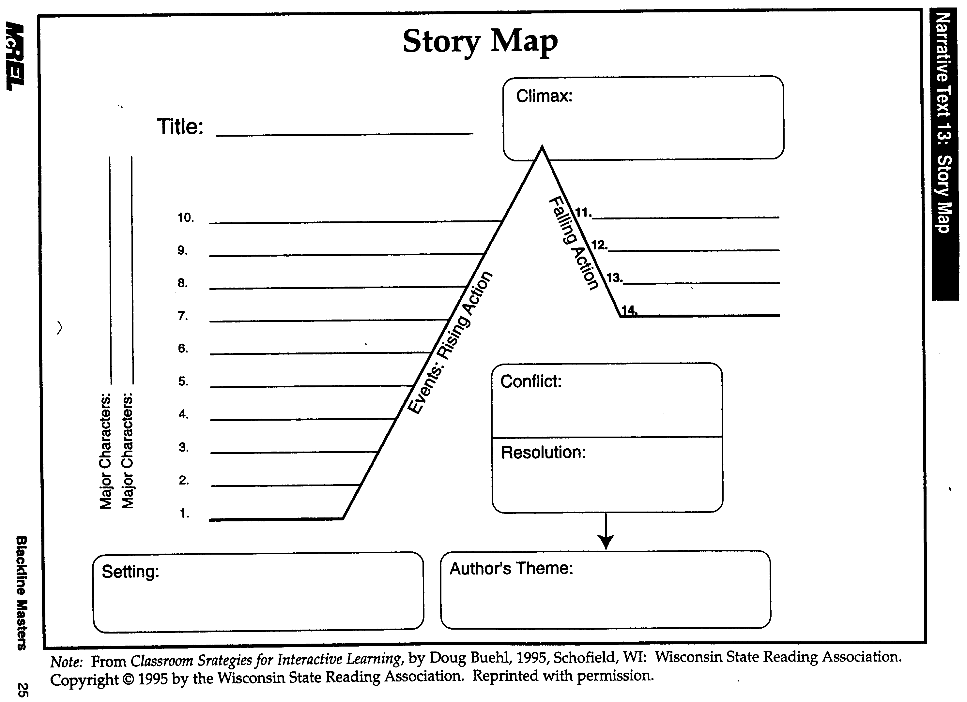
www.dailyteachingtools.com
Notes:
Story maps are very helpful but our 6th grade students need to come prepared with an understanding of all the elements so that when the application of writing is asked of them, along with the intertwining of text types such as narrative nonfiction or expository essay (a form of argument writing with a narrative flare), students will have the knowledge base.
PARCC MCF state: From the importance of organization to the nuance of word choice, shaping narratives that reflect real or imagined experiences or events reinforces what students are learning elsewhere. The close attention to detail required by students to craft an effective and coherent narrative calls on a skill set similar to that being developed by other writing tasks. To tell an interesting story effectively or to provide an accurate description of a historical incident requires students to present vivid, relevant details that situate events in a time and place while crafting a narrative structure that lends coherence and significance to those details. As an easily grasped and widely used way to share information and ideas with others, both narrative story writing connected to texts and narrative descriptions of historical, scientific, or technical events or procedures serve as writing forms that are directly relevant to college and career readiness.

Slide 69
Narrative Strategies on Illinois Literacy in Action
Grades K-2
From Start to Finish
Shared Writing
http://www.illinoisliteracyinaction.org/uploads/4/0/7/1/40712613/k-2_3_all.pdf
Grades 3-5
Postcard
Story Map
http://www.illinoisliteracyinaction.org/uploads/4/0/7/1/40712613/st._3_3rd_-_5th.pdf
Grades 6-8
Using Mentor Texts
Write Alouds
http://www.illinoisliteracyinaction.org/uploads/4/0/7/1/40712613/6-8_ela_3_all.pdf
Grades 9-12
Story Maps
Write Alouds
http://www.illinoisliteracyinaction.org/uploads/4/0/7/1/40712613/9-12_ela_st._3_all.pdf
Notes:
Update:
Make sure users know that they have to select their grade level and THEN WRITING to get to the writing resources.

Slide 70
Lunch

Slide 71
Demonstration
https://www.youtube.com/watch?v=_G00nYT_nQg
Flip
Chart
Activity
How many standards can be incorporated into ONE task
Notes:
An additional PowerPoint - titled Electronic Flip Chart Activity - can be used instead of the video or demonstration.
The video on this slide will emphasize the following:
Standards 1-3 which we have just talked about are the 3 types of writing required in the New Illinois Learning Standards. When students are writing an opinion/argument, informative/explanatory or a narrative, standards 4-10 work together to support all 3 writing types.
Let’s take an example subject such as animal testing from the debate site www.procon.org. Students make a claim after researching and reading several articles and material. The teacher has asked them to decide which side of the debate they choose to reside on and to come up with a few reasons why. They will be constructing a letter to an outspoken activist group regarding their argument.
Students meet standard 1 by making their claim and supporting it with evidence
They meet standard #4 by organizing their writing to be clear and coherent
Standard #5 is met if students have opportunities to revise, edit and strengthen their writing.
Standard #6 is met if they use technology to publish their letter
Standard #7 is met when conducting a short research project which they do when accessing several sources
Standard #8 is met when students recall information from several sources
Standard #9 is achieved when students draw evidence from the texts to support their research, and finally
Standard #10 is met because students are writing to a specific task, purpose and audience.

Slide 72
The Writing Standards
.
3 Types of Writing
Standards 4-6
Standards 7-9
Standard #10
Standard #10
Notes:
We will now move onto the production and distribution of writing, standards 4-6.

Slide 73
Standards #4 - #6 Production and Distribution of Writing
#4 - Produce well developed and organized writing –
appropriate to task, audience and purpose. (Begins in
grade 3)
#5 – Develop and strengthen writing
#6 – Produce and publish writing – use technology
http://www.illinoisliteracyinaction.org/uploads/2/9/4/9/29499299/isbe_-_the_writing_process.pdf
Notes:
The Writing Process is key part of the CCSS. It is important to note that during the writing process, the writer moves fluidly back and forth between the tasks and phases that contribute to creating the final written product. (click the link under the graphic to bring up the writing process document)
For standard #4, teachers need to connect their targets to not only the writing genre, such as defined in the presentation thus far but also to the task expected. The words “appropriate to task, purpose and audience” are highlighted to remind teachers that when students are given specific tasks, an audience to write to and a purpose for writing, students will have a focus and be more engaged in the writing task.
Standard #5 is about incorporating the language standards along with knowledge of text structures to assist with strengthening the revision/editing process.
Standard #6 assists students with the formal publishing process but also incorporates the use of technology. There are a number of digital tools that teachers can us to help students with the writing process and be creative in publishing that writing
There is a separate document on the writing website that discusses the writing process and it’s special place in the standards. A highlighted point in this document is that research and writers agree that almost 70% of a student’s time should be spent in planning or prewriting stage. A facilitator may wish to print this document off to support their presentation for this segment of the standards.

Slide 74
“App”etizers for writing
Handout
Notes:
Apps that support the CCSS: (see handout for descriptions)
Spy Tools for Kids
Story Kit
Trading Cards
Story Spark
Bookabi
Storybird—website—not an app
Story Creator
Things to Think About
Story Dice (at time of presentation creation, cost $1.99 for app)

Slide 75
The Writing Standards
.
3 Types of Writing
Standards 4-6
Standards 7-9
Standard #10
Standard #10
Notes:
Standards 7-9 are about using research to present knowledge. These should be embedded into one of the writing types and the writing process should be utilized if students are being asked to write a formal research paper.
Update:
Previously, the following were in the notes: “If the PARCC Model Content Frameworks are viewed, research papers are suggested to occur at every quarter in grades 3-12 and every 6 weeks in grades K-2. The time frame in a research cycle shouldn’t be longer than two weeks total and the skills should be connected to the targets that are already being assessed. Skills could also be connected to ones that students may be practicing in other content areas. “
These docs are being updated and will return to the website when complete.

Slide 76
Grades K-2:
Shared Research
Grades 3-5
K-1st – With guidance and support, recall/gather information from provided sources to answer a question.
2nd – Same as above with scaffolds toward independence.
3rd – Gather info. from sources, take notes, sort evidence.
4th – Take notes (draw evidence), categorize, list sources.
5th – Same as above with summarizing and paraphrasing.
Notes:
Standards 7-9 ask students to construct research and to show what they have learned. As you can see, these standards are progressive and build skills year after year.

Slide 77
Standards #7- #9 Research to Build and Present Knowledge
6th -8th Grades
9th -12th Grades
Conduct short research projects to answer a question from several sources by drawing evidence
Gather info from print and digital sources
Assess credibility (accuracy 7th – 8th )of sources
Quote or paraphrase info while avoiding plagiarism
Provide basic bibliographic info.
Use search terms effectively and a standard form of citation (7th – 8th )
Same as 6th – 8th plus
Conduct more sustained research projects.
Synthesize multiple and more authoritative sources
Integrate information into the text selectively to maintain the flow of ideas
Use advanced searches effectively
Notes:
Standards 7-9 ask students to construct research and to show what they have learned. As you can see, these standards are progressive and build skills year after year.

Slide 78
Research Resources www.allaboutexplorers.com
Notes:
One part of research is to understand the reliability and validity of a website. These two slides offer two resources to support teachers in offering some creative sites to help students with an important research problem – believing whatever they see on the internet. Because we wanted to make a point about finding useless information even in a site which looked at first to be fairly well put together, all of the Explorer biographies have fiction sprinkled in with facts. While many of the facts are true or based on truth, many inaccuracies, lies, and even downright absurdities are mixed in indiscriminately. Read more at: http://langwitches.org/blog/2009/02/21/teaching-informationresearch-skills-in-elementary-school/ | Langwitches Blog

Slide 79
Research Resource
http://zapatopi.net/treeoctopus/
Notes:
This website is also a good resource for internet reliability. This site actually ‘sells’ mugs and t-shirts so it must be authentic right?

Slide 80
The Writing Standards
.
3 Types of Writing
Standards 4-6
Standards 7-9
Standard #10
Standard #10
Notes:
Finally, Standard 10 addresses writing routinely which constitutes different lengths of time but it also addresses for different tasks purposes and audiences. Writing Standard 10 is much like Reading Standard 10…all year long, many opportunities, and many different genre.

Slide 81
Standard #10: Range of Writing A Balanced and Generous Diet of Writing
Grades 3-8:
Write routinely over extended time frames (a time for research, reflection, and revision) and shorter time frames (a single sitting or a day or two for a range of discipline-specific tasks, purposes, and audiences.
Notes:
Grades K-2 do not have a standard #10.

Slide 82
Standard #10: Range of Writing A Balanced and Generous Diet of Writing
Grades 9-12:
Write routinely over extended time frames (time for research, reflection, and revision) and shorter time frames (a single sitting or a day or two) for a range of tasks, purpose, and audiences.
Notes:
Task, purpose and audience are essential in understanding this standard.

Slide 83
Writing Task Activity
Classroom
& PARCC Writing
Notes:
This activity will help educators recognize the differences between PARCC writing tasks and the three writing types.

Slide 84
Group Activity
Notes:
Today we will be completing an activity that will help teachers identify current writing practices in their classroom and possible needed revisions to the writing tasks that take place throughout the year/semester. We will be dividing into grade level groups and recording current writing tasks happening in our classrooms. (If participants are in dissimilar grade levels, this can be an independent activity.)

Slide 85
Step #1
Write down the types of writing happening in your classroom over the course of the year.
Notes
Travel Brochure
Essay on Chapter Book
Research Paper
Book Report
Journal Writing
Summaries
Poetry
Notes:
Update:
Previously a box was on this slide that talked about the PARCC Writing Forms. This has been removed by PARCC but the different types of writing displayed on the slide are still appropriate.
Have participants list the different writing tasks they have students complete in a year (or semester).

Slide 86
Step #2
Place standard number next to each type to indicate targeted standard.
Examples:
Poetry – W.3, W.10
Notes – W.9, W.10
Travel Brochure – W.2, W.4-6, W.7, W.10
Notes:
Writing Standards handout is needed for this activity.
Have participants scan the writing standards and place a standard number or numbers next to each writing task. This will help them identify standards they are currently meeting and standards they may need to address. More than one number can be placed by a writing task.
Participants can share their discoveries with the whole group. For example, “I noticed that I have my students write mostly informative /explanatory tasks, a few narrative and only one opinion. I think I need to adjust this in my classroom.”
It’s important to be aware of any standard #s that are missing or are not addressed often.
Tell participants that we will come back to this activity after we look at PARCC ‘s writing tasks.

Slide 87
Writing on the PARCC Assessment
Students will write three responses as part of the Performance Based Assessment (PBA).
A literary analysis task (LAT)
A narrative task (NT)
A research simulation task (RST)
Notes:
This slide lists the 3 wiritng tasks students will be asked to complete.

Slide 88
A Great Resource for Assessing Our Standards
Click on a grade level button.
Click on “Guidance for Literacy Task Design”(top document).
This document includes the “must haves” for designing literacy tasks that will resemble PARCC writing and are aligned to the Standards.
Notes:
This slide provides participants with resources to help them identify how Literacy Tasks should be designed. This type of task are common on PARCC/SAT assessments. Emphasize to participants that thee are great tasks to use regardless of PARCC. They help assess our reading and writing standards.
UPDATE:
The previous document referred to on this slide has been updated. Follow the directions on the slide to access it.

Slide 89
Rubrics
Grade 3
Literacy Analysis Task/Research Simulation Task Rubric
Narrative Task Rubric
Grades 4-5
Literacy Analysis Task/Research Simulation Task Rubric
Narrative Task Rubric
Grades 6-8
Literacy Analysis Task/Research Simulation Task Rubric
Narrative Task Rubric
Grades 9-12
The SAT Rubric is located on the 11th Grade Page.
All rubrics can be found on: www.illinoisliteracyinaction.org
Select a grade level button on the home page.
Choose the writing button.
Scroll halfway down the page and select PARCC/SAT and/or Rubrics.
Notes:
The rubrics that will be used to assess student writing on PARCC can also be used in the classroom. It is important to provide opportunities for students to complete tasks like PARCC tasks in the classroom. They are good “writing to sources” tasks and valuable for students to be able to do regardless of PARCC.
6 different rubrics consist of: (LAT – Literacy Analysis Task, RST – Research Simulation Task, NT – Narrative Task)
Grade 3 LAT/RST (Informative/Explanatory and Opinion) Rubric
Grade 3 Narrative Rubric
Grades 4-5 LAT/RST (Informative/Explanatory and Opinion) Rubric
Grades 4-5 Narrative Rubric
Grades 6-11 LAT/RST (Informative/Explanatory and Argumentative) Rubric
Grades 6-11 Narrative Rubric
UPDATE:
Grades 11 – SAT Rubric – (Additional Resources for SAT can be found at the directions on the slide.
Different rubrics are needed for entire writing process…these can be found on the illinoisliteracyinaction.org page and are listed under each writing type.

Slide 90
A
Literary Analysis
B
Narrative Task
C
Research Simulation
Notes:
For the sake of our next activity, I am going to label each type of task with an A, B and C

Slide 91
Step #3 Next to each writing task, place an A,B or C to indicate PARCC task preparation.
A
Notes:
Looking back at the writing tasks from your classroom, now place an A, B, or C next to each writing task that prepare students for the PARCC task. The purpose of this activity is for teachers to evaluate the writing tasks required of their students and if they meet the standards AND prepare them for PARCC. Give participants 5-10 minutes to complete the activity.

Slide 92
Step #4 Discuss in group: 1. Are all my classroom tasks meeting the standards? 2. Which ones may need more attention? 3. How might I better align my classroom tasks?
A
Notes:
Provide time for participants to share out the answers to the questions in their groups or as a whole group.

Slide 93
A Closer Look:
Guidance for Literacy Task Design
Where to find:
Click on a grade level on the home page.
It is at the top of the each grade level home page.
Purpose:
Provides example tasks and resources and necessary components of literacy tasks.
Outlines the types of writing required for the Illinois Learning Standards and PARCC/SAT.
Notes:
UPDATE: The previous doc linked on this slide has been revised and renamed to Guidance for Literacy Task Design. This slide has been updated.
This slide reminds facilitators to take a closer look at the resource mentioned on slide 67. There are guidance documents for all grade levels. They are on the www.illinoisliteracyinaction.org site. Following the directions on the slide to find them.

Slide 94
Did You Know?
When students write about the texts they read, their reading and writing improve.
When students learn and engage in the writing process behind creating texts, their reading and writing improve.
When students write their own texts frequently, their reading and writing improve.
Kelly Gallagher
Notes:
Kelly Gallagher says it best. (Have participants read silently). As we work towards increasing students 21st century literacy skills, reading and writing can not be separated. Producing students who can read and write proficiently are helping them to be ready for college and or career and most importantly, for life.

Slide 95
Reflection Time
1
Notes:
Have participants reflect on the workshop as they reflect and write the following:
“Based on today’s workshop, what is 1 thing you will stop doing and 1 thing you will start doing. Record on a post it note.
For example:
I will stop rushing students through the writing process.
I will start having more writing for comprehension tasks.
Make sure participants rate their learning on the posttest.

Slide 96
The following slides are optional additional components that the can be added to the discretion of the presenter.

Slide 97
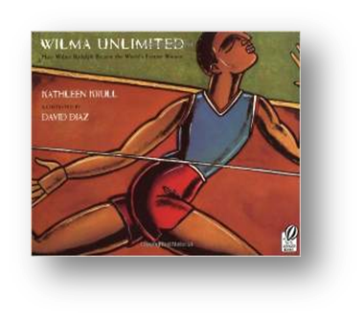
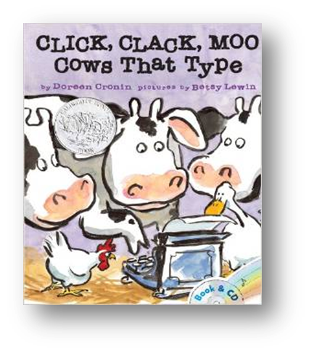
Mentor Text Activity
Handouts
www.storylineonline.net
Notes:
Provide Mentor Text handouts for participants. These are located on every grade level about half way down the grade level page. Click on “Mentor Texts” and then ISBE Mentor Text Suggestions.
Optional: What the video provided on the page where Lucy Calkins discusses mentor texts.
The lists provided are not an exhaustive list for schools or any organization to purchase. These are just a few guided suggestions of texts that lend themselves to the standard they have been suggested to support.
How might you use mentor texts in a training in your area? The following are some ideas:
Use www.storylineonline.net to have famous actors read their favorite texts aloud to students…analyze portions of texts for a close reading.
Check out some mentor texts from the library to put on display.
Have participants bring in mentor texts they use in the classroom to share with participants.
Give participants time to explore the links shown earlier in the presentation to find a mentor text they may want to start using in their classroom. Provide time to share out their ideas.

Slide 98
Additional Components
EQuIP Rubric
PARCC Model Content Frameworks
Implementation Guides
Notes:
Update: The PARCC Model Content Frameworks are being revised but can still be located and used. Click a grade level, then click the writing button and scroll down for PARCC/SAT. The original ones are currently there but will be revised in the near future.
Additional components that presenters can choose from are listed on the slide. All of these tools have connections to writing. How could any one of these items or a combination of them be utilized to assist teachers or district leaders with writing implementation?
Necklace – EQuIP Rubric
Earrings – PARCC Model Content Frameworks
Bracelet – Implementation Guides

Slide 100
Contact us!
jbrown@isbe.net
krhodus@isbe.net

