Slide 1
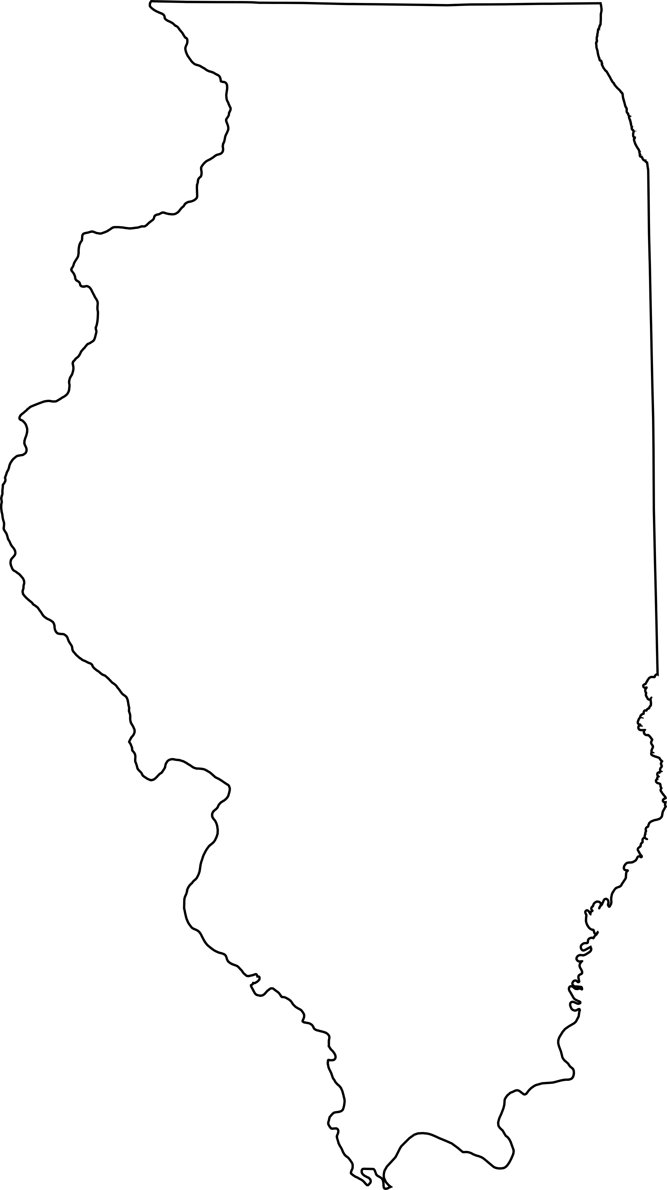
NGSS Resources
Notes:
Facilitator Notes:
If time allows, go through each of the slides to share the resources and relevant uses.
If time does not allow, ensure participants know where to locate this PowerPoint on: FoundationalSevices.org

Slide 2
NGSS Publications
What resources are available to help understand the Next Generation Science Standards?
How are these resources used?

Slide 3
NGSS Publications
A Framework for K-12 Science Education outlines a broad set of expectations for students in science and engineering in grades K-12.
Notes:
Facilitator Notes:
These expectations informed the development of new standards for K-12 science education and, subsequently, revisions to curriculum, instruction, assessment, and professional development for educators.

Slide 4
NGSS Publications
Next Generation Science Standards identifies the science all K-12 students should know.
Notes:
Facilitator Notes:
The standards are rich in content and practice and arranged in a coherent manner across disciplines and grades to provide all students an internationally benchmarked science education.

Slide 5
NGSS Publications
Developing Assessments for the Next Generation Science Standards recommends strategies for developing an assessments system that meets the Framework's vision.
Notes:
Facilitator Notes:
This is consisting of assessments designed to support classroom instruction, assessments designed to monitor science learning on a broader scale, and indicators designed to track opportunity to learn.

Slide 6
NGSS Publications
Guide to Implementing the Next Generation Science Standards provides guidance to district and school leaders and teachers charged with developing a plan and implementing the NGSS as they change their curriculum, instruction, professional learning, policies, and assessment to align with the new standards.
Notes:
Facilitator Notes:

Slide 7
NGSS Publications
Science Teachers' Learning provides guidance for schools and districts on how best to support teachers' learning and how to implement successful programs for professional learning.
Notes:
Facilitator Notes:
Professional learning should be focused on reinforcing and expanding teacher knowledge of the major ideas and concepts in science, instructional strategies, and the skills to implement those strategies in the classroom.

Slide 8
NGSS Publications
All of the following documents are available to download, read online, or purchase on The National Academies Press.
The links below allow the documents to be read online.
A K-12 Framework for Science Education
Next Generation Science Standards
Volume 1: The Standards-Arranged by Disciplinary Core Ideas and by Topics
Volume 2: Appendices
Developing Assessments for the Next Generation Science Standards
Guide to Implementing the Next Generation Science Standards
Science Teachers' Learning: Enhancing Opportunities, Creating Supportive Contexts

Slide 9
NGSS Website
What resources are available for Next Generation Science Standards?
How are these resources used?

Slide 10
NGSS Website
On the Next Generation Science Standards site, one can access standards and many valuable resources.
NGSS - Home
Stay Connected: Subscribe to NGSS NOW Newsletter (Sample)
Search the Next Generation Science Standards & Appendices
Next Generation Science Standards & Appendices
How to Read a Performance Expectation
Utilize Valuable Resources
Resources Library
Evidence Statements: (Summary) (Intro & Overview) (K-5) (6-8) (9-12)
Bundling the NGSS
Classroom Sample Tasks: (Intro & Overview) (View and Download)

Slide 11
NGSS Website
NGSS has provided resources to evaluate lessons, units, and curriculum for alignment to the NGSS.
EQuIP Rubric for Lessons & Units: Science
NGSS EQuIP Professional Learning Facilitator’s Guide
EQuIP Rubric
NGSS PEEC-Alignment
PEEC Alignment

Slide 12
Professional Associations
What resources are available to help understand the Next Generation Science Standards?
How are these resources used?

Slide 13
Professional Associations
National Science Teachers Association
NGSS Hub
NGSS@NSTA Webinars
Framework Links
Illinois Science Teachers Association

Slide 14
NGSS
Educator Resources
What resources are available for Administrators?
What resources are available for Parents?
What resources are available for Teachers?

Slide 15
Administrator Resources
Overview: NGSS Overview for Principals
Resources:
STEM Teaching Tools - Practice Brief 21: What School Building Administrators Should Know About the New Vision for K-12 Science Education
Instructional Leadership for Science Practices
EdLeaders Network:
All Illinois administrators currently have free access to ELN (Edleaders Network) developed by the Illinois Principals Association.
Search for NGSS for a variety of webinars and videos
Some resources have been developed in conjunction with the Illinois Science Teachers Association and with ISBE/ROE Foundational Services
Professional Learning: Illinois Administrator Academy on NGSS

Slide 16
Parent Resources
Overview: NGSS Parent Guide
Information:
NGSS Fact Sheet
How Will Science Education Change with NGSS?
How can you help your child succeed in Science? IDEAS FOR PARENTS
Video: Sample Parent Teacher Conference

Slide 17
Teacher Resources
NGSS Classroom & Resources
NGSS@NSTA – Classroom Resources
Next Generation Science Storylines
Teachers Try Science
STEM Teaching Tools
Classrooms in Action
Notes:
Talking Points:
Teachers often ask about “vetted” materials. Both NSTA and Achieve are working to vet materials.
Mike Fumagalli, Illinois teacher who works with Achieve to provide EQuIP trainings: "The 7 EQuIP trainers were given lessons from the New York Hall of Science. These lessons were evaluated and feedback was provided by filling in the rubric. The lessons were then revised informed by evidence, feedback and guidance using the rubric. All of those artifacts are posted on the Teachers Try Science website linked here http://www.teacherstryscience.org/lp.“
Ted Willard, Program Director for NSTA recommends checking out the classroom resources tab on the NGSS@NSTA hub. NSTA has a group of 55 curators (one for every topic in NGSS) who are working to identify lessons and other resources that support specific PEs, practices, core ideas, and crosscutting concepts in NGSS. The curators have been trained in use of the EQuIP rubric, but they aren’t necessarily taking each resource through a full evaluation. Instead, they are writing tips to explain how using the resource can support the goal in question. In some cases, that involves using the resource as originally described by the developer, but in most cases, the curators are making recommendations on how teachers can modify the resource during instruction. As you can imagine, the curators have had trouble identifying good resources, so we expect the work to evolve over time."

Slide 18
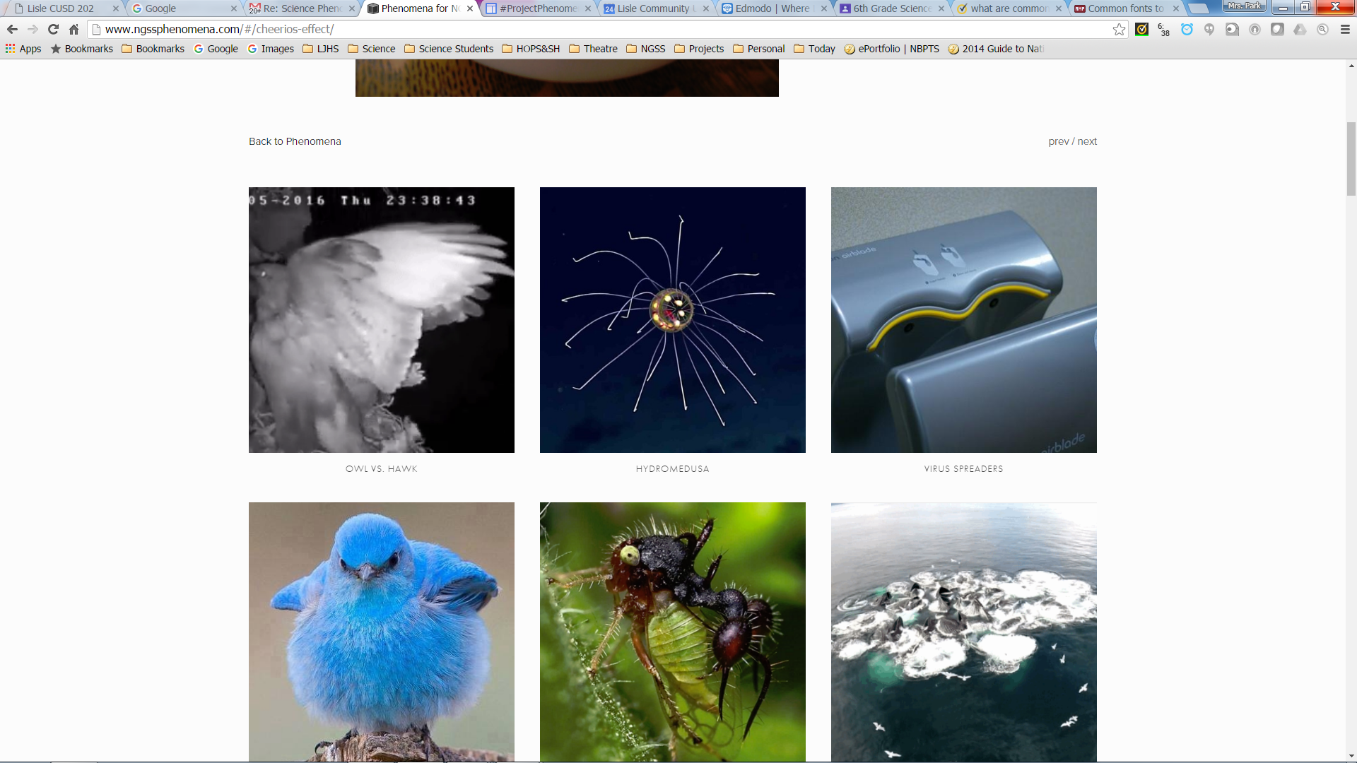
Teacher Resources
Science Phenomena Resources
Science Phenomena
NGSS Phenomena
Digital Public Library of America
Monthly Phenomena from NGSS NOW Newsletter
Wonderopolis

Slide 19
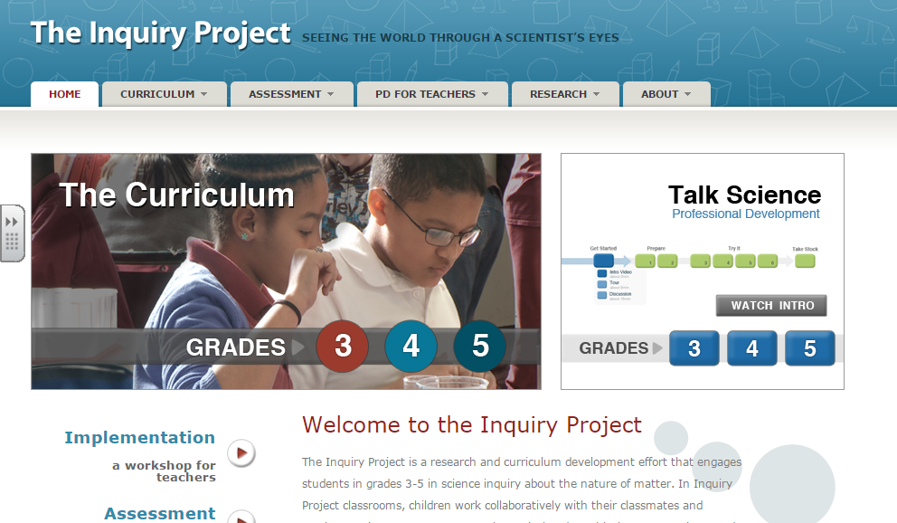
Teacher Resources
Science Pedagogical Resources
Using the Practices
PRISM - Practice Resources in Science and Math
Discussion Based Learning in Science:
Talk Science Project
Talk Science Resources
Talk Science Primer
Videos:
Making Claims from Evidence
Notes:
Talking Points:
During the presentation, we have used some of the ideas presented in the Talk Science Primer and on the Talk Science Project for group work in Science.

Slide 20
Teacher Resources
NGSS Assessment Resources
Assessment Guidelines for NGSS
Developing Assessments for the Next Generation Science Standards
Assessment Literacy
Sample NGSS Classroom Assessments
Next Generation Science Assessment
Samples Classroom Assessment Tasks
Other NGSS Assessment Resources
Science Assessment Item Collaborative
How to Develop 3D Formative Assessments for the Science Classroom
ISBE Assessment
Large Scale Assessment Update
Notes:
Please see most up-to-date Assessment Talking Points.

