Slide 1

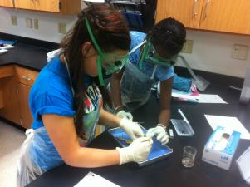
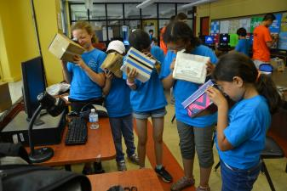
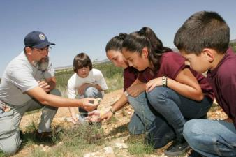
Foundational Services
Science
Phase 4

Slide 2

Facilitator Notes – Set Up
Notes:
Supplies:
Participants will be working in the same group throughout the sessions. This will enhance networking, but will also enable participants to maximize the product.
Groups will need to be created. It is recommended that groups are comprised of 3 individuals. If necessary, 2 and 4 may work.
It is best if groups are created with same grade (K-5) or same gradeband and subject area (6-12).
Suggestions for groupings:
  Provide participants with a survey in advance. See sample survey.
  Set up the room with specific meeting areas – grade levels/subject areas.
Survey (sent in advance)
Tables:
  Seating Arrangement
  Table Labels
  Group Norms Table Tents
  Markers
Display:
  Discussion Goals
  Discussion Norms
Supplies Table
  Chart Paper
  Stickie Notes
PowerPoint
Participant Workbook
Google Folders for each unit/group with documents and comments.
Notes:
During the Facilitation of Small and Whole Group Discussion, utilize the Talk Moves Map. Potentially, reread the Talk Science Primer before facilitation.
From ACs on October 9th and 10th – Reminders for facilitating discussions/small group workshop:

Slide 3
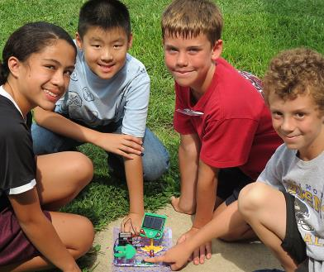
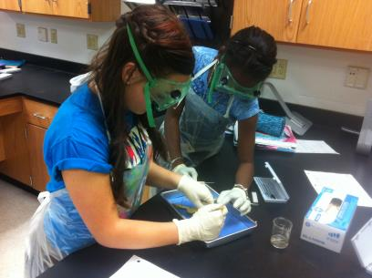

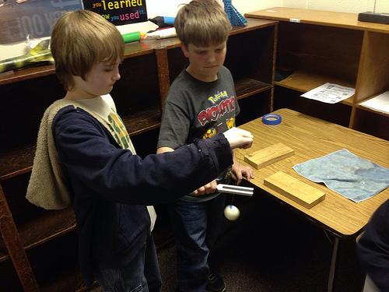




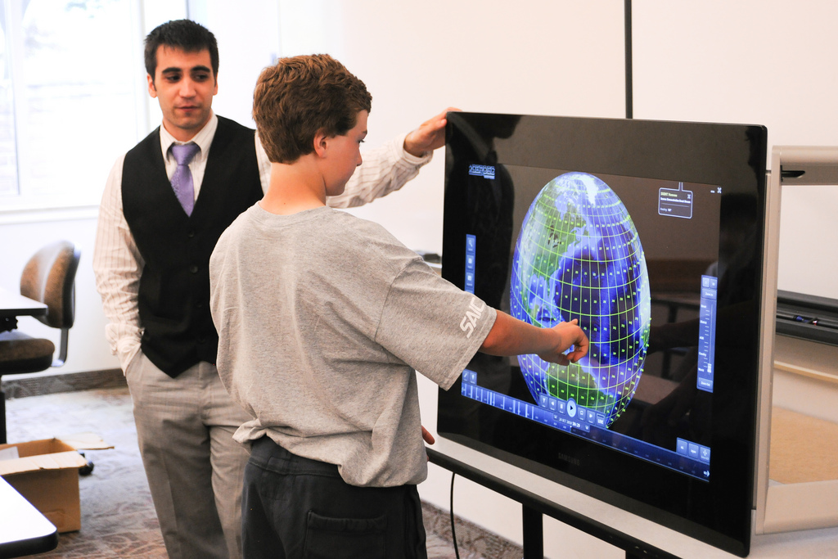
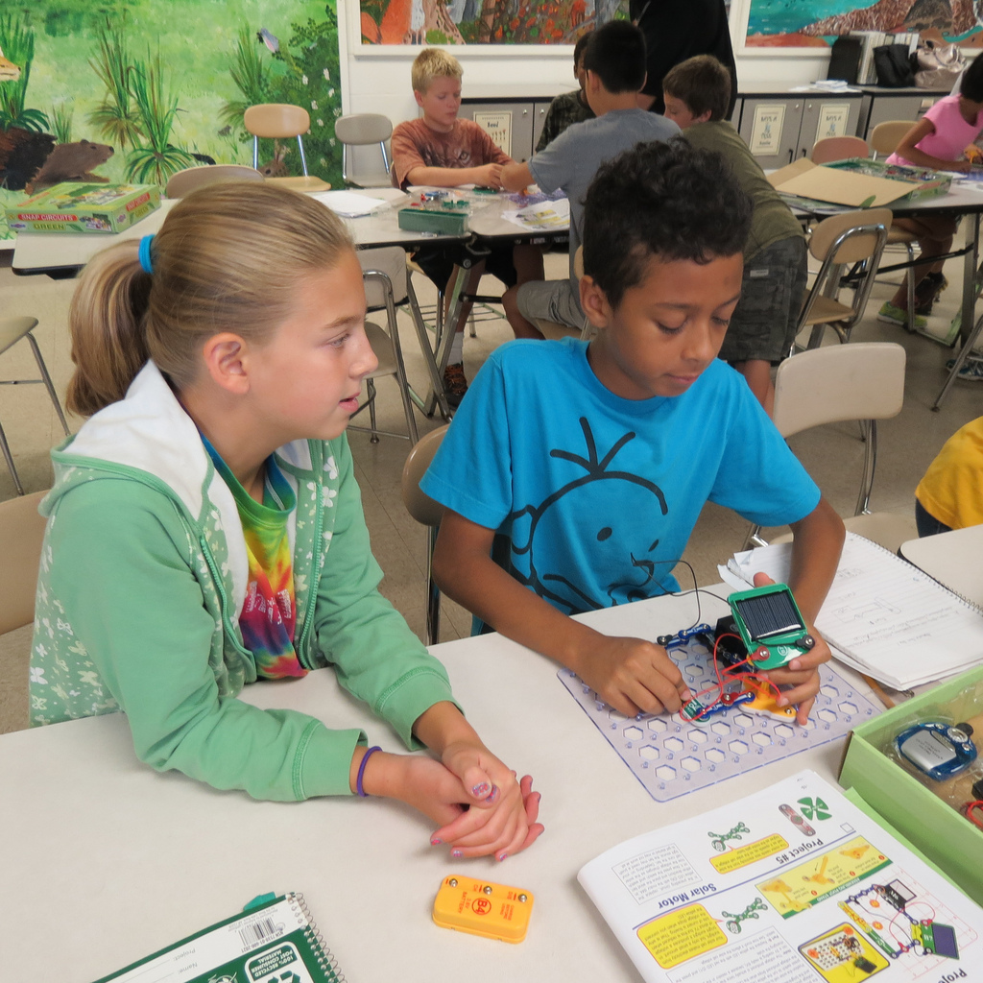
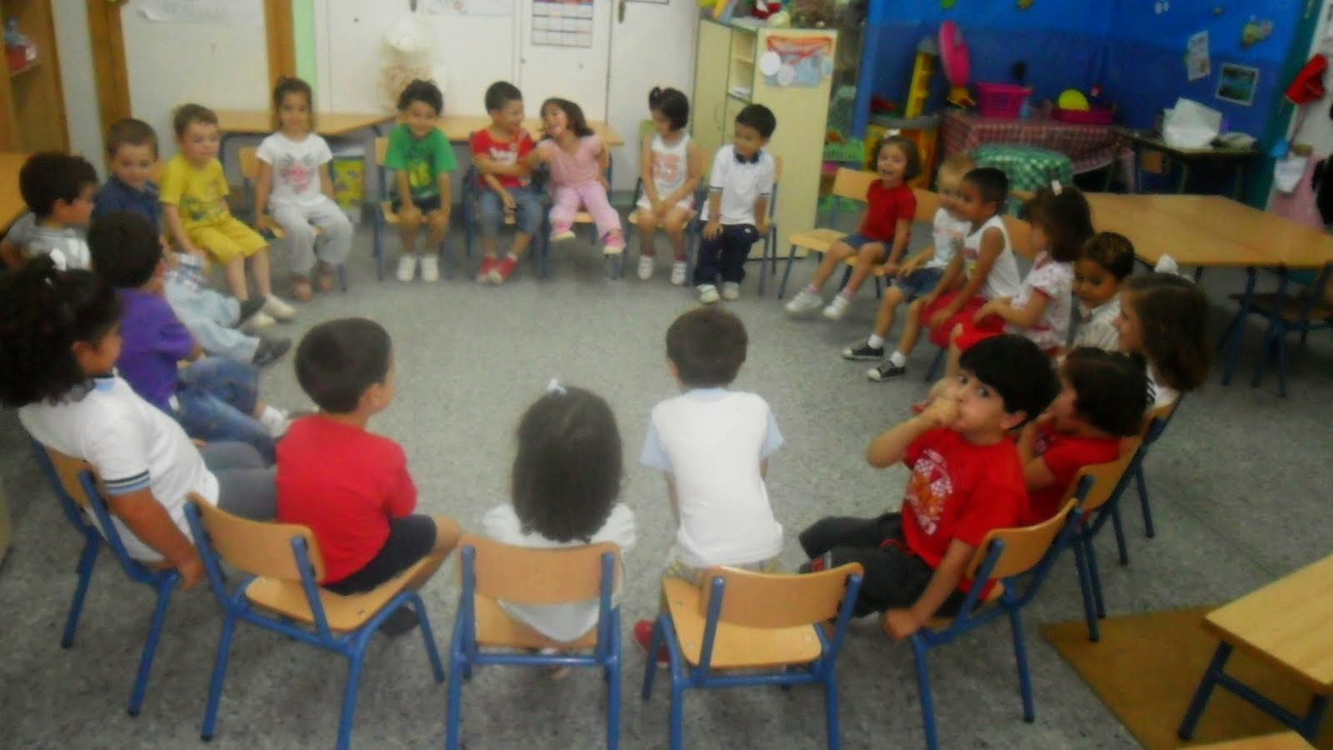

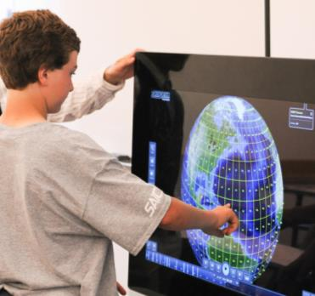
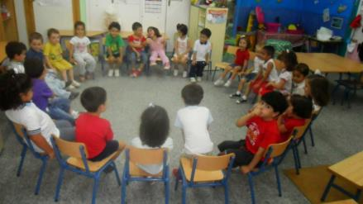
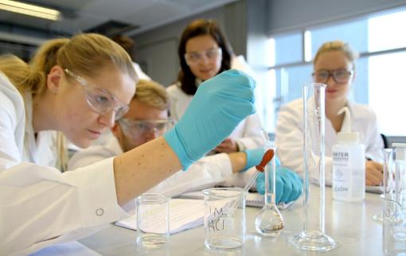


Notes:
Talking Points
All of these photographs depict students engaged in a scientific activity, and hopefully, scientific thought.
In the first two phases for Foundational Services for Science, we asked the question: How does one actually create lessons and units of study that facilitate a learning environment in which students truly are engaged in scientific activity and scientific thought?
To answer this question, we had to first grasp the shifts in the Next Generation Science Standards. In the first phase, we were familiarized with the intended purpose of NGSS and the three-dimensional learning called for by these standards. The focus of the first module was to gain an overview of the type of learning called for in NGSS, three-dimensional learning, the three-dimensions, and how to access the NGSS.
In the second phase, we went beyond awareness and began to utilize NGSS tools to make sense of the dimensions. We practiced using tools to unpack the disciplinary core idea, to identify and utilize phenomena, and to examine the appendices to make sense of grade band progressions in the crosscutting concepts and science and engineering practices.
In the third phase for Foundational Services for Science, we can called upon our past experiences and focused on “Developing and Evaluating Units of Study Aligned to NGSS.” However, this phase was simply an introduction to a process. Similar to a cake tasting; we were able to get a “taste” of each part of the process.
In this fourth phase for Foundational Services for Science - Workshop: Building Units of Study Aligned to NGSS, we will fully engage in the process of developing a unit of study aligned to the Next Generation Science Standards. This process with take time and require revision as the unit is rolled out to students. Because the nature of NGSS relies on students as scientists, this will require trial and error with groups of students.

Slide 4
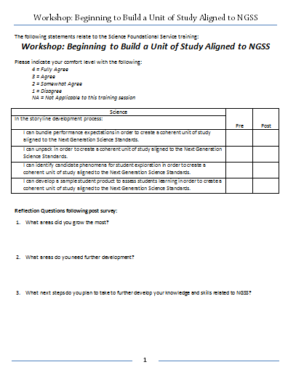
Pre & Post
Survey
Please take a moment to complete the Pre portion of the Pre and Post Survey for
Workshop: Beginning to Build a Unit of Study Aligned to NGSS.
Use the 1 to 4 rating scale described on the survey.
Notes:
Facilitator Notes
Survey is provided in the workbook.

Slide 5
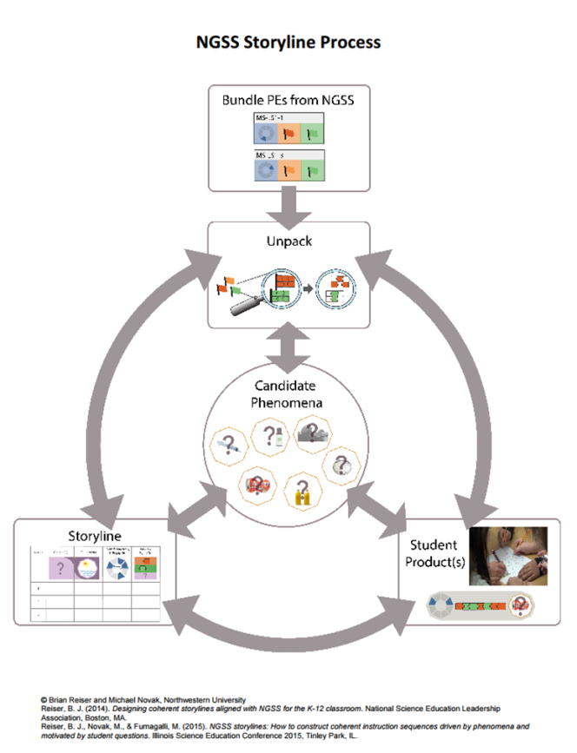
Storyline Development
Process
Notes:
Talking Points
The process of developing a storyline was developed by Brian Reiser and Michael Novak and colleagues. See Reiser, B. J., Novak, M., & Fumagalli, M. (2015). NGSS storylines: How to construct coherent instruction sequences driven by phenomena and motivated by student questions. Paper presented at the Illinois Science Education Conference 2015, Tinley Park, IL. For more on storylines see http://www.nextgenstorylines.org/
The process of developing a storyline is compromised of five different phases.
While the process may seem linear at times, it is important to note the multiple arrows in this graphic.
These arrows represent the fluid nature in which this process develops. At times, one phase will lead us back to a phase we had previous “completed.” For example, when working on student product, one might need to go back to unpacking to clarify understanding of the disciplinary core ideas.
You will also notice the coloring of the different images on this diagram. Michael Novak is very skilled at creating graphic designs – this being a visual to represent the process. Each of these colors was purposeful – blue for Science and Engineering Practices, orange for Disciplinary Core Ideas, Green for Crosscutting Concepts, Purple for Phenomena. In the unpacking section, you will note the dark and light orange – this signifies that we will often have primary and secondary performance expectations that we bundle and unpack.
We will be working our way through the phases of the storylining process. The intention is for us to engage in each phase. As a result, we will more deeply understand the process as well.
This will enable us to use this process to both develop or evaluate NGSS units of study – which we will practice in this phase as well.

Slide 6
Session 2
What is the science our students must understand?
Notes:
Talking Points
With our potential bundle in mind, we will now move onto the next phase of the storyline development process to determine: what science must our students understand?

Slide 7
Session 2: Facilitator Notes
Time: 4 hours
Supplies:
Notes:
Participants will need physical copies of their performance expectations and corresponding framework. To prepare these materials, you may want to:
have a break between Session 1 and Session 2 or
prepare in advance from the survey.
PowerPoint
Chart Paper
Stickie Notes
Markers
Shared Google Folder:
  2 - Unpacking: Unpacking
Participant Workbook
Performance Expectations and corresponding Disciplinary Core Ideas from the Framework.

Slide 8
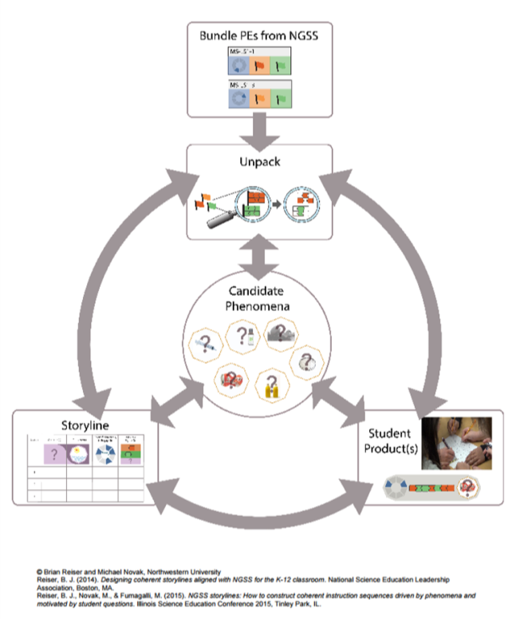

Unpack to
Make Sense of the Science
Storyline Development
Process
Notes:
Talking Points
To continue the process of developing a storyline, it is essential to make sense of the science.
Before diving back in, let’s take a moment to activate our prior knowledge.
On page 5 in your workbook, there is a section to jot down your thoughts.
Take a moment and jot down what comes to mind when considering this step.
Let’s take a moment to discuss in a small group: What do we recall about the process of unpacking to make sense of the science?
Facilitator Notes
Provide participants with 1-2 minutes to jot their thoughts.
Provide participants with 1-2 minutes to discuss in small groups.
Engage participants in a whole group discussion.
Have a member scribe the groups thoughts on chart paper.
Limit the discussion to 10-15 minutes.
Use this discussion to pre-assess participants familiarity with the purpose and process of unpacking.
On the following slides, review the purpose and process of unpacking as needed.

Slide 9
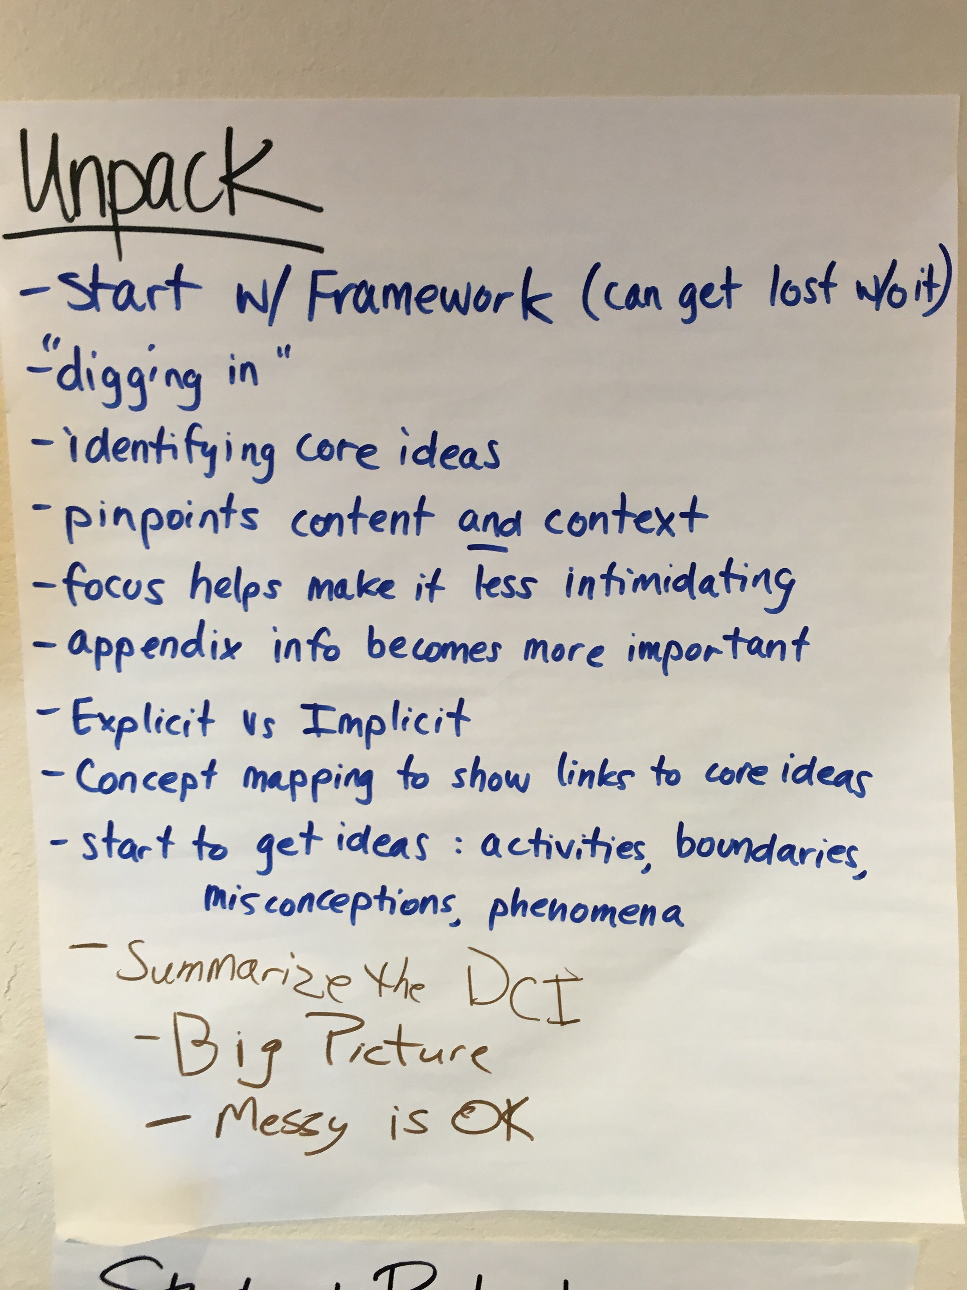
Sample
Notes:
Oct 9 & 10 AC Training

Slide 10

Our Target Is…
In the Storyline Development Process:
I can unpack in order to create a coherent unit of study aligned to the Next Generation Science Standards.
Notes:
Talking Points
Within Session 2, you will be unpacking to make sense of the science.

Slide 11
Unpack to
Make Sense of the Science
Overview
Closely read and mark up the full description of the performance expectations in the Framework.
  What are all these pieces?
  What are the pieces that are implicit, but are needed?
Break the DCIs needed for the PE apart into the specific understandings that need to be developed.
Summarize the ideas from the Disciplinary Core Ideas in the Framework.
  What content ideas will students need to know?
  What must students be able to do?
Notes:
Facilitator Notes/Talking Points
Engage the participants in a brief review of the information on the slide. Use the following as sample questions…
Let’s take a moment to review the Overview of Unpacking to Make Sense of the Science.
Did we capture these ideas in our brief discussion?
Do we have any questions?
Have a participant scribe the whole groups additional thoughts on same chart paper from the review with a different color marker.
Previous Talking Points/Facilitator Notes from Phase 3…
When examining the performance expectations, it is clear that more information is needed to determine what core ideas need to be part of a unit of study. Often the performance expectations are so concise, that a little digging is needed to make sense of the science.
This phase of the process is referred to as unpacking. In Foundational Services for Science Phase 2, we introduced the process of unpacking. Let’s review our work from Phase 2.
As we review this phase of developing a storyline, there is a section to take notes on p14 in the workbook.
Pay close attention to the coloring of the image for unpacking. What does it tell us?

Slide 12


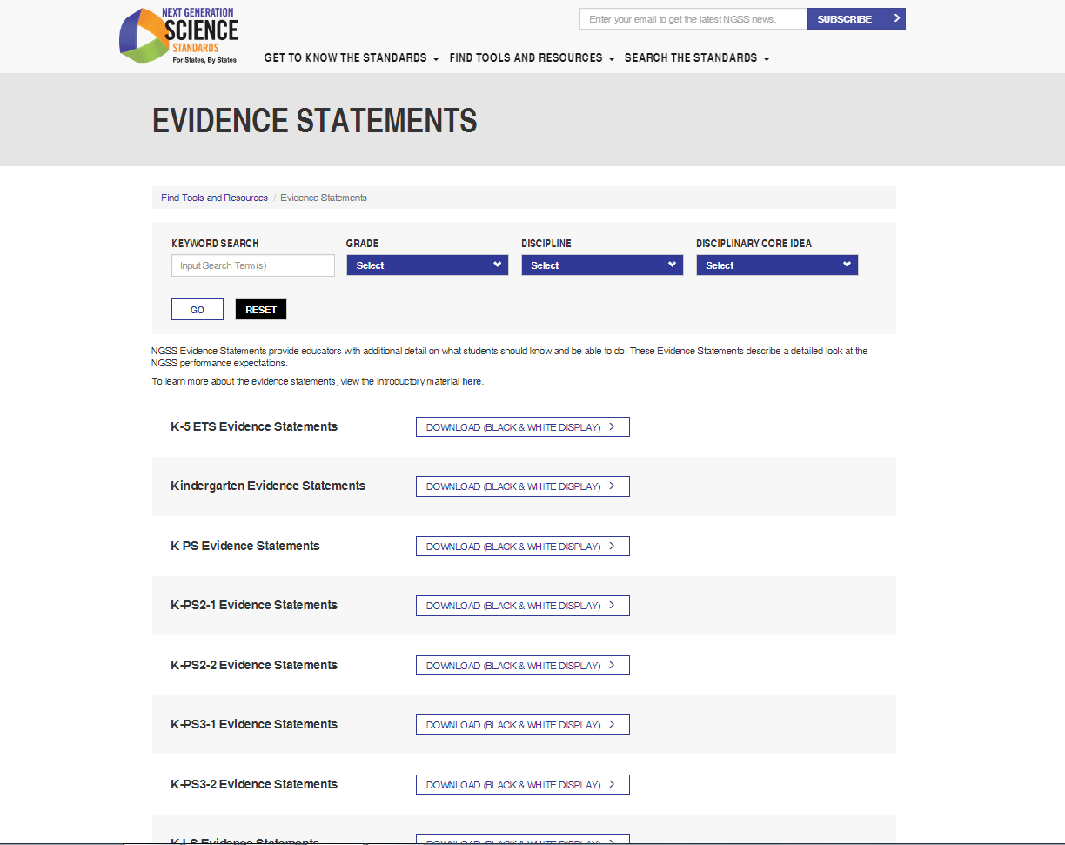



Unpack to Make Sense of the Science
Performance Expectation
Make Sense of the DCI
Summarize the DCI
Read and Mark the DCI
Notes:
Facilitator Notes/Talking Points
Engage the participants in a brief review of the information on the slide. Use the following as sample questions…
Let’s take a moment to review the process of Unpacking to Make Sense of the Science.
Did we capture these ideas in our brief discussion?
Do we have any questions?
Have a participant scribe the whole groups additional thoughts on same chart paper from the review with a different color marker.
Previous Talking Points/Facilitator Notes from Phase 3…
While there is no one way to make sense of what science educators are supposed to be teaching, the method we practiced in Phase 2 has been developed over the past decade.
Illinois science educators used this method with the creators, Dr. Brian Reiser and Michael Novak during the ISBE Curriculum Resource Project. (With the changes in the Illinois state government and Board of Education, this project has unfortunately been put on hold.) This method was further developed during the Math and Science Partnership (MSP) Grant that involved NGSX, a research group out of Northwestern University and Clark University with Dr. Brian Reiser and his team of Michael Novak, Tara McGill, Aimee Park, and others using NGSX to train 24 Area Teacher Leaders who then trained 24 participants in NGSX in their own regions. In addition, NGSX has worked with many other states and teams of teachers as they make sense of NGSS and attempt to bring it life in their classrooms.
While there may be other methods or approaches to making sense of the Science, or we could simply wait for curriculum developers to do make sense for the teachers, this method of diving deeply into the science and making sense of the big picture of content builds background knowledge in the new approach to content learning in science education.
This process can be used as the beginning steps of creating units of study or this process can be used to evaluate a curriculum for alignment to NGSS. No matter what the situation, being able to make sense of the Disciplinary Core Ideas is essential to inform educational practice in Science classrooms.

Slide 13


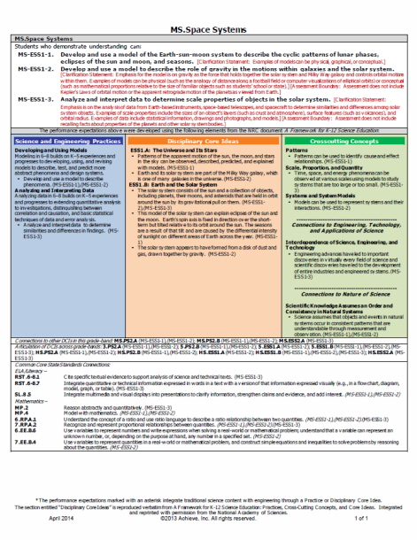
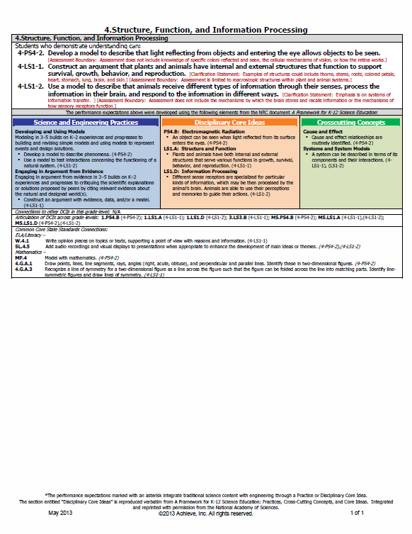
Performance Expectations
Make Sense of the DCI
Summarize the DCI
Read and Mark the DCI
Performance Expectation
Notes:
Talking Points
In Phase 2 Foundational Services for Science, you saw an example from Lisle Junior High School in which they are working on developing a middle school science unit addressing the middle school NGSS for Space. In Phase 2 Foundational Services for Science, you too engaged in a similar process to unpack PS4. B Electromagnetic Radiation. These are the bundled performance expectations for Space in Middle School and Light in Fourth Grade. A sample of the bundles are provided in RESOURCE: The Process of Developing Storylines. In Phase 3 Foundational Services for Science, you repeated this process for weather and climate.
In this session, you will be working with the bundle of performance expectations that you have selected.

Slide 14
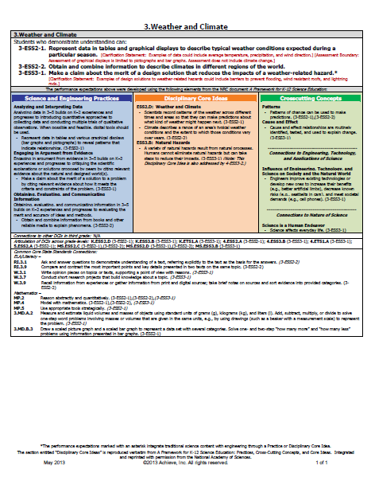
Unpack to
Make Sense of the Science
Task: Performance Expectations
  Read over the performance expectations, foundational boxes, and connections.
  Annotate the performance expectations.
  Consider these questions:
    What is explicit in this performance expectation?
    What questions come to mind in examining this performance expectation?
Notes:
Facilitator Notes
Set aside 5 minutes for this task.
The intention is to look over these standards as individuals before engaging in partner talk to prepare for the large group discussion.
Participants will use the performance expectations that they have selected in their bundle. Participants or facilitator will need to print a copy of these performance expectations for the participants.
Talking Points
Now, it is time to unpack to make sense of the Science once again.
This unpacking will focus on the disciplinary core ideas related to your bundle.
We will begin by examining the Performance Expectations for implicit and explicit ideas.

Slide 15
Unpack to
Make Sense of the Science
Task: Performance Expectations
  Working with a partner, briefly review your notes and thoughts with one another.
Notes:
Facilitator Notes
Set aside 5 minutes for this task.
The intention is to engage in a quick elbow partner talk to prepare for the large group discussion.
Talking Points
Now, working with a partner, briefly review your notes and thoughts with one another.

Slide 16
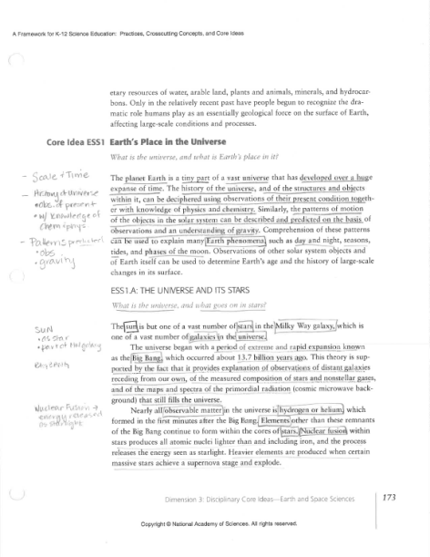
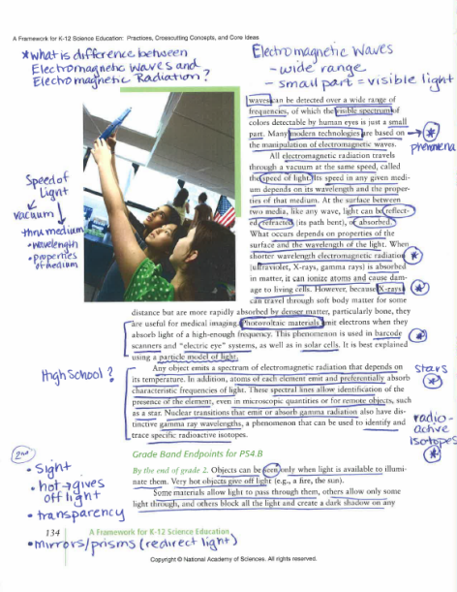
Read & Mark the DCI
Make Sense of the DCI
Summarize the DCI
Read and Mark the DCI
Performance Expectation
Notes:
Talking Points
We look here at a sample of unpacking for the previously displayed bundle of performance expectations. A sample of the unpacking is provided in RESOURCE: The Process of Developing Storylines.
You have engaged in the process of unpacking in both Phase 2 and 3 of Foundational Services.
In this session, you will be working with the bundle of performance expectations that you have selected. Therefore, you will unpack the disciplinary core ideas related to the performance expectations you have selected.

Slide 17
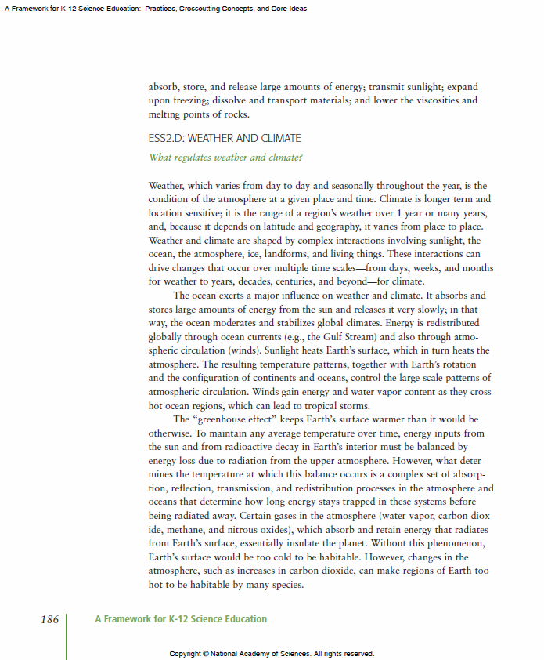
Unpack to
Make Sense of the Science
Task: Read the DCI
Using the Framework, determine the core ideas within this performance expectation.
Individually, read and make notes. Underline the most important ideas you find. Write questions or thoughts in the margins. Read "between the lines" to see what understandings are implicit.
Be prepared to explain the core ideas to the group.
Notes:
Facilitator Notes
Set aside 10 minutes/disciplinary core idea for this task.
Participants need to work individually and the room should be quiet. If available, allow for participants to spread out to areas that will allow them to focus.
Participants will use the disciplinary core ideas related to the performance expectations that they have selected in their bundle. Participants or facilitator will need to print a copy of these sections of the Framework for the participants.
Talking Points
To gain a deeper understanding of the science ideas in this disciplinary core idea, we will read the corresponding section of the Disciplinary Core Ideas.
In the Resource Packet from Phase 3, you will find two samples of annotating the reading – light and space - and your own work on weather and climate.

Slide 18
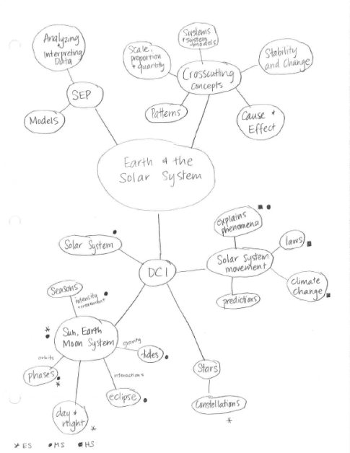
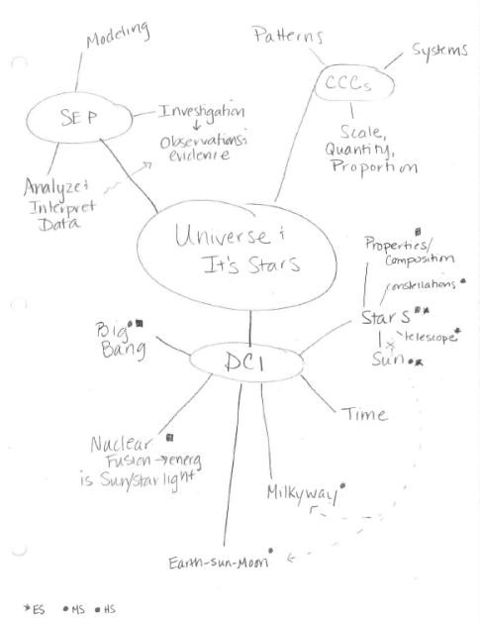
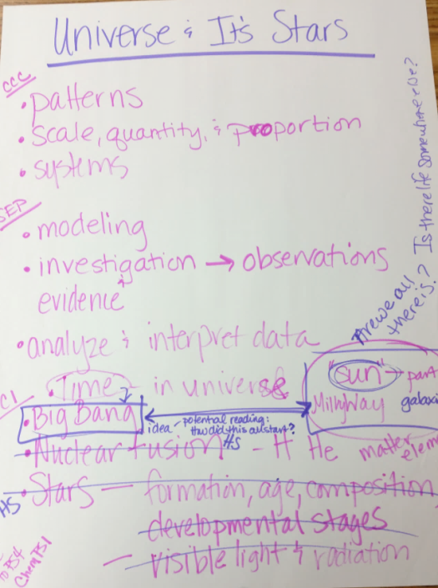
Make Sense of the Ideas
Make Sense of the DCI
Summarize the DCI
Read and Mark the DCI
Performance Expectation
Notes:
Talking Points
Once we have read and marked up the framework. We need to make sense of what is in our heads and discuss.
The next step requires some processing. Lisle Junior High School teachers engaged in a discussion and got their ideas out on the table. As they discussed, they scribed their thoughts.
From their rich scientific discussion of ideas, Lisle Junior High School teachers used a concept map to link the ideas and make sense of the connections.

Slide 19
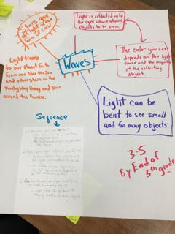
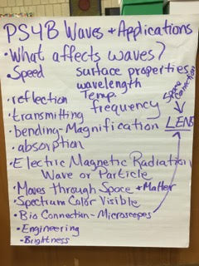
Make Sense of the Ideas
Make Sense of the DCI
Summarize the DCI
Read and Mark the DCI
Performance Expectation
Notes:
Talking Points
Here are some example photographs from participants making sense of PS4. B Electromagnetic Radiation in Phase 2 Foundational Services for Science.

Slide 20

Unpack to
Make Sense of the Science
Task: Make Sense of the Ideas
Working in a small group, make sense of the ideas you unpacked from the Framework.
Using whatever process makes sense to your group, create a list or image of the core ideas within the Framework on the chart paper.
As you are working, ask yourselves the following questions:
    Do your statements and connections go beyond vocabulary?
    Are the ideas on your list or image both the explicit and implicit ideas in the framework.
    Did you include the "how" and "why"?
Notes:
Facilitator Notes
Set aside 20 minutes/disciplinary core idea for this task.
Provide each table with large chart paper. Explain to the groups that as they discuss, they should scribe their thoughts on the chart paper. Encourage the groups to use the chart paper as soon as possible. Remind participants that this does not need to be perfect, this is a rough draft of their thinking.
Provide stickie notes in a central area for participants to access as needed.
Move from table to table.
Sit down and listen to the participants at the table.
Do not answer questions. Ask questions.
Use Talk Moves.
Talking Points
Now it is time to make sense of what we have read. Working as a group, you will use the chart paper to organize your thoughts from the reading. It is essential to use the paper as a way of working through your thoughts, not as a final draft.

Slide 21
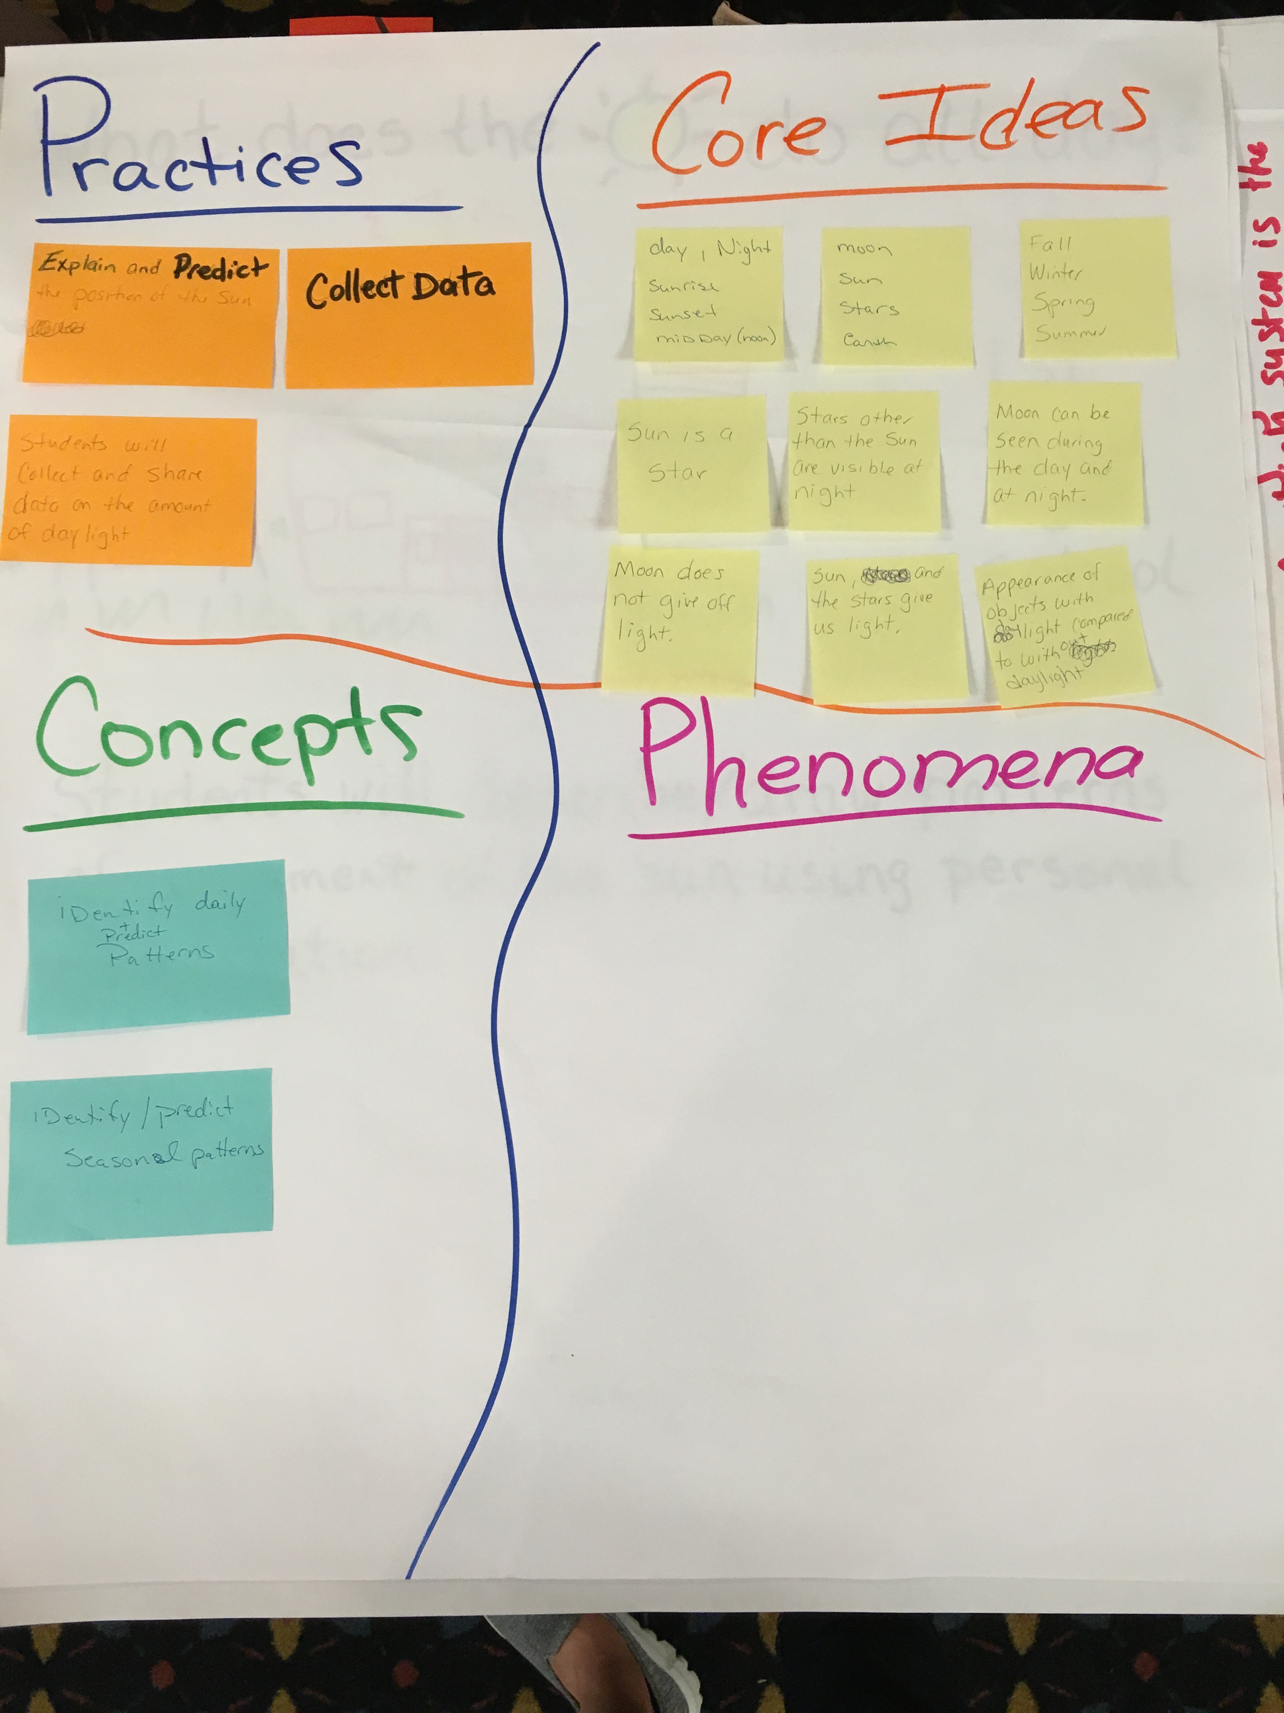
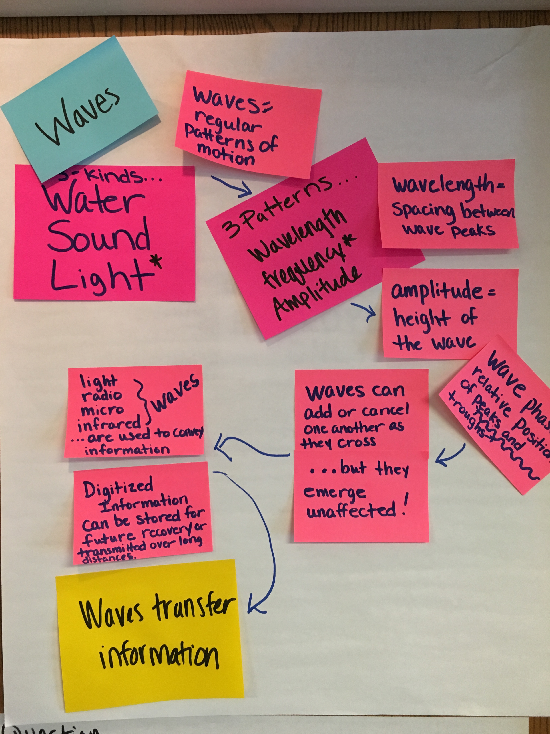

Slide 22
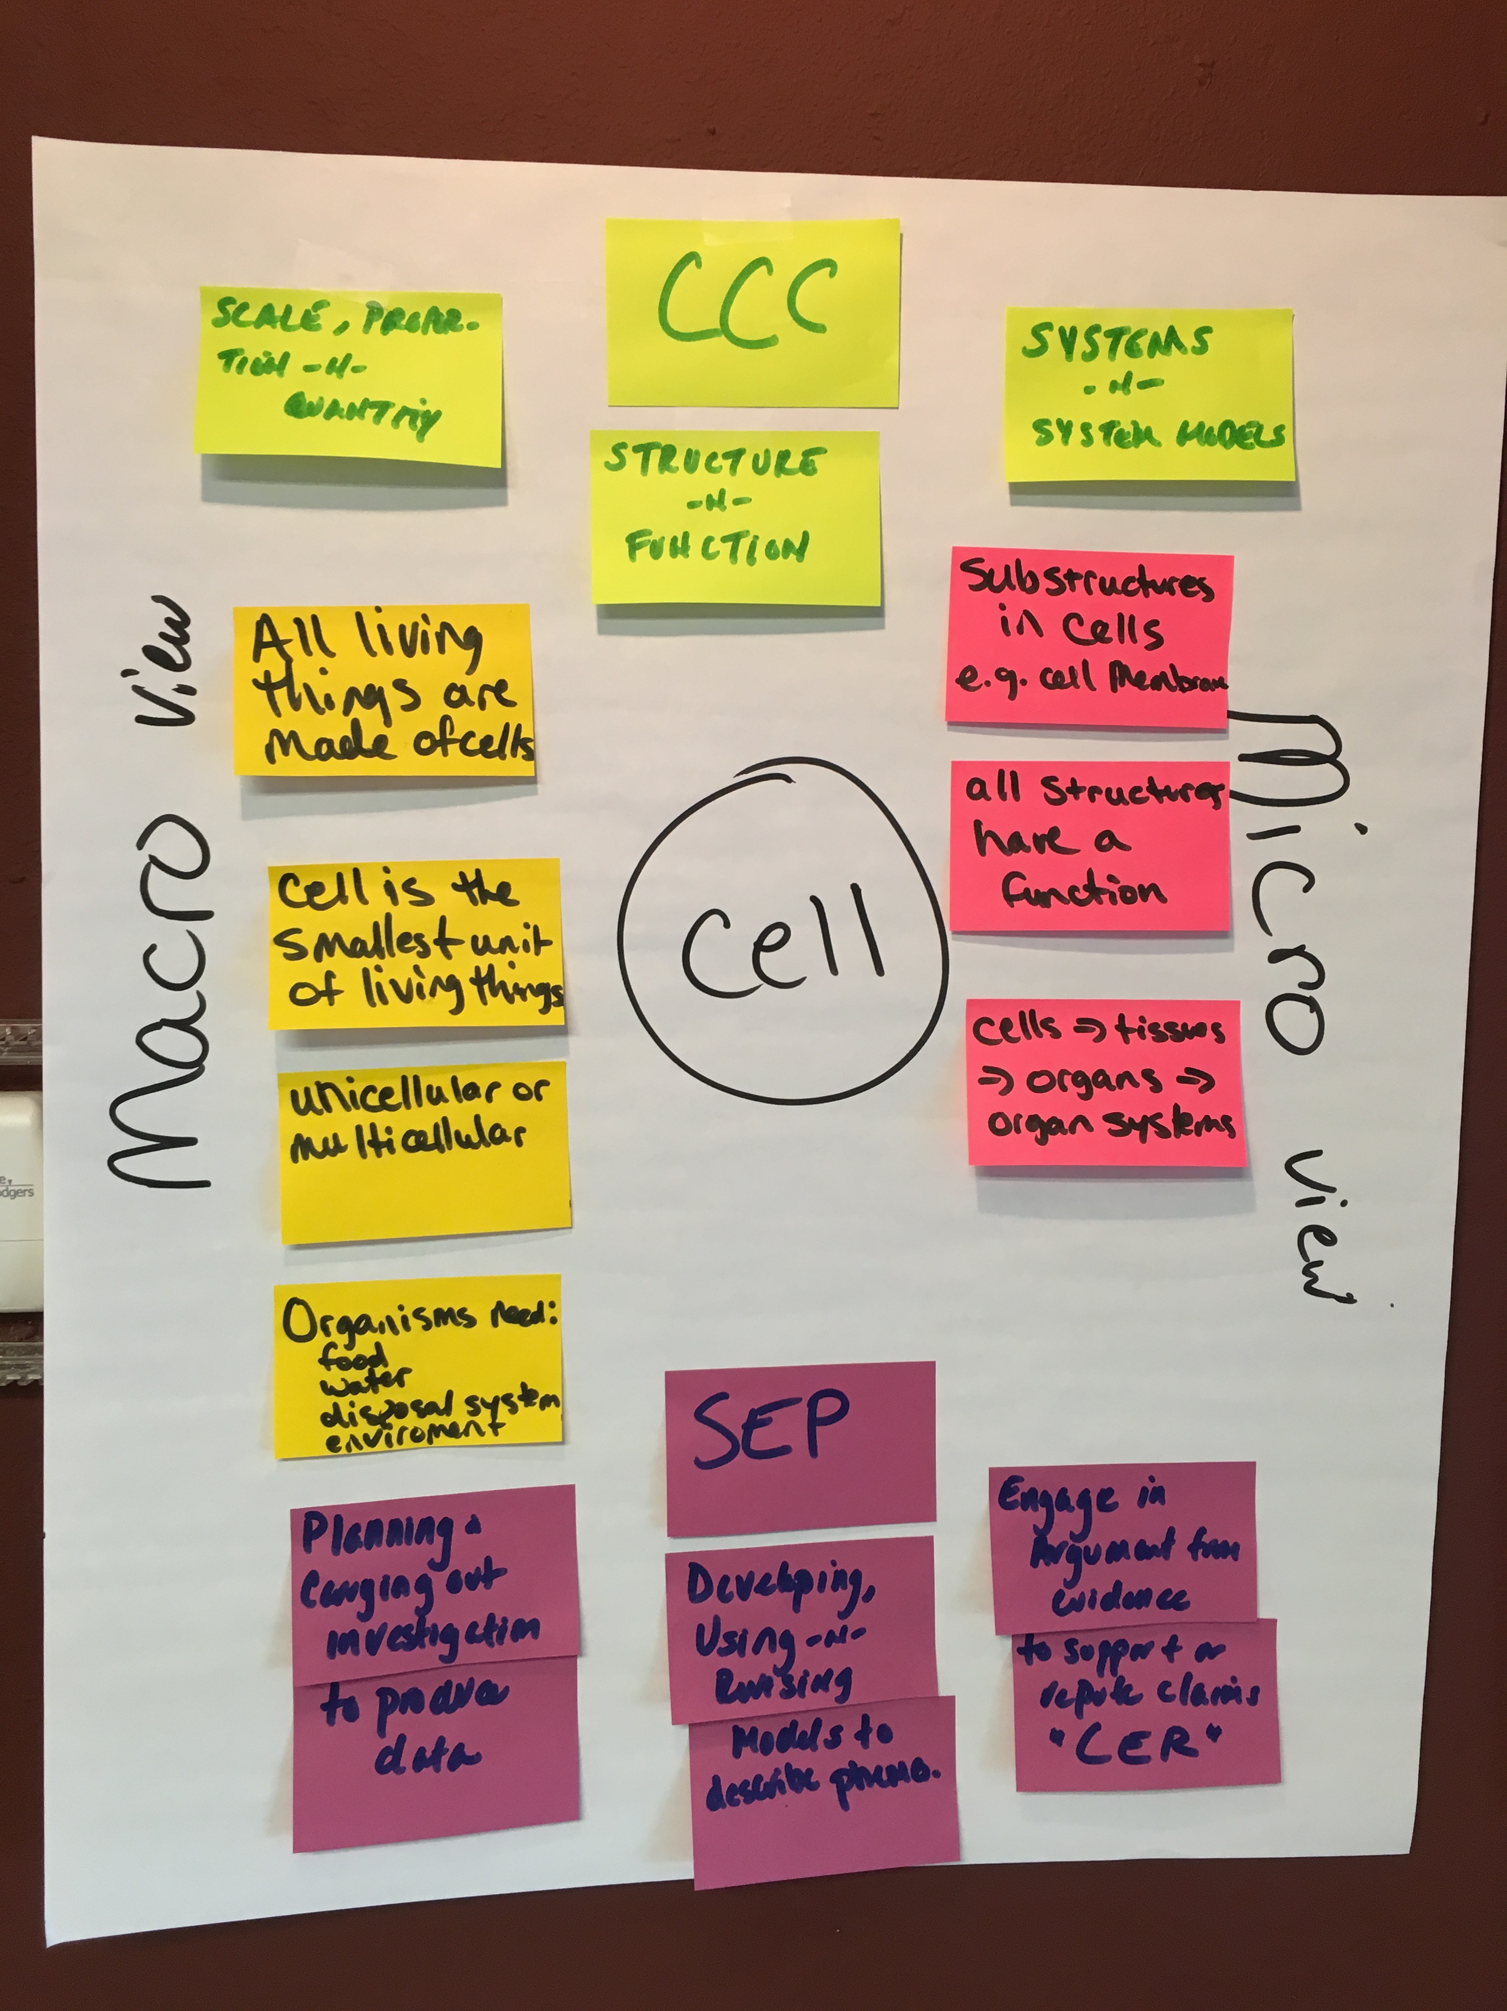
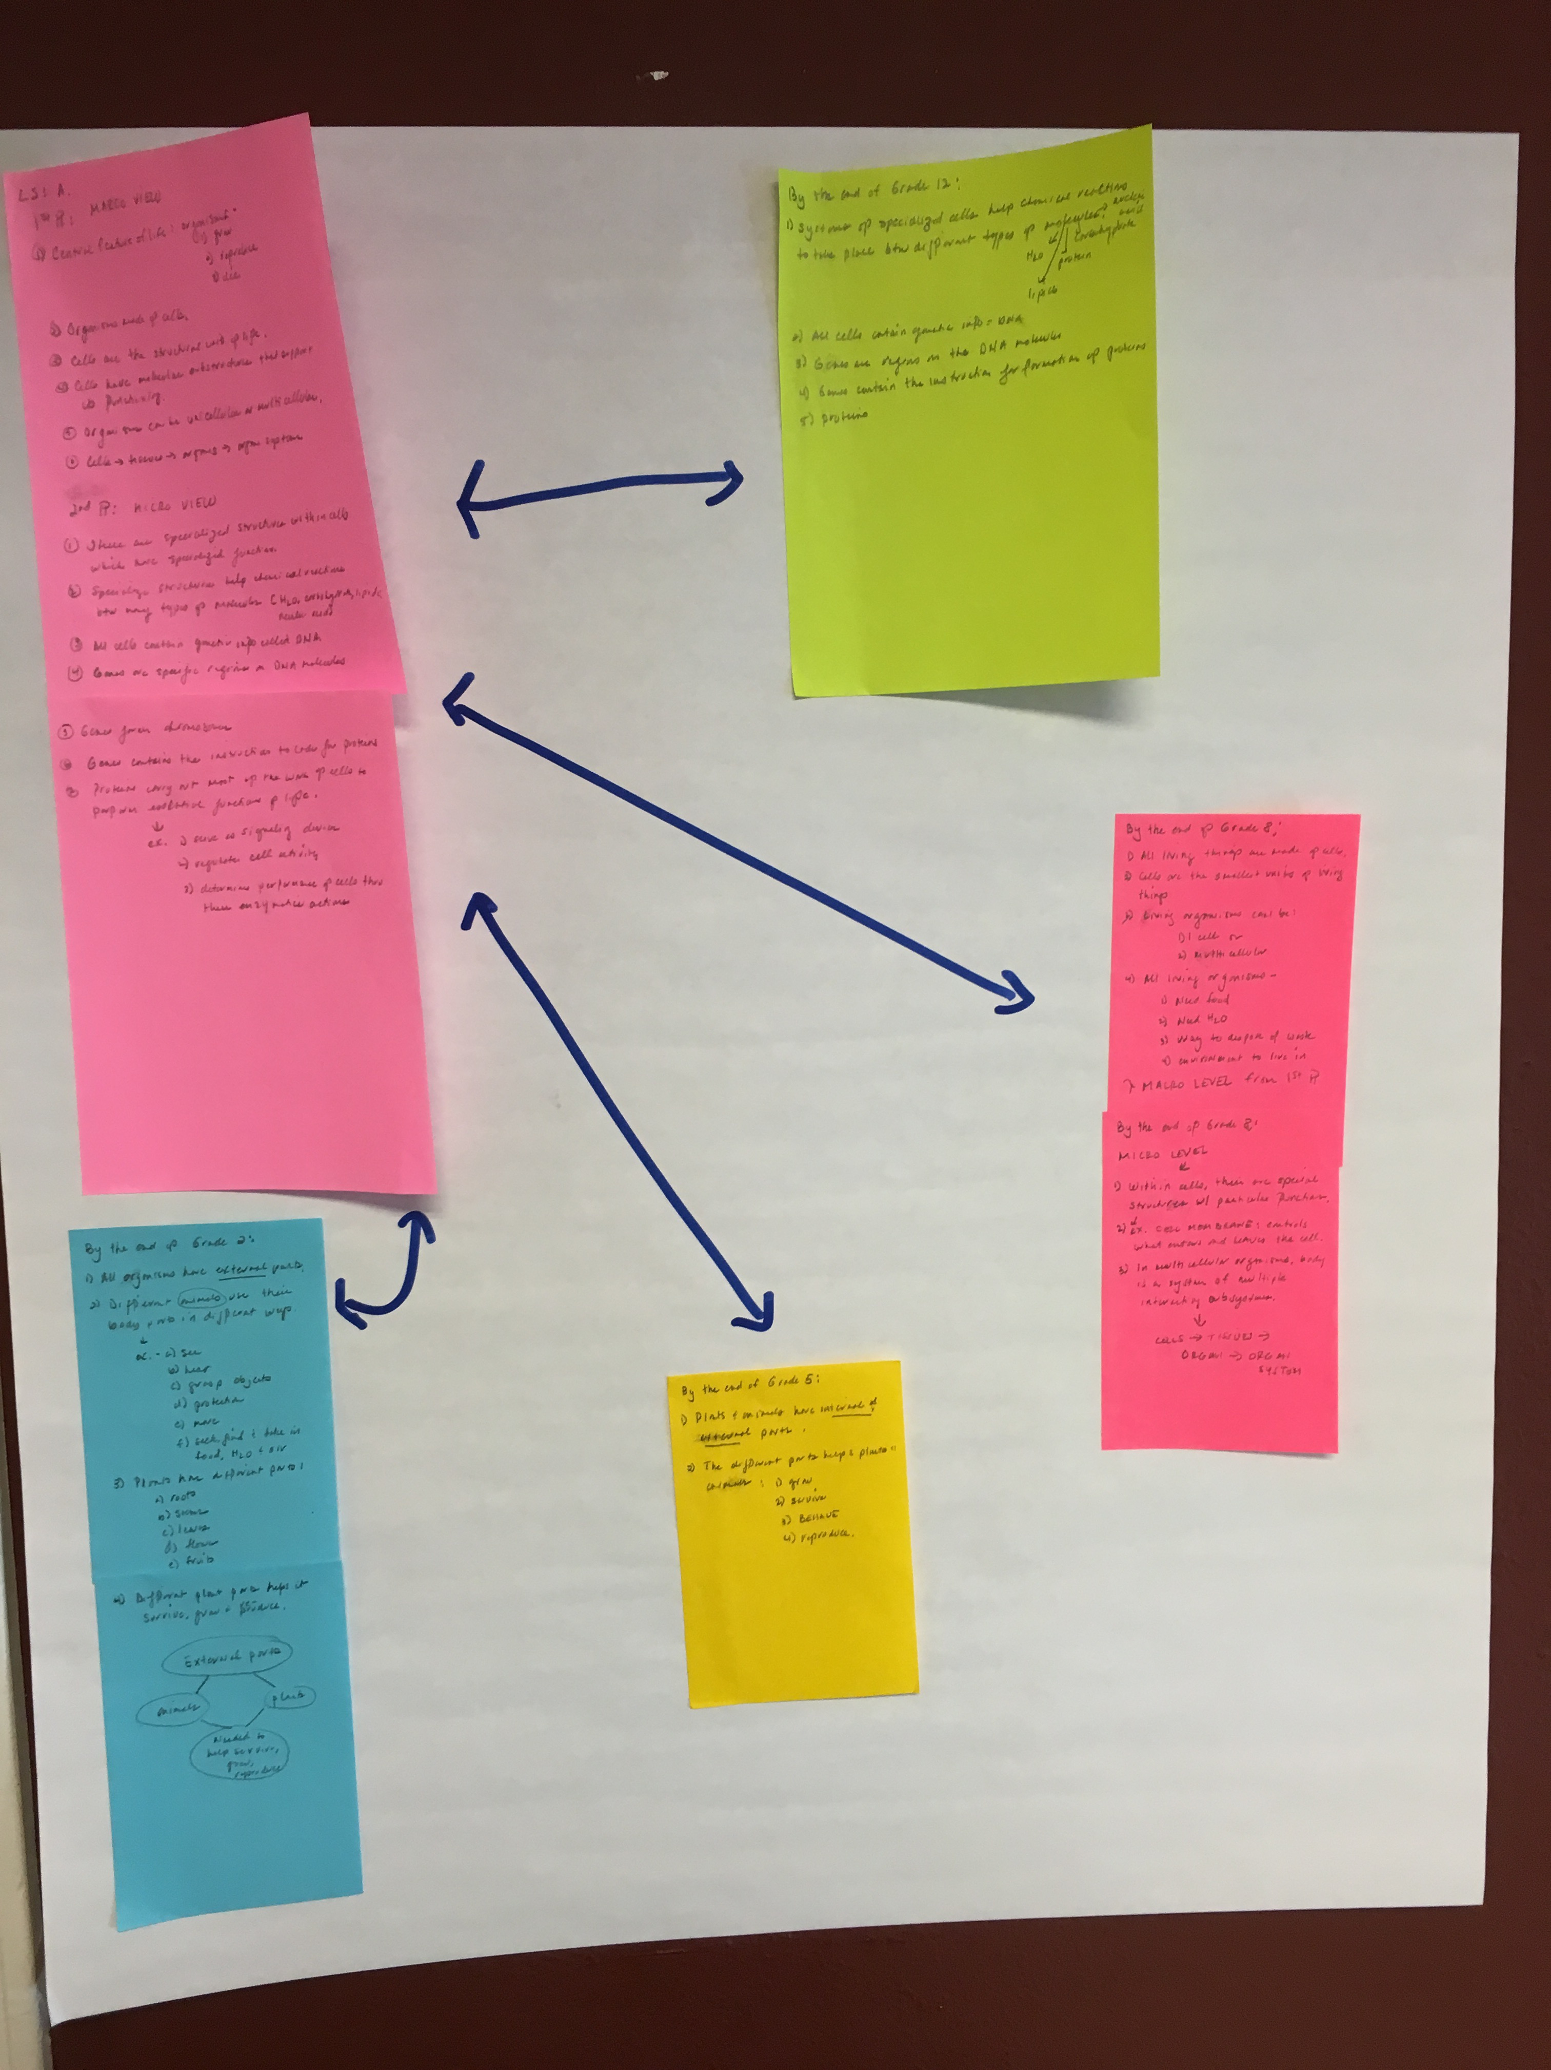

Slide 23
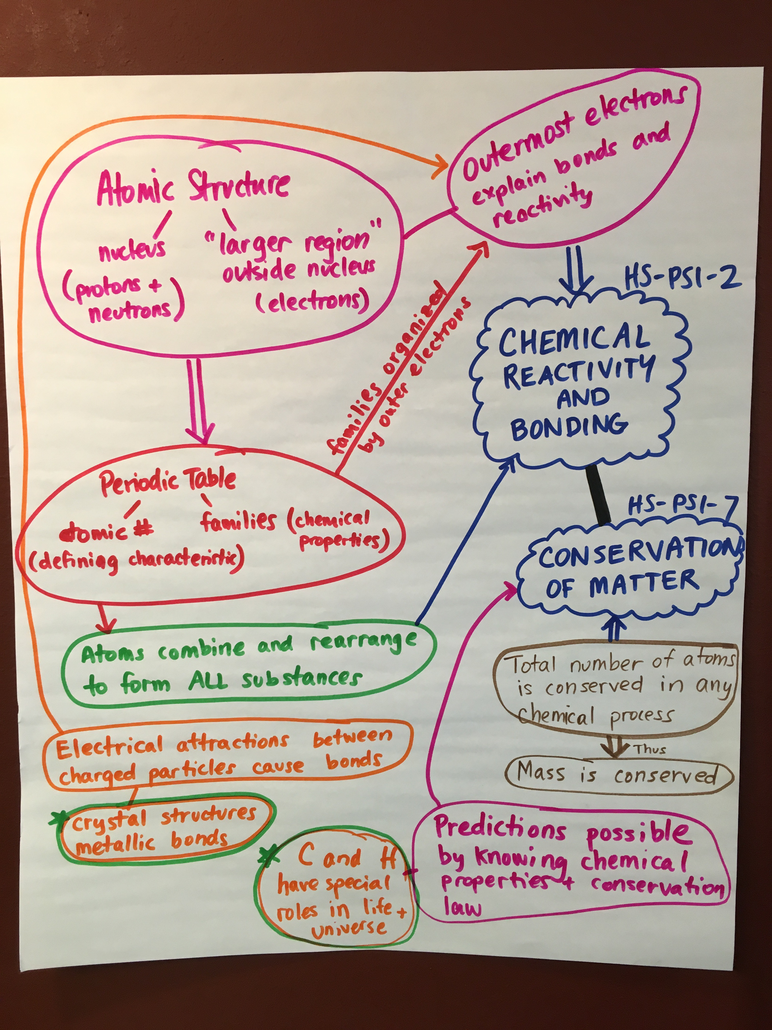
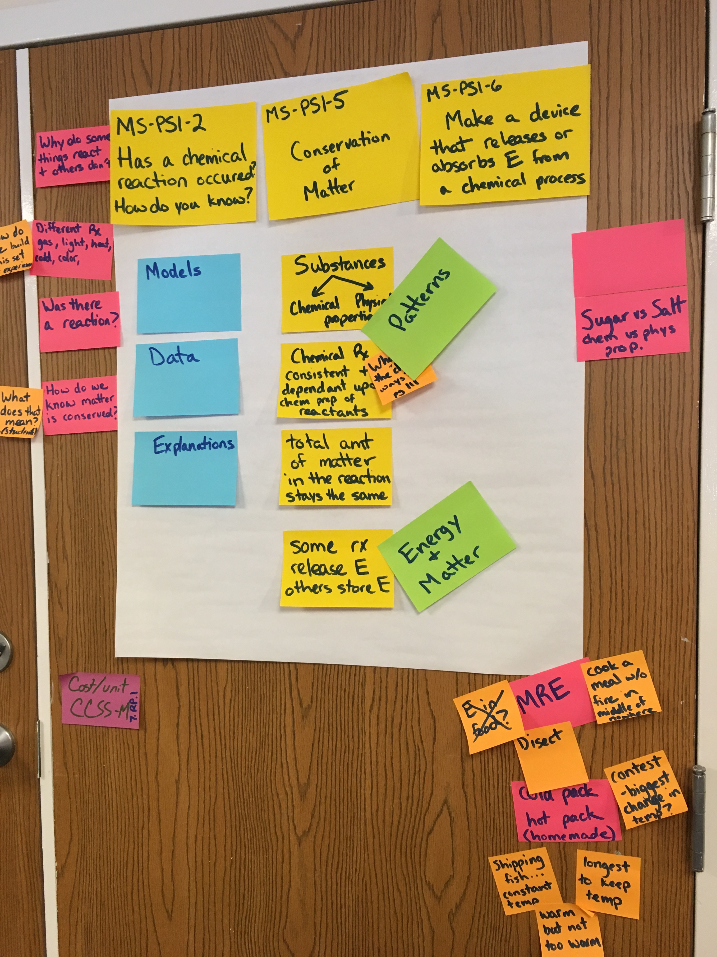

Slide 24
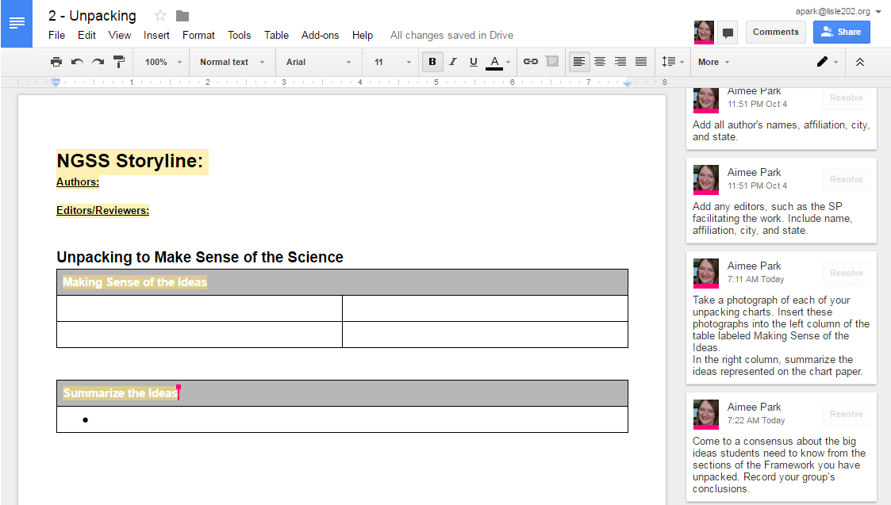
Unpack to
Make Sense of the Science
Task: Make Sense of the Ideas
Record your work on the Google Doc called 2-Unpacking in the shared Google Folder.
Take a photograph of each of your unpacking charts. Insert these photographs into the left column of the table labeled Making Sense of the Ideas.
In the right column, summarize the ideas represented on the chart paper.
Notes:
Facilitator Notes
Set aside 10 minutes for this task.
After reviewing the instructions, show participants the document on the Google Shared Folder and demonstrate how to add the photos to the google form.
Talking Points
Now it is time to capture our work. As we continue in the Storyline Development Process, we will find the need arises to revisit our unpacking. This should enable us to do so.

Slide 25
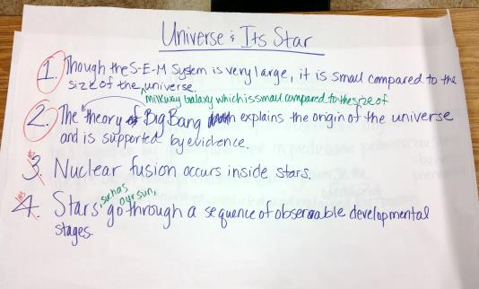
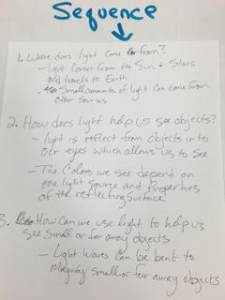
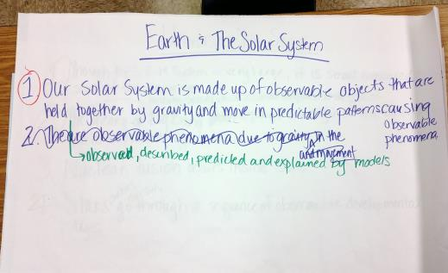
Summarize the Ideas
Make Sense of the DCI
Summarize the DCI
Read and Mark the DCI
Performance Expectation
Notes:
Talking Points
After all the work of unpacking, Lisle Junior High School teachers worked together to summarize the big ideas in these two core ideas of Space Science.
Through discussion, the teachers worked to reword and add clarification to the statements that would be the essence of the lessons and unit they are building.
Similarly, after working to unpack, participants in Phase 2 Foundational Services for Science worked to reword and add clarification to the statements that would be the essence of the lessons and unit they are building.

Slide 26
Unpack to
Make Sense of the Science
Task: Summarize the Ideas
Working as a small group, come to a consensus about the big ideas students need to know from the sections of the Framework you have unpacked.
In the table labeled Summarize the Ideas, record your group’s conclusions.
Notes:
Facilitator Notes
Set aside 10-15 minutes minutes/disciplinary core idea for this task.
Talking Points
Working in a small group, you will now take a step back to consider your unpacking collectively.
What are the big ideas that connect this disciplinary core idea?
What concepts should guide the manner in which we shape our instructions and student experiences?
As you discuss, scribe your thoughts into the Google Doc.

Slide 27

Unpack to
Make Sense of the Science
  As a whole group, take a moment to share out our progress.
Notes:
Facilitator Notes:
Instruct participants to display work/chart papers on the walls.
Set aside about 7-8 minutes/group.
Lead the group in a discussion regarding their progress as small groups.
Use Talk Moves to elicit participants reactions and responses to the questions posed.
If breaking these sessions into multiple days, consider assigning homework:
Between now and our next meeting, continue to work on unpacking with your team.
Record these ideas on your group’s shared Google Doc.
Talking Points
Now we will discuss as a whole group for a few minutes.
Where are we at in the process of making sense of the science?
What is working? What is a challenge?
What questions do we have?
What do we want to consider?

Slide 28



Session 2 Reflection
Task: What Do I Want to Remember?
  Reflect on this portion of the storyline development process - What reminders or notes do you want to make for yourself?
  Work as a large group to generate a list of general reminders and/or notes.
  After discussing as a large group, consider your personal needs and record your reminders in your workbook on your Understanding the Process page 3.
Notes:
Talking Points
Now that we have worked through this phase of the storyline development process, let’s take a moment and generate any reminders or notes.
Facilitator Notes
Use Talk Moves to elicit participants reminders and notes.
Scribe the groups thoughts on a white board or large sheet of chart paper.
Talking Points
Let’s consider your needs for reminders and notes.
Take a moment and record your reflections in your workbook on page 7.
Facilitator Notes
Provide a few moments for participants to record their plans.
Following the reflection use the following talking points to move into the next portion of the presentation.
Talking Points
We just made sense of the core ideas. Though we know that we may have to revisit this phase of the process, we are ready to move onto the next phase of the process – considering candidate phenomena.

