Slide 1
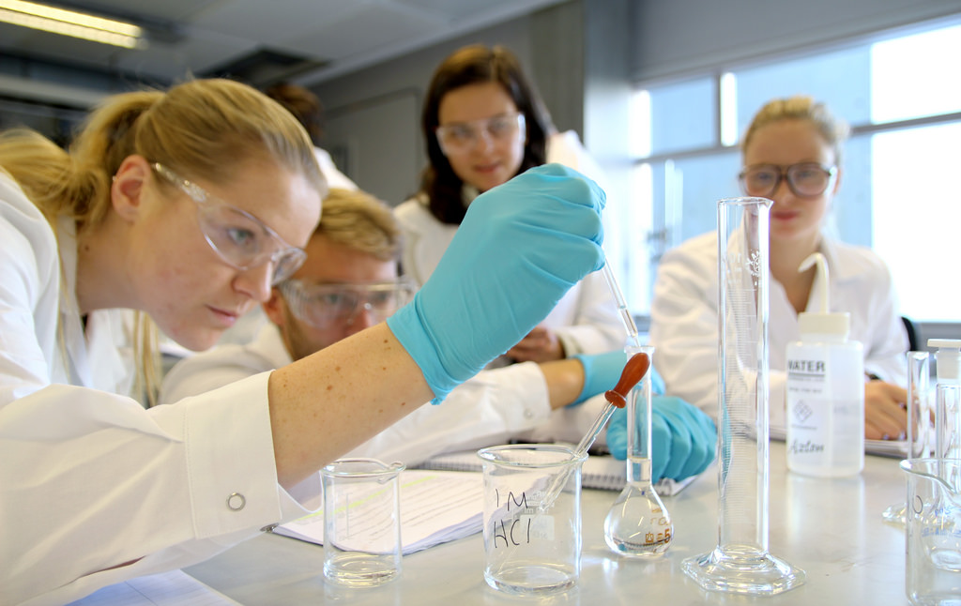
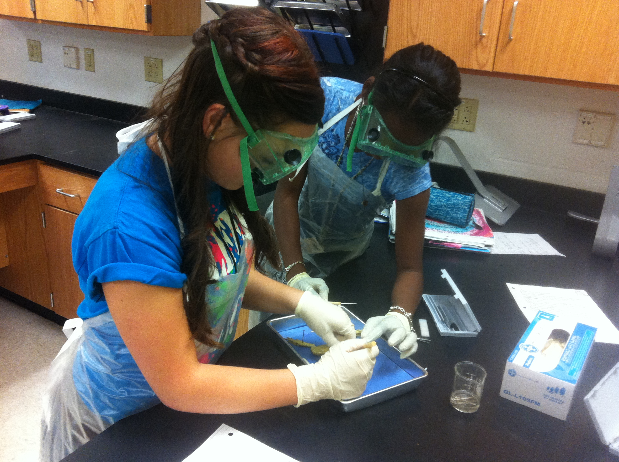
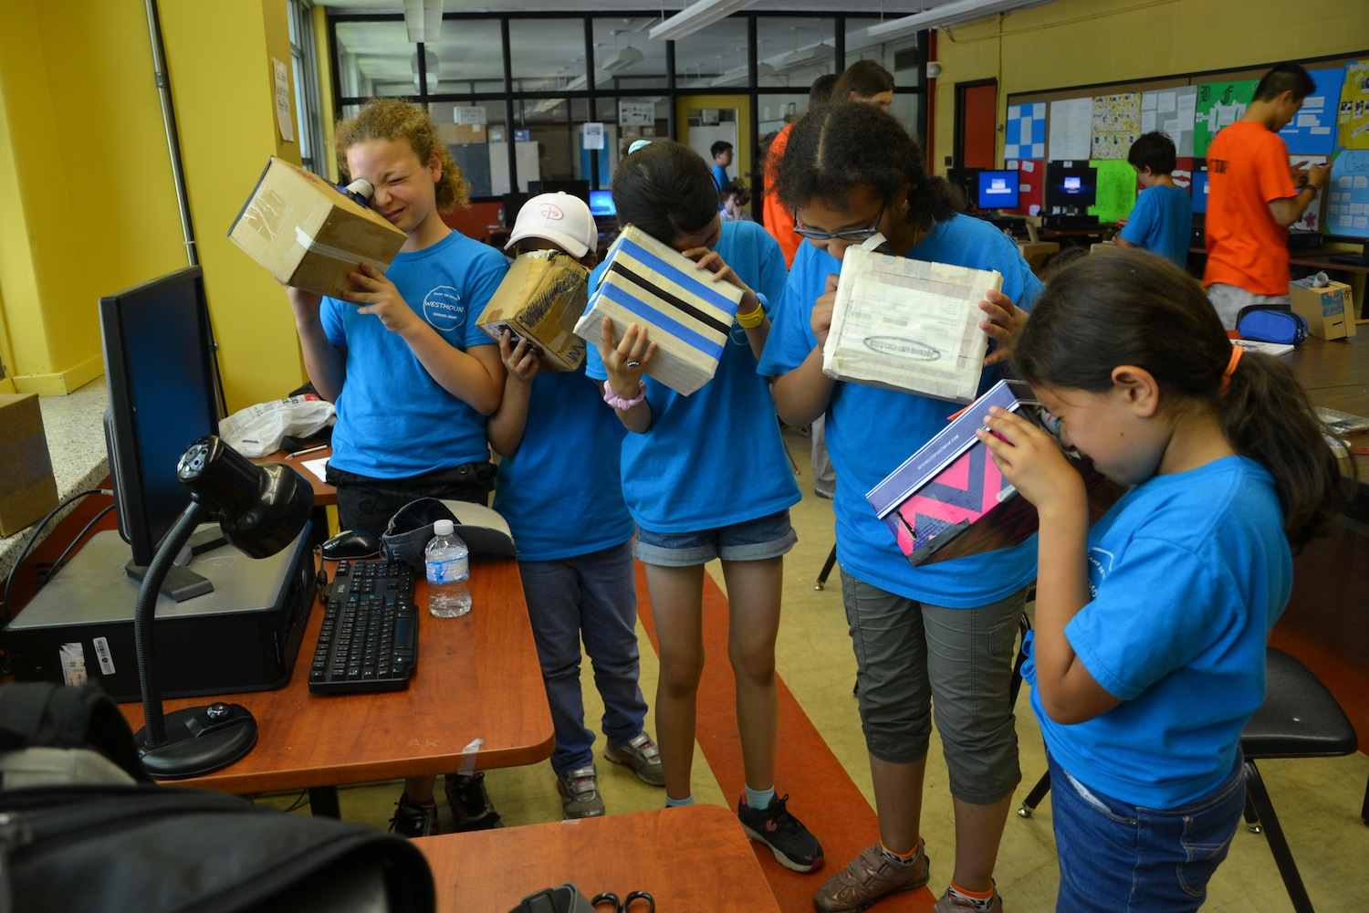
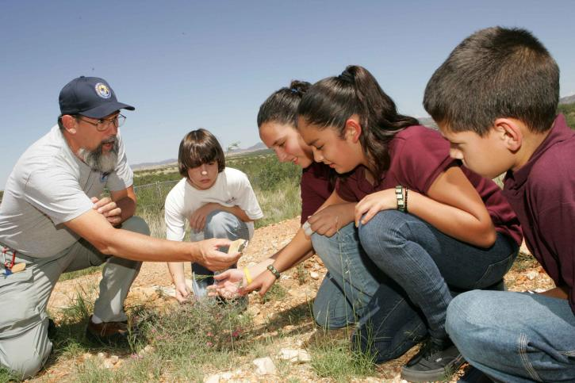
Foundational Services
Science –
Phase 1

Slide 2
Facilitator Notes – Set Up
Notes:
Supplies
Participants will be working in groups throughout the sessions. This will enhance networking, but will also enable participants to maximize NGSS experience. Groups will need to be created. When participants return from lunch, new groupings can form.
Suggestions for groupings:
  As participants enter, provide each with a card (numbered, pictures of different practices, etc.) to randomly assign participants. Tables are labeled with corresponding cards (numbers, practices, etc.)
  As participants enter, provide each with a piece of candy. Tables are labeled with candy types.
Group Norms Table Tents
Table Labels
Cards (1/participant)
Hang the following posters:
  Roadways
  Driving Question Board (DQB)
  Three-Dimensional Learning Consensus Poster

Slide 3
Session 4
Three-Dimensional Learning

Slide 4
Session 4: Facilitator Notes
Supplies
Time: 45 minutes
Notes:
Workbook: Creating Your Own NGSS Analogy
Workbook: Analyzing Lessons for Three-Dimensional Learning
Three-Dimensional Learning Consensus Poster
Workbook: Reflection
Three-Dimensional Learning
  Review Talking Points
  Activity: Participants create their own analogy for three-dimensional learning.
  Activity: Participants analyze Three-Dimensional Learning by examining a performance expectation and their own experiences with today’s lesson and previous classroom experiences.
Reflection
  Activity: Revisit the working definition poster for Three-Dimensional Learning. Participants revisit their definition and engage in a synthesis discussion regarding Three-Dimensional Science Learning.
  Activity: Participants reflect on performance expectations.
  Revisit the Driving Question Board

Slide 5

Our Targets are…
I can articulate the most significant shifts in the NGSS from the previous Illinois Learning Standards in Science.
I can describe three-dimensional learning.
I can explain how different an NGSS classroom should look compared to a traditional science classroom.
Notes:
Talking Points
The targets for this session, then, focus on bringing our experiences together to solidify our understanding of the shifts in NGSS, primarily Three-Dimensional Learning.

Slide 6
Three-Dimensional Learning
How is “THREE-DIMENSIONAL LEARNING” both the biggest and the most essential shift in the NGSS?
What does “THREE-DIMENSIONAL LEARNING” look like in lessons and/or units in science classrooms?
Notes:
Talking Points
The next Session of this training includes two essential questions that all participants should be able to answer by the conclusion of the segment.
How is “THREE-DIMENSIONAL LEARNING” both the biggest and the most essential shift in the NGSS?
What does “THREE-DIMENSIONAL LEARNING” look like in lessons and/or units in science classrooms?
Understanding how to determine whether or not a lesson or unit embodies three-dimensional learning is crucial to being able to use the EQuIP Rubric to examine lessons and units to determine alignment to the NGSS, as well as to being able to the development of aligned lessons and units.

Slide 7

What is Three-Dimensional Learning?
Three-dimensional learning shifts the focus of the science classroom to environments where students use practices, disciplinary core ideas, and crosscutting concepts to make sense of phenomena and/or to design solutions to problems.
Practices
Core Ideas
Crosscutting Concepts
Notes:
Talking Points
As discussed in Session One, three-dimensional learning is the working together of the three dimensions (practices, core ideas, and crosscutting concepts).
Three-dimensional learning shifts the focus of the science classroom to environments where students use practices, disciplinary core ideas, and crosscutting concepts together to make sense of phenomena and/or to design solutions to problems.

Slide 8
What Does Three-Dimensional Learning Look Like?
Practices
Core Ideas
Crosscutting Concepts
Notes:
Talking Points
Think of the three components of Three-Dimensional Learning as three intertwining stands of a rope. While the rope can be separated into its three different strands, the strength of the rope is determined by the strands working together; separating the strands weakens the rope so that it is no longer effective for our intended use.
Likewise, while in the past we may have separated out the knowledge and skills students need in the study of science, in actuality, knowing and doing cannot be separated if our goal is the kind of usable, conceptual understanding students need to think, act, and learn like scientists.
Three-dimensional learning, the intertwining or working together of practices, core ideas, and crosscutting concepts, is, therefore, a non-negotiable for NGSS lessons and units.
Scientific ideas are best learned when students engage in practices.
Three-dimensional learning allows students to utilize core ideas, through the lens of crosscutting concepts, while engaging in practices to solve problems, make decisions, explain real-world phenomena, and integrate new ideas.

Slide 9

Engaging in Three-Dimensional Learning
Notes:
Talking Points
Scientific ideas are best learned when students engage in practices.
Three-dimensional learning allows students to utilize core ideas, through the lens of crosscutting concepts, while engaging in practices to solve problems, make decisions, explain real-world phenomena, and integrate new ideas.

Slide 10
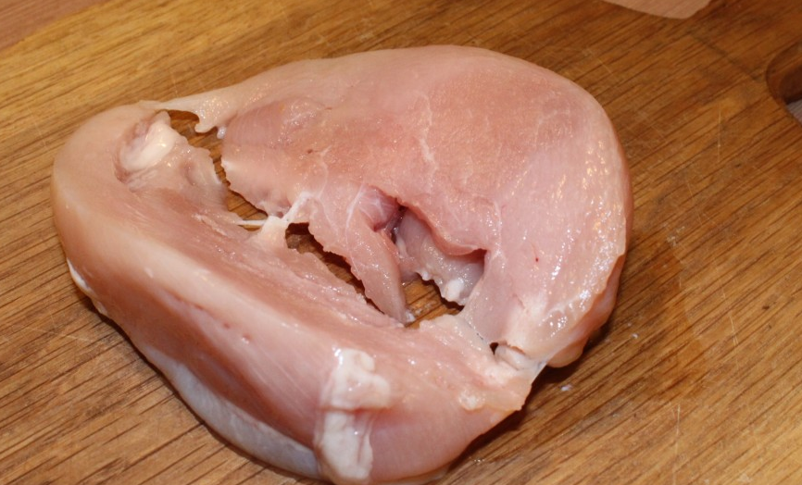

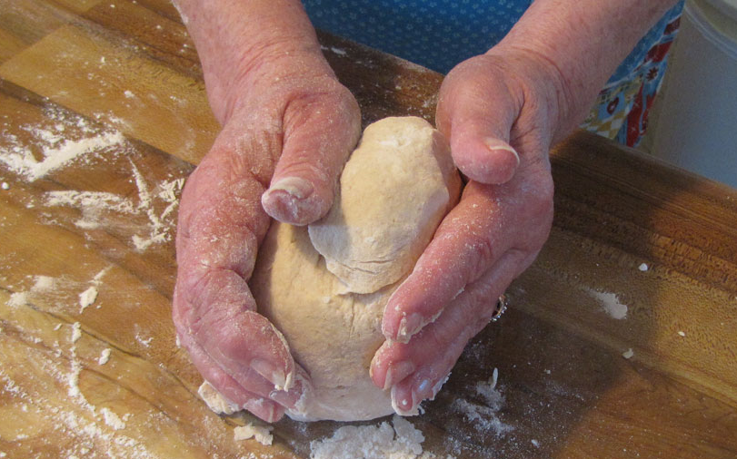

Another Analogy
Three-Dimensional Learning is like making a really great meal.
The cooking techniques are the practices.
The main ingredients are the core ideas.
The herbs and spices are the crosscutting concepts.
Notes:
Talking Points
Let’s continue thinking about Three-Dimensional Learning metaphorically for a minute.
As stated by Joe Krajcik, “To use the EQuIP rubric, you first need a solid understanding of the disciplinary core ideas, science and engineering practices, and crosscutting concepts, each of which is described in detail in the Framework. Understanding each of these dimensions is essential, but real transformation comes with understanding how these dimensions blend and work together; this is the critical and perhaps most important shift in the NGSS. The EQuIP rubric refers to this blending of DCIs, practices and CCCS as three-dimensional learning” (http://nstacommunities.org/blog/2014/04/25/equip/).
Borrowing an idea from Ted Willard at NSTA, Joe often compares three-dimensional learning to making a really good meal.
As Joe says so well, “Think of knowing how to do various techniques in the kitchen like kneading bread, cutting tomatoes, beating an egg, frying or roasting, and so forth as the practices. You could know how to do all of these things and still not be able to prepare a really good meal. Just as students could be skilled in various practices and not be able to gain content knowledge if the practice was done in isolation.”
“Now think of picking out really good ingredients for the meal. You want to pick out a high-quality piece of fish or poultry or excellent pasta for the meal. These are your core ideas. A disciplinary core idea is essential to explaining a number of phenomena. Your main ingredient is essential to the meal. But just as the DCI works with practices to make sense of phenomena and design solutions, you need to know how to cook that main ingredient. But something is still missing. The meal tastes bland. What is missing?
“To make a really good meal, we need to use spices and herbs to enhance the flavor of the main ingredients. The crosscutting concepts enhances our understanding of the core ideas.”
“Similarly, to really make sense of phenomena and to design solutions all three dimensions are necessary. To make a really wonderful meal, good main ingredients are necessary, but you need to know how to use various techniques to prepare them, and you must have the species and herbs to enhance the flavors. All three work and blend together to make a great meal. Similarly, to foster three-dimensional learning where all learners can make sense of phenomena and design solutions, all three dimensions need to work and blend together” (http://nstacommunities.org/blog/2014/04/25/equip/).
Furthermore, when you learn various techniques for one type of ingredient, those techniques can be used more skillfully as you approach different ingredients. In the same manner, when you enhance a meal with spices and herbs, you learn how to enhance more and more ingredients with those seasonings. Thus, with each experience, we can more fully develop our overall knowledge.

Slide 11
Create Your Own Analogy
Three-Dimensional Learning is like ____________:
Where _______________ are the Practices;
_______________ are the Core Ideas; and
_______________ are the Crosscutting Concepts.
Notes:
Facilitator Notes
Individual Task:
Allow 5 minutes for individuals to create an analogy.
Use Workbook: Participants have been provided with a template.
Whole Group Task:
Have participants share their analogies.
Use Talk Moves to elicit participants reactions and responses from other participants.
Talking Points
Now, take a few minutes and create your own analogy for three-dimensional learning.
Let’s share the analogies with the entire group.

Slide 12
MS. Waves and Their Applications in Technologies for Information Transfer
Students who demonstrate understanding can:
MS-PS4-2. Develop and use a model to describe that waves are reflected, absorbed, or transmitted through various materials. [Clarification Statement: Emphasis is on both light and mechanical waves. Examples of models could include drawings, simulations, and written descriptions.] [Assessment Boundary: Assessment is limited to qualitative applications pertaining to light and mechanical waves.]
Scientific & Engineering Practices
Disciplinary Core Ideas
Crosscutting Concepts
Developing and Using Models Modeling in 6–8 builds on K–5 and progresses to developing, using, and revising models to describe, test, and predict more abstract phenomena and design systems.
Develop and use a model to describe phenomena
PS4.B: Electromagnetic Radiation
When light shines on an object, it is reflected, absorbed, or transmitted through the object, depending on the object’s material and the frequency (color) of the light.
Structure and Function
Structures can be designed to serve particular functions by taking into account properties of different materials, and how materials can be shaped and used.
Notes:
Facilitator Notes
Use Talk Moves to elicit participants reactions and responses from other participants.
Talking Points
Thinking back to Session Two, three-dimensional learning will be required in order for students to demonstrate the understanding demanded by the Performance Expectations.
So, let’s analyze a Performance Expectation in order to see how three-dimensional learning provides the essential structure for a Performance Expectation.
First, let’s look at the actual expectation [Facilitator: Click for slide animation.]: “Students who demonstrate understanding can . . . Develop and use a model to describe that waves are reflected, absorbed, or transmitted through various materials.” MS-PS4-2.
Being able to do this, however, requires students to incorporate practices, disciplinary core ideas, and crosscutting concepts.
[Facilitator: Click for slide animation.] So, in order to meet this Performance Expectation, students are required to incorporate the specific science and engineering practices of “developing and using models to describe phenomena.”
In addition, students must incorporate disciplinary core ideas. [Facilitator: Click for slide animation.] This Performance Expectation specifies one disciplinary core idea from physical science: when light shines on an object, it is reflected, absorbed, or transmitted through the object, depending on the object’s material and the frequency (color) of the light.” What are these two core ideas? [Solicit responses from participants. Refer them to the handout if necessary.]
Finally, to meet this Performance Expectation, students will need to incorporate the crosscutting concept of structure and function. [Facilitator: Click for slide animation.]
You can see, then, how for all Performance Expectations, the whole is truly greater than the sum of its parts.

Slide 13

Engaging in Three-Dimensional Learning
Practices
Core Ideas
Crosscutting Concepts
Notes:
Facilitator Notes
Individual Task:
Allow 3 minutes for individuals to compare their three-dimensional learning experience from today with previous learning experiences.
Use Workbook: Participants have been provided with a template.
Small Group Task:
Allow 5 minutes for small groups to discuss their comparisons.
Whole Group Task:
Have participants share examples of three-dimensional learning from their experiences
Conduct a Consensus Discussion. Recall that consensus discussion does not mean the group needs to agree on everything. Instead, this is a discussion to determine what consensus exists at this point.
Use Talk Moves to elicit participants reactions and responses.
Scribe (or ask for a volunteer scribe) points of agreement on poster.
Talking Points
Now, let’s consider how this looks in an actual classroom. Consider the lesson you experience at the onset of our professional development, note how and where you saw yourself as students engaged in three-dimensional learning.
What did that look like?
How did the practices, disciplinary core ideas, and crosscutting concepts work together so that students could make sense of phenomena and/or design solutions to problems?
How was this different than other experiences in the classroom?
Have you seen other experiences like this in a classroom? If they were close, how could they be modified to reach three-dimensional learning?
Take about 3 minutes to reflect on the lessons or unit you’ve experienced where practices, core ideas, and crosscutting concepts have worked together for effective learning to occur. Again, this does not mean that students passively receive content, and then apply it, or that there is an implicit crosscutting concept that does not support student learning. Rather all three dimensions work together.
[After about 3 minutes, ask participants to take an additional 5 minutes to share and compare at their tables.]
[Then ask two or three table groups to provide examples of three-dimensional learning from their experiences.]
[Then ask participants to share in a consensus discussion. Record the groups thoughts on a poster paper labeled Three-Dimensional Learning.]

Slide 14
Session 4 Reflection
How is “THREE-DIMENTIONAL LEARNING” both the biggest and the most essential shift in the NGSS?
What does “THREE-DIMENTIONAL LEARNING” look like in lessons and/or units in science classrooms?
Notes:
Facilitator Notes
Individual Task:
Allow 5 minutes for individuals to reflect
Use Workbook: Participants have been provided with reflection page.
Talking Points
At your tables, quickly review two essential questions from Session 4 to ensure your understanding before going on to Session 5.
Identify and be prepared to ask any clarifying questions you still have when we revisit our Driving Question Board.
[Allow approximately 5 minutes, and then address any remaining questions. If it is apparent that participants are still having trouble clearly understanding three-dimensional learning, do not move on until they have reached this understanding.]
Now that we have had time to reflect, let’s revisit our consensus poster on Three-Dimensional Learning from Session 2. Is there anything we would like to add, change, remove, etc.?

Slide 15
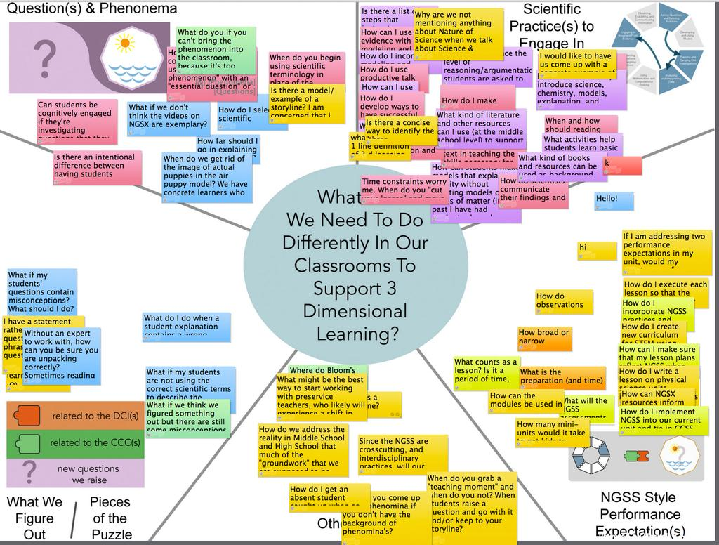
Revisiting Our Driving Question Board
Notes:
Facilitator Notes
Whole Group Task:
Revisit the DQB.
Use Talk Moves to elicit participants reactions and responses.
Talking Points
At this point, we are going to revisit the Driving Question Board. [Facilitator: click to animate]
Are any of the questions that you placed on the board answered at this point in our professional development?
Similar to the students, what artifact could we attach to the question?

Slide 16
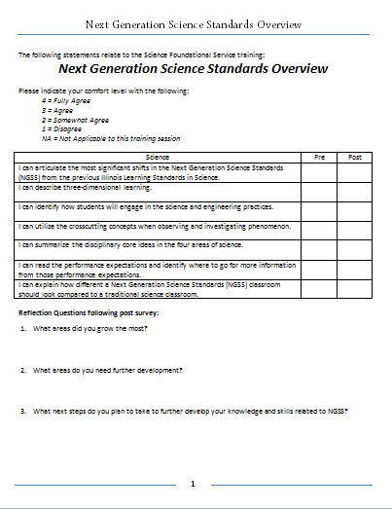
Pre & Post
Survey
Please take a moment to complete the Post portion of the Pre and Post Survey for NGSS Science Overview Training.
Use the 1 to 4 rating scale described on the survey.
Answer the reflection questions on the bottom of the page as well

