Slide 1
AC Materials for reference
Full document of Writing To Read
https://www.carnegie.org/media/filer_public/9d/e2/9de20604-a055-42da-bc00-77da949b29d7/ccny_report_2010_writing.pdf
Full document of Why Teach Spelling
http://centeroninstruction.org/why-teach-spelling

Slide 2
Materials for presentation
Handouts:
Pretest/Postest
*Literacy is Critical
Writing to Read Synopsis
Slide 18 & 20
Explicit Instruct./Scaffolding Guide
Summarize/Note Taking Booklet
Tulare Grade Level Standards
Guide to Creating Text Dependent Questions
*Modeling Creating Questions Handout (Mary Celeste)
Tools for Learning Handout (Text Structure – Sue Beers)
*Why Teach Spelling
Toolbox for Routine Writing Handout
Instructional Writing Time Pamphlet
*Guidance for Writing Scope and Sequence (Grade Level Documents)
Task/Lesson Planning Template (K-2 available as well)
Task Activity Focus Handout
Grade level texts (ReadWorks, Newsela, etc..)
PRC Access Handout
*Model Content Frameworks by grade level (Located at isbe.net, ELA, PLS level 2)
*Optional

Slide 3
Writing to Read
2016 ELA Foundation Services
Notes:
Welcome and introductions

Slide 4
Agenda
Discover Writing To Read Recommendations & Instructional Practice Strategies
Identify PARCC Task Connections
Design Classroom Tasks Align to Writing to Read and PARCC That Assist in Teaching the Standards

Slide 5
Outcomes (Pre)
Articulate the three recommended writing practices to enhance students’ reading.
Identify strategies aligned with each recommended practice.
Identify components of the recommended practices that match PARCC writing tasks.
Compose a classroom task that aligns with the Writing to Read research, standards and PARCC expectations.
Locate resources to help with implementation of “writing to read” practices.
Notes:
Distribute pre/post assessment and allow participants to fill out the pre portion of the assessment. As a presenter, walk around the room to get a sense of where the participants rank themselves so you know which parts of the presentation to emphasize or on which to spend more/less time base on participant ranking.

Slide 6
Learning Forward Standards
Implementation: Professional learning that increases educator effectiveness and results for all students applies research on change and sustains support for implementation of professional learning for long-term change.
Resources: Professional learning that increases educator
effectiveness and results for all students requires
prioritizing, monitoring, and coordinating resources for
educator learning.
Notes:
Address the Learning Forward Outcomes: http://learningforward.org/docs/pdf/standardsreferenceguide.pdf
The Learning Forward standards (adopted by IL) outline the characteristics of effective professional learning. The standards are drawn from research and based on evidence-based practice. They describe a set of expectations for effective professional learning to ensure equity and excellence in educator learning. The standards serve as indicators that guide the learning, facilitation, implementation, and evaluation of professional learning.

Slide 7
ELA Work & Foundation Services
2012-2013—Created Reading Strategies*
2013-2014 – Shift Kits/EQuIP
2014-2015 – Writing Matters
2015-2016 – Writing to Read
*Not part of Foundation Services
Notes:
This slide provides an overview of the ELA Content Specialists’ work and Foundation Services since 2012. The standards have all been at the heart of our work. The reading standards are located at http://www.isbe.net/common_core/htmls/resources.htm
Click on ELA Resources. Some of the resources you will receive today (Summarizing and Note Taking Document and Toolbox for Routine Writing) have some of these reading strategies in it.

Slide 8
Cause for Concern
Over half of adults scoring at the lowest literacy levels are dropouts (National Center for Educational Statistics, 2005).
Only one out of three students is a proficient reader (Lee,Grigg and Donahue, 2007).
Only one out of four twelfth-graders is a proficient writer (Salahu-Din, Persky, and Miller, 2008).
Three out of ten high school students do not graduate on time (Gewertz, 2009).
One out of every five college freshman must take a remedial reading course (SREB, 2006).
Nearly one third of high school graduates are not ready for college-level English composition courses (SREB, 2006).
Forty percent of high school graduates lack the literacy skills employers seek(National Governors Association, 2005).
Lack of basic skills costs universities and businesses as much as $16 billion annually (Greene,2000).
Poor writing skills cost businesses $3.1 billion annually (National Commission on Writing, 2004).
Notes:
Notes:
(Optional Handout: Literacy is Critical to Success – taken directly from p.7 of Writing to Read)
Before the standards were even created and continuing through today, results from assessments have made it clear that our nation’s students are still struggling at a basic level with literacy.
Click through each statistic noted in the Writing to Read report.
Additional Information:
The National Commission on Writing also addresses this concern. They say, “If students are to make knowledge their own, they must struggle with the details, wrestle with the facts, and rework raw information and dimly understood concepts into language they can communicate to someone else. In short, if students are to learn, they must write.” This quote is on slide 98.

Slide 9
Because of these staggering statistics, it was necessary for Illinois to…
Adopt higher level, grade specific standards…
that focus on reading and writing in all content areas…
and then to identify research based strategies to use in the classroom.
Notes:
Notes:
“It was necessary for states to adopt standards that help teachers focus instruction on complex reading and writing practices in all subjects so students will be better prepared for college and/or career. These standards are in alignment to what research says works.
Today we will focus on what one particular piece of research suggests for our classrooms…..

Slide 10
Writing to Read
Evidence for How Writing
Can Improve Reading
A Report from Carnegie Corporation of New York
2010
Steve Graham and Michael Hebert: Vanderbilt University
Notes:
Handout – Full Writing to Read Report for ACs or Synopsis of Writing to Read for SPs
(Optional) Participants may wish to have a few minutes to scan the report prior to engaging more with the rest of the presentation.
Notes:
Read slide.
The following information gives background information on the report as well as additional information on why this report is so important to schools/districts.
From Writing to Read Forward – page 2 by Vartan Gregorian – President, Carnegie Corporation of New York
Writing to Read builds on Writing Next by providing evidence for how writing can improve reading. As both reports warn, American students today are not meeting even basic literacy standards and their teachers are often at a loss for how to help them. In an age overwhelmed by information, we are told, for example, that all available information doubles every two to three years, we should view this as a crisis, because the ability to read, comprehend and write – in other words, to organize information into knowledge, can be viewed as tantamount as a survival skill.. Why? Because in the decades ahead, Americans face yet another challenge: how to keep our democracy and our society from being divided not only between rich and poor, but also between those who have access to information and knowledge, and thus power to achieve upward mobility, and the power over their own lives, and their families’ ability to thrive and succeed and those who do not.

Slide 11
Optional Activity
http://centeroninstruction.org/files/Synopsis%20Writing%20to%20Read.pdf
Notes:
Allow participants time to review the synopsis information.

Slide 12
Meta-analysis
1) Does writing about material read enhance
students’ comprehension of the text?
2) Does teaching writing strengthen students’
reading skills?
3) Does increasing how much students write
improve how well they read?
Notes:
Notes:
The Writing to Read report comprehensively summarizes high-quality research using the powerful statistical method of meta-analysis. Meta-analysis is a statistical technique for integrating, summarizing and interpreting sets of empirical research that involve quantitative measures. In this report, meta-analysis was used to investigate the effectiveness of writing about the text, the effectiveness of the teaching of writing, and the effectiveness of having students write more. (p. 9)
This allows researchers to determine the consistency and strength of the effects of an instructional practice, and to highlight practices holding the most promise.
A meta-analysis was performed to answer three basic questions about the impacts of writing on reading
1)Does writing about material read enhance students’ comprehension of the text?
2)Does teaching writing strengthen students’ reading skills?
3) Does increasing how much students write improve how well they read? (pg. 4 – Executive Summary, “Writing to Read”)

Slide 13
https://www.youtube.com/watch?v=uavRS3hJwIU&index=10&list=PLLxDwKxHx1yJr3yJBP0TqCEW9h4alf3Ga
Notes:
Notes:
Have participants watch this 1 minute video clip from one of the Writing to Read authors, Steve Graham.

Slide 14
The Evidence is Clear
Writing can be a vehicle for improving reading.
Art
Math
In particular, having students write about a text they are reading enhances how well they comprehend it.
Science
Literature
Government
Psychology
Notes:
Note:
As Steve Graham mentioned in the previous video, almost every subject requires that you read something. Writing is a powerful tool to think about what you read. The research provides instructional practices that help students do just that.
This result is consistent with the finding from Writing Next that writing about science, math, and other types of information promotes students’ learning of the material. In addition, teaching writing not only improves how well students write, as demonstrated in Writing Next; it also enhances students’ ability to read a text accurately, fluently, and with comprehension. (pg. 6)

Slide 15
Scientific Studies
ES = Effect Size: An effect size reports the average difference between one type of instruction and a control condition. It indicates the strength of the effect.
ES of 0.80 is a large or strong effect
ES of 0.50 is a medium or moderate effect
ES of 0.20 is a small or mild effect
Notes:
Notes:
Have participants review slide.
Explain that when we look at scientific research, it’s important that we understand how effect size works. Explain this slide using the graphics to help the participants understand what is considered a large or a small effect size. (pg. 9-12 of Writing to Read)
Additional Note:
The recommendations from this report are in no way meant to detract from the significant contributions that other types of research make to the understanding of the effects of writing on reading.

Slide 16
Translation
“Research shows an effect size of between .4 and .7 is the equivalent of going from the 50th percentile to the 65th percentile.”
(Black & Wiliam, 1998)
Notes:
Notes:
It is important to note that we do not want to minimize the moderate or even small effect size because they are both worthy of acknowledgement. They both make gains. The recommendations do improve student growth both in reading and writing.

Slide 17
3 Core Writing Recommendations That Will Enhance Students’ Reading
Have students write about the texts they read.
Teach students the writing skills and processes that go into creating text.
3. Increase how much students write.
Notes:
Notes:
The Writing to Read report address 3 core writing recommendations that will enhance students’ reading. Read the 3 recommendations.

Slide 18
Notes:
SLIDE 18 and 20 are also HANDOUTS.
Notes:
The recommendations and instructional practices are taken from page 5 of the Writing to Read report and on pg 2-3 in the synopsis. In today’s training, we will get through each one of the recommendations and strategies to help meet those recommendations. These are highlighted from the previous slide.
Additional Notes:
Writing to Read does not identify ALL the ways that writing can enhance reading any more than Writing Next identified all of the possible ways to improve students’ writing. However, all of the Writing to Read instructional recommendations have shown clear results for improving students’ reading.
The strategies shared on the slides in this presentation are specifically from the report. We also share several other strategies that support the research.

Slide 19
Activity
Notes:
Activity: (Should be done while sharing previous slide)
Each participant will mark the effect sizes on their own papers: a line at the .80, a line at .50 and a line at .20. Participants should mark a thick line at the .80, a moderate line at the .50 and a thin line at .20. The thick line represents a large effect size, the medium a medium effect size and the thin line a small or mild effect size.
Participants should TURN AND TALK and discuss which items seem to dictate to be the most effective. They should also note where the research mentions elementary, middle/high school….. Reveal the lines after activity is over.
Ask these questions: Do you note which findings are the most effective? Does .20 mean that it is not effective?

Slide 20
Notes:
HANDOUT: Writing to Read Effect Sizes with Confidence Intervals - Slide 20
Materials: Writing Utensil
Notes:
This slide is taken from page 12 of the Writing to Read report.
Activity:
Each participant will mark the effect sizes on their own papers: a line at the .80, a line at .50 and a line at .20. Participants should mark a thick line at the .80, a moderate line at the .50 and a thin line at .20. The thick line represents a large effect size, the medium a medium effect size and the thin line a small or mild effect size.
Participants should TURN AND TALK and discuss which items seem to dictate to be the most effective. They should also note where the research mentions elementary, middle/high school….. Reveal the lines after activity is over.
Ask these questions: Do you note which findings are the most effective? Does .20 mean that it is not effective?
Additional Note: Some findings are from norm referenced tests and some are not – see bottom of the slide.

Slide 21
Notes:
Note:
Let’s start with Recommendation #1.

Slide 22
Recommendation #1
Have students write about the text they read.
Students’ comprehension of science, social studies, and language arts texts is improved when they write about what they read.
Notes:
Notes:
This is recommendation 1. In today’s training, we will get through each one of the recommendations, present strategies to help meet those recommendations and show how our New Illinois Learning Standards (NILS) connect to each one.
Additional Notes:
The evidence shows that having students write about what they read does enhance their reading, abilities. In fact, fifty-seven out of sixty-one outcomes (93 percent) were positive, indicating a consistent and positive effect for writing about what they read. (Those participating in the research were in grades 2-12) with the majority in middle and high school. These positive effects were evident when students wrote about text in science and social studies as well as in English.

Slide 23
Notes:
Notes:
The first instructional practice is to respond to a text in writing by writing personal reactions AND/OR analyzing and interpreting text. Ask participants to determine the effect size of this instructional practice.
Reminder:
Even when the practices are used together, they do not constitute a full curriculum. The writing practices described in this report should be used by educators in a flexible and thoughtful way to support students’ learning. (pg. 5)

Slide 24
Writing About Text Proved to Be Better Than Just…
Reading It
Reading and Discussing It
Reading and Rereading It
Receiving Reading Instruction
Reading and Studying It
Notes:
Notes:
Share slide.

Slide 25
Writing about a text…
Each of these skills targets the heart of the standards
“Enhances comprehension because it provides students with a tool for visibly and permanently
recording,
connecting,
analyzing,
personalizing, and
manipulating key ideas in text.”
Notes:
Notes:
This slide reminds participants how writing about a text enhances comprehension by noting the skills required when doing just that.
Our grade specific standards provide specific guidance on what students should be doing when reading and writing.

Slide 26
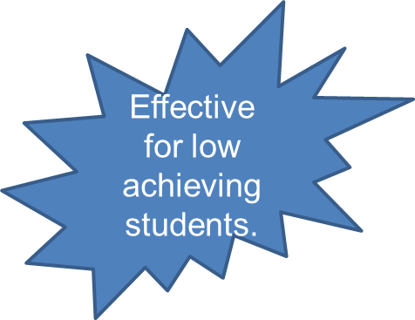
If coupled with EXPLICIT INSTRUCTION
Instructional Practice
Respond to a Text in Writing
(Writing Personal Reactions that Analyze and Interpret the Text)
Notes:
Notes:
Writing a response involves either
1. A personal reaction to the text or analysis and interpretation of it. The personal reaction includes writing a personal response to narrative material read OR writing about a personal experience related to it.
2. ANALYSIS and INTERPRETATION activities, in contrast, focus on writing analysis of the characters in a novel, writing a paper showing how to apply material that was read, composing a letter to another student explaining how to play a game described in a text, and analyzing a text in writing to develop a particular point of view.
Additional Research Support:
Newer and better understandings of textual material are likely to occur when students write about text in extended ways involving analysis, interpretation, or personalization. (Langer and Applebee, 1987).
HANDOUT: Give out with 2nd click. Explicit Instruction/Scaffolding Guide
Writing about reading texts was also an effective activity for lower-achieving students. The important thing to note is that it is only effective with low achieving students when they were explicitly taught strategies for writing about what they read. Explicit instruction is an important ingredient in the successful teaching of literacy practices.
“EXPLICIT INSTRUCTION is characterized by a series of supports or scaffolds, whereby students are guided through the learning process with clear statements about the purpose and rationale for learning the new skill, clear explanations and demonstrations of the instructional target, and supported practice with feedback until independent mastery has been achieved.” (Anita Archer and Charles Hughes, 2011). Rosenshine (1987) described this form of instruction as “a systematic method of teaching with emphasis on proceeding in small steps, checking for student understanding, and achieving active and successful participation by all students”

Slide 27
Optional Activity
Notes:
Optional Activity –– If time allows give participants time to read through the 16 Elements of Explicit Instruction listed on the Explicit Instruction handout.
One idea:
1. highlight in yellow what elements you do well
2. highlight in green what you need to improve, and
3. circle the one you will start working to improve.

Slide 28
Notes:
Note:
The 2nd instructional practice is to “Write Summaries of a Text”.
Ask participants to determine the effect size of this instructional practice.

Slide 29
Summarizing Text Proved to Be Better Than Just…
Simply Reading the Text
Reading and Rereading the Text
Reading and Studying the Text
Notes:
Notes:
The Writing to Read” report states that….”summarization instruction improves both writing quality and reading comprehension.”
Have participants read silently as animation brings in each practice that summarizing proves better than.

Slide 30
Instructional Practice
Write Summaries of a Text
Readers must recognize:
which ideas are indispensable to the original text.
which ones can be dropped altogether or combined.
the need for paraphrasing the text using their own words.
Notes:
Notes:
Share slide aloud or have participants read silently.
Add “If we want students to learn and remember specific information, what should we have them do? (Read and write summaries of the information they need to learn.” (pg. 15 of Writing to Read)
Additional Notes:
What is summarizing? Summarizing is how we take larger selections of text and reduce them to their bare essentials: the gist, the key ideas, the main points that are worth noting and remembering. Webster's calls a summary the "general idea in brief form"; it's the distillation, condensation, or reduction of a larger work into its primary notions.
What do we do when we summarize? We strip away the extra verbiage and extraneous examples. We focus on the heart of the matter. We try to find the key words and phrases that, when uttered later, still manage to capture the gist of what we've read. We are trying to capture the main ideas and the crucial details necessary for supporting them.
Optional Information About Summaries from pg. 15 of the Report:
For students in grades 3-12, writing summaries about text showed a consistently positive impact on reading comprehension. It significantly improved middle and high school students’ comprehension of text AND it showed an even stronger effect on elementary students’ comprehension.
Transforming a mental summary of text into writing requires additional thought about the essence of the material and the permanence of writing creates an external record of this synopsis that can be readily critiqued and reworked. As a result, summary writing seems likely to improve comprehension of the material being summarized.
Summarization has a large and consistent positive impact on student outcomes on both reading and writing. Across 19 studies with students in grades 3-12, the effect size was .52 showing summary writers at the 70th percentile with others at the 50th percentile

Slide 31
Optional Activity
Notes:
Optional Activity:
Turn and Talk with your neighbor(s) what students have to do in order to write a summary.
Share out making sure participants mention the following:
Reread, pull out important details, group formation, etc.

Slide 32
Summaries
the main points that are worth noting and remembering
What is summarizing?
What do we do when we summarize?
What happens when we
ask students to
summarize?
What do we want students to do when we ask them to summarize?
try to capture the main ideas and the crucial details necessary for supporting them.
they write down
next to nothing
they write way
too much
they write down
everything
they give incomplete sentences
they don't write
enough
they copy word for word
focus on key details
break down the larger ideas
pull out main ideas
use key words and phrases
write only enough to convey the gist
Notes:
HANDOUT:
Refer to HANDOUT (Summarizing and Note Taking Booklet) after going through slide. Tell them that the upcoming strategies and as well as additional ones are included in the booklet.
Notes:
Read aloud as slide is animated to unveil what a summary is, what we do when we summarize, and what usually happens when we ask students to summarize as well as what we want them to do.
What happens when we ask students to summarize?
they write down everything
they write down next to nothing
they give incomplete sentences
they write way too much
they don't write enough
they copy word for word
What do we want students to do when we ask them to summarize?
pull out main ideas
focus on key details
use key words and phrases
break down the larger ideas
write only enough to convey the gist

Slide 33
Optional Activity
Notes:
Optional Activity: Ask participants to look at the table of contents of page 2 of the handout. The 1st 18 pages are dedicated to summarizing strategies that are mentioned in the Writing to Read Report as well as other research-based summarizing strategies. If time allows, have participants choose one strategy to read through and report out to a small group or entire group that might work for their classroom or that they already use. Note: the first few pages have strategies that are specifically for lower grades.

Slide 34
Summarization of Shorter Text
Strategy
Students are directly taught rules for how to write a summary of material read. This can involve teaching them how to write a summary of a paragraph using the following operations:
Identify or select the main information
Delete trivial information
Delete redundant information
Write a short synopsis of the main and supporting information for each paragraph.
(Rinehart, Stahl and Erickson, 1986)
Notes:
Notes:
The strategy on this slide is from page 15 of the Writing to Read Report. It is included in the Summarizing and Note Taking Booklet. (page 8)
In teaching this strategy, the teacher first explains each step and its purposes. Use of the strategy is then modeled, and students practice applying it, receiving teacher help and assistance as needed.

Slide 35
Summarization of Longer Text
The GIST
Students read a brief text
Students write a single-sentence summary of the information (20 words or less)
When students are proficient, the teacher provides more extensive texts that have been marked with stopping points where students stop and write the GIST summaries they have been practicing
When the article is complete, the students combine the brief summaries and craft them into an overall summary
Notes:
Notes:
The strategy on this slide is not in the actual Writing to Read document but a good strategy for summarization. It is included in the Summarizing and Note Taking Booklet. (page 9) (GIST- Generating Interaction between Schemata and Text)
When teaching students how to create a GIST, use familiar text such as the story of Goldilocks and the Three Bears. “Goldilocks tried the Bears’ breakfasts, chairs, and beds, always with the same result: baby’s stuff was just right for her.”

Slide 36
Summarizing a Longer Text
Create a skeleton outline starting with a thesis statement.
Generate main idea subheadings for each section of the text.
Add 2 or 3 important details for each main idea.
Convert outline into a written summary.
(Taylor and Beach, 1984)
Notes:
Notes:
The strategy on this slide is from page 15 of the Writing to Read Report. It is included in the Summarizing and Note Taking Booklet. Participants can refer to page 9 of the booklet for this strategy.

Slide 37
Notes:
Note:
The 3rd instructional practice is to “Write Notes about a Text”.
Ask participants to determine the effect size of this instructional practice.

Slide 38
Writing Notes About Text Proved to Be Better Than Just…
Reading
Reading and Underlining Important Information
Reading and Rereading
Receiving Explicit Instruction In Reading Practices
Reading and Studying
Notes:
Note:
Have participants read silently as animation brings in each practice that writing notes about text proves better than just…
Restate that….”note taking improves both writing quality and reading comprehension.”

Slide 39
Instructional Practice
Write Notes About a Text
Determine most relevant information
Reduce text into transformational ideas (changing into your own words)
Condense ideas into key phrases or words
Notes:
Notes:
The act of writing notes about text material should enhance comprehension (Kiewra, 1989)
This writing practice involves sifting through a text to determine what is most relevant and transforming (changing text into own thought/ideas) and reducing the substance of these ideas into written phrases or key words. Intentionally or unintentionally, note takers organize the abstracted material in some way, connecting one idea to another, while blending new information with their own knowledge, resulting in new understandings of text.

Slide 40
Optional Activity
Notes:
Optional Activity:
Ask participants to share how they were taught to take notes. Ask them to turn and talk about the skills that are needed to model note taking. Share Donna Ogle experience: Donna went to a school district to model KWL charts. She had to MODEL it 19 times before students were able to do it independently. We must take the time to model and continually share the information in order for students to internalize the concepts.

Slide 41
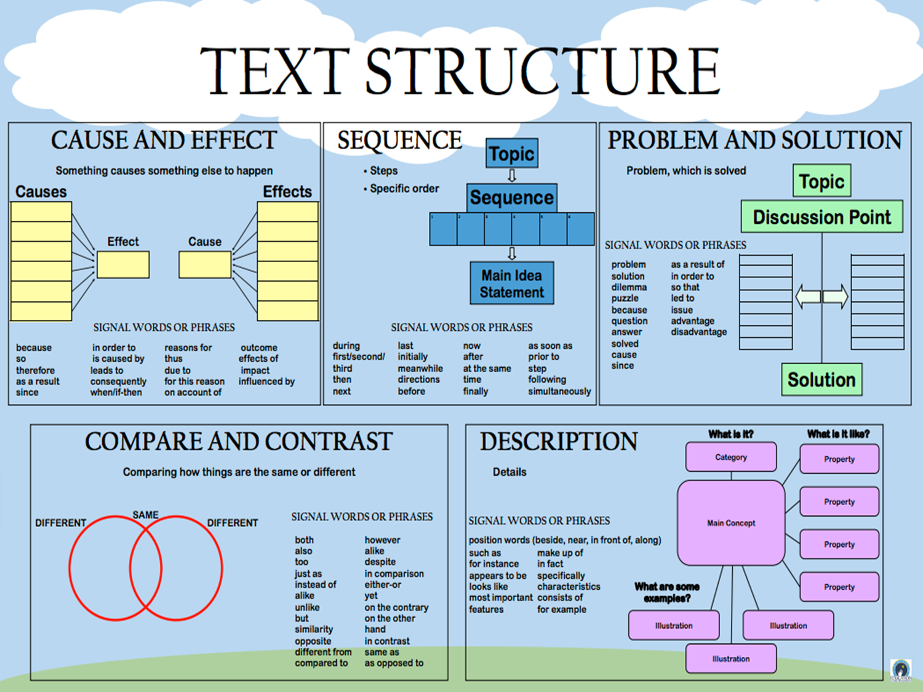
Note Taking
Structured Note Taking
Creating a written organizational structure for material read. (ex. Flow Chart depicting changes in the events of a story over time).
Denner, 1987
Notes:
Notes:
Reference HANDOUT: Summarizing/Note Taking Strategies
The strategy on this slide is from page 16 of the Writing to Read Report. These are 2 mentioned note taking strategies within the report. They are included in the Summarizing and Note Taking Booklet on page 29.
Additional Information about Structured Note Taking
Using graphic organizers specific to a particular text, structured notes assist students in understanding the content of their reading. For example, providing a cause and effect graphic organizer help students to look for causes and effects when reading. As students become better readers, the goal if for them to read and recognize the structure the author has written the text in and then to take notes accordingly.

Slide 42
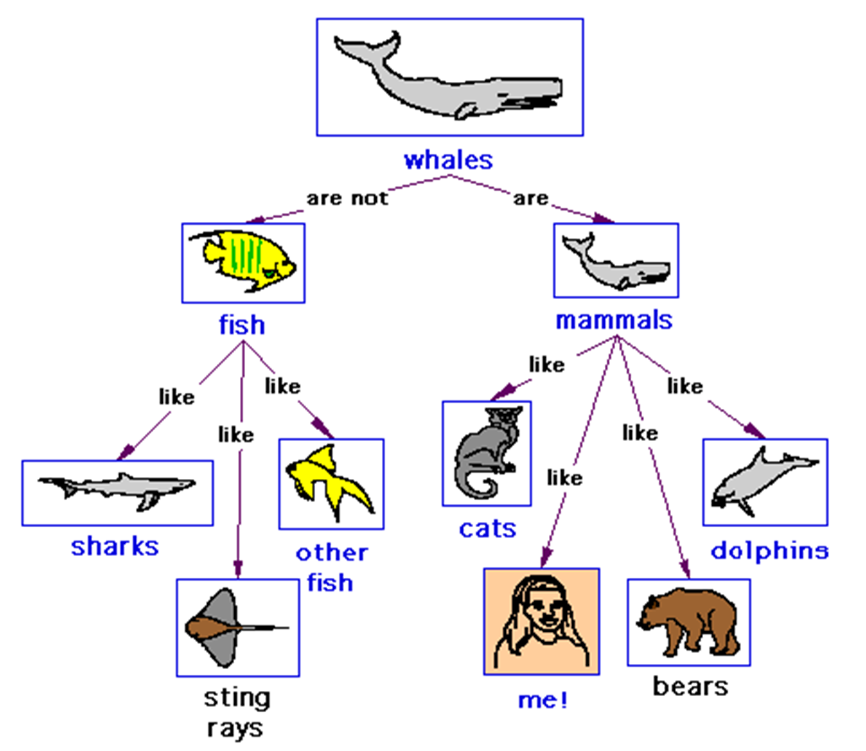
Note Taking
Concept Mapping
Important concepts from the text are placed in a circle and then students show how the concepts link together using words and lines.
(Chang, Chen, and Sung, 2002)
Notes:
Notes:
The strategy on this slide is from page 16 of the Writing to Read Report. These are 2 mentioned note taking strategies within the report. They are included in the Summarizing and Note Taking Booklet, page 21.
Additional Information About Concept Mapping
One way of teaching concept mapping is to first present a model of an expert concept map for a particular reading. After discussing this map, students then practice completing other expert maps that are incomplete, moving from more to less complete maps, until they can create their own map for material read.

Slide 43
Annotating Text
https://www.youtube.com/watch?v=zy45es1HyO0
Notes:
Note:
Good note taking leads to quality summaries. This particular video shows how annotation of a text can help students summarize.
Students can annotate a text to leave tracks of their thinking so they can learn, understand, and remember what they read. During the reading process, the reader marks the text at appropriate points, using words, symbols or cues to keep the reader focused on the text such as main ideas and details.
Pg. 34 of the summarizing/note taking guide has additional ideas on annotation.
Idea:
Place a text, such as the one shared in the video, inside a sheet protector. Students take notes directly on the sheet protector, and then remove the original text so that only the notes are seen on the sheet protector. This forces students to write a summary in their own words.

Slide 44
Optional Activity
Notes:
OPTIONAL ACTIVITY:
Page 36 of the summarizing/note taking booklet mentions tangible items that students can use to take notes. Participants can read through the various items mentioned on pages 36 and 37 as well as brainstorm other items that students might use for note taking.
Basket Idea
One idea is to have items available for participants to create their own basket of kinesthetic tools. Remind participants the key bullet points listed at the top of page 36 when teaching students to use the tools. Share out how they might use these in their classroom.

Slide 45
In order to get students to respond either personally or to analyze or interpret, questions are needed.
Notes:
Notes:
Ask participants to determine the effect size of this instructional practice.
The 4th instructional practice is answering questions about a text in writing (1st click) as well as creating and answering written questions about a text. This naturally pairs with the 1st bullet point about responding to a text in writing. (2nd click – read aloud red box). The combining of the 2 demonstrate to teachers how to create classroom tasks aligned to the standards as well as prepare for PARCC. (We will refer to PARCC Tasks later in the presentation).
Reminder: Even when the practices are used together, they do not constitute a full curriculum. The writing practices described in this report should be used by educators in a flexible and thoughtful way to support students’ learning. (pg. 5)

Slide 46
If coupled with EXPLICIT INSTRUCTION
Instructional Practice
Answering Questions About a Text in Writing
Creating AND Answering Written Questions About a Text
Notes:
Notes:
1. When having students answer questions about a text, the questions should target grade specific standards. If your grade level standards ask students to make an inference, then a question should be targeting inferences. If your grade level standards ask for students to identify vocabulary in context, then questions should target vocabulary, etc…
When having students creating and then answering questions about a text, keep in mind that this must be modeled for students of all grade levels.
EXPLICIT INSTRUCTION is required for low achieving students. (Remind them of the Explicit Instruction and Scaffolding Handout shared earlier.) The information is repeated here about explicit instruction because the Writing To Read research reiterated the information here as well.
Notes About Effect Size:
Writing questions or answers to questions about text has a small but consistently positive effect on reading comprehension for grades 2-12.
Eight studies were reviewed and the average effect size found was 0.40 meaning that students in the control group who were expected to write questions and answers about text scored at the 66th percentile while the other group ended up at only the 50th percentile.

Slide 47
What Should Guide Question Development?
Grade level reading standards
They provide useful guidance for appropriate questions to frame writing responses to text.
Asking higher level questions
They push readers to think
deeply about the texts.
Notes:
HANDOUTS:
Tulare Grade Level Standards
SAP Guide to Creating Text Dependent Questions
Notes:
(Tulare) After reading through the slide, have participants locate their grade specific standards packet from the Tulare Office of Education.
Ask participants to note what on these documents might be helpful to them when creating questions or how they may use them in their school/district. Share out. Grade level standards provide the higher level thinking questions we want to target.
(TDQ Handout)
When creating questions, use the guidelines found in the “Guide to Creating Text Dependent Questions” from Student Achievement Partners.

Slide 48
Questioning
Strategy
Answering Questions in Writing
Generating Questions in Writing
Students create written questions about text. For instance, students are taught the difference between a good question and a bad question, and then practice generating and answering their own questions about text.
If they cannot answer a question, they generate a new one that can be answered.
Writing responses to questions inserted into text or presented at the end of a segment of text.
(Peverly and Wood, 2001)
(Cohen, 1983)
Notes:
Notes:
The strategies on this slide are from page 17 of the Writing to Read Report. Read through each one aloud.

Slide 49
Optional Activity
http://www.maryceleste.net/part2.htm
Notes:
Optional Activity
The presenter can model an activity for students to create/generate questions while reading/listening to a text. The handout “Modeling Creating Questions: The Mary Celeste” can be modeled by the presenter or just independently viewed. Feel free to use a different text if it is more accessible/appropriate. (For example: Harris Burdick by Chris Van Allsburg) or any text that is appropriate to grade level/content.
Site for texts that are read aloud by Screen Actors Guild: http://www.storylineonline.net/a-to-z-book-directory/?sort=titleb

Slide 50
Notes:
Note:
Let’s look at recommendation #2.
Ask participants to determine the effect size of this instructional practice.

Slide 51
Recommendation #2
Teach students the writing skills and processes that go into creating text.
Students’ reading skills and comprehension are improved by learning the skills and processes that go into creating texts.
Notes:
Notes:
The 2nd recommendation noted on the Writing to Read report is to teach students the writing skills and processes that go into creating text. Pg.17
While writing and reading are not identical skills, both rely on common processes and knowledge (Fitzgerald and Shanahan, 2000). Evidence shows that writing instruction does in fact strengthen a variety of reading skills.
Students reading skills and comprehension are improved by learning the skills and processes that go into creating text. The following slides list the skills and processes suggested.
Reminder:
Even when the practices are used together, they do not constitute a full curriculum. The writing practices described in this report should be used by educators in a flexible and thoughtful way to support students’ learning. (pg. 5)

Slide 52
Notes:
Notes:
The 1st instructional practice in teaching students the writing skills and processes that go into creating texts has many components.
Ask participants to determine the effect size of this instructional practice.

Slide 53
Instructional Practices
Teach the Process of Writing
Teach Text Structures for Writing
Teach Paragraph or Sentence
Construction Skills
Notes:
Notes:
This instructional practice includes:
process of writing
text structures of writing
paragraph or sentence construction skills
Additional Information:
While writing and reading are not identical skills, both rely on common processes and knowledge (Fitzgerald and Shanahan, 2006). Consequently, educators have long believed that the benefits of writing instruction carry over to improved reading. Our evidence shows that writing instruction does in fact strengthen a variety of reading skills.

Slide 54
The Writing Process
The writing process consists of steps the writer should take when producing written language that conveys meaning.
Retrieved from: www.ilwritingmatters.org , Select Standard 4/5 on each grade level page.
Notes:
Notes:
The writing process consists of steps the writer should take when producing written language that coveys meaning.
Students should have opportunities to
write frequently for real audiences;
engage in cycles of planning (prewriting), drafting, and revising text;
take personal responsibility and ownership of writing projects;
interact and help each other with their writing;
participate in a supportive writing environment; and
receive assistance and instruction as needed (Graham and Perin, 2007b).
Publishing was not mentioned in the writing to read document.
For further information on this, visit the Writing Matters site for the writing process document which can be downloaded or viewed as needed. If time, it might be helpful to take participants to the site to visit to view the resources available to assist with writing.

Slide 55
Text Structures for Writing
Students’ reading skills can also be enhanced by teaching them how to use text structure as an aid for writing text. To illustrate, students are taught the basic elements of persuasion by identifying and discussing them in model essays. They then write their own persuasive texts using these elements, and revise the texts based on feedback from peers and the teacher.
Crowhurst, 1991
K-5 Resource:
http://www.readingrockets.org/article/how-teach-expository-text-structure-facilitate-reading-comprehension
3rd – 12th Resource:
http://www.adlit.org/strategies/23336/
Notes:
Notes:
Have participants read through the slide on how reading skills can be enhanced by teaching them how to use text structure as an aid for writing text.
There is benefit to teaching students the basic elements of the different structures of text by identifying them and discussing them in model essays. Then they can write their own texts using these elements, and revising them based on feedback from peers and the teacher. (Crowhurst, 1991)
The links on the slide provide additional information for participants.

Slide 56
Activity
Notes:
Handout: Text Structures - Tools for Learning by Sue Beers
Have participants peruse through the handout packet. Ask them how these handouts can help students create texts.
Let them know that a simple way to introduce each text structure is to have students use signal words and a template/frame/graphic organizer (found in handout) to create different text structures or to summarize a text passage using the graphic organizer as a planning template. The hope is over time that students are able to create their own text structure examples and revise first drafts using other signal words.

Slide 57
Paragraph or Sentence Construction Skills
Teaching students how to write more sophisticated sentences by learning how to combine less complex sentences into more complex ones, requires modeling and strategy instruction.
Notes:
Notes:
Have participants read through the slide.
Teaching patterns for constructing sentences or larger units of text should improve reading skills. The practice of putting smaller units of writing together to create more complex ones should result in greater skill, to understanding such units in reading (Neville and Searls, 1991) (pg. 18) This is the premise for the strategy found on the next slide.

Slide 58
Sentence Combining
Teacher models how to
combine simpler sentences into more complex ones.
Students practice
combining similar sentences.
(Hunt and O’Donnell, 1970)
Notes:
Notes:
This strategy is found on pg. 20 of the Writing to Read report. Have participants read the slide.

Slide 59
Optional Activity
Notes:
Optional Activity
Say: “An interesting twist on this approach is to have students combine sentences in material they are reading or disassemble such sentences.”
Have participants look at the following website (Intervention Central) for additional information examples and classroom ideas.
http://www.interventioncentral.org/academic-interventions/writing/sentence-combining-teaching-rules-sentence-structure-doing

Slide 60
Sentence Combining
Combining sentences encourages a writer to take two or more short, choppy sentences and combine them into one effective sentence.
http://www.readingrockets.org/strategies/sentence_combining
Notes:
Notes:
By learning this skill, students enhance their writing style. Sentence combining skills can be developed over several short practice sessions and should be considered as one component of an overall writing program.

Slide 61
Activity
Notes:
Choose which grade level will be presented—K-5 or 6-12…hide the slide that will not be used and continue activity directions.
Activity:
Have partners write down the first few words of each sentence. 2. Rewrite the paragraph combining sentences. 3. Share.
First words of each sentence:
I went
I went
I went
My friends
We rode
I rode
Roy brought
We played
We played
We were
We were
Connie and Roy’s mom
We ate
We had

Slide 62
K-5 Partner Activity
I went to the park. I went on Saturday. I went with my friends. My friends are Marie, Connie, and Roy. We rode our bikes. I rode my new bike. Roy brought his basketball. We played basketball. We played for two hours. We were hot. We were thirsty. Connie and Roy’s mom brought us lemonade and sandwiches. We ate them for lunch. We had a lot of fun.
Notes:
Notes:
Have participants read the paragraph. Ask what is wrong with the text. (sentences are short – start the same – boring). Tell participant that one strategy for identifying problems with too many simple sentences can be identified by writing down the first few words of each sentence.
Activity:
Have partners write down the first few words of each sentence. 2. Rewrite the paragraph combining sentences.
3. Share.
First words of each sentence:
I went
I went
I went
My friends
We rode
I rode
Roy brought
We played
We played
We were
We were
Connie and Roy’s mom
We ate
We had

Slide 63
6-12 Partner Activity
The ants were busy.
They were on the ground.
There were big ones.
The big ones were black.
The big ones had shiny bodies.
And there were little ants.
The little ones were dusty.
The little ones were quick.
“The ants were busy on the ground, big black ones with shiny bodies, and little dusty quick ants.”
http://www.ncte.org/library/NCTEFiles/Resources/Journals/CNP/0261-august08/NP0261Sentence.pdf
Notes:
Notes:
This sentence is actually borrowed from John Steinbeck’s The Pearl.
Have participants read the short sentences. Ask what is wrong with the text. (sentences are short – start the same – boring). Tell participants that one strategy for identifying problems with too many simple sentences can be identified by writing down the first few words of each sentence.
Activity:
Have partners write down the first few words of each sentence. 2. Rewrite the paragraph combining sentences. 3. Share, then click to show answer to participants.
Creating cued sentence sets is a little more involved—and a task I generally don’t give to my students. The process isn’t too dissimilar from what I’ve already described:
• Determine what kinds of constructions might be most beneficial for your students to learn.
• Find sentences in their reading that contain those constructions.
• Write these in kernel sentences, like the open-ended example shown previously.
Here’s the difference: these kernel sentences include cues for how to combine them. To create these cued sets,
I follow directions given by Bill Strong in his book Creative Approaches to Sentence Combining (NCTE/ERIC, 1986. p. 25):
Begin with the base clause.
Underline items that should be added or kept.
Put punctuation, added words, or word-endings in parentheses after the sentence in which they should be included.
As an example, the following sentence from The Pearl by John Steinbeck contains an appositive:
“The ants were busy on the ground, big black ones with shiny bodies, and little dusty quick ants” (3).
If I want students to learn to create that structure, I add cues to the kernel sentences, creating this exercise:
The ants were busy.
They were on the ground. (,)
There were big ones.
The big ones were black.
The big ones had shiny bodies. (WITH) (,)
And there were little ants.
The little ones were dusty.
The little ones were quick.

Slide 64
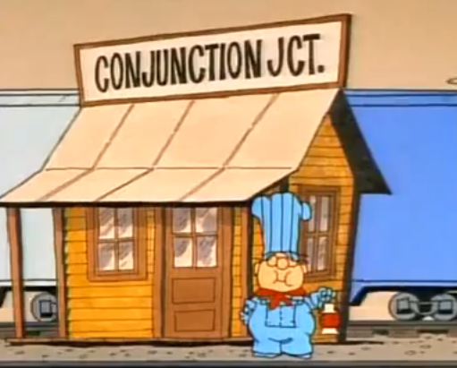
Teaching Sentence Combining
Analyze the use of punctuation and sentence types in a mentor text.
Practice combining sentences with guidance (guided practice)
Analyze sentences in their own writing.
Practice combining sentences in their own writing with guidance and support from peers and adults (try a new approach).
http://www.youtube.com/watch?v=4AyjKgz9tKg
Notes:
Notes:
School House Rock has one song dedicated to combining sentences (with conjunctions).
If time allows, watch the video clip. (3 minutes in length)
Here are some possible video clips for teaching sentence combining.
Conjunction Junction – School House Rock: http://www.youtube.com/watch?v=4AyjKgz9tKg

Slide 65
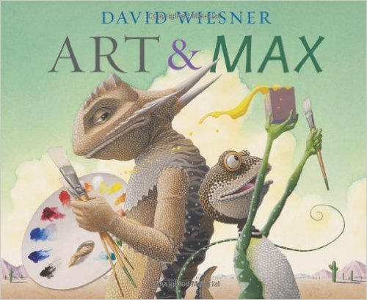
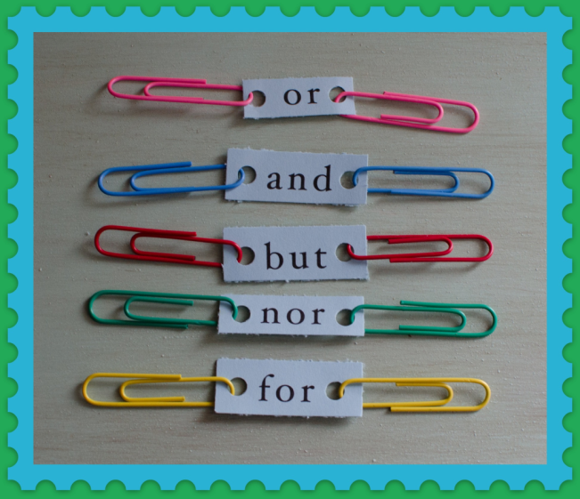
Sentence Combining Resources
http://www.readingrockets.org/strategies/sentence_combining
Notes:
Notes:
Additional strategies and ideas can be found at the site on this slide.
Mentor texts can be utilized to demonstrate how authors crafted sentences. Teachers can select sentences to deconstruct or view how the author combined them. The reading rockets website offers mentor texts that demonstrates sentence crafting.
For the paperclip sentence combining strategy, visit: https://squeeny.wordpress.com/2013/12/30/conjunction-junction/

Slide 66
Notes:
Notes:
The 2nd instructional practice in teaching students the writing skills and processes that go into creating texts is teaching spelling and sentence combining (improving reading fluency).
Ask participants to determine the effect size of this instructional practice.

Slide 67
Instructional Practice
Teach Spelling and Sentence Construction Skills
(Improves Reading Fluency)
Notes:
Notes:
The 2 instructional practices on this slide are beneficial for improving reading fluency.
Spelling
Teaching students how words are spelled provide them with schemata about specific connections between letters and sounds, making it easier for them to identify and remember words in text containing these connections.
Sentence Construction
The practice of putting smaller units of writing together in order to create more complex ones – from letters to words or words to sentences – should result in greater skill in understanding of these units in reading.

Slide 68
Teach Spelling and Sentence Construction Skills (Improves fluency)
Spelling
Sentence Construction
Teaching students how words are spelled provides them with schemata about specific connections between letters and sounds, making it easier for them to identify and remember words in text containing these connections.
The practice of putting smaller units of writing together in order to create more complex ones – from letters or words or words to sentences – should result in greater skill in understanding of these units in reading.
(Ehri, 1987; Moats, 2005/2006)
(Ehri, 2000; Neville and Searls, 1991)
Notes:
Notes:
Participants can read through the 2 strategies on the slide from the Writing to Read report– pg. 19.
Make the connection that the language standards/foundational skills standards include spelling and sentence construction.
(Improves Reading Fluency)
Writing instruction had a strong and consistent impact on improving students’ reading fluency. When we consider the older student in a chemistry class, the morphology of words is even more important to consider when creating schemata and complex connections. For example specific instruction in the word part of geo meaning “relating to the earth” gives students a possible connection when it comes up in other words.

Slide 69
Notes:
Notes:
Make the connection that the language standards/foundational skills standards include spelling.
Ask participants to determine the effect size of this instructional practice.

Slide 70
Instructional Practice
Teach Spelling Skills
(Improves Word Reading Skills)
Notes:
Note:
This is the 3rd instructional practice listed with Recommendation #2.

Slide 71
Teach Spelling Skills (Improves word reading)
Teaching students how to spell makes it easier for them to identify and remember words in text. (Ehri, 1987; Moats, 2005/2006)
Spelling and word reading rely on the same underlying knowledge, and therefore instruction and practice in one should aid development of the other. (Ehri, 2000; Snow, Griffin, and Burns, 2005)
Notes:
Notes:
These examples come straight from the Writing to Read document page 19. Have participants read through or read aloud to them.

Slide 72
Spelling Resources
Florida Center for Reading Research Student Activities
http://www.fcrr.org/curriculum/SCAindex.shtm
Center on Instruction:
Spelling Video
http://centeroninstruction.org/why-teach-spelling
https://vimeo.com/72895477
Notes:
Possible Handout:
The document on the left comes from Center On Instruction – Why Teach Spelling? The link under it takes you to the document.
Florida Center for Reading Research Student Activities:
Utilizing the Florida Center on Reading Research (FCRR) can aid teachers with classrooms strategies/activities to assist with spelling. Go to http://www.fcrr.org/curriculum/SCAindex.shtm and then click on the grade level in the center of the page. This will open up a listing of the activities with their alignment to the standards. Click on the activity and the entire activity will open for classroom use.
Center on Instruction Spelling Video:
The video on this slide is for presenters/participants to view on their own and can be thought of as an optional activity for trainings that want to emphasize spelling. The video is 54 minutes long.
Does spelling have a place in today’s instructional schedule? Deborah K. Reed, author of the Center on Instruction publication Why Teach Spelling? provided the answer to this question in a May 10, 2012 webinar with a brief review of the research about the impact of spelling on reading abilities, spelling development, and approaches to spelling instruction. Then she described tools for evaluating the components of spelling instructional materials and investigating how spelling instruction is addressed in the Common Core State Standards grade-level expectations

Slide 73
Optional Activity
Notes:
Optional Activity
Portions facilitator may wish to print for participants:
Checklist for Evaluating a Spelling program pgs. 36-38 – This can be used for participants to evaluate their current program.
Table of CCSS linked to Spelling pg. 41-49 (K-12) – This can be used for a reminder of what our new standards require us to do in the area of spelling.
Ask students to highlight which statements were most enlightening/hard to employ/using now.

Slide 74
Notes:
Notes:
The final recommendation is to increase how much students write.
Ask participants to determine the effect size of this instructional practice.

Slide 75
Recommendation #3
Increase how much students write.
Students’ reading comprehension is improved by having them increase how often they produce their own texts.
Notes:
Notes:
This slide lists the final recommendation – Increase how much students write. This coordinates with writing standard #10 – we want students writing all the time.
Increasing how much students write does in fact improve how well they read. Students’ reading comprehension is improved by having them increase how often they produce their own texts. Reading and writing are communication activities and writers can gain insights about reading by creating a text for an audience to read, even when the student is the intended audience (Nelson and Calfee, 1998).
The process of creating a text prompts students to be more thoughtful and engaged when reading text produced by others. By writing, students learn to make their assumptions and premised explicit as well as observe the rules of logic when composing a text (Applebee, 1984), making them more aware of such issues in the material they read. Finally writing involves generating meaning by using experience and knowledge to create a text and build relationships among words, sentences, and paragraphs (Wittrock, 1990).

Slide 76
Increasing the Amount of Writing
Notes:
Notes:
HANDOUTS:
INSTRUCTIONAL WRITING TIME PAMPHLET
TOOLBOX FOR ROUTINE WRITING – Additional writing ideas for the classroom.
Activities for increasing the amount of writing in the studies reviewed included writing about self-selected topics or topics chosen in collaboration with peers, setting aside fifteen extra minutes a day for sustained writing, using the Internet to write to pen pals, writing journal entries about daily experiences, interacting with others using a dialogue journal, and writing short passages using inference words. (pg. 20 Writing to Read Report)

Slide 77
Optional Activity
Notes:
Optional Activity Using the “Instructional Writing Time” pamphlet
Have participants read through either page 2 (elementary or page 3 (middle/high) of the writing time pamphlet. Share out what the recommendations mean for their classroom.

Slide 78
Increasing Students’ Writing
Daily Writing About Self-Selected Topics
Pen Palling
Two or more writers dialogue with each other about topics of interest. This can involve a younger student writing to an older student and vice versa.
Allows students to write about any topic of their choice.
(Scheffler, Richmond, Smith, and Draper, 1991)
(Peters, 1991)
Notes:
Notes:
This slide identifies 2 strategies to increase student writing. They can be found on page 20 of the Writing to Read report.

Slide 79
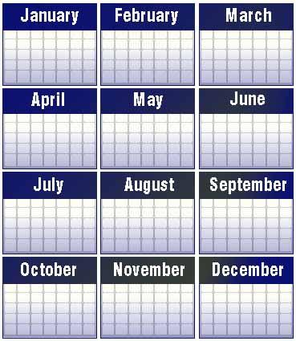
Biggest Enemy
If you can read everything your students write, you’re not assigning enough writing!
Notes:
Notes:
Our schedules are what seem to prevent us from infusing writing as often as needed. The writing time handout given on slide 76 gives guidelines on how much writing should take place each day.

Slide 80
Optional Activity
http://mikeschmoker.com/writemore.html?_sm_au_=iVV4fSDNkr7GFkf6
Notes:
Optional Activity:
Many teachers are concerned with the grading required from assigning writing. The link below is an article from Mike Schmoker about grading practices regarding writing. If participants read the article, have them share the key take-aways.
http://mikeschmoker.com/write-more.html?_sm_au_=iVV4fSDNkr7GFkf6
On page 53 of Teaching Adolescent Writers, Kelly Gallagher explains his philosophy of grading. His philosophy is to grade 1 of every 4 pieces of writing his students create. See the book for more details.

Slide 81
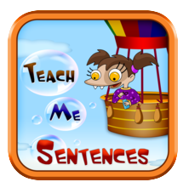
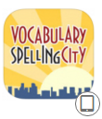
Infuse Technology
iDiary
Lifecard
Postcards*
Tools for Students*
Teach Me Sentences
Vocabulary Spelling City
Corkulous
Make Sentences
Padlet
MaxJournal
Notability*
Notes:
NOTES: (It is not necessary to go through each app and encourage participants to share their favorite digital tools that meet the instructional practices and recommendations discussed today.)
Ask participants what technology tools they use in the classroom. Share out.
Finally, we don’t want to forget that infusing technology with our writing is more engaging but keeping in mind that just like tasks in the classroom, some have more heavy hitting power than others. We want to make sure there is a connected purpose to a task for utilizing tech and that proper modeling has been displayed before turning over to students for independent use.
The apps on this slide have been vetted by Apple Distinguished Educators (ADEs) or by a jury of educator peers at Graphite.com. We strongly urge you to try the apps before recommending them for use.
*Some apps may have a small cost associated with them.
iDiary: (ages 5-13) iDiary for kids has a daily journal at its heart where kids can express themselves periodically writing, drawing, pasting photos. They can easily navigate to their old entries and explore their past musings. iDiary not only allows for typing in entries, but also for drawing or writing on the screen with your finger or a stylus.
MaxJournal (13 and up) Maxjournal is a simple and elegant way to make a daily diary or journal, with extensive photo scrapbooking features. In Maxjournal, you can add up to 30 photos for every journal entry. Photos can be added directly into your text, and positioned and rotated. The text will automatically wrap around your photos with no extra work on your part. Additional photos can be added to your journal sidebar, which is a great place to collect and organize photos that you do not add to your main text.
*Lifecard Postcards: With Lifecards you can use up to 4 of your photos to design your own imaginative postcard directly on your phone. While you edit the card you can freely zoom and pan to get the important details right. You can insert, move, scale, and rotate photos from your photo-album, and you can also insert texts and select font, color, size, and alignment.
*Notability: Notability helps students take notes they'll want to review, revisit, and actively use. If there's a chart in the textbook they want to reference quickly, they can snap a picture and add it to their notes. If a concept is better explained by drawing a picture, they can do it right there, too. On a single page of notes, students can type, write, draw, highlight, record audio, cut, paste, and even insert content captured from websites. When they're finished, students can organize notes for later easy access. Audio recording accessibility as well.
*Tools for Students: App features 25 graphic organizers for students to use to organize their thinking while reading or preparing to write. Covers all common comprehension skills: cause /effect, main idea/detail, sequence events, pro/con, story elements, characterization, word meaning, plot, KWL and much more. Newest app, ReadNRespond has Forms for response to literature.
*Corkulous: (6-12) Free and Paid versions: Corkulous is an app that turns your mobile device into a virtual corkboard that you can use to brainstorm, list, and present ideas, projects, and presentations. Just like on a traditional corkboard, you can organize photos, post-it notes, notecards, and lists.
Teach Me Sentences: (PK-2) Teach me sentences is an exciting interactive game that helps your child reap idly learn to make and complete their own sentences all with just touch of their finger. App is providing a platform to teach your child how to make a sentences, joining sentences, correct sentences.
Make Sentences: This app teaches sentence construction from collection of words. Let your child make a sentence by picking and placing words in correct sequence from given list of scattered words. This app utilizes ABA method of intervention delivery to children with developmental disabilities, special education needs or Autism.
Vocabulary Spelling City: SpellingCity is a word game app designed to help kids learn spelling and improve vocabulary and grammar skills. It's got 10 free sample lists for K­­–12 students that include math and science words, compound words, sound-alike words, analogies, and prefix/suffix words.
Padlet: (6-12) Great for EXIT SLIPS! Padlet (formerly Wallwisher) is a website that allows kids to collect info from the Internet and pin it onto virtual bulletin boards using a simple drag-and-drop system. Videos, text, links, images -- basically anything -- can be added to a board and organized there, like a page full of Post-it notes. Kids can also upload documents they've created, like class notes or completed assignments. More than one person can contribute to a Padlet wall, opening the door to teamwork and group projects.

Slide 82
PARCC Tasks
Notes:
Notes:
1st Click - The Writing to Read instructional practices synchronize with PARCC writing tasks.
2nd Click - PARCC tasks require students to read passages and then respond by answering questions about the text in writing.

Slide 83
PARCCs Multiple Texts
Notes:
Additionally, the PARCC assessment requires students to read/view multiple sources and THEN answer questions and write to a prompt. The standards call for the use of multiple texts in all areas (reading, writing, speaking and listening, and the content areas) as displayed on the next slide.

Slide 84
Where does using multiple texts appear in the Anchor Standards?
ELA
R.CCR.7: Integrate and evaluate content presented in diverse formats and media, including visually and quantitatively, as well as in words.*
R.CCR.9: Analyze how two or more texts address similar themes or topics in order to build knowledge or to compare the approaches the authors take.
R.CCR.10: Read and comprehend complex literary and informational texts independently and proficiently
W.CCR.8: Gather relevant information from multiple print and digital sources, assess the credibility and accuracy of each source, and integrate the information while avoiding plagiarism.
W.CCR.9: Draw evidence from literary or informational texts to support analysis, reflection, and research.
HISTORY
CCSS.ELA-LITERACY.RH.6-8.2 Determine the central ideas or information of a primary or secondary source; provide an accurate summary of the source distinct from prior knowledge or opinions.
CCSS.ELA-LITERACY.RH.6-8.7 integrate visual information (e.g., in charts, graphs, photographs, videos, or maps) with other information in print and digital texts.
CCSS.ELA-LITERACY.RH.6-8.9 Analyze the relationship between a primary and secondary source on the same topic.
SCIENCE
CCSS.ELA-LITERACY.RST.6-8.7 Integrate quantitative or technical information expressed in words in a text with a version of that information expressed visually (e.g., in a flowchart, diagram, model, graph, or table).
CCSS.ELA-LITERACY.RST.6-8.8 Distinguish among facts, reasoned judgment based on research findings, and speculation in a text.
CCSS.ELA-LITERACY.RST.6-8.9 Compare and contrast the information gained from experiments, simulations, video, or multimedia sources with that gained from reading a text on the same topic.
SL.CCR.2 Integrate and evaluate information presented in diverse media and formats, including visually, quantitatively, and orally.
Notes:
Notes:
The PARCC tasks also have students read more than one text about a topic. The ELA Anchor Standards on this slide address what standards require students to read/view more than one source.

Slide 85
Combining ideas and allowing an evolving understanding of text.
Creating original insights, perspectives, and understandings by reflecting on text(s) and merging elements from text(s) and existing schema.
T
E
X
T
S
Y
N
T
H
E
S
I
S
Notes:
Notes:
Writing from multiple sources requires students to synthesize. Synthesizing is the most demanding and elaborate approach to writing about text and it matches with what PARCC requires of our students as well as our standards. A student friendly definition for synthesis is “Put pieces together to see them in a new way.”

Slide 86
Activity
Notes:
ACTIVITY:
Ask participants to determine the literacy skills necessary to synthesize; then share next slide. Complete this in a list form with partners or as a whole group on chart paper.

Slide 87
Skills Needed for Synthesis
The skills needed to synthesize reading materials are the ability to summarize information, paraphrase it, and compare and contrast it. Other necessary skills are the ability to separate fact from opinion, draw inferences based on the facts presented, and evaluate that information to form your own conclusions.
Notes:
Notes:
Have participants read the slide. The red words represent the verbs/skills students are required to do in order to synthesize. Check their list against the red words listed on the slide.
Synthesis is the most complex of the reading strategies. Synthesizing lies on a continuum of evolving thinking. Synthesizing runs the gamut from taking stock of meaning while reading to achieving new insight” (Harvey and Goudvis, 2005). In order to synthesize, students must have teachers model and scaffold synthesizing.

Slide 88
Activity
Notes:
Activity: (this refers to next slide and video link)
Say to participants:
“As you are watching this video take notes of the components mentioned in the video necessary for aligned classroom instruction.” After watching, have participants mention what components were mentioned as well as ones they did not hear about in the video. This activity could also be done as a whole group on chart paper.

Slide 89
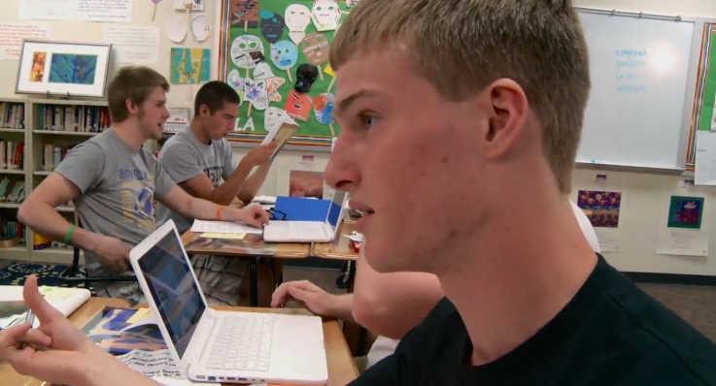
Instructional Practice =
https://www.teachingchannel.org/videos/design-ela-instruction-to-meet-standards-parcc
Notes:
Notes:
Watch this video clip (4 min.) from Teaching Channel which directs teachers to think about the instruction that needs to happen in the classroom to prepare them for the types of tasks they will see on PARCC and to be able to do them INDEPENDENTLY.
Participants should hear that they need quality questions, a complex text(s), opportunities for students to engage with rigorous activities, etc..
Note: The video refers to step #6 which is part of a handout that can be accessed on the Teaching Channel page on the lower right hand side of the screen. A video is available for each step on Teaching Channel.

Slide 90
5th Grade Sample
Texts(s)
Where the Red Fern Grows and “The Lighthouse Lamp” are written from different points of view. Write an essay analyzing the impact of point of view on events in the passage from Where the Red Fern Grows and the impact of point of view on events in the poem, “The Lighthouse Lamp.” Use specific examples from both texts to support your answer.
Task
Questions
Notes:
Notes:
When looking at a PARCC sample, we can identify necessary components that mirror PARCC, BUT it also mirrors what research says we should be doing in the classroom.
Click 1 – Text to be read
Click 2 – Questions about the text
Click 3 – A writing task—this is the engagement piece and synthesis of material.

Slide 91
Optional Activity
Notes:
Additional Note:
Optional Handout/Activity
This optional activity will require the use of the Guidance for Writing Scope and Sequence documents, that assist participants delve into more grade specific resources for PARCC tasks. Show participants where they can access the documents. (ilwritingmatters.org: Choose grade level and the document is at the top of the page).
Ideas are:
IF you provide hard copies of the documents, give participants time to skim their document. After giving them time to skim, have them share out how these documents might help them to plan their writing scope and sequence and classroom lessons/tasks.
IF you provide hard copies of the documents, go through the document together as a whole group (making sure the participants each have their own grade level). Even though each grade level docs are different due to different standards, the documents have the same components. Review together.
Participants can do the same types of activities as mentioned above, but instead of a hard copy, they can view the documents on individual electronic devices.
Each Grade Level Writing Scope and Sequence Document has a page that mentions the necessary components required in teaching lessons to help meet the standards as well as PARCC tasks near the end of the document. Page numbers are different for each grade level.

Slide 92
Must Haves for Lessons/Units
Choose Text(s)
Develop Questions (use grade specific reading standards)
Provide Opportunities for Engagement (incorporate a variety of writing practices)
Notes:
Notes:
Based on the “Writing to Read” report, the New Illinois Standards as well as what PARCC requires of students, there are 3 MUST HAVES for classroom instruction.
Texts
Questions
Opportunities for Engagement
As we begin our culminating activity, we must keep these three MUST HAVES in mind for planning lessons or units.

Slide 93
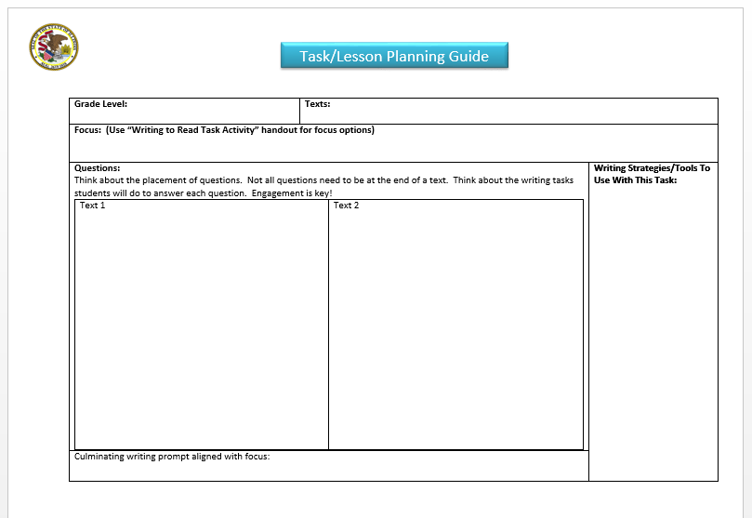
A Peek at Our Culminating Activity
Notes:
The presenter uses the tools that each grade band group will use and describes the process of completing the Task/Lesson Planning Template.

Slide 94
Activity
1. Divide into Grade Level/Content Groups.
2. Read text(s) and determine focus of texts.
Develop questions aligned to grade level standards to get at the focus.
Consider the writing opportunities from the “Writing to Read” recommendations/instructional practices when developing the task.
Develop a writing prompt.
Be prepared to share.
Notes:
New HANDOUTS:
Task/Lesson Template – to record group’s work
Task Activity Focus Handout – this handout provides each grade level possible writing prompts that may be on PARCC. They are to choose one focus and then develop questions based on that. After reading the articles,
Two texts per grade band from (ReadWorks, Newsela, etc…)
HANDOUTS Referred to Previously in the Presentation:
Tulare Standards
Guide to Creating Text Dependent Questions
Slide 18 handout
Summarizing and Note Taking Booklet
Toolbox for Routine Writing Handout
Divide groups into grade levels (K-2, 3-5, 6-8 or 9-12 for example) Have preselected texts based on your participants grade levels.
Hand out the Task Activity Focus Handout. This handout provides teachers with possible key areas of focus that the question prompts will target on PARCC.
Participants will develop their own questions using the Standards (Tulare Handout) and the Guide to Creating Text Dependent Questions. (Student Achievement Partners)
Consider when designing your activity where the questions should fall within the timing of the text. Remember…..questions do not have to come at the end of the selection. Let the standards guide the questions that are to be asked.
Consider how students should record the answers to their questions in writing, dictating and/or drawing keeping in mind the recommendations and practices from the Writing to Read report.
Writing a writing prompt that targets the focus.
Determine how much time you will give each group dependent on your schedule.
6. Each group shares out.

Slide 96
PARCC Resource Center (PRC)
How to access the PRC (Handout)
Important information/differences
Rubrics
Anchor Papers and Annotations
https://prc.parcconline.org/assessments/parcc-released-items?title=&field_subject_tid=&field_grade_level_unlimited_tid=All&page=2
Notes:
Share the following resources to end the day’s presentation.
PRC Access Handout
Rubrics: the first year of implementation, the rubrics had different scoring “lanes” or categories than the current version. When viewing the first round of samples, it is important to keep this in mind as the categories of reading comprehension and written expression have been combined on the Prose Constructed Response. The original rubric and current rubric do not alter the score outcomes or instructional practices. The changes were for internal purposes.
Anchor sets are representative examples of student performance at every score point and are used to ensure that scorers interpret rubrics consistently. Anchor sets include annotations that reference both the rubric and examples from the student response to explain why the response received a particular score.

Slide 97
How to Access the PRC
1) Click on the “Human” icon in the upper right of the PRC
2) Click “Create account”
3) Fill in the information required, marked with a “*” red asterisk.
4) Educators from PARCC Member organizations will see an optional new
field open to enter a “PARCC Member Code.”
Illinois’ code is IL1818
5) Check the box after reading the “Terms of Use” and “User
Generated Content Disclaimer”
6) Click “Create new Account”
You will be automatically logged into the PRC and an email will be sent to the address provided confirming registration.
https://prc.parcconline.org
Notes:
There is a handout for this slide for the directions.

Slide 98
How to Use PARCC Annotated Student Samples In the Classroom
Practice scoring student responses against Anchor Papers, Annotations, and Rubrics.
Annotate a sample to share with students: show areas for improvement/strengths
Select a specific area to model, such as clarity or coherence; showcase strong and weak attributes from samples.
Create PARCC-like tasks throughout year
Notes:
Notes:
These are just suggestions of how to utilize the annotated samples. This is not a suggested activity for the training.
Bullet One:
Review the anchor papers, annotations, and rubric.
Look for the anchor paper that most closely resembles the level of achievement reached in the response being scored.
• Using the anchor papers, rubric, and annotations as a guide, determine the score each paper would receive for each of the traits in the rubric.

Slide 99
If students are to make knowledge their own, they must struggle with the details, wrestle with the facts, and rework raw information and dimly understood concepts into language they can communicate to someone else. In short, if students are to learn, they must write.
National Commission on Writing
Notes:
Notes:
As the training comes to a close, have participants read or the presenter can read aloud the quote from the National Commission on Writing.

Slide 100
Outcomes (Post)
Articulate the three recommended writing practices to enhance students’ reading.
Identify strategies aligned with each recommended practice.
Identify components of the recommended practices that match PARCC writing tasks.
Compose a classroom task that aligns with the Writing to Read research, standards and PARCC expectations.
Locate resources to help with implementation of “writing to read” practices.
Notes:
Distribute post assessment and allow participants to fill out the post portion of the assessment.

Slide 101
Kathi Rhodus krhodus@illinoiscsi.org
Jill Brown jbrown@illinoiscsi.org

Slide 102
Additional Resource Links
20 Videos from Dr. Steven Graham:
https://www.youtube.com/playlist?list=PLLxDwKxHx1yJr3yJBP0TqCEW9h4alf3Ga
Writing Resources:
www.ilwritingmatters.org

Slide 103
References
Gallagher, K. (2006). Teaching adolescent writers. Portland, Me: Stenhouse.
Graham, S and Herbert, M. (2010). Writing to read: evidence for how writing can improve reading. Report from Carnegie Corporation of New York.
Graham, S. (2012). Address given at UIRA Conference, Ogden, Utah
Graham, S., MacArthur, C., & Fitzgerald, J. (2013). Best Practices in Writing Instruction, 2nd Edition (pp. 334-348). New York & London: The Guilford Press.
Harvey, S., & Goudvis, A. (2005). The comprehension toolkit. Portsmouth, NH: Firsthand/Heinemann.
Moats, L. C. (2012). LETRS Module 9: Teaching Beginning Spelling and Writing (K-3). Longmont, CO: Cambium Learning Sopris.
Shanahan, T. Thank Goodness the Writing Scores are Going to Drop. Retrieved August 1, 2013, from http://www.shanahanonliteracy.com

