Slide 1
Statewide System of Support Foundational Services August 2015 Illinois State Board of Education In Collaboration with Regional Offices of Education/Intermediate Service Centers and the Illinois Center for School Improvement
Notes:
Last update – 8-14-15 sfd

Slide 2
Using Rising Star for Continuous Improvement Planning
Notes:
(Facilitator: Please see notes section throughout presentation as well as accompanying facilitator’s guide.)

Slide 3
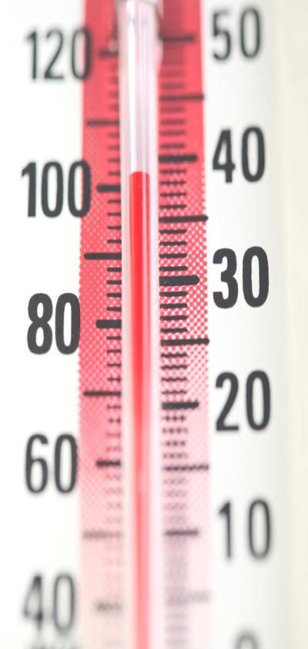
Pre-Assessment
Looking at the pre-assessment, please indicate your level of agreement with the statements provided.
Notes:
Pre-Session Activity provide participants with a hard copy of the pre-post assessment. Guide participants to keep their pre-post assessment out on the table so the facilitator is able to informally assess participants responses throughout the training.

Slide 4
Coming Together
Discuss with your team or a new acquaintance:
What are differences between “writing a plan” and “continuous improvement planning?”
Be prepared to share one comment.
Talk
Time
Notes:
Facilitator gathers attention for the opening activity.
Participants consult with their teams (ideally) or introduce selves to partners and follow slide instructions to discuss the difference between “writing a plan” and “continuous improvement planning.”
Participants record ideas on the Training Takeaway handout. They will have an opportunity to share later.

Slide 5
Session Objectives
Identify the key vocabulary used in Rising Star
Describe the four steps used in the Rising Star continuous improvement tool
Identify the benefits of using Rising Star as a tool for continuous improvement planning.
Identify state level expectations and regional support available for continuous improvement planning
Notes:
Facilitator previews session outcomes as central to the state-wide provision of foundational services to districts.

Slide 6
Stand and Identify
As the facilitator reads various roles that apply in a district, stand up if the role applies to you.
Notes:
Facilitator reads the following statements:
Stand up if you …
Have attended school
If you have been in education for 20 + years
If you have been in education for 10+ years
If you have been in education for less than 10 years
If you are a brand new teacher/educator
If you are a Superintendent
If you are a Principal
If you are a Classroom Teacher
If you are a Curriculum and Instruction leader
If you are in a role not yet specified
Participants raise hands to participate.

Slide 7
Group Norms
Stay focused
Listen actively
Manage electronic devices
Maintain confidentiality
Participate to the fullest extent of your ability
Question respectfully in a culture of candor
Notes:
Facilitator introduces norms. He/she may ask a negative polling question, “Is there anyone who cannot live with these norms?”

Slide 8
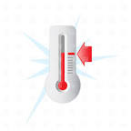
Process Points
Temperature Checks/
Parking Lot Questions
Training Takeaways
Tool Tips
Head Starts
Notes:
Facilitator explains process points built into the training for effectiveness and previews that participants will see visual reminders on slides throughout the day.
“temperature checks” - gauges of learning, pauses for questions from participants including those posted in the “parking lot”
“training takeaways” - pauses to reflect on and record useful ideas to use in team meetings
“tool tips” – practical tips learned in the field for the effective use of Rising Star
“head starts” – opportunities for application, using the Rising Star platform, specific to each district.

Slide 9
Continuous Improvement Planning is…
Time
to
Share
Notes:
Participants share ideas from opening activity (recorded on Training Takeaway Handout) with large group.
Facilitator records ideas on chart paper.

Slide 10
Continuous Improvement Planning
It is…
Dynamic, ongoing
Based on evidence, best practice indicators
Inclusive of school community
Focused on student learning
Notes:
Facilitator reviews slide, reinforcing ideas that were already mentioned and introducing ideas that were missed.
Participants record further ideas on Training Takeaway Handout.

Slide 11
Continuous Improvement Planning
It is not…
Static, completed
Based on intuition, opinion of what works
Exclusive to a few planners
Consumed by peripheral concerns
Notes:
Facilitator reviews slide, reinforcing ideas that were already mentioned and introducing ideas that were missed.
Participants record further ideas on Training Takeaway Handout.

Slide 12
Continuous Improvement Cycle
Data
Informed CIP
Assess Current Practices
Choose a Goal
Create a Plan
Implement the Plan
Monitor the Plan
Make Adjustments
High Priority
Creating Sustainability
Collaborative
Notes:
Facilitator: overview process cycle:
Continuous improvement planning is not an annual or two year planning process, as has been recorded as an E-Plan on IIRC.
Rising Star is a collaborative, data-informed continuous improvement process. It does not start and end each year or every two years. It is continuous because the cycle of assessing indicators, creating tasks to bring high priority / high opportunity indicators to full implementation, and monitoring tasks does not end. Indicators of effective practice are routinely revisited. The tasks are checked for progress and continually monitored.
The Continuous Improvement Cycle is identical at both the district and school levels, where teams assess current practice relative to the indicators, create the improvement plan, implement the plan, monitor plan progress, and make adjustments in course.

Slide 13
Team Approach
Does the district/school already have a leadership/improvement team?
What is the team’s current focus/responsibility?
How often/for how long does the team meet?
What other teams already exist that are related to continuous improvement planning?
Notes:
Facilitator emphasizes the importance of team representation and presents teaming considerations.
Participants discuss these questions in their teams and record ideas on Training Takeaway Handout.

Slide 14
District Team Assessment
DISTRICT TEAMS/COMMITTEES | MEETING PURPOSE AND EXPECTED OUTCOMES | MEETING SCHEDULE | MEMBERS | CONTINUOUS IMPROVEMENT CONNECTION 1= low, 5=high
Attendance Team | Monitor attendance Increase attendance rate | 2nd Mondays 7:40 – 8:15a | Lead Teachers | 1 2 3 4 5
Curriculum and Learning Team | Implement Common Core Curriculum Portfolios | 1st Mondays 3:00 – 4:00p | Lead Teachers Principal | 1 2 3 4 5
Discipline Committee | Improve behavior Decrease office referrals | 3rd & 4th Mondays 7:40- 8:15a | Principal Counselors Lead Teachers | 1 2 3 4 5
Leadership Team | Create Rising Star Plan Monitor Rising Star implementation | 3rd Wednesdays 7:40- 8:15a | Principal Lead Teachers | 1 2 3 4 5
RtI Team | Review Student Data Provide interventions | 4th Fridays 7:40- 8:15a | Principal Special Ed Teachers Social Worker | 1 2 3 4 5
Notes:
Facilitator presents this example of how existing team structures may be assessed.
Participants can considers how existing committee structure can be adjusted to meet continuous improvement planning needs.

Slide 15
Continuous Improvement Planning Leadership Team Members
District Superintendent/Principal or Designee
Process Manager
District or School Internal Capacity Builder
CIP Leadership Team Member (Teacher, Program Directors – i.e. Bilingual/ESL, Special Education, Gifted, Technology Planner, School Board Member, Parent, or Community Member)
Open Chair (Optional)
Notes:
Participants consider representation needs in their context.

Slide 16
Continuous Improvement Planning Leadership Team Roles
Superintendent/Principal or Designee - identified leader who facilitates the process- maintains focus and purpose
Process Manager - interfaces with online tool to enter agendas, minutes, data in a timely manner
Internal Capacity Builder – coaches team members on continuous improvement process and platform
Team Members –actively participate in the process, complete tasks, if appropriate, toward improvement
Open Chair – invited to provide expertise to the team
Notes:
Facilitator introduces titles and functions of team roles and asks for questions to check understanding.

Slide 17
Continuous Improvement Planning Leadership Team Success
Are changes needed to the schedule and structure of team meetings to ensure success with Rising Star?
Are changes needed in the composition of the team to ensure diverse viewpoints in the school community are represented?
Notes:
Participants discuss with team/partner the questions on the slide and record ideas on Training Takeaway handout.

Slide 18
Rising Star
A free on-line tool available for district and school continuous improvement planning.
A web-based continuous improvement planning system based upon indicators of effective professional practices supported by research briefs (Wise Ways®).
Resides on the Illinois Interactive Report Card (IIRC) hosted by Northern Illinois University.
Notes:
Facilitator
identifies Rising Star as a platform for recording the work of continuous improvement.
refers to prior discussion on characteristics of continuous school improvement and emphasizes that Rising Star is a nationally utilized tool designed to facilitate a continuous improvement process.
emphasizes that the state effort to combine Rising Star on IIRC, with access to district and school level data, further facilitates a continuous improvement process that is data-driven and focused on student achievement.

Slide 19
Illinois Interactive Report Card
http://iir.niu.edu
Notes:
Facilitator ensures all participants have a Rising Star login/password, either their own or a sample.
Facilitator walks through steps to enter IIRC and begin navigating Rising Star.
Participants navigate on own device along with facilitator.

Slide 20
Getting Started
Notes:
Facilitator highlights registration steps for administrators.

Slide 21
My IIRC Portal
Notes:
Facilitator shows how to access Rising Star on the My IIRC portal. Reminder: when registering, a superintendent or principal can set up the district or school master account, and then use “Account Tools” (located on the MyIIRC home screen) to grant user permissions, etc.

Slide 22
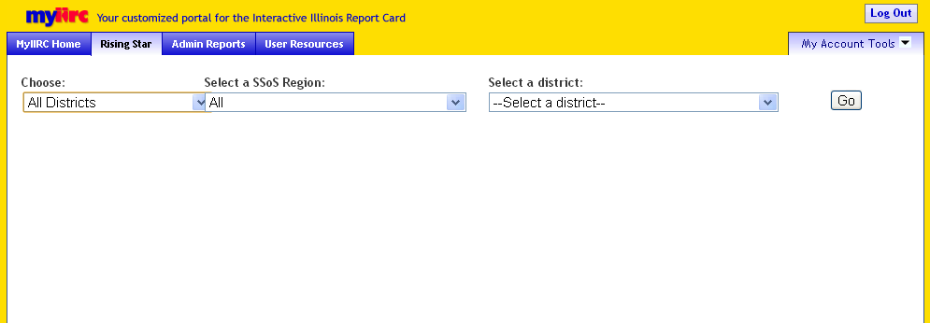
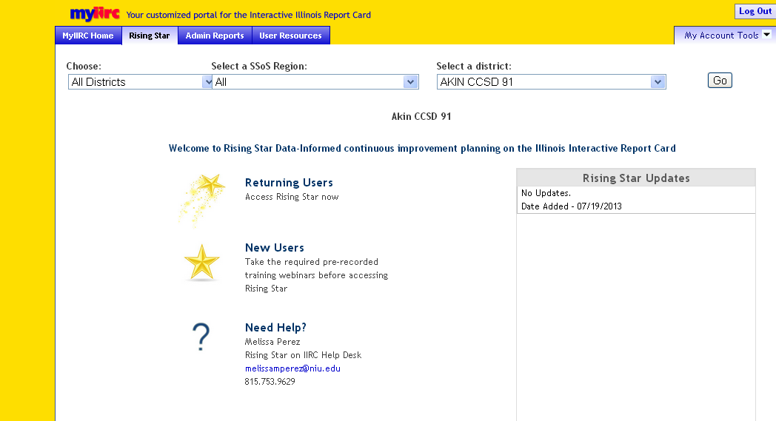
Notes:
Facilitator demonstrates how to filter for a district/school in Rising Star.

Slide 23
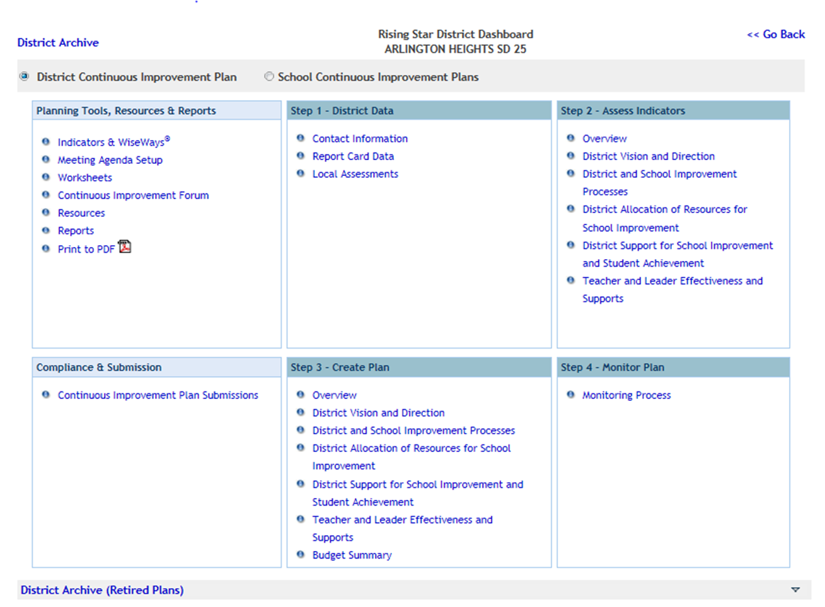
Rising Star Dashboard
Notes:
Facilitator Provides overview of the Rising Star District/School Dashboard.
Note: District or School Continuous Improvement Plan is indicated on top bar.

Slide 24
Four-Step Process
Notes:
Facilitator emphasizes the four-step continuous improvement process embedded in Rising Star and shares that participants will be exploring and practicing each step throughout the training.
District Data
Assess Indicators
Create plan
Monitor plan

Slide 25
Previewing Terms
Important terms to listen for and learn today:
Culture of Candor
Indicator of Effective Practice
Objective
Opportunity Score
Priority Score
Index Score
Wise Ways®
Notes:
Target # 1 from pre-post
Facilitator points out terminology posters within the room. (If poster printouts of any size are unavailable, facilitator mentions key words for participants to jot down in an “important terminology” sections of their Training Takeaway Handout.)
Possibilities for terminology activity include:
Post the provided terminology posters in room, point them out to participants, and have participants refer to them as needed for definition reminders throughout the day.
OR
Post the provided terminology posters in room and ask participants to stand and visit each poster, saying hello to other participants and jotting notes from the posters they think they may need on their Training Takeaway Handouts. The purpose of this would be to allow movement and interaction among participants, in addition to previewing terminology.

Slide 26
Step 1 – District Data
Notes:
Facilitator
introduces the analysis of a data and root causes as an important first (and continual) step in the continuous improvement process.
reminds participants to think broadly about data, including sources outside of Rising Star.
the resources in the left two boxes are key and should be highlighted by the facilitator

Slide 27
Excellence and Equity
for all students
Student Learning
Processes Programs
Policies
Demographics
Perceptions
Based upon Victoria Bernhardt’s Multiple Measures of Data
Notes:
Facilitator
offers reminder to think broadly about the use of data to inform the continuous improvement process
references effectiveness of analyzing where multiple data indications overlap to determine root causes of achievement trends
introduces these categories of data, some of it extending beyond what is housed in Rising Star on IIRC
Credit for this framework: Bernhardt, V. 2004. Data Analysis for Schoolwide Improvement. Larchmont, NY. Eye on Education

Slide 28
Data in Rising Star on IIRC
Contact Information
Report Card Data
Local Assessments
Notes:
Facilitator overviews types of data housed in the Rising Star online platform.

Slide 29
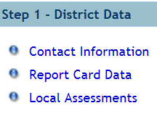
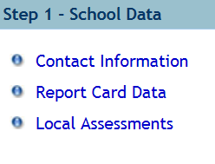
Step 1- Data
Notes:
Facilitator uses system to show where to locate data through links under Step 1 on the Dashboard.

Slide 30
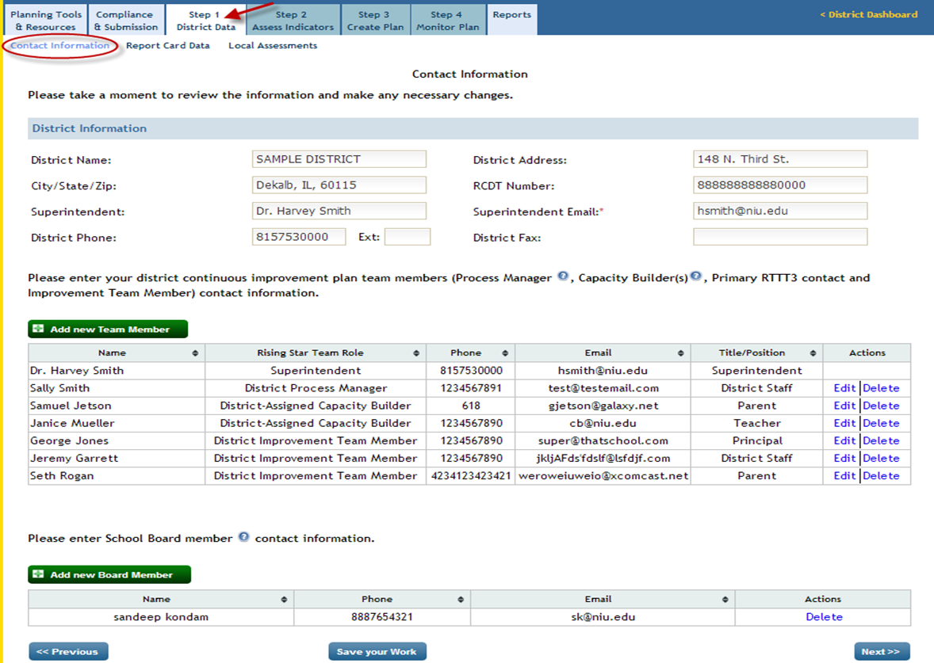
Contact Information
Notes:
Facilitator refers back to the team composition discussion and shows where team member information is entered. Reminder: only two members of the team can enter and edit information. The other team members have “read only” privileges.

Slide 31
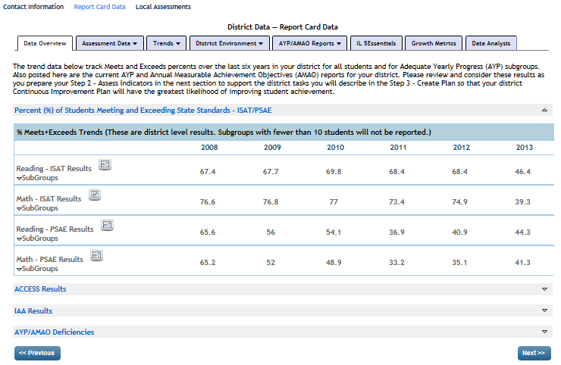
District Report Card Data Tabs
Notes:
Facilitator highlights report card data tabs and information found within.
Participants explore this section of Rising Star.

Slide 32
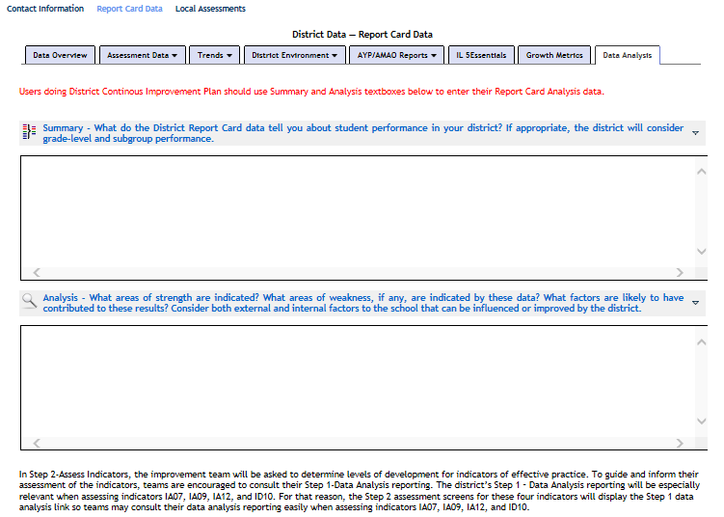
Summary and Analysis
Notes:
Facilitator leads participants to the Summary and Analysis page for report card data (and highlights for participants that there is also a summary and analysis page for local data).
In this and all sections highlighting pages where teams enter information, facilitator may model how to type in information without actually entering/submitting it.

Slide 33
Step 2 – Assess Indicators
Notes:
Facilitator leads participants back to the Rising Star Dashboard to Step 2 – assess indicators.

Slide 34
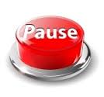
Why Assess Indicators?
It drives the continuous improvement process.
Indicators of Effective Practice are supported by research.
The initial assessment of effective instructional practices can be hurried or even overlooked as districts/teams are tempted to rush into the Create Plan phase of the process.
Notes:
Facilitator introduces the assessment of current levels of development of indicators of best practice as an important foundational step in the continuous improvement process.

Slide 35
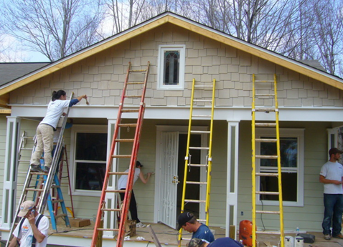
Where to Begin
What are your focus areas?
Notes:
Facilitator emphasizes prioritization of indicators to assess. “Like building a house,” choosing indicators requires strategic thinking.
Analogy: “Where do you begin?” If the roof is leaking, you might start there, etc.

Slide 36
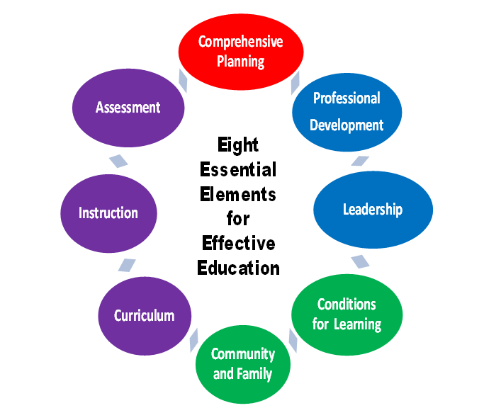
Notes:
Facilitator points to the Eight Essential Elements for Effective Education, ISBE’s comprehensive framework organizing categories of best practice.

Slide 37
Indicators of Effective Practice are Mapped
Notes:
Facilitator references indicator map to remind participants that indicators are further organized into priority groupings for submission (Ex. Smart Start and Smart Plan), special district processes (Ex. Race to the Top), and other considerations (Ex: ELL). Districts can refer to Pacing Guide for further guidance. (Facilitator stresses that all indicators will not be assessed in one year.) This is not a slide into which you need to go into great detail, but it is there as a reference for users.

Slide 38
Selecting Indicators of Effective Practice District-Level Dashboard
Notes:
Facilitator previews five organizational categories of indicators in Rising Star. On the School-Level Dashboard these categories are different.

Slide 39
Selecting Indicators of Effective Practice
Notes:
Facilitator points out five categories of indicators in Rising Star (tabs) and how to use filter function to find relevant indicators.
Participants explore this section of Rising Star.

Slide 40
Steps to Assess an Indicator of Effective Practice
Develop shared understanding of indicator.
Determine current level of development.
Assign opportunity and priority scores.
Level of development and priority/opportunity scores should reflect team consensus.
Notes:
One of the four steps
Facilitator previews main steps to assess an indicator and explains that each will be further broken down into steps.

Slide 41
Reaching Consensus
Team members individually explain reasoning.
Facilitator asks those who did not respond with the majority: What would it take to change?
Facilitator allows brief conversation/discussion.
Facilitator asks a negative poll such as, “Can anyone not live with or support this rating?"
Notes:
Facilitator offers suggestions for how to facilitate consensus-building on the team.

Slide 42
Your Turn: Choose Team Roles
Superintendent/Principal or Designee - identified leader who facilitates the process- maintains focus
Process Manager - interfaces with online tool to enter agendas, minutes, data in a timely manner
Team Members –actively participate in the process, complete tasks, if appropriate, toward improvement
Open Chair – invited to provide expertise to the team
Notes:
Facilitator introduces titles and functions of team roles and asks for questions to check understanding.
Internal Capacity Builder – coaches team members on continuous improvement process and platform – removed from the slide; however, still important to note, especially for larger districts, this may be a role that can/will be filled

Slide 43
Choose Continuous Improvement Leadership Team Members
Administrator
Teacher
Parent
Support Staff
Board Member
Community Member
Other
Role Play
Notes:
Participants also choose fictional roles to role-play to emphasize different perspectives during the activity.

Slide 44
Tool Tip
Send electronic copies of Wise Ways® of chosen indicators with the agenda, so that team members may read and digest them before the team meeting.
Notes:
Facilitator shares tip and asks briefly for one or two other tips from participants related to assessing indicators in Rising Star.

Slide 45
Head Start: Develop shared understanding of indicator
Read corresponding Wise Ways® research brief.
Highlight/annotate key ideas in Wise Ways®.
Discuss as a team to form shared understanding of full implementation.
Notes:
Activity
Participants use system or and/or handouts and follow slide directions to assess indicator IC05 on teaming.

Slide 46
Head Start: Determine current level of development
According to shared understanding of the Wise Ways®, determine your level of development – full, partial, or no development.
Provide detailed evidence substantiating your team’s choice.
Notes:
Participants use system or and/or handouts and follow slide directions to assess indicator IC05 on teaming.

Slide 47
Head Start: Assign priority/opportunity scores
Assign a priority score indicating relative importance.
Assign an opportunity score indicating ease of accomplishment.
Multiply to obtain an index score, which may be used to prioritize indicators to plan for later.
Notes:
Participants use system or and/or handouts and follow slide directions to assess indicator IC05 on teaming.

Slide 48
Training Takeaway
Reflect on writing tasks to create a plan:
What is difficult about it?
What makes it easier?
How is this different?
Why is it valuable?
Notes:
Facilitator refers participants to Training Takeaway Handout.
Participants record notes and reflections on Step 3 – create a plan.
(Recommended – take a break here or before.)

Slide 49
Temperature Check
Before we go to lunch . . .
Post a sticker on the chart that
reflects your current level of
understanding . . . Or . . .
Check in with your Pre-Post Evaluation
Notes:
Temperature Check – before lunch break: Guide participants to keep their pre-post assessment out on the table so the facilitator is able to informally assess participants responses throughout the training.

Slide 50
Lunch and Getting Acquainted
Notes:
Facilitator asks participants to complete a “temperature check” at start of lunch break.
Participants indicate their comfort level (“temperature”) by posting one sticker on the chart before session resumes.

Slide 51
Step 3 – Create Plan
Notes:
Facilitator leads participants back to the Rising Star Dashboard to Step 3 – create plan.

Slide 52
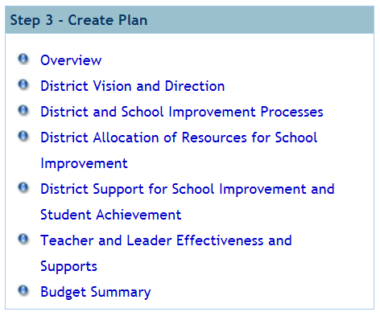
Selecting Objectives for a Continuous Improvement Plan
Notes:
Facilitator points out that planning tabs are the same as tabs in the indicator assessment step.

Slide 53
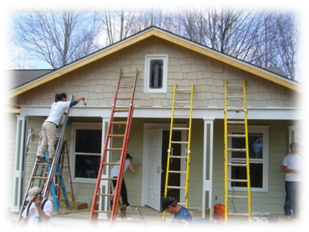
Where to begin planning…
Choose indicators to assign tasks based on:
Existing strategic plan goals
Data analysis review
Indicator assessment
Priority/opportunity scores
District/school alignment
Program requirements
Notes:
Facilitator re-emphasizes strategic thought in choosing which indicators to actively plan for and implement.

Slide 54
Avoiding Misalignment
Notes:
Facilitator uses analogy to describe the frustrating results of a lack of alignment in planning, for example, between district and school priorities.

Slide 55
System Alignment
Indicators of Effective Practice chosen on the district and school levels should be aligned or complementary.
Example:
District Objectives School Objectives
ID10 ID10 to align with District
ID06 IIC03 to align with District
IA07 IIIC12 to address ELL needs
Notes:
Facilitator discusses the need for aligning school and district plans, to reflect major district priorities while also allowing room for school-specific needs.

Slide 56
Tool Tip
The team may choose to focus on a
small number of indicators at one time.
Any indicator that your team enters
tasks/dates for will be included as an objective in the system.
Notes:
Facilitator shares tip and asks briefly for one or two other tips from participants related to planning for objectives in Rising Star.

Slide 57
Create Plan – List of Objectives
Mr. John Doe
Notes:
Facilitator leads participants in system, showing how to choose an assessed indicator to become an objective in the plan.

Slide 58
Create Plan – Adding Tasks
Notes:
Facilitator leads participants in system to illustrate where and how to add tasks.
Participants explore this section of Rising Star.

Slide 59
Head Start: Create a plan for an objective
An Indicator of Effective Practice becomes an objective when entered into the plan.
Assign a due date and personal responsible to oversee completion of tasks for the objective.
Describe full implementation based on understanding from the Wise Ways®.
Backwards map, listing specific tasks needed to reach full implementation.
Notes:
Participants complete Create a Plan Activity following instructions on slide, using indicator IC05, as it was assessed earlier.
Facilitator aids in instructions, reminding teams NOT to complete this activity in the system, as it will add this objective and tasks to their plan. (They may not choose this indicator as a planning priority.)
(Participants will not use the Rising Star platform for this step during the training.)

Slide 60
Review the Work
List team’s objective, list of tasks on chart paper.
Post on the wall and join your team at poster.
Participate in a “gallery walk,” reading each poster before moving on at the signal.
Use adhesive notes to add tasks/suggestions to strengthen planning for each indicator.
Incorporate feedback to revise your tasks.
Notes:
Activity
Facilitator provides instructions and timing for gallery walk activity and time to revise accordingly.
Participants follow directions on the slide.

Slide 61
Training Takeaway
Reflect on writing tasks to create a plan:
What is difficult about it?
What makes it easier?
How is this different?
Why is it valuable?
Notes:
Facilitator refers participants to Training Takeaway Handout.
Participants record notes and reflections on Step 3 – create a plan.
(Recommended – take a break here or before.)

Slide 62
Step 4 – Monitor Plan
Notes:
Facilitator leads participants back to the Rising Star Dashboard to Step 4 – monitor plan.

Slide 63
Monitoring Considerations
What to monitor
What to gather
When to gather and submit data
How to gather data
Who will gather data
How to record data
How to manage monitoring data
How to communicate monitoring expectations and results
Notes:
Facilitator asks participants to think strategically about monitoring implementation of targets in the district/school.
Reminder: Monitoring progress is a crucial part of every continuous improvement meeting. The meeting agenda and minutes template are designed to encourage this practice.
Participants consider listed monitoring considerations that may be discussed in regard to specific objectives and tasks.

Slide 64
Monitoring for Improvement
It is…
Intentional to measure plan implementation
Consistent across all levels of the system
Identifying where support is needed to improve
Based on clear, transparent measures
Examining adult implementation, not just student measures
Notes:
Facilitator reviews slide emphasizing monitoring for improvement, not compliance.

Slide 65
Monitoring for Improvement
It is not…
Gathering large amounts of unused data
An evaluation of individual performance
A “gotcha” to find what is being done wrong
Based on unclear, hidden measures
Examining student data in isolation
Notes:
Facilitator reviews slide, emphasizing monitoring for improvement, not compliance.
Reminder: Just as it was important to distinguish what continuous improvement planning “is” and “is not,” the characteristics of mentoring of this process correspond accordingly.

Slide 66
Training Takeaway: Monitoring for Improvement
It is…
Intentional to measure plan implementation
Consistent across system
Identifying where support is needed to improve
Clear, transparent measures
Including adult implementation
It is not…
Gathering large amounts of unused data
An individual evaluation
A “gotcha” – finding what someone is doing wrong
Unclear, hidden measures
Based only on student data
Notes:
(This slide combines content of last two slides, to provide visual reference during reflections.)
Facilitator refers participants to Training Takeaway Handout.
Participants record notes and reflections on Step 4 – monitor plan.

Slide 67
Monitoring Steps in Rising Star
After tasks are completed, team judges whether the objective has been met
Facilitator asks probing questions to guide accurate assessment of completion
If met, team provides a status report describing evidence of full development
For objectives not yet fully implemented, team develops additional targeted tasks
Notes:
Facilitator overviews steps to monitor a Rising Star plan.
Reminder: Continuous improvement is an ongoing process, and when an objective is met, new priorities are chosen.

Slide 68
Monitoring Practice
Refer to your created tasks for an indicator
Discuss as a team:
What would monitoring look like for this indicator and each task?
How would a team monitor to determine if this indicator was fully implemented?
What questions might team members ask to determine if it was being implemented as envisioned? Write them on handout.
Notes:
Facilitator: Refer participants to chart paper used to create tasks.
Participants: Follow prompts on the screen and record thoughts on the Training Takeaway Handout.
(Participants will not use the Rising Star platform for this step during the training.)

Slide 69
Monitor Plan – List of Objectives
Notes:
Facilitator points out features of monitoring page and color coding to easily track tasks in plan. Facilitator should go to IIRC and point out the monitoring coloring code system. This slide is a prompt for the facilitator.
Participants explore this section of Rising Star.

Slide 70
Tool Tip
Collectively create the agenda for the next meeting at the end of each meeting, including the end of the year.
Keep momentum going!
Notes:
Facilitator shares tip and asks briefly for one or two other tips from participants related to monitoring in Rising Star.

Slide 71
More on the District Dashboard
Notes:
Facilitator leads participants back to Dashboard to point out additional features, such as link to archived plans.

Slide 72
More on the District Dashboard
Notes:
Facilitator emphasizes the helpfulness of the tools, resources, and reports available from the Dashboard.

Slide 73
Head Start – Using Tools
Explore the “Planning tools, Resources, and Reports” on the Rising Star Dashboard.
Identify how at least one can be used to streamline/enhance your improvement process.
Record ideas on Training Takeaway handout.
Discuss with your team.
Be prepared to share one idea.
Notes:
Participants explore tools and resources in the system and follow directions on the slide to record and share out ideas for how to use them.
Facilitator points out especially helpful features that may have been missed, such as agendas/minutes, certain reports, and forum.

Slide 74
Preparing for a Meeting
Consult the handout listing meeting steps.
Order the steps to ensure a successful continuous improvement planning meeting using Rising Star.
Discuss with team to develop shared protocol.
Record protocol on Training Takeaway Handout.
Notes:
With new knowledge of tools and resources in the system, participants complete Preparing for a Meeting Activity following instructions on slide.
Facilitator emphasizes that there is not one correct “formula,” but that the development of a shared meeting protocol that becomes a standard way of doing things in the team is important.

Slide 75
Identify state level expectations and regional support available for continuous improvement planning.
Notes:
Facilitator previews objective 3, stressing that foundational support is available.

Slide 76
Compliance and Submission
Notes:
Facilitator begins with practical information on how to find a list of submission forms and dates, all housed within the system.
Title One, RTTT3, Special Ed, and ELL plans are still using the Rising Star platform for compliance and submission.

Slide 77
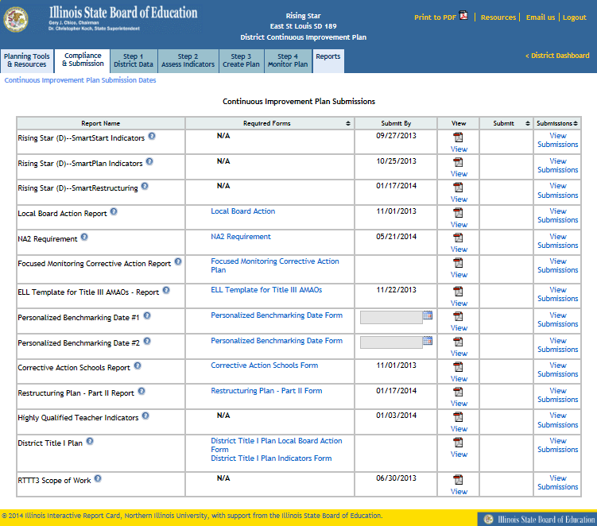
Notes:
Participants explore this section of Rising Star. This the compliance list. Go onto Rising Star and show participants this list
Facilitator highlights chosen submission forms/dates.

Slide 78
Foundational Services to Districts
Continuous Improvement Planning
Foundational Services Service Providers
(ISBE in collaboration with local ROEs/ISCs) will offer:
Technical assistance
Professional development training
Networking opportunities
Notes:
Facilitator explains the joint effort between ISBE and ROEs/ISCs to provide continuous, foundational support in these content areas.
Foundational Services ppt is on the IARSS CIP webpage. http://iarss.org/foundational-services/

Slide 79
Benefits?
Discuss, in table groups, the benefits of using Rising Star as a tool for continuous Improvement planning.
Notes:
Facilitator highlights content area of foundational support.

Slide 80
Temperature Check
Post a sticker on the chart that
reflects your finishing level of
Understanding.
Notes:
Temperature Check – Final :

Slide 81
Training Feedback
Please use adhesive notes to offer feedback.
“Plus” = positive aspects to keep the same
“Delta” = aspects to change and improve
Notes:
Participants offer plus/delta feedback on chart paper using adhesive notes.

Slide 82
Closing Connections
Select the 2-3 ideas that you learned today that will enhance your work.
Record the ideas on Training Takeaway Handout.
Discuss with your team.
Notes:
Participants complete Closing Connections Activity with teams/partners, following instructions on the slide.

Slide 83
Team Next Steps
How will information learned today impact your continuous improvement process?
What are the next steps to keep momentum?
Record next steps and persons responsible on your Training Takeaway handout.
Notes:
Participants discuss and record concrete next steps with their teams.

Slide 84
Post Evaluation
Check for your Foundational Services Evaluation email from www.iarss.org/foundational-services
Complete the post and reflection questions
Receive your Professional Development Hours - Evidence of Completion - through the email link
Keep this formative assessment in your professional development folder to use as evidence of your learning and identified next steps
Notes:
Participants:
Complete post evaluation online.
Guide participants to keep the hard copy of the pre-post assessment out on the table so the facilitator is able to informally assess participants responses.

Slide 85
Notes:
Example closing remarks: Continuous Improvement Planning is intended to be an improvement upon planning methods in the past. It is a chance for honest probing, reflection, and effective planning based on evidence. It is an opportunity, and Rising Star is a tool, to facilitate the important human process that leads to change for the better. Thank you for investing your time and effort in the continuous improvement of your schools.

