Slide 1
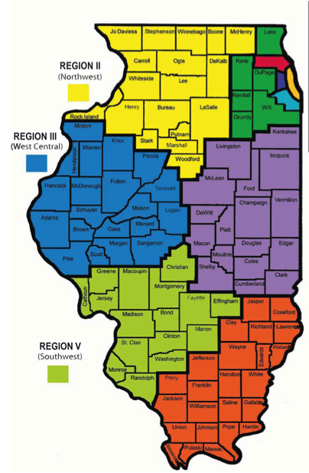
Mathematics Instructional Design, Delivery, and Assessment
Grades 3-5
ISBE Math Foundational Services
June 2016
Notes:
Mathematics Instructional Design, Delivery, and Assessments

Slide 2
Mathematics Instructional Design, Delivery, and Assessments Pre Post
I can use the Math Implementation Guides to drive curricular decisions
I can facilitate a number talk in a math classroom utilizing the IL Teach and Talk
I can assess using open-ended questions representative of the instructional shifts for Math
I can embed the PARCC Released Items (3-12) where appropriate in my curriculum throughout the year
I can use appropriate models of instruction in the 3-5 classroom including place value on the four operations and benchmarking in fractions (3-5 only)

Slide 3
Professional Learning Standards
Resources: We will show you how to find and use the ILTeachandTalk.org and PRC.PARCConline.org.
Learning Design: Integrate the theories of Number Talks and Re-engagement Lessons in student learning.
Implementation: We continue on the path of implementing the Illinois Learning Standards.

Slide 4
Assessment
Delivery
Design
Notes:
The tasks we create influence the design of what we are doing, but then this interacts with the delivery which leads us to the assessment, which then circles back to the design. Quality instruction can’t leave without all three components working successfully together.

Slide 5
Look at the 3-5 Implementation Guides.
Read through Primary Resources, Materials (Curriculum) and Classroom Culture.
Consider where you are in your implementation.

Slide 6
Notes:
https://www.youtube.com/watch?v=3icoSeGqQtY
Consider pausing video and giving educators time to independently answer.
Is this appropriate for students to see? What part(s)?

Slide 7
The National Council of Teachers of Mathematics (NCTM) in their 1991 professional standards describes discourse as ways of representing, thinking, talking, agreeing, and disagreeing; the way ideas are exchanged and what the ideas entail; and as being shaped by the tasks in which students engage as well as by the nature of the learning environment.
Notes:
http://www.mathsolutions.com/documents/how_to_get_students_talking.pdf
A Number Talk really focuses on computation while a Math Talk can be good discussion surrounding a rich task that goes beyond computational fluency and might ask for application knowledge.
Both can be set up as a routine set to last between 5 and 15 minutes.
For todays purposes we will use the word Math Talks as it is more encompassing.

Slide 8
Math Talks
In your Table Groups discuss:
What are some main components of a Math Talk?
How do you do a Math Talk?
Notes:
Activate some prior knowledge

Slide 9
Grade 3 number talk
Notes:
http://www.mathsolutions.com/videopage/videos/Final/Classroom_NumberTalk_Gr3.swf

Slide 10
Getting Started
Teacher poses a purposeful problem
Students signal when they are ready to give a solution
Teacher collects answers orally
Students explain or defend their answer
Teacher records student strategies
Teacher asks questions to facilitate Mathematical Discourse
Class comes to consensus
Notes:
Making Number Talks Matter by Cathy Humphreys and Ruth Parker

Slide 11
Opportunity for application
Why reinvent the wheel?
Il Math Teach and Talk
http://www.ilteachandtalk.org/
Take some time to review and then choose a standard and a ppt slide
Pick someone's at the table to do.

Slide 12
Compare
Use a number line or area model to justify your answer.
Notes:
4.NF.2
Common numerator – 3rd grade problem: 2/5 < 2/3
Additional ppt to consider is 3.OA.3 Multiplication and Division Strategies; Shows “student” work

Slide 13
Teacher Evaluation
Math Talks
Fluency
Rigor
Growth Mindset
Assessment
Notes:
Domain 2 – Classroom Environment: 2a: creating an environment of respect and report, 2b: establishing a culture for learning. Climate and Culture,
Domain 3 – Instruction; 3a: Communicating with students, 3b: Using questioning and discussion techniques

Slide 14
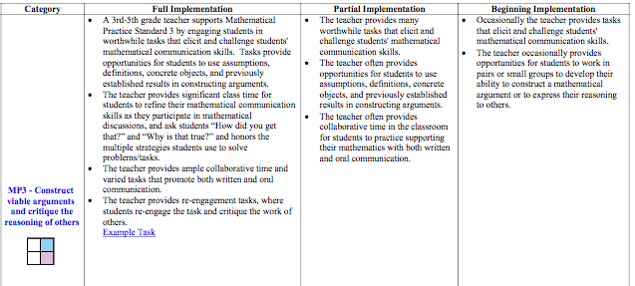

Slide 15
Planning a Number Talk
Anticipate different strategies | Recording Methods
Questions | Reflections
Notes:
Making Number Talks Matters Grades 4-10
By Cathy Humphreys & Ruth Parker
Anticipate different strategies students might use for solving the problem (or how they might “see” a dot card)
How will you record each of these strategies?
What questions might you ask to fully understand and represent a student’s thinking and/or method?
In reflecting on this Number Talk, what do you want to remember, what problem might you do next, and why?

Slide 16
Jigsaw Concerns
Trouble getting students to participate
I don’t understand what the student is saying
Only a few students participate
How to handle mistakes (student and teacher)
How do I keep the conversation going?
Notes:
1. Start with dot talks. Use “previous students’ work as examples” (so students are explaining someone else's work). Show a video or two of math talks and discuss expectations.
2. Ask clarifying questions, “What I think I heard you say…”, :I want to make sure I understand what you mean. Could you please repeat that last part?”, “Who can explain what…..said in your own words?”
3. Review classroom culture and how it is a safe place for everyone to share ideas. Have students use physical clues to indicate when they have an answer. Encourage those who often speak to come up with more than one way to “see” the problem. Call on others who show they are prepared. “I would like to hear from someone who hasn’t had a chance to share.” Increase wait time. Have students turn and talk to a neighbor than share out what their neighbor said.
4. Own up to mistakes. Opportunity to talk about mistakes as chances to learn, “Yikes. I think there is something wrong here. Can anyone help me think about this?” “I just confused myself. Hmm- Where am I? Can anyone help me think about this?” “Do you want to revise your answer.” “I would like to revise my answer.” “Let me think about this overnight and we can talk about it tomorrow.” Turn mistakes into class investigations. Discuss where the reasoning went awry.
5. Ask “What questions do you have for…?” “Why did you do…?” compare and contrast student strategies. Discuss efficiency of strategies.

Slide 17
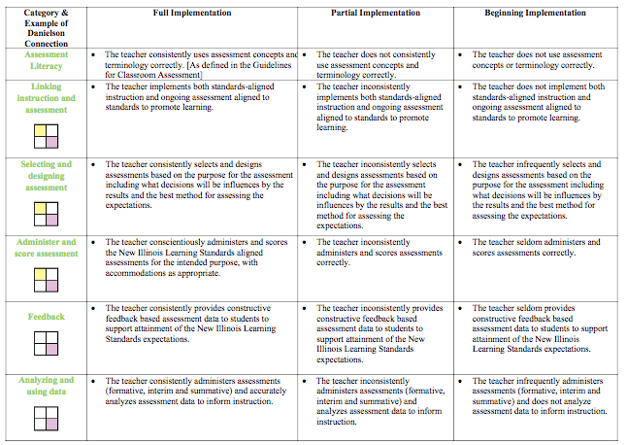

Slide 18
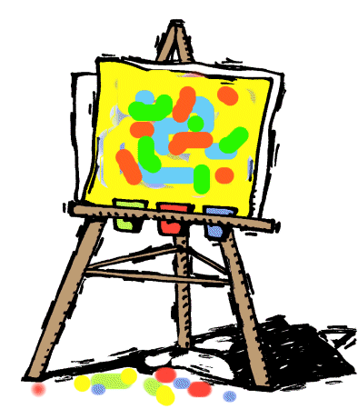
Create your own Math Talk based on the following PARCC Problem
Share with a partner
Make sure all components are present
Think about, reflect or practice how you will facilitate this problem
Notes:
PARCC
PRC page: prc.parcconline.org
il code: il1818

Slide 19
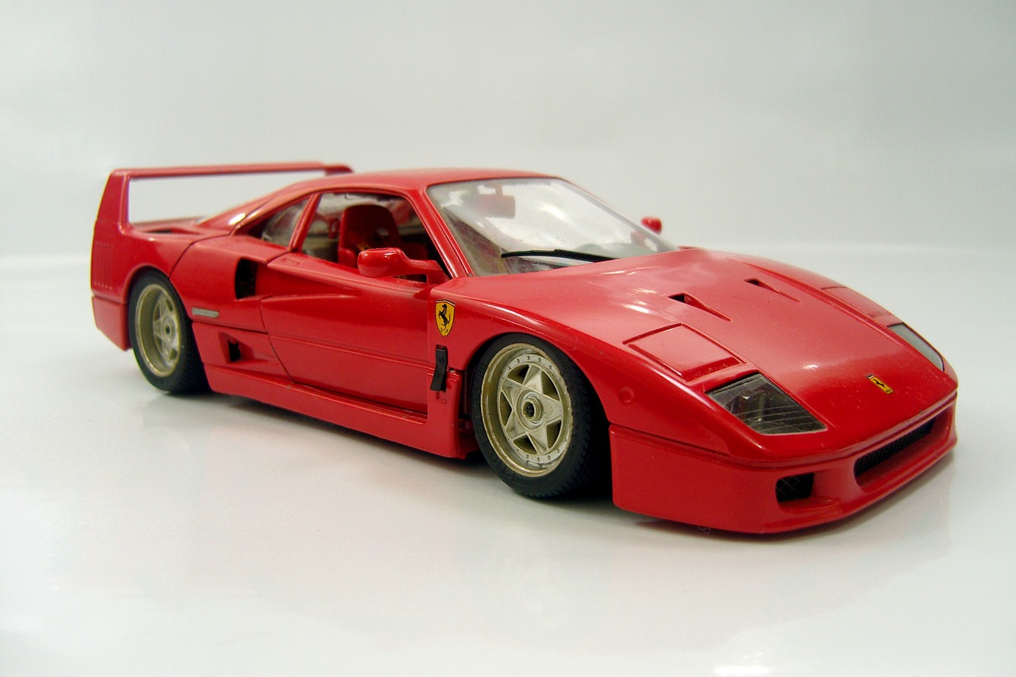
Tom and Ann collect toy cars. Tom has 39 more toy cars than Ann. Ann has 38 blue cars and 58 red cars.
Part A
How many toy cars does Tom have?
Part B
Ann gives Tom 18 toy cars from her collection. How many toy cars does Ann have now?
Notes:
Prc.parcconline.org
A (38+58)+39=135
- I did 38 + 58 first. 30 + 50 =80 and 8+8 = 16, and 80 + 16=96. Then, I did 96 + 39. I took 4 off the 39 and put it with the 96 to make 100. So 39-4=35. I then added 100+35 = 135.
- I added all the tens together first 30+30+50 = 110. Then I added all the ones together 9+8+8 = 9+16=25. Then I added 110+25=135.
B (38+58)-18=78
Possible ways to solve B:
I used the total from the previous problem for Ann’s cars, which was 96. I then subtracted 96-18, so, I did 96-10 and got 86, then 86-6 which was 80 and then 80-2 which gave me my answer of 78.
I realized it might be easier to assume that Ann gave Tom all blue cars. So, I did 38-18 which is 20. And then said Ann still had 20 blue cars and 58 red cars, so 58+20 = 78. 78 total cars.
3° grade pba released
#10
VF654116
Type I
3.OA.8
Sub claim A

Slide 20
Create your own Math Talk based on a PARCC Problem and an upcoming lesson in your classroom
Share with a partner
Make sure all components are present
Think about, reflect or practice how you will facilitate this problem
Notes:
PARCC
PRC page il code

Slide 21
Re-engagement Tasks
Re-engagement is not Re-teaching. Re-teaching presents the same material again to a group of students. Re-engagement involves students thinking about mathematical concepts in a new way. Formative re-engaging lessons are directly tied to the results of formative assessments. They reengage students in the core mathematical ideas of the assessment task in order to deepen their understanding of the core math and build a better conceptual foundation to learn further mathematics.

Slide 22
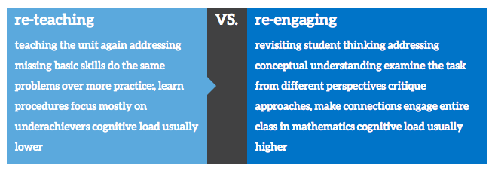
Notes:
Additional information, including videos, http://www.insidemathematics.org/classroom-videos/formative-re-engaging-lessons

Slide 23
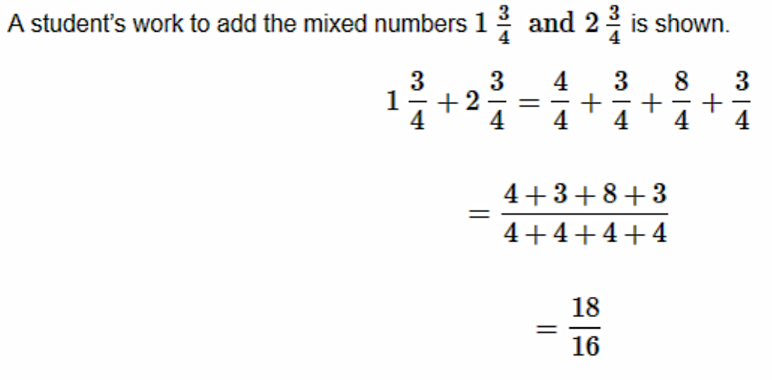
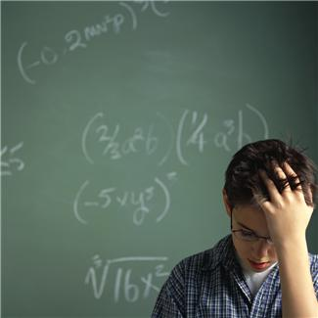
Explain any errors you see in the work. Find the correct solution. Show your work or explain your answer.
Notes:
Prc.parcconline.org
Grade 4 pba released
#12
M02080
Type II
4.C.6-2
Sub claim C
18/4 or equivalent
The student should not have added the 4’s together in the numerator.
It would be (4+3+8+3)/4 because once you have like denominators, you can add the number of 4’s you have in all.

Slide 24
Re-engagement
Student 1
Student 2
Notes:
Re-engagement
Looking at student responses
Grade 4 pba released
#12
M02080
Type II
4.C.6-2
Sub claim C
18/4 or equivalent
The student should not have added the 4’s together in the numerator.
It would be (4+3+8+3)/4 because once you have like denominators, you can add the number of 4’s you have in all.
Student 1: Score 0 Practice Set
Student 2: score 0. missing correct solution. Does not how how to get correct response or explain error analysis.

Slide 25
Student 3
Student 4
Notes:
Re-engagement
Looking at student responses
Grade 4 pba released
#12
M02080
Type II
4.C.6-2
Sub claim C
18/4 or equivalent
The student should not have added the 4’s together in the numerator.
It would be (4+3+8+3)/4 because once you have like denominators, you can add the number of 4’s you have in all.
Student 3: Score 2, partial credit Showed correct answer, show how to get correct answer, not clear on error analysis.
Student 4: Score 3, Practice Set

Slide 26
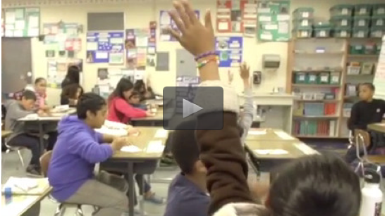
5th Grade Re-engagement Lesson Video
Notes:
Determine how long you want the video to run based on how much time you have.
http://www.insidemathematics.org/classroom-videos/formative-re-engaging-lessons/5th-grade-math-interpreting-fractions/lesson-part-1
“Students were asked to look at an area model and 3 different numerical representations (2 1/3, 7/3, and 7/9) given by different students to represent the area model. They were asked which student they agreed with and why. They then shared their reasoning with partners and with the class as a whole. To structure students’ responses and provide access to all, students were asked to use the sentence frame: I agree with ___ because.”

Slide 27
Create your own Re-engagement Lesson based on a PARCC Problem and an upcoming lesson in your classroom
Share with a partner
Think about, reflect or practice how you will facilitate this problem
Notes:
PARCC
PRC page il code

Slide 28
Resources
Number Talks - Helping Children Build Mental Math and Computation Strategies (K-5), by Sherry Parrish Making Number Talks Matter - Developing Mathematical Practices and Deepening Understanding, Grades 4-10, by Cathy Humphreys & Ruth Parker.

Slide 29
Mathematics Instructional Design, Delivery, and Assessments Pre Post
I can use the Math Implementation Guides to drive curricular decisions
I can facilitate a number talk in a math classroom utilizing the IL Teach and Talk
I can assess using open-ended questions representative of the instructional shifts for Math
I can embed the PARCC Released Items (3-12) where appropriate in my curriculum throughout the year
I can use appropriate models of instruction in the 3-5 classroom including place value on the four operations and benchmarking in fractions (3-5 only)

Slide 31
Extra PARCC Items

Slide 32
Select the three choices that are equivalent to
1
3
6
Notes:
3° grade
Answers A, B, D.
Follow-up questions. Make your own fraction equivalent to 6/6. How many fractions are there that are equivalent?
3° grade pba released
#4
VF646687
Type I
3.NF.3c.
Sub claim A

Slide 33
Jeanie has different colored buttons as shown. She wants to determine the total number of buttons she has altogether.
20 blue
19 orange
31 red
28 yellow
Part A
Jeanie explains there are a total of 818 buttons because
0 + 9 + 1 + 8 = 18 in the ones place, so she writes down 18. Then 2 + 1 + 3 + 2 = 8 in the tens place, so she writes down 8 in front of the 18.
Explain why Jeanie’s reasoning is incorrect. Find the total number of buttons she has altogether.
Part B
Jeanie explains there are 28 more red buttons than orange buttons because the smaller number is always subtracted from the larger number. So she got 9 – 1 = 8 in the ones place and 3 – 1 = 2 in the tens place.
Explain why Jeanie’s reasoning is incorrect. Find how many more red buttons than orange buttons she has.
Notes:
3° grade pba released
#14
0435-M01415
Type II
3.C.4-7
Sub claim C
Part A 98 because she needed to take the 10 ones and make it 1 ten.
Part B 12 because she had to take 1 ten and make it 10 ones so that she can subtract the ones.

Slide 34
Andre visits the library. It takes Andre 26 minutes to walk from his house to the library. He stays at the library 45 minutes. His mother drives him home, which takes 15 minutes.
How many more minutes does Andre spend at the library than traveling to and from the library?
Show all the steps for solving the problem. Explain each step and give the final answer.
Notes:
3rd grade released pba
#17
VF442639
Type III
3.D.1
Sub claim D
4 minutes.
He spent 26 + 15 traveling = 41
45-41= 4

Slide 35
Several pizzas of the same size were left over at a party.
Select the three comparisons of the leftover pizza that are correct.
Notes:
3rd eoy released
#12
VH000905
Type I
3.NF.3d
Sub claim A

Slide 36
Notes:
3rd grade eoy released
#14
VF563153
Type
I
3.NF.2
A

Slide 37
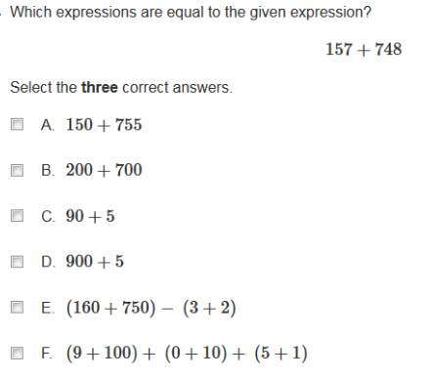
Notes:
3rd grade eoy released
#16
M00887
Type
I
3.NBT.2
B

Slide 38
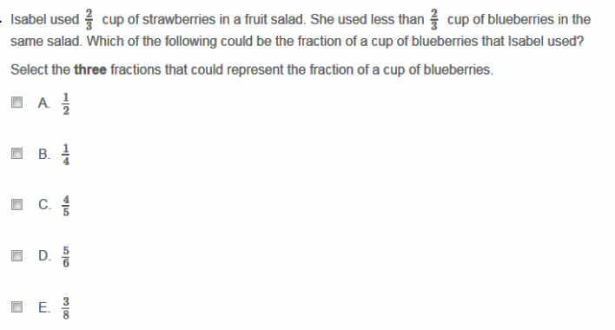
Notes:
Grade 4pba released
#5
VF524029
Type
I
4.NF.2-1
A

Slide 39
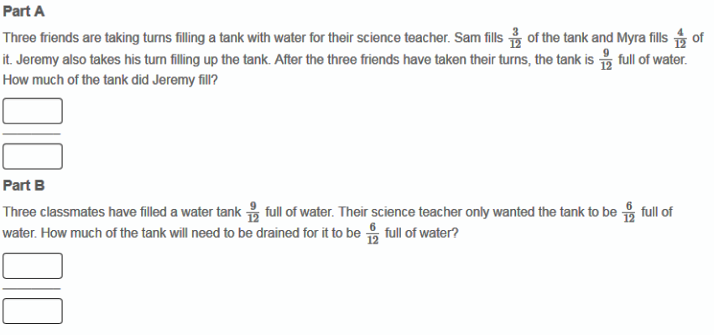
Notes:
Grade 4 pba released
#9
0040
-
M00265
M00265
MM00265
Type
I
4.NF.3d
A

Slide 40
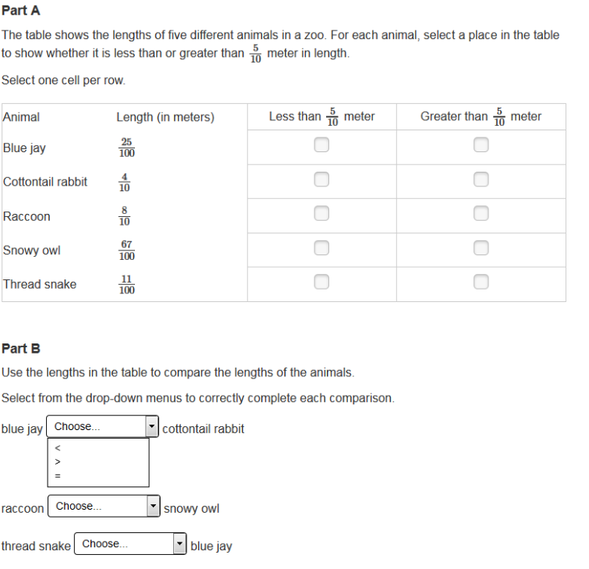
Notes:
Grade 4 pba released
#10
VF884212
Type
I
4.NF.A.Int.1
A

Slide 41
Notes:
Grade 4 pba released
#10
VF884212
Type
I
4.NF.A.Int.1
A

Slide 42
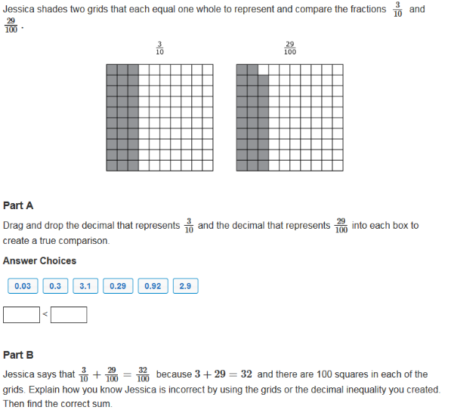
Notes:
Grade 4 pba released #11
VF643125
Type II
4.C.4-5
C

Slide 43
Notes:
Grade 4 pba released #11
VF643125
Type II
4.C.4-5
C

Slide 44
Notes:
Grade 4 eoy released #4
M00077
Type
I
4.NBT.4-1
A

Slide 45
Notes:
Grade 4 eoy released
#5
VF646344
Type
I
4.NF.3b-1
A

Slide 46
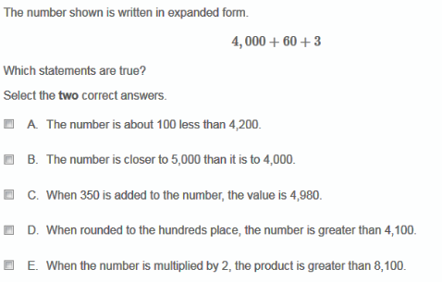
Notes:
Grade 4 eoy released
#14
M02214
Type
I
4.NBT.Int.1
A

Slide 47
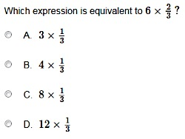
Notes:
Grade 4 eoy released #18
M01870
Type
I
4.NF.4b-2
A

Slide 48
A photographer has 591 photos of animals and 234 photos of plants. He wants to put all of the photos into photo books. Each page of the photo books holds 8 photos. What is the fewest number of pages he could use in the photo books?
Notes:
Good for interpreting remainder
Grade 4 eoy released
#21
M01477
Type
I
4.OA.3-2
A

Slide 49
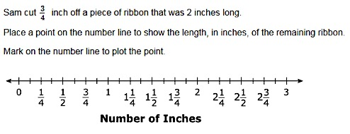
Notes:
Grade 4 eoy released
#27
VF524361
Type
I
4.MD.2-2
B

Slide 50
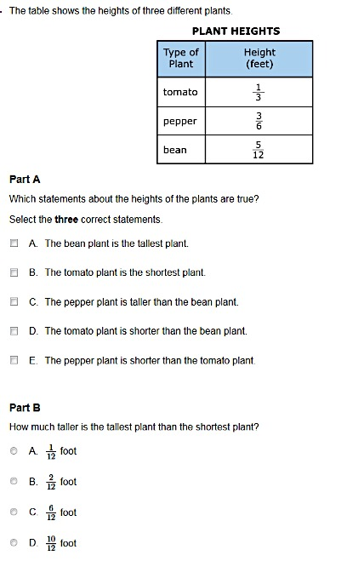
Notes:
Grade 4 eoy released
#32
0272
-
M01260
Type
I
4.NF.Int.1

Slide 51
Notes:
Grade 4 eoy released
#32
0272
-
M01260
Type
I
4.NF.Int.1

Slide 52
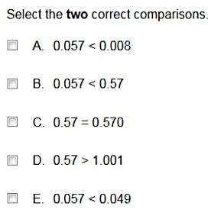
Notes:
Grade5 pba released
#5
VH006453
Type
I
5.NBT.3b
A

Slide 53
Notes:
Grade 5 pba released
#8
0066
-
M00729
Type
I
5.NBT.Int.1
A

Slide 54
Notes:
Grade 5 pba released
#11
M01285
Type II
5.C.7-3
C

Slide 55
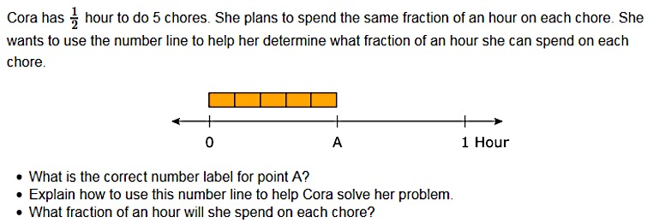
Notes:
Grade 5 pba released
#12
M02372
Type II
5.C.5-3
C

Slide 56
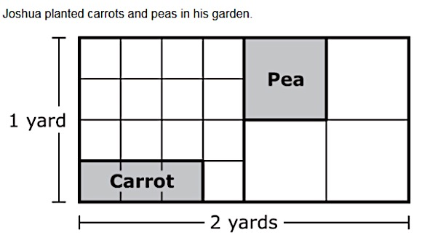
Notes:
Grade 5 pba released
#15
VF822728
Type
III
5.D.1
D

